Slide 1
Title Page, Introduction, and Testimonies of the Three and Eight Witnesses
Lesson 1

Slide 2
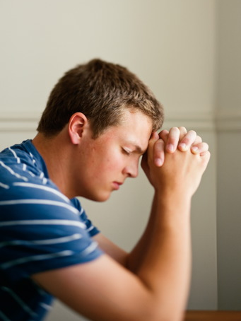
Devotional
Hymn:
Prayer:
Thought:

Slide 3
Consider These Statements:
I know the Book of Mormon is true.
I believe the Book of Mormon is true.
I assume the Book of Mormon is true.
I don’t know if the Book of Mormon is true.

Slide 4
Title Page
“The Book of Mormon, an account written by the hand of Mormon upon plates taken from the plates of Nephi.”

Slide 5
Purposes
Read the first two paragraphs of the title page, looking for phrases that state the purposes of the Book of Mormon.

Slide 6
Jesus Is the Christ
The Book of Mormon was written to convince all people that Jesus is the Christ.

Slide 7
Jesus Is the Christ
The Book of Mormon was written to convince all people that Jesus is the Christ.
What do you think it means to know that Jesus is theChrist?

Slide 8
Jesus Christ
The word Christ is a title. It is the Greek equivalent of the word Messiah, which means “the anointed.”

Slide 9
Jesus Christ
The word Christ is a title. It is the Greek equivalent of the word Messiah, which means “the anointed.”
In the premortal existence, Jesus was anointed or chosen by Heavenly Father to be our Savior (see Guide to the Scriptures, “Messiah,” scriptures.lds.org; Bible Dictionary, “Anointed One”).

Slide 10
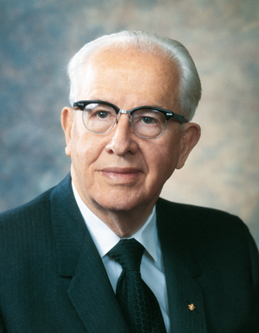
President Ezra Taft Benson
“The honest seeker after truth can gain the testimony that Jesus is the Christ as he prayerfully ponders the inspired words of the Book of Mormon.
“Over one-half of all the verses in the Book of Mormon refer to our Lord. Some form of Christ’s name is mentioned more frequently per verse in the Book of Mormon than even in the New Testament.
Continued on next page.

Slide 11
President Ezra Taft Benson, cont.
“He is given over one hundred different names in the Book of Mormon. Those names have a particular significance in describing His divine nature” (Ezra Taft Benson, “Come unto Christ,” Ensign, Nov. 1987, 83).

Slide 12
A Name or Title
Turn to any chapter of the Book of Mormon and see if you can locate names or titles that refer to Jesus Christ.

Slide 13
A Name or Title
Turn to any chapter of the Book of Mormon and see if you can locate names or titles that refer to Jesus Christ.
What can that name or title teach us about Jesus Christ?

Slide 14
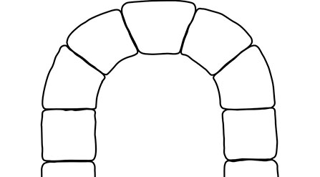
Keystone
Where on this arch is the keystone?

Slide 15
Keystone
Where on this arch is the keystone?
What purpose does a keystone serve?

Slide 16
Keystone
Where on this arch is the keystone?
What purpose does a keystone serve?
What happens to the arch if the keystone is removed?

Slide 17
The Keystone of Our Religion
Read the statement by the Prophet Joseph Smith in paragraph six of the introduction to the Book of Mormon.

Slide 18
The Keystone of Our Religion
Read the statement by the Prophet Joseph Smith in paragraph six of the introduction to the Book of Mormon.
According to the Prophet Joseph Smith, what is the keystone of our religion?

Slide 19
The Keystone of Our Religion
Read the statement by the Prophet Joseph Smith in paragraph six of the introduction to the Book of Mormon.
According to the Prophet Joseph Smith, what is the keystone of our religion?
How would you explain why the Book of Mormon is the keystone of our religion?

Slide 20
President Ezra Taft Benson
“There are three ways in which the Book of Mormon is the keystone of our religion. It is the keystone in our witness of Christ. It is the keystone of our doctrine. It is the keystone of testimony. …
Continued on next page.

Slide 21
President Ezra Taft Benson, cont.
“… Just as the arch crumbles if the keystone is removed, so does all the Church stand or fall with the truthfulness of the Book of Mormon. The enemies of the Church understand this clearly. This is why they go to such great lengths to try to disprove the Book of Mormon, for if it can be discredited, the Prophet Joseph Smith goes with it.
Continued on next page.

Slide 22
President Ezra Taft Benson, cont.
“So does our claim to priesthood keys, and revelation, and the restored Church. But in like manner, if the Book of Mormon be true … then one must accept the claims of the Restoration and all that accompanies it” (Ezra Taft Benson, “The Book of Mormon—Keystone of Our Religion,” Ensign, Oct. 2011, 54, 55).

Slide 23
The Book of Mormon
If the Book of Mormon is true, what other aspects of the restored gospel must also be true?

Slide 24
The Book of Mormon
If the Book of Mormon is true, what other aspects of the restored gospel must also be true?
In your own words, how would you summarize the importance of receiving a testimony of the truthfulness of the Book of Mormon?

Slide 25
The Book of Mormon
If we know the Book of Mormon is true, then we will also know that Jesus is the Christ, that Joseph Smith was a prophet of God, and that The Church of Jesus Christ of Latter-day Saints is the Lord’s kingdom on the earth today.

Slide 26
Witnesses
Read “The Testimony of the Three Witnesses” and look for what they saw and heard.

Slide 27
Witnesses
Read “The Testimony of the Three Witnesses” and look for what they saw and heard.
Read “The Testimony of the Eight Witnesses” and look for what they saw and touched.

Slide 28
Testimony of Witnesses
Why do you think the Lord might have provided these two different kinds of experiences for these witnesses of the Book of Mormon?

Slide 29
Testimony of Witnesses
Why do you think the Lord might have provided these two different kinds of experiences for these witnesses of the Book of Mormon?
Although we may not have the opportunity to see or touch the plates, we can know for ourselves that the Book of Mormon is true.

Slide 30
Truth of the Book of Mormon
Read Moroni 10:3–5, looking for how we can know the Book of Mormon is true.

Slide 31
Truth of the Book of Mormon
Read Moroni 10:3–5, looking for how we can know the Book of Mormon is true.
As we read, ponder, and pray about the Book of Mormon, the Holy Ghost will witness that it is true.

Slide 32
Video
“Testimony of the Book of Mormon” (https://www.lds.org/media-library/video/2010-03-08-testimony-of-the-book-of-mormon?lang=eng)

Slide 33
The Book of Mormon
What are your feelings about the Book of Mormon? Do you have a testimony of it you can share?

