Slide 1
1 Nephi 7
Lesson 11

Slide 2
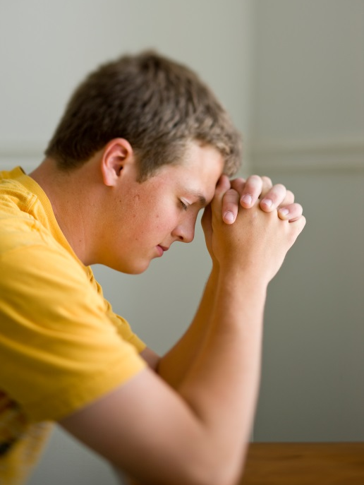
Devotional
Hymn:
Prayer:
Thought:
Notes:
738194

Slide 3
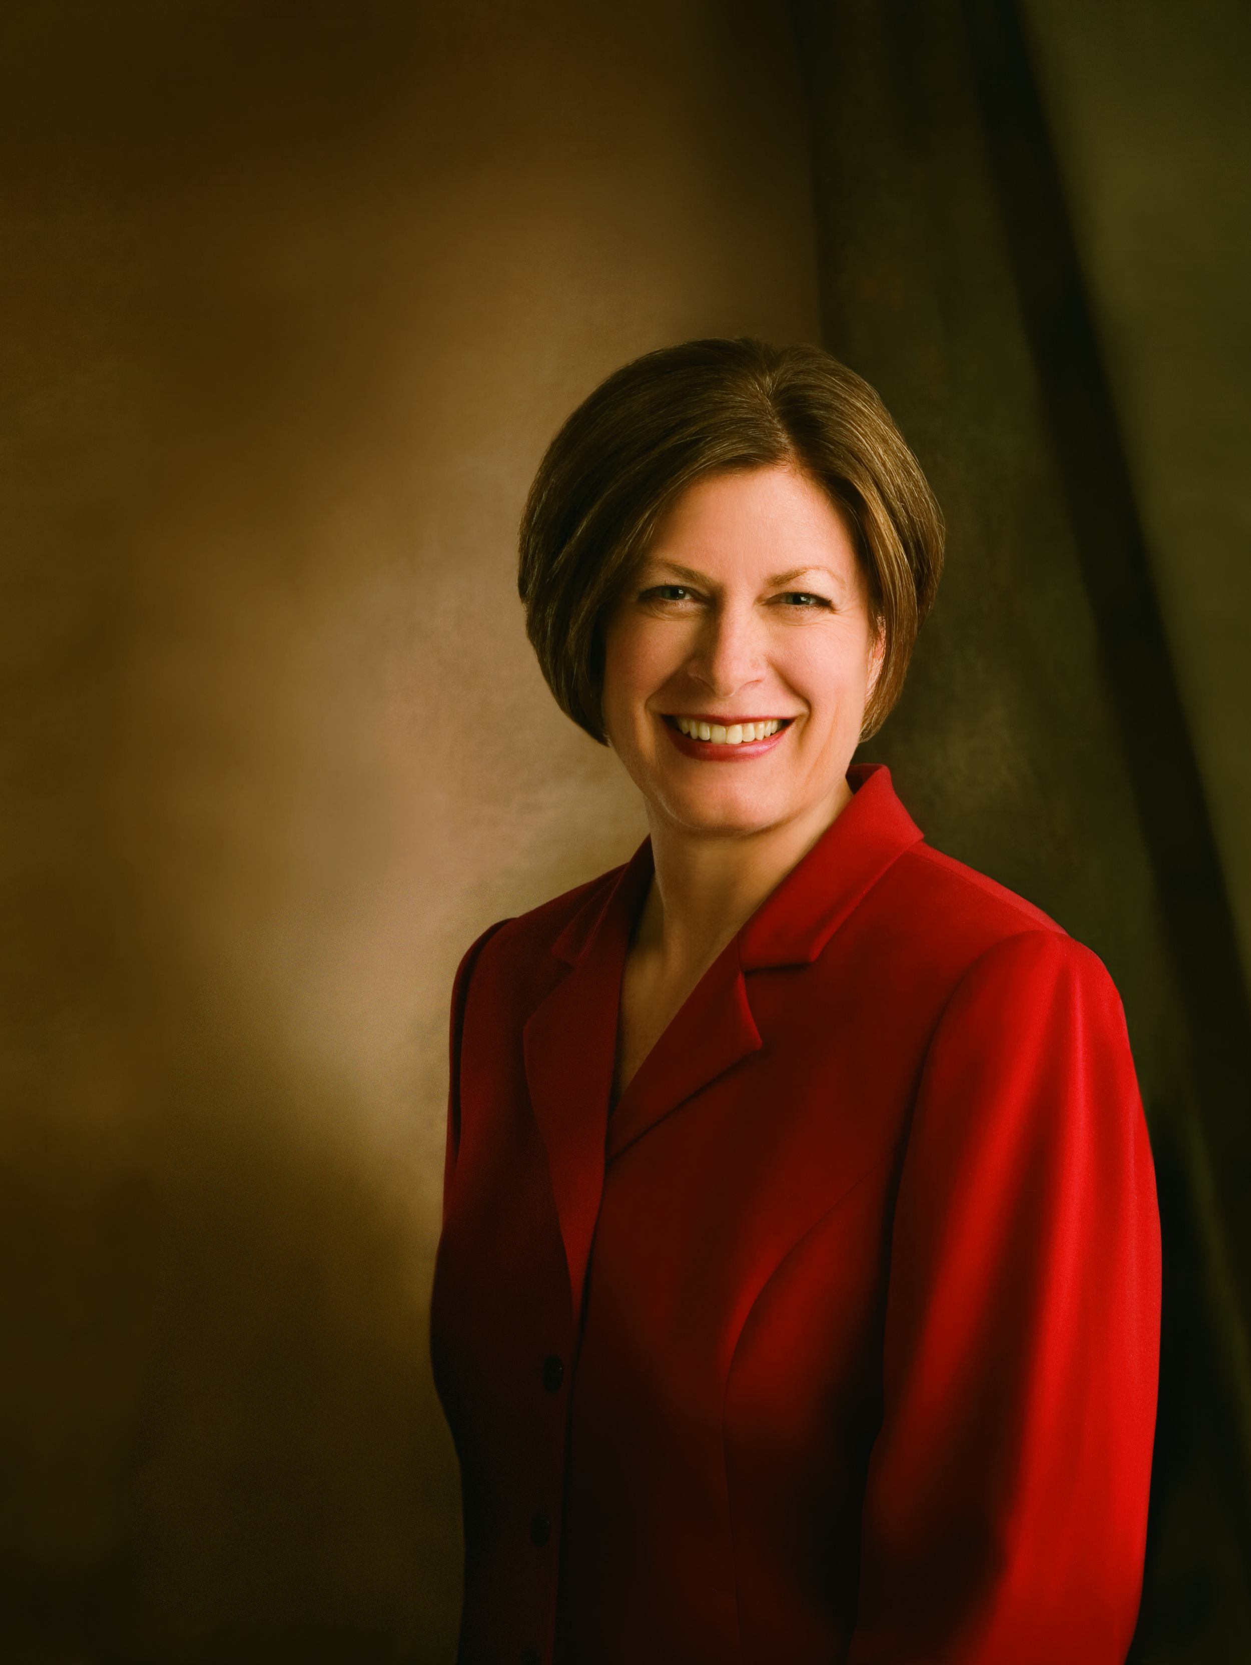
Sister Julie B. Beck
“As I meet with young single adults around the world, I ask them, ‘Why does the First Presidency care so much about you and provide so many resources for you?’” (Julie B. Beck, “Teaching the Doctrine of the Family,” Ensign, Mar. 2011, 12).

Slide 4
Sister Julie B. Beck
“As I meet with young single adults around the world, I ask them, ‘Why does the First Presidency care so much about you and provide so many resources for you?’” (Julie B. Beck, “Teaching the Doctrine of the Family,” Ensign, Mar. 2011, 12).
How would you answer Sister Beck’s question?

Slide 5
Sister Julie B. Beck
“These are some of the answers I get: ‘We are future Church leaders.’ ‘We need training so we can stay strong.’ ‘Our testimonies are strengthened in our seminary and institute classes.’ ‘We need to meet other great Latter-day Saint youth.’ ‘We are the hope of the future.’ I have rarely heard, ‘So I will someday be a better father or a better mother.’
Continued on next page.

Slide 6
Sister Julie B. Beck, cont.
“Evidence is all around us that the family is becoming less important. Marriage rates are declining, the age of marriage is rising, and divorce rates are rising. Out-of-wedlock births are growing. Abortion is rising and becoming increasingly legal. We see lower birth rates. We see unequal relationships between men and women, and we see cultures that still practice abuse within family relationships. Many times a career gains importance over the family.
Continued on next page.

Slide 7
Sister Julie B. Beck, cont.
“Many of our youth are losing confidence in the institution of families. They’re placing more and more value on education and less and less importance on forming an eternal family. Many don’t see forming families as a faith-based work. …
“This generation will be called upon to defend the doctrine of the family as never before. If they don’t know it, they can’t defend it” (Julie B. Beck, “Teaching the Doctrine of the Family,” 12, 14, 17).

Slide 8
Commandment to Lehi
Read 1 Nephi 7:1–2. What did the Lord command Lehi to do?

Slide 9
Commandment to Lehi
Read 1 Nephi 7:1–2. What did the Lord command Lehi to do?
What truth can we learn from this commandment?

Slide 10
Commandment to Lehi
Read 1 Nephi 7:1–2. What did the Lord command Lehi to do?
What truth can we learn from this commandment?
The Lord commands us to marry and raise up children unto Him.

Slide 11
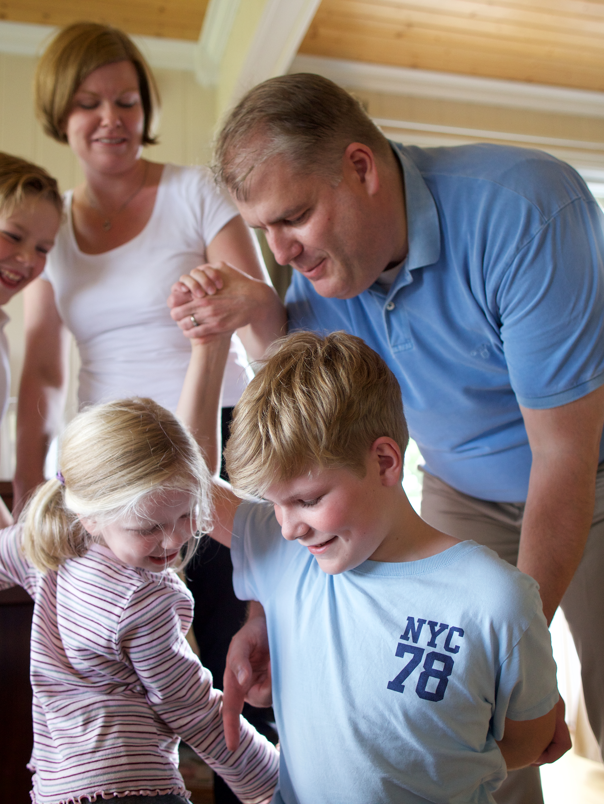
Marriage
“We, the First Presidency and the Council of the Twelve Apostles of The Church of Jesus Christ of Latter-day Saints, solemnly proclaim that marriage between a man and a woman is ordained of God and that the family is central to the Creator’s plan for the eternal destiny of His children” (“The Family: A Proclamation to the World,” Ensign or Liahona, Nov. 2010, 129).

Slide 12
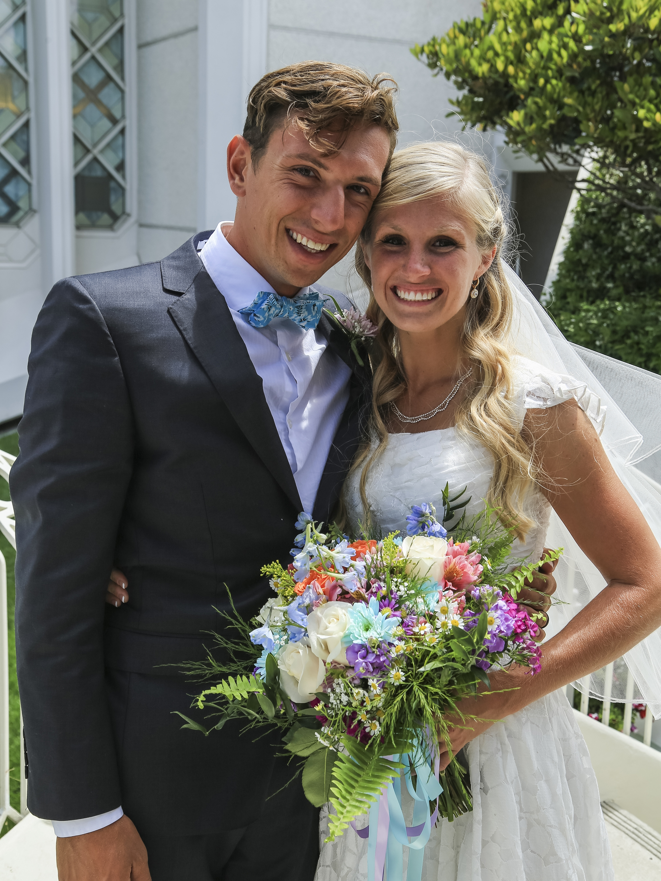
The Family: A Proclamation to the World
What is the eternal destiny of God’s children?

Slide 13
The Family: A Proclamation to the World
What is the eternal destiny of God’s children?
How do marriage between a man and a woman and parenthood help us become like God?

Slide 14
Parenthood
“We declare that God’s commandment for His children to multiply and replenish the earth remains in force. …
“… Parents have a sacred duty to rear their children in love and righteousness, to provide for their physical and spiritual needs, and to teach them to love and serve one another, observe the commandments of God, and be law-abiding citizens wherever they live. Husbands and wives—mothers and fathers—will be held accountable before God for the discharge of these obligations” (“The Family: A Proclamation to the World,” 129).

Slide 15
Raise Up Children
What does it mean to raise up children unto the Lord?

Slide 16
Raise Up Children
What does it mean to raise up children unto the Lord?
How can youth prepare now to marry and to raise children in the gospel?

Slide 17
Marry and Raise Children
Read 1 Nephi 7:3–5. How did the Lord help Nephi and his brothers obey the commandment to marry and raise children?

Slide 18
Marry and Raise Children
Read 1 Nephi 7:3–5. How did the Lord help Nephi and his brothers obey the commandment to marry and raise children?
Apply the principle you identified in 1 Nephi 7:1–2 by seeking to strengthen your family and preparing to marry and raise up children to the Lord.

Slide 19
The Lord’s Help
Think of an aspect of your life in which you would like the Lord’s help.

Slide 20
The Lord’s Help
Think of an aspect of your life in which you would like the Lord’s help.
As you continue to study 1 Nephi 7 today, look for ways you can receive the Lord’s help in that aspect of your life.

Slide 21
Nephi’s Teaching
Read 1 Nephi 7:12–13, looking for the truth Nephi taught his brothers to persuade them to continue their journey to the promised land instead of returning to Jerusalem.

Slide 22
Nephi’s Teaching
Read 1 Nephi 7:12–13, looking for the truth Nephi taught his brothers to persuade them to continue their journey to the promised land instead of returning to Jerusalem.
Based on what Nephi asked his brothers (see verse 12), how would you complete this statement to form a principle: If we exercise faith in the Lord, … ?

Slide 23
Nephi’s Teaching
Read 1 Nephi 7:12–13, looking for the truth Nephi taught his brothers to persuade them to continue their journey to the promised land instead of returning to Jerusalem.
Based on what Nephi asked his brothers (see verse 12), how would you complete this statement to form a principle: If we exercise faith in the Lord, … ?
If we exercise faith in the Lord, He is able to do all things for us according to His will.

Slide 24
Nephi’s Warning
According to 1 Nephi 7:14–15, Nephi told those who wanted to return to Jerusalem that if they returned, they would perish when Jerusalem was destroyed.

Slide 25
Nephi’s Warning
According to 1 Nephi 7:14–15, Nephi told those who wanted to return to Jerusalem that if they returned, they would perish when Jerusalem was destroyed.
Read 1 Nephi 7:16. How did Laman and Lemuel respond to Nephi’s warning?

Slide 26
Nephi’s Warning
According to 1 Nephi 7:14–15, Nephi told those who wanted to return to Jerusalem that if they returned, they would perish when Jerusalem was destroyed.
Read 1 Nephi 7:16. How did Laman and Lemuel respond to Nephi’s warning?
How would you feel if you had been in Nephi’s situation? What would you do?

Slide 27
Nephi’s Warning
According to 1 Nephi 7:14–15, Nephi told those who wanted to return to Jerusalem that if they returned, they would perish when Jerusalem was destroyed.
Read 1 Nephi 7:16. How did Laman and Lemuel respond to Nephi’s warning?
How would you feel if you had been in Nephi’s situation? What would you do?
Read 1 Nephi 7:17–18. How did Nephi exercise faith in the Lord?

Slide 28
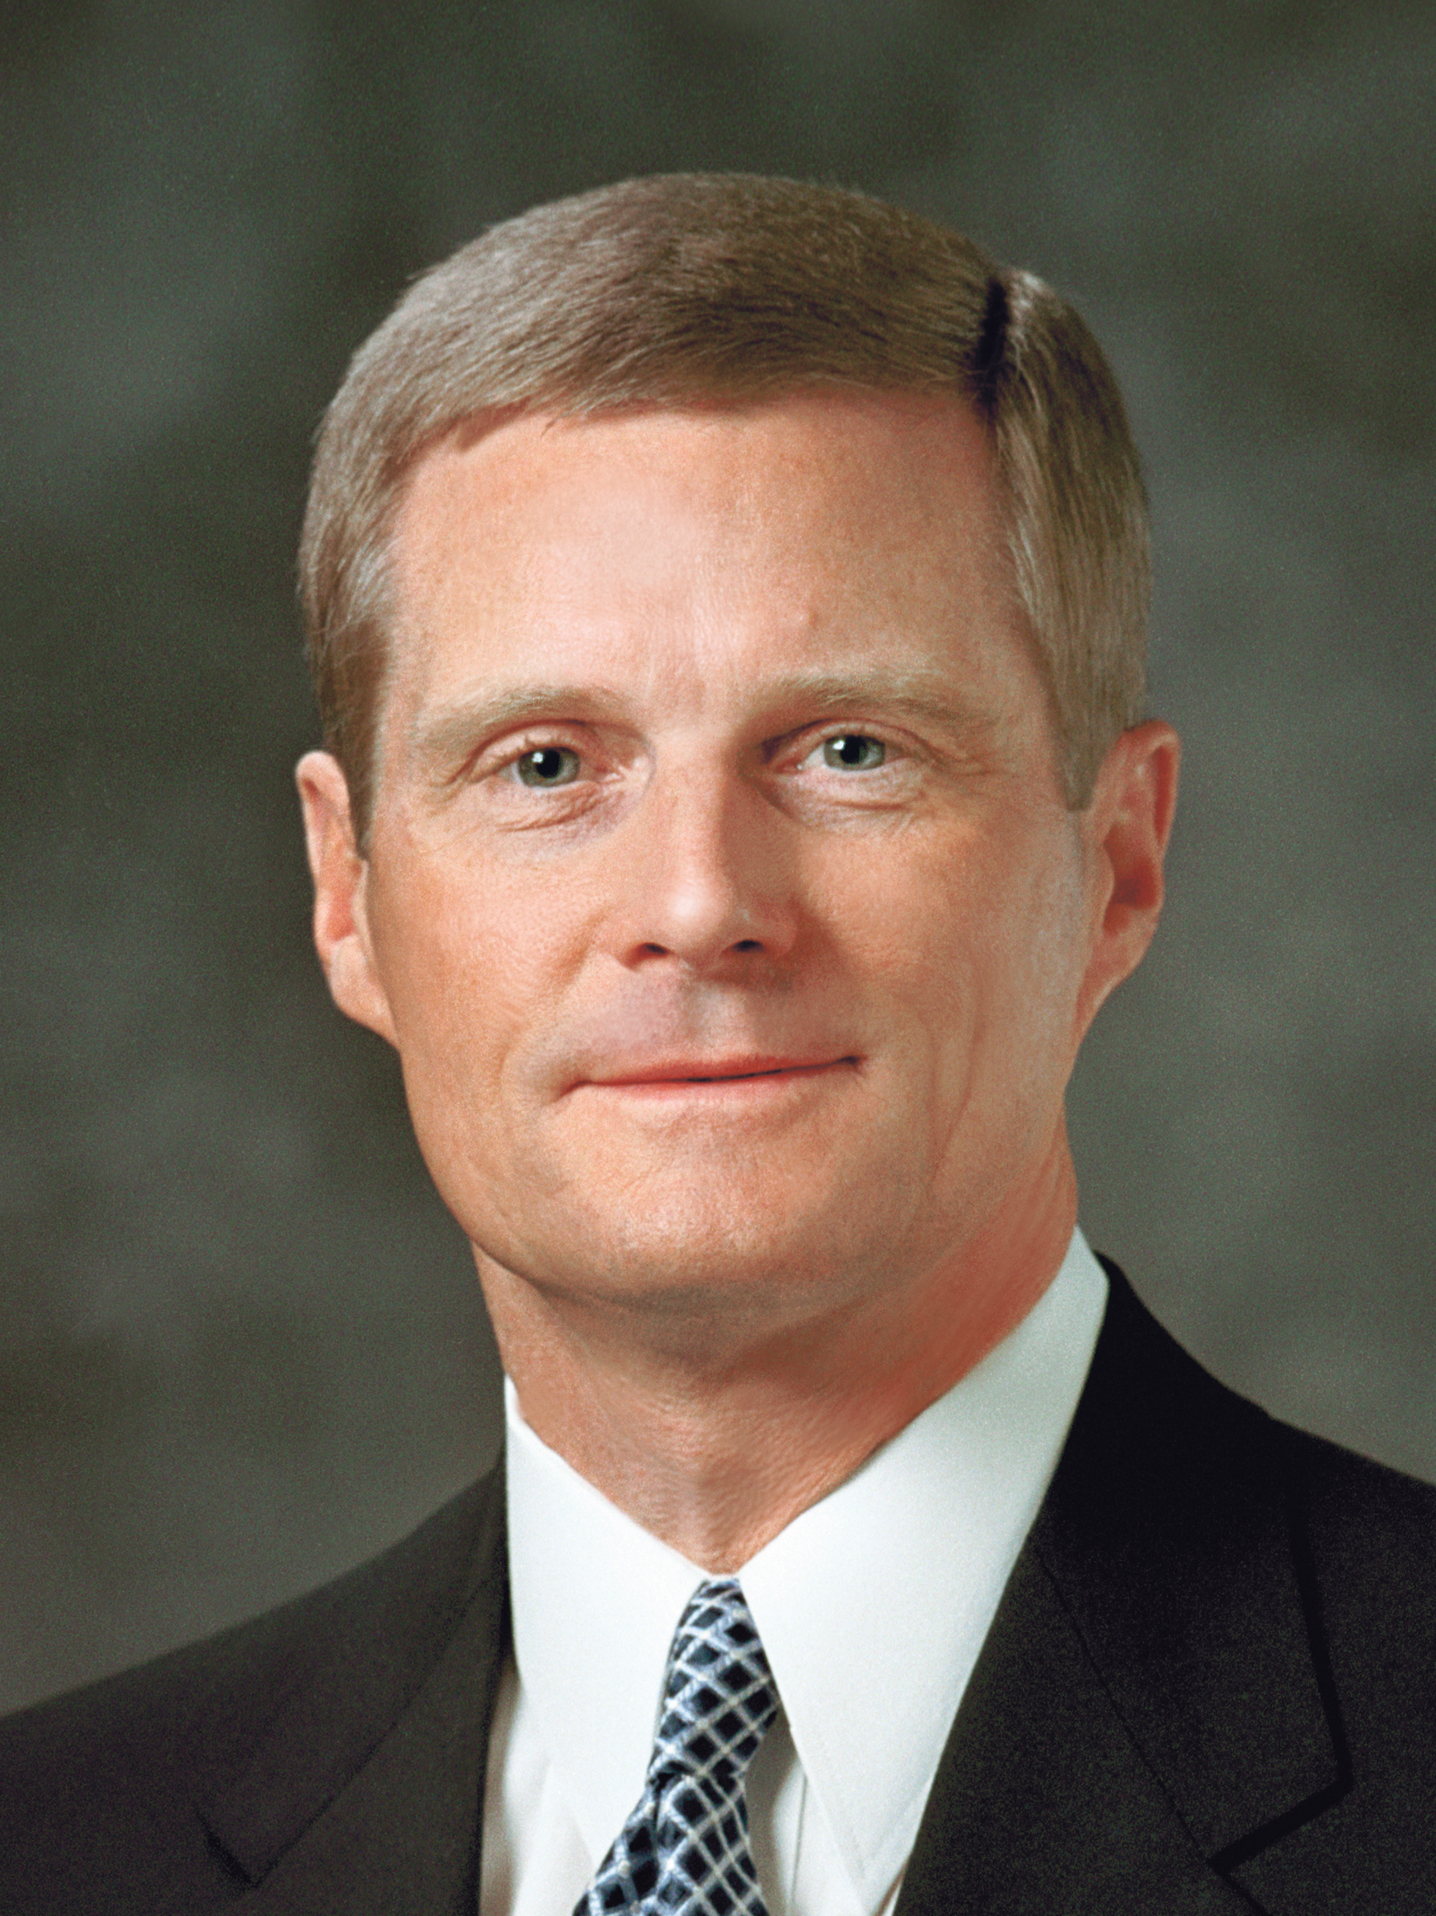
Elder David A. Bednar
“It is especially interesting to me that Nephi did not pray … to have his circumstances changed. Rather, he prayed for the strength to change his circumstances” (David A. Bednar, “In the Strength of the Lord” [Brigham Young University devotional, Oct. 23, 2001], 4, speeches.byu.edu).

Slide 29
Exercising Faith in the Lord
How is the principle we learned from 1 Nephi 7:12 illustrated in Nephi’s experience?

Slide 30
Exercising Faith in the Lord
How is the principle we learned from 1 Nephi 7:12 illustrated in Nephi’s experience?
In addition to praying, what are other ways that we can exercise faith in the Lord in order to receive strength or help from Him?

Slide 31
Exercising Faith in the Lord
How is the principle we learned from 1 Nephi 7:12 illustrated in Nephi’s experience?
In addition to praying, what are other ways that we can exercise faith in the Lord in order to receive strength or help from Him?
When have you exercised faith in the Lord and received strength or help from Him?

Slide 32
Laman and Lemuel
Read 1 Nephi 7:19–20. Who convinced Laman and Lemuel to stop trying to kill Nephi?

Slide 33
Laman and Lemuel
Read 1 Nephi 7:19–20. Who convinced Laman and Lemuel to stop trying to kill Nephi?
Read 1 Nephi 7:21–22. What did Nephi choose to do?

Slide 34
Laman and Lemuel
Read 1 Nephi 7:19–20. Who convinced Laman and Lemuel to stop trying to kill Nephi?
Read 1 Nephi 7:21–22. What did Nephi choose to do?
What does it mean to “frankly forgive” (verse 21)?

Slide 35
Laman and Lemuel
Read 1 Nephi 7:19–20. Who convinced Laman and Lemuel to stop trying to kill Nephi?
Read 1 Nephi 7:21–22. What did Nephi choose to do?
What does it mean to “frankly forgive” (verse 21)?
How did Nephi’s brothers respond after Nephi forgave them?

Slide 36
Forgiveness
What principle can we learn from Nephi’s example of forgiveness?

Slide 37
Forgiveness
What principle can we learn from Nephi’s example of forgiveness?
Choosing to frankly forgive others can bring peace.

Slide 38
Forgiveness
What principle can we learn from Nephi’s example of forgiveness?
Choosing to frankly forgive others can bring peace.
Why is forgiveness especially important in our families?

Slide 39
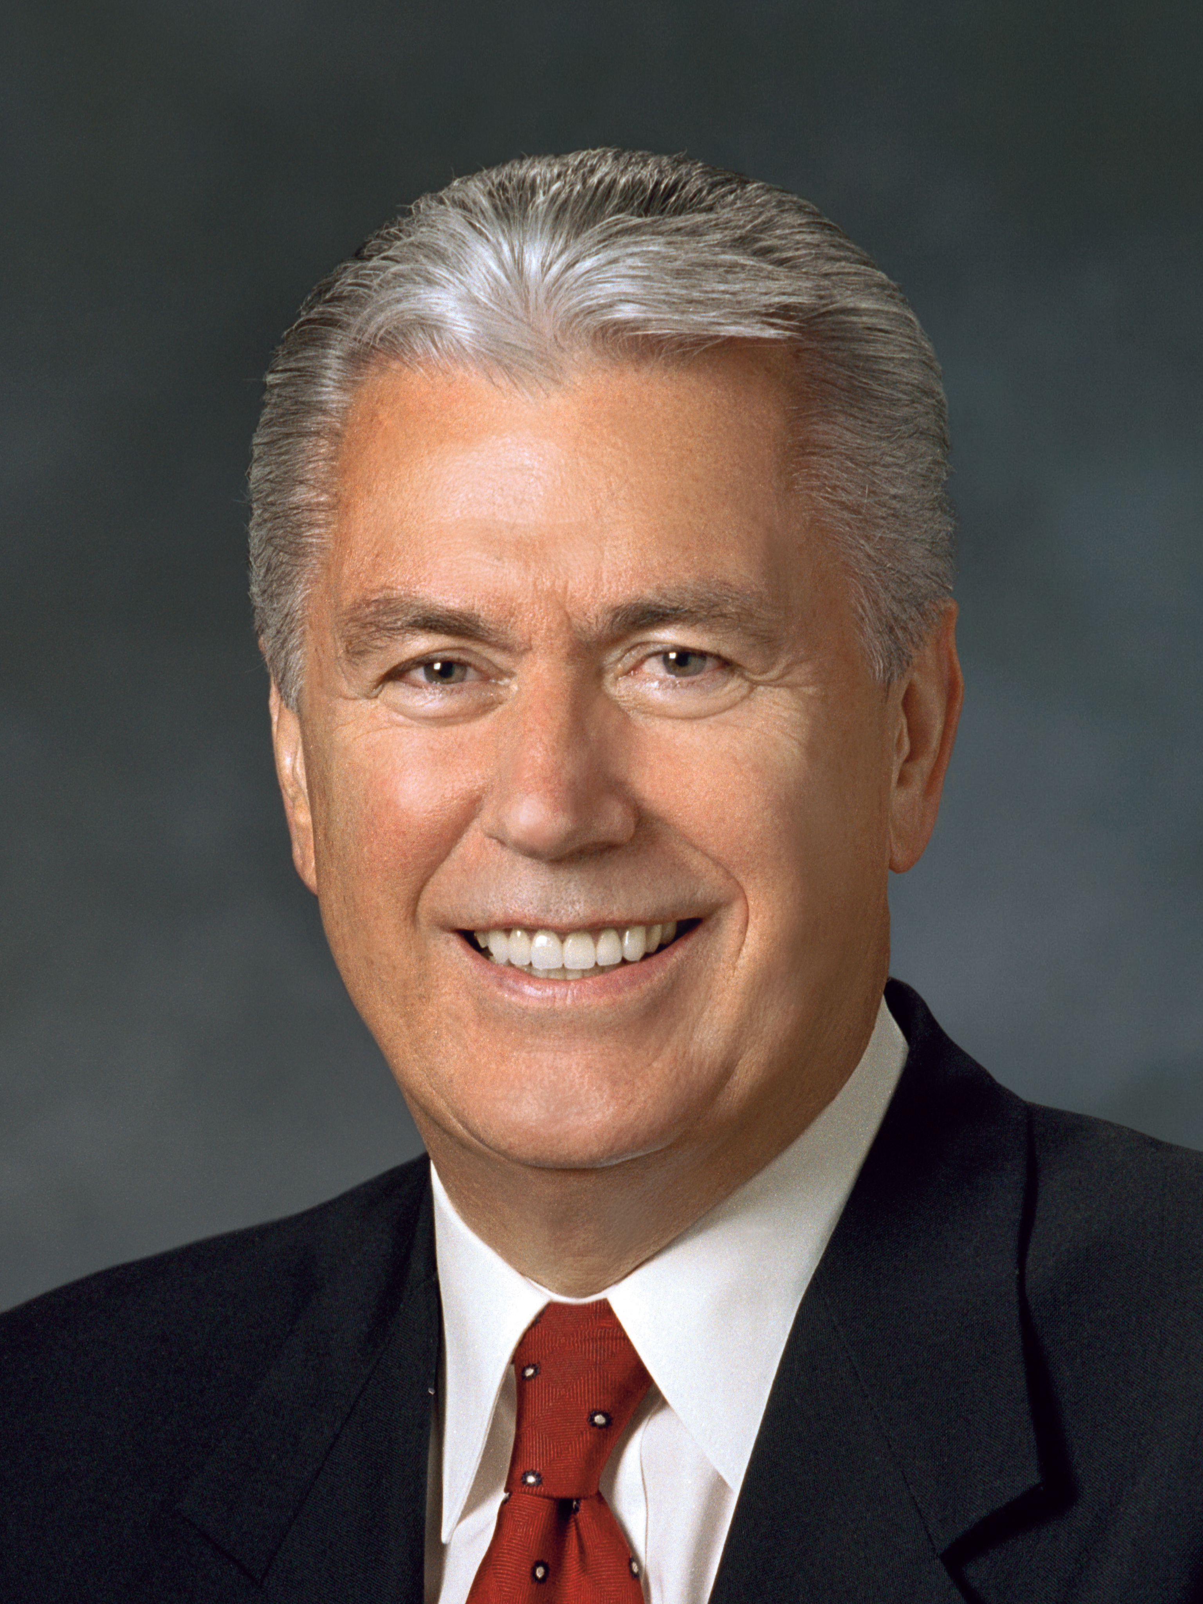
President Dieter F. Uchtdorf
“I have discovered one thing that most [happy families] have in common: they have a way of forgiving and forgetting the imperfections of others and of looking for the good.
“Those in unhappy families, on the other hand, often find fault, hold grudges, and can’t seem to let go of past offenses.
Continued on next page.

Slide 40
President Dieter F. Uchtdorf, cont.
“As we accept [our Savior’s] ways and overcome our pride by softening our hearts, we can bring reconciliation and forgiveness into our families and our personal lives. God will help us to be more forgiving, … to be first to apologize even if something wasn’t our fault, to lay aside old grudges and nurture them no more” (Dieter F. Uchtdorf, “One Key to a Happy Family,” Ensign, Oct. 2012, 5, 6).

