Slide 1
1 Nephi 8
Lesson 12

Slide 2
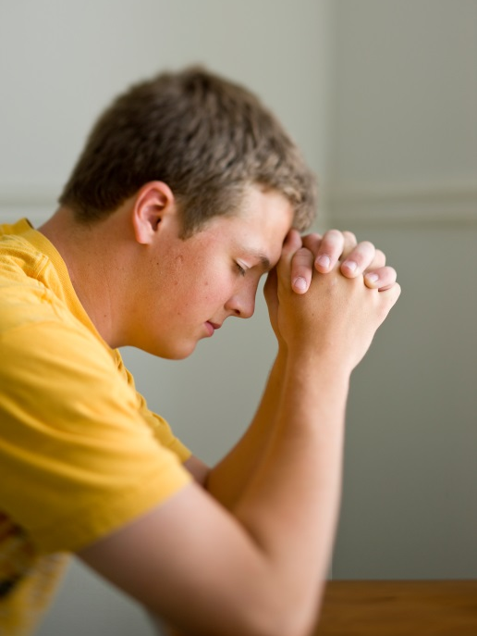
Devotional
Hymn:
Prayer:
Thought:
Notes:
738194

Slide 3
The Gospel of Jesus Christ
What are some reasons why people turn away from the gospel of Jesus Christ even if they know it is true and have received great blessings from it?

Slide 4
The Gospel of Jesus Christ
What are some reasons why people turn away from the gospel of Jesus Christ even if they know it is true and have received great blessings from it?
How can I remain faithful to the Lord and His gospel when I am surrounded by temptations and individuals who try to persuade me to make poor choices?

Slide 5
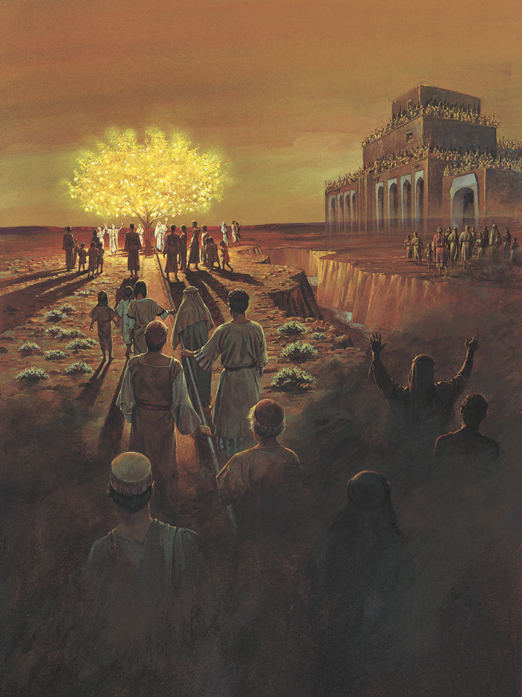
Lehi’s Vision
Read 1 Nephi 8:5–12. What objects were the focus of Lehi’s vision?

Slide 6
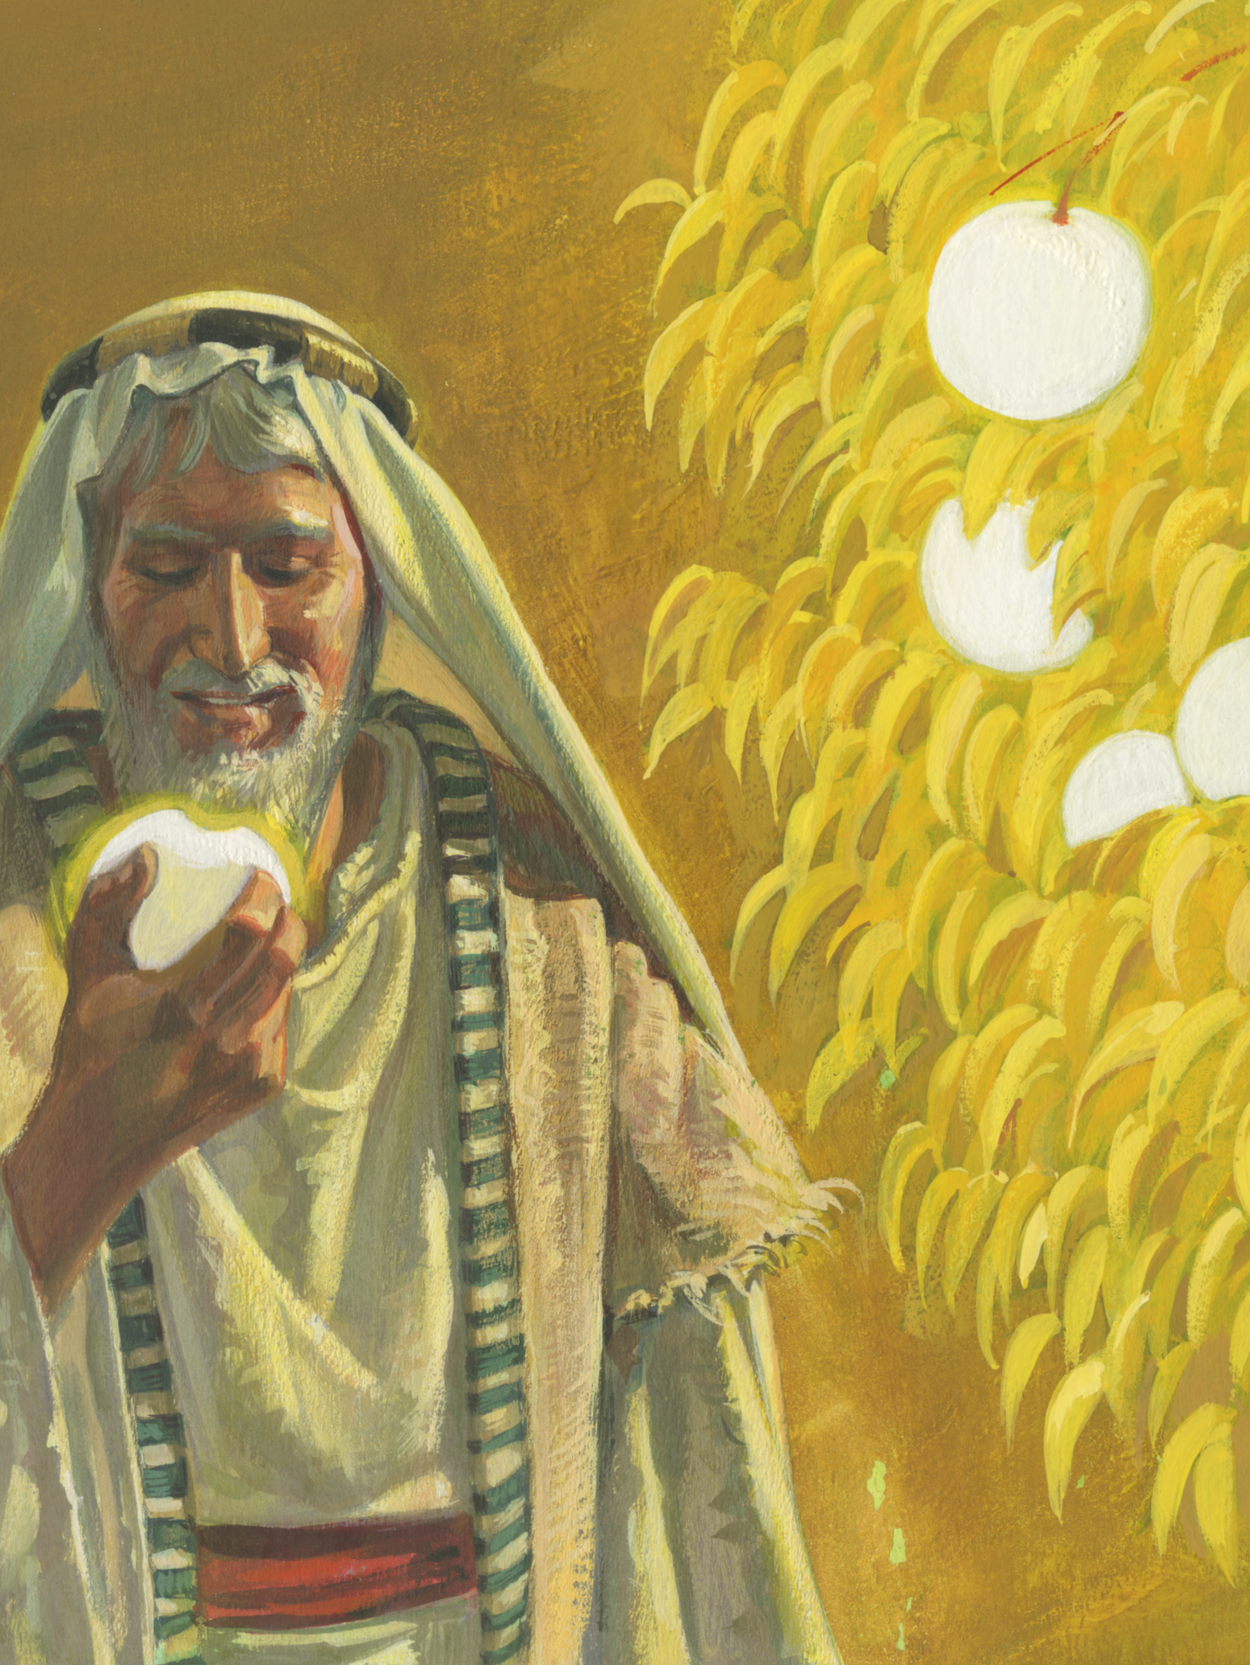
The Fruit of the Tree
According to 1 Nephi 8:10–12, what words and phrases did Lehi use to describe the fruit?

Slide 7
The Fruit of the Tree
According to 1 Nephi 8:10–12, what words and phrases did Lehi use to describe the fruit?
If you were offered some of the fruit that Lehi tasted, would you partake of it? Why?

Slide 8
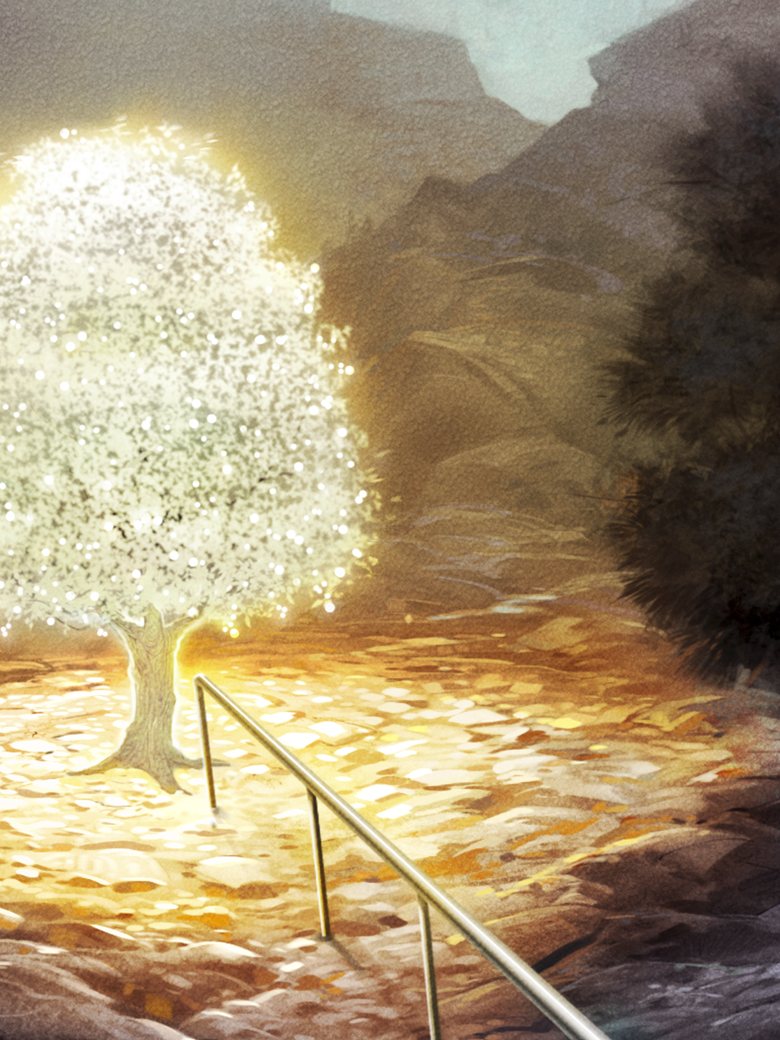
The Tree
Read 1 Nephi 11:21–23, looking for what the tree in Lehi’s dream represented.

Slide 9
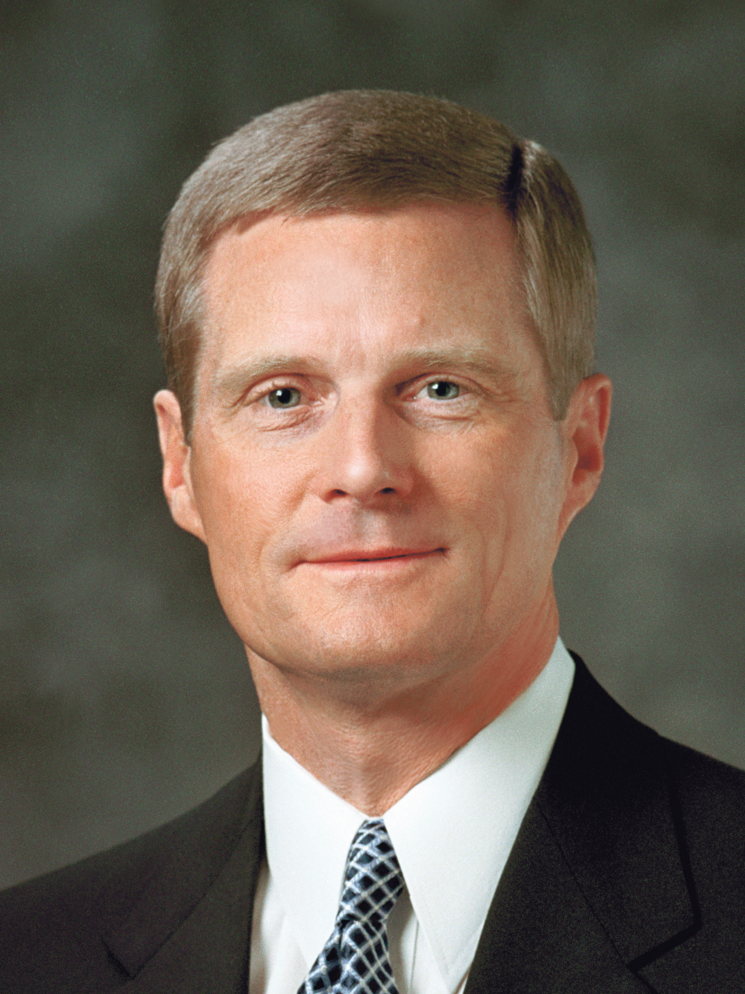
Elder David A. Bednar
“The greatest manifestation of God’s love for His children is the mortal ministry, atoning sacrifice, and Resurrection of the Lord Jesus Christ. The fruit on the tree can be considered a symbol for the blessings of the Savior’s Atonement” (David A. Bednar, “Come and See,” Ensign or Liahona, Nov. 2014, 109).

Slide 10
Elder David A. Bednar
According to Elder Bednar, what does the fruit of the tree of life represent?

Slide 11
The Savior’s Atonement
Based on how Lehi felt after partaking of the fruit, how would you complete this principle: As we partake of the blessings of the Savior’s Atonement, we are filled with … ?

Slide 12
The Savior’s Atonement
Based on how Lehi felt after partaking of the fruit, how would you complete this principle: As we partake of the blessings of the Savior’s Atonement, we are filled with … ?
As we partake of the blessings of the Savior’s Atonement, we are filled with joy and a desire to help others come unto Him.

Slide 13
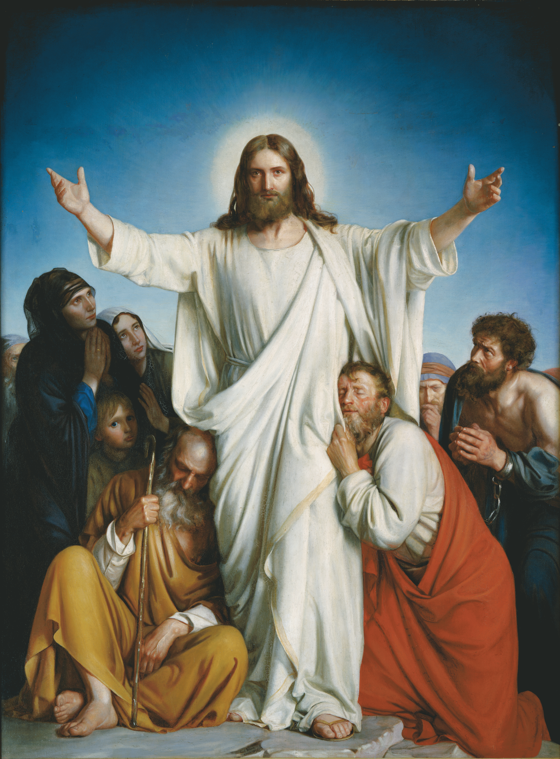
The Atonement of Jesus Christ
What are some of the blessings of the Atonement of Jesus Christ?

Slide 14
The Atonement of Jesus Christ
What are some of the blessings of the Atonement of Jesus Christ?
What are some ways we can partake of the blessings of the Savior’s Atonement?

Slide 15
The Atonement of Jesus Christ
What are some of the blessings of the Atonement of Jesus Christ?
What are some ways we can partake of the blessings of the Savior’s Atonement?
When have you partaken of the blessings of the Savior’s Atonement and been filled with joy and a desire to bring others to the Savior?

Slide 16
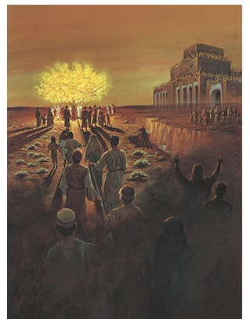
Lehi’s Vision
In Lehi’s vision, the Lord used other symbols along with the tree and fruit to teach Lehi how to come unto Jesus Christ and partake of His Atonement. What other symbols do you see in this picture and what might those symbols represent?

Slide 17
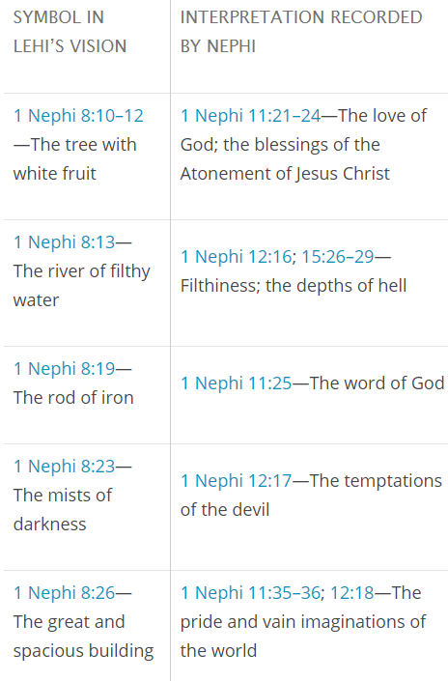
Chart

Slide 18
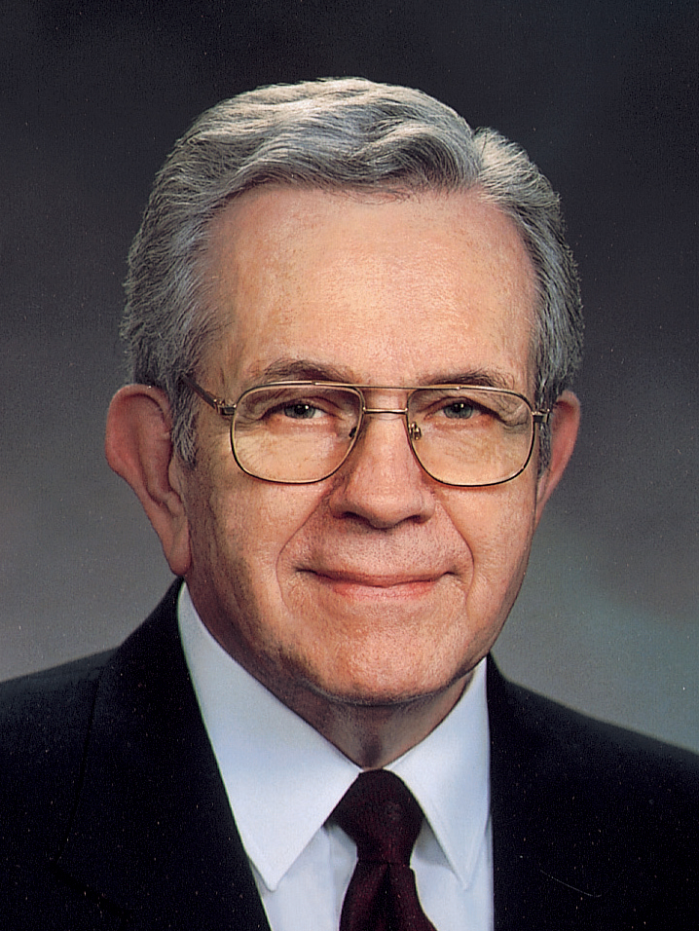
President Boyd K. Packer
“You may think that Lehi’s dream or vision has no special meaning for you, but it does. You are in it; all of us are in it” (Boyd K. Packer, “Finding Ourselves in Lehi’s Dream,” Ensign or Liahona, Aug. 2010, 22).

Slide 19
The First Group of People
Read 1 Nephi 8:21–23. What did the people do? Why did they do it?

Slide 20
The First Group of People
Read 1 Nephi 8:21–23. What did the people do? Why did they do it?
What do their actions represent?

Slide 21
The First Group of People
Read 1 Nephi 8:21–23. What did the people do? Why did they do it?
What do their actions represent?
What principle can we learn from their actions?

Slide 22
The First Group of People
Read 1 Nephi 8:21–23. What did the people do? Why did they do it?
What do their actions represent?
What principle can we learn from their actions?
If we yield to the temptations of the devil, we will be led away from the path of righteousness and from the blessings of the Savior’s Atonement.

Slide 23
The Second Group of People
Read 1 Nephi 8:24–28. What did the people do? Why did they do it?

Slide 24
The Second Group of People
Read 1 Nephi 8:24–28. What did the people do? Why did they do it?
What do their actions represent?

Slide 25
The Second Group of People
Read 1 Nephi 8:24–28. What did the people do? Why did they do it?
What do their actions represent?
What principle can we learn from their actions?

Slide 26
The Second Group of People
Read 1 Nephi 8:24–28. What did the people do? Why did they do it?
What do their actions represent?
What principle can we learn from their actions?
If we are ashamed of Jesus Christ and His gospel, we can fall away into forbidden paths and become lost.

Slide 27
The Third Group of People
Read 1 Nephi 8:30. What did the people do? Why did they do it?

Slide 28
The Third Group of People
Read 1 Nephi 8:30. What did the people do? Why did they do it?
What do their actions represent?

Slide 29
The Third Group of People
Read 1 Nephi 8:30. What did the people do? Why did they do it?
What do their actions represent?
What principle can we learn from their actions?

Slide 30
The Third Group of People
Read 1 Nephi 8:30. What did the people do? Why did they do it?
What do their actions represent?
What principle can we learn from their actions?
If we continually hold fast to the word of God, we can overcome temptation and partake of the blessings of the Atonement of Jesus Christ.

Slide 31
The Fourth Group of People
Read 1 Nephi 8:31–34. What did the people do? Why did they do it?

Slide 32
The Fourth Group of People
Read 1 Nephi 8:31–34. What did the people do? Why did they do it?
What do their actions represent?

Slide 33
The Fourth Group of People
Read 1 Nephi 8:31–34. What did the people do? Why did they do it?
What do their actions represent?
What principle can we learn from their actions?

Slide 34
The Fourth Group of People
Read 1 Nephi 8:31–34. What did the people do? Why did they do it?
What do their actions represent?
What principle can we learn from their actions?
We can remain faithful by choosing not to heed those who mock us as we partake of the blessings of the gospel.

Slide 35
The Gospel of Jesus Christ
What causes some people today to be ashamed of Jesus Christ and of living His gospel?

Slide 36
The Gospel of Jesus Christ
What causes some people today to be ashamed of Jesus Christ and of living His gospel?
Think of someone you know who has remained faithful to the gospel by choosing not to heed the mocking of the world. What have you learned from that person’s example?

Slide 37
The Gospel of Jesus Christ
What causes some people today to be ashamed of Jesus Christ and of living His gospel?
Think of someone you know who has remained faithful to the gospel by choosing not to heed the mocking of the world. What have you learned from that person’s example?
How can we continually hold fast to the word of God? How does this help us to overcome temptation?

Slide 38
The Tree
Why would you like to arrive and remain at the tree Lehi saw in his vision?

Slide 39
The Tree
Why would you like to arrive and remain at the tree Lehi saw in his vision?
What will you do in order to arrive or remain there?

