Slide 1
1 Nephi 10–11
Lesson 13

Slide 2

Devotional
Hymn:
Prayer:
Thought:
Notes:
738194

Slide 3
A Scenario
Three young men attend the same Church meeting. After returning home, one young man feels that the meeting was boring and a waste of his time. Another thinks the meeting was nice but is unaffected by it. The third returns home uplifted by the Holy Ghost and receives inspiration and direction for his life, even beyond what was taught in the meeting.

Slide 4
A Scenario
Three young men attend the same Church meeting. After returning home, one young man feels that the meeting was boring and a waste of his time. Another thinks the meeting was nice but is unaffected by it. The third returns home uplifted by the Holy Ghost and receives inspiration and direction for his life, even beyond what was taught in the meeting.
How is it possible that the three young men could attend the same meeting but have such different experiences?

Slide 5
Reaction to Lehi’s Vision
This situation is similar to the experience of Laman, Lemuel, and Nephi when they heard their father’s prophecies and the account of his vision. Laman and Lemuel did not understand their father’s words and disputed about what they heard (see 1 Nephi 15:2). Nephi, on the other hand, turned to the Lord for understanding. He provided an excellent example of how to seek and receive revelation.

Slide 6
Lehi’s Prophecies
After relating his vision of the tree of life, Lehi also gave a series of prophecies. These included details of the coming of Jesus Christ to earth 600 years after Lehi left Jerusalem (see 1 Nephi 10:4), His baptism by John the Baptist (see 1 Nephi 10:7–10), His Crucifixion and Resurrection (see 1 Nephi 10:11), and the impending scattering and gathering of Israel (see 1 Nephi 10:12–14).

Slide 7
Nephi’s Desires
Read 1 Nephi 10:17–19. What did Nephi desire to see, hear, and know?

Slide 8
Nephi’s Desires
Read 1 Nephi 10:17–19. What did Nephi desire to see, hear, and know?
The phrase “mysteries of God” in verse 19 refers to “spiritual truths known only by revelation” (Guide to the Scriptures, “Mysteries of God,” scriptures.lds.org).

Slide 9

Learning Truth
What principle can we learn from 1 Nephi 10:19 about how we can learn truth by the power of the Holy Ghost?

Slide 10
Learning Truth
What principle can we learn from 1 Nephi 10:19 about how we can learn truth by the power of the Holy Ghost?
If we diligently seek truth, then God will reveal it to us by the power of the Holy Ghost.

Slide 11
Seeking Truth
Read 1 Nephi 11:1. What did Nephi do to diligently seek truth?

Slide 12
Seeking Truth
Read 1 Nephi 11:1. What did Nephi do to diligently seek truth?
How do our desires affect our ability to receive revelation?

Slide 13
Seeking Truth
Read 1 Nephi 11:1. What did Nephi do to diligently seek truth?
How do our desires affect our ability to receive revelation?
How might believing that God can reveal truth to us influence our ability to receive revelation?

Slide 14
Seeking Truth
Read 1 Nephi 11:1. What did Nephi do to diligently seek truth?
How do our desires affect our ability to receive revelation?
How might believing that God can reveal truth to us influence our ability to receive revelation?
How can pondering help us receive revelation?

Slide 15
Revelation
Think of a time when diligently seeking truth has led you to receive revelation by the power of the Holy Ghost. Revelation can include receiving guidance when making a decision, gaining increased understanding, receiving comfort, or receiving an assurance that something is true.

Slide 16
Revelation
Think of a time when diligently seeking truth has led you to receive revelation by the power of the Holy Ghost. Revelation can include receiving guidance when making a decision, gaining increased understanding, receiving comfort, or receiving an assurance that something is true.
What will you do to diligently seek truth so you can receive revelation by the power of the Holy Ghost?

Slide 17
The Questions of the Spirit
Read 1 Nephi 11:2–6 and look for questions the Spirit asked Nephi while the Spirit and Nephi were on the mountain.

Slide 18
The Questions of the Spirit
Read 1 Nephi 11:2–6 and look for questions the Spirit asked Nephi while the Spirit and Nephi were on the mountain.
What did the Spirit promise Nephi? (See verse 6.)

Slide 19

The Tree of Life
In 1 Nephi 11:7–15 Nephi was shown the tree of life. He described it as “the tree which is precious above all” (verse 9) and asked to know what it meant. Nephi was then shown a vision of an “exceedingly fair” virgin in the city of Nazareth (verse 13), after which an angel appeared to him.

Slide 20
The Angel’s Question
Read 1 Nephi 11:16–17, looking for what the angel asked Nephi and how Nephi responded.

Slide 21
The Angel’s Question
Read 1 Nephi 11:16–17, looking for what the angel asked Nephi and how Nephi responded.
What did Nephi know?

Slide 22
The Angel’s Question
Read 1 Nephi 11:16–17, looking for what the angel asked Nephi and how Nephi responded.
What did Nephi know?
What didn’t he know?

Slide 23
The Angel’s Question
Read 1 Nephi 11:16–17, looking for what the angel asked Nephi and how Nephi responded.
What did Nephi know?
What didn’t he know?
The word condescension means the voluntary descent from a position of rank or dignity. The angel showed Nephi several examples of the condescension of God.

Slide 24
What Did Nephi See?
Read 1 Nephi 11:18–23, looking for what Nephi saw.

Slide 25
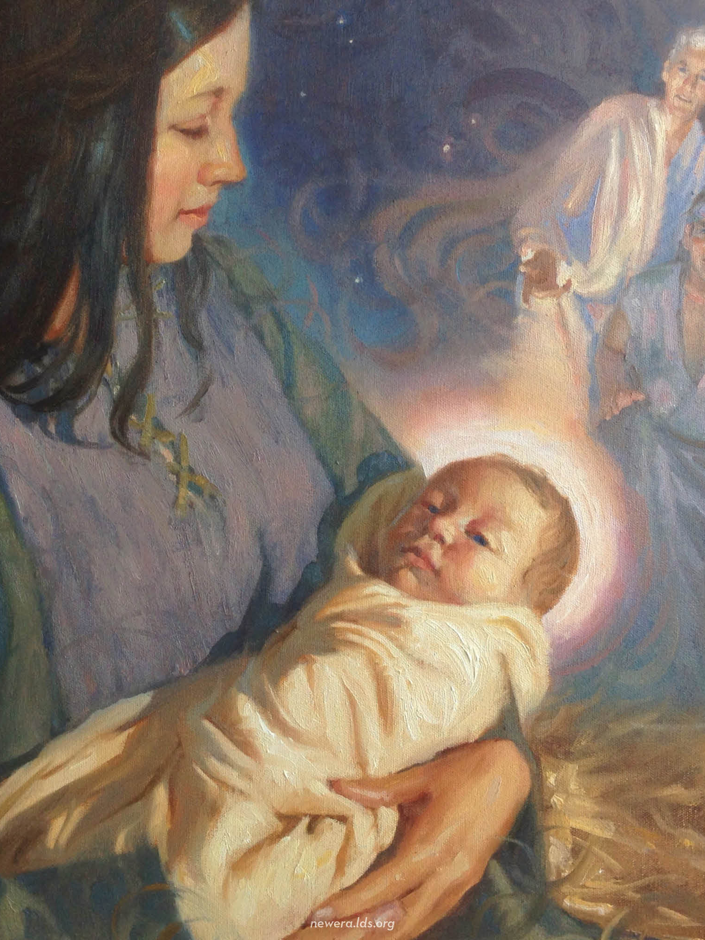
The Condescension of God
The condescension of God refers to both God the Father and Jesus Christ.

Slide 26
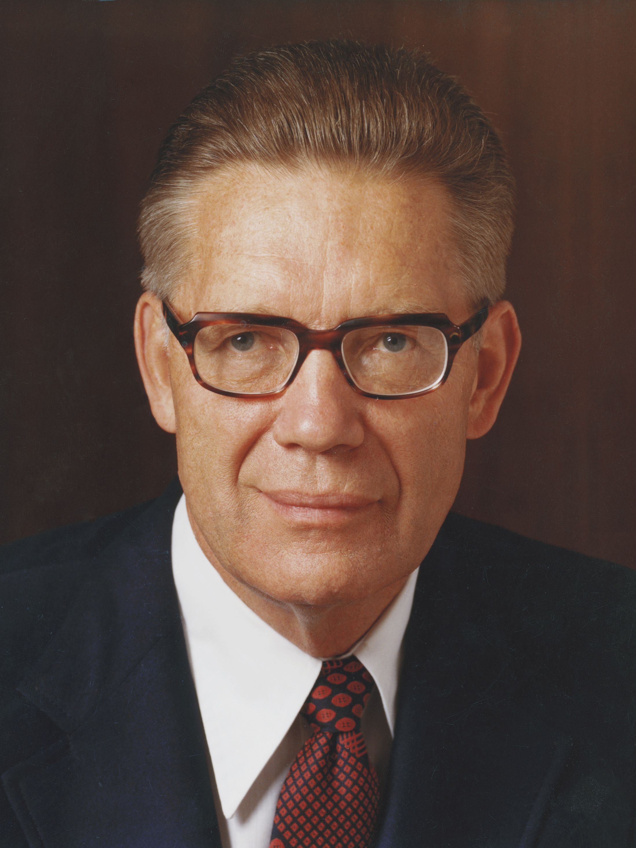
Elder Bruce R. McConkie
“The condescension of God lies in the fact that he, an exalted Being, steps down from his eternal throne to become the Father of a mortal Son” (Bruce R. McConkie, The Mortal Messiah [1979], 1:314).

Slide 27
The Father of Jesus Christ
Consider marking phrases in verses 18–23 of 1 Nephi 11 that indicate that God is the Father of Jesus Christ.

Slide 28
The Father of Jesus Christ
Consider marking phrases in verses 18–23 of 1 Nephi 11 that indicate that God is the Father of Jesus Christ.
The phrase “the condescension of God” (verse 16) also refers to the condescension of Jesus Christ.

Slide 29
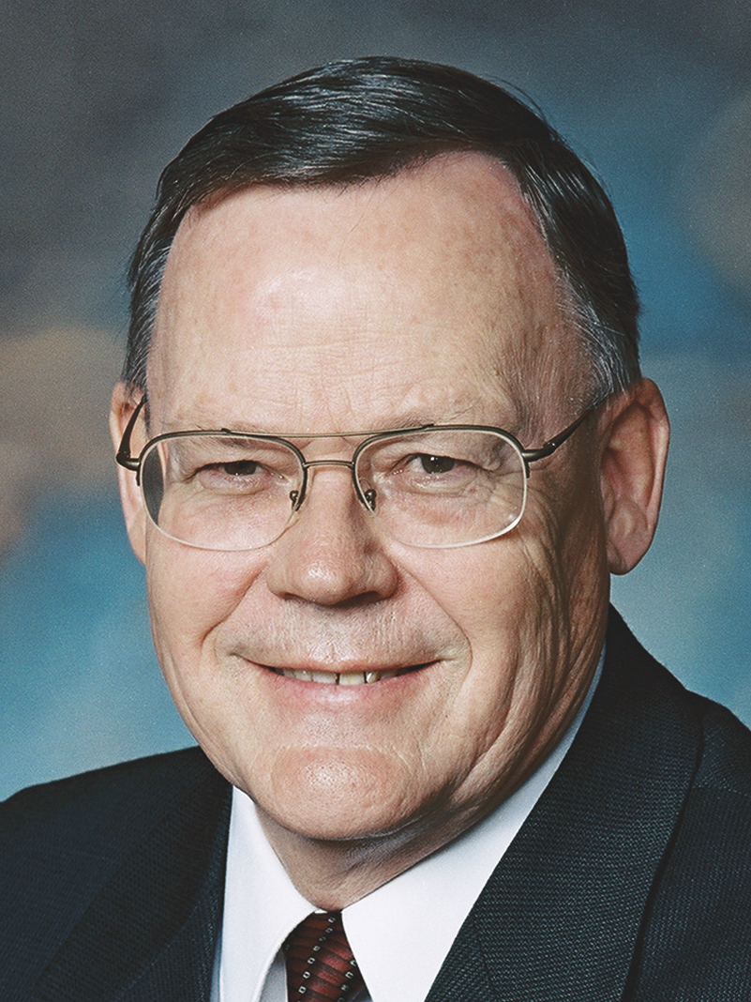
Elder Gerald N. Lund
“Here was Jesus—a member of the Godhead, the Firstborn of the Father, the Creator, Jehovah of the Old Testament—now leaving His divine and holy station; divesting Himself of all that glory and majesty and entering the body of a tiny infant; helpless, completely dependent on His mother and earthly father.
Continued on next page.

Slide 30
Elder Gerald N. Lund, cont.
“That He should not come to the finest of earthly palaces and be … showered with jewels but should come to a lowly stable is astonishing. Little wonder that the angel should say to Nephi, ‘Behold the condescension of God!’ (1 Ne. 11:26.)” (Gerald N. Lund, Jesus Christ, Key to the Plan of Salvation [1991], 16).

Slide 31
The Savior in Mortality
Read 1 Nephi 11:26–27, 28, 31. What did Nephi learn about how the Savior would spend His time in mortality?

Slide 32
The Savior in Mortality
Read 1 Nephi 11:26–27, 28, 31. What did Nephi learn about how the Savior would spend His time in mortality?
How do the Savior’s actions show His condescension?

Slide 33
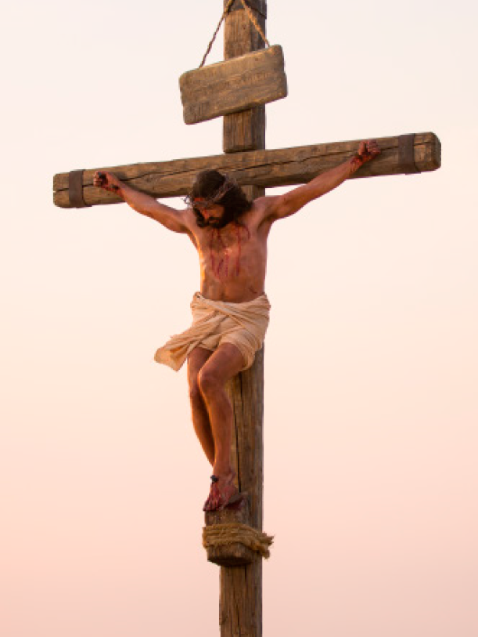
Condescension of Jesus Christ
Read 1 Nephi 11:32–33, looking for what these verses teach about the condescension of Jesus Christ.

Slide 34
Condescension of Jesus Christ
Read 1 Nephi 11:32–33, looking for what these verses teach about the condescension of Jesus Christ.
In what ways might the Savior’s suffering and Crucifixion provide the ultimate example of His condescension?

Slide 35
Condescension of Jesus Christ
What does the Savior’s willingness to condescend to suffer and die for us demonstrate about His feelings for us?

Slide 36
Condescension of Jesus Christ
What does the Savior’s willingness to condescend to suffer and die for us demonstrate about His feelings for us?
The condescension of Jesus Christ demonstrates His love for us.

Slide 37
The Love of God
How does your knowledge of the birth, mortal ministry, and Atonement of Jesus Christ help you understand the love that He and Heavenly Father have for you?

Slide 38
The Love of God
How does your knowledge of the birth, mortal ministry, and Atonement of Jesus Christ help you understand the love that He and Heavenly Father have for you?
How does knowing about the Savior’s condescension and love influence your feelings about Him?

