Slide 1
1 Nephi 12–13
Lesson 14

Slide 2
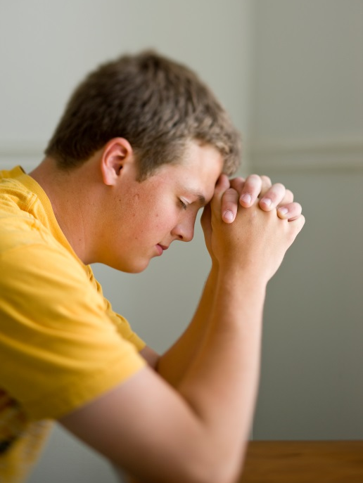
Devotional
Hymn:
Prayer:
Thought:
Notes:
738194

Slide 3
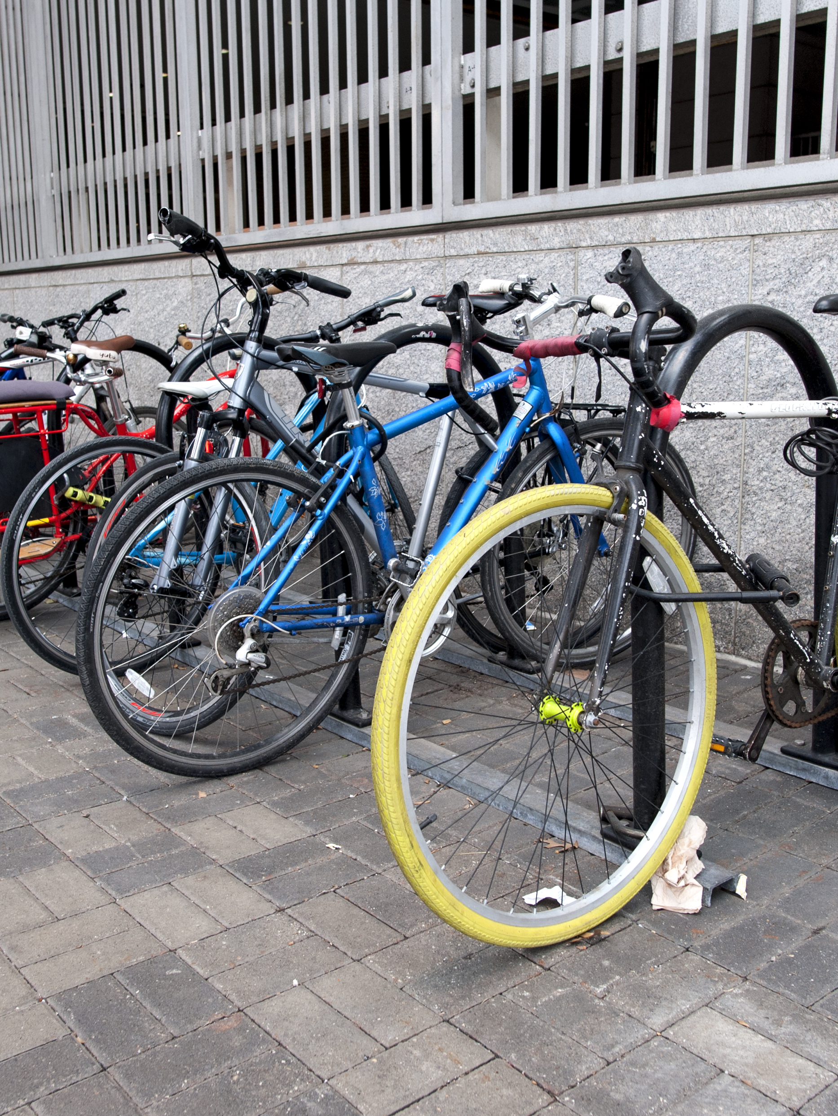
Parts of a Bicycle
What are some parts of a bicycle that, if removed, would make it unsafe to ride? Why?

Slide 4
Parts of a Bicycle
What are some parts of a bicycle that, if removed, would make it unsafe to ride? Why?
Imagine that this is your bicycle and that someone deliberately removed the parts we’ve discussed. What might those actions indicate about their feelings toward you?

Slide 5
1 Nephi 12
1 Nephi 12 is a continuation of Nephi’s vision. In it, the angel showed Nephi how the symbols in the vision of the tree of life would apply to his posterity. He was shown that some of his descendants would receive all the blessings of the Atonement of Jesus Christ. However, Nephi also saw that his descendants would eventually be destroyed by his brothers’ posterity (the Lamanites).

Slide 6
What Nephi Saw
Read 1 Nephi 13:1–4, 6, looking for what Nephi saw forming among the Gentiles.

Slide 7
What Nephi Saw
Read 1 Nephi 13:1–4, 6, looking for what Nephi saw forming among the Gentiles.
Read 1 Nephi 13:5, 7–9, looking for what those in the great and abominable church desire and seek to accomplish.

Slide 8
What Nephi Saw
Read 1 Nephi 13:1–4, 6, looking for what Nephi saw forming among the Gentiles.
Read 1 Nephi 13:5, 7–9, looking for what those in the great and abominable church desire and seek to accomplish.
According to verses 5 and 9, what do those of the great and abominable church seek to accomplish?

Slide 9
What Nephi Saw
Read 1 Nephi 13:1–4, 6, looking for what Nephi saw forming among the Gentiles.
Read 1 Nephi 13:5, 7–9, looking for what those in the great and abominable church desire and seek to accomplish.
According to verses 5 and 9, what do those of the great and abominable church seek to accomplish?
Satan and his followers want to destroy the Saints of God and bring them into captivity.

Slide 10
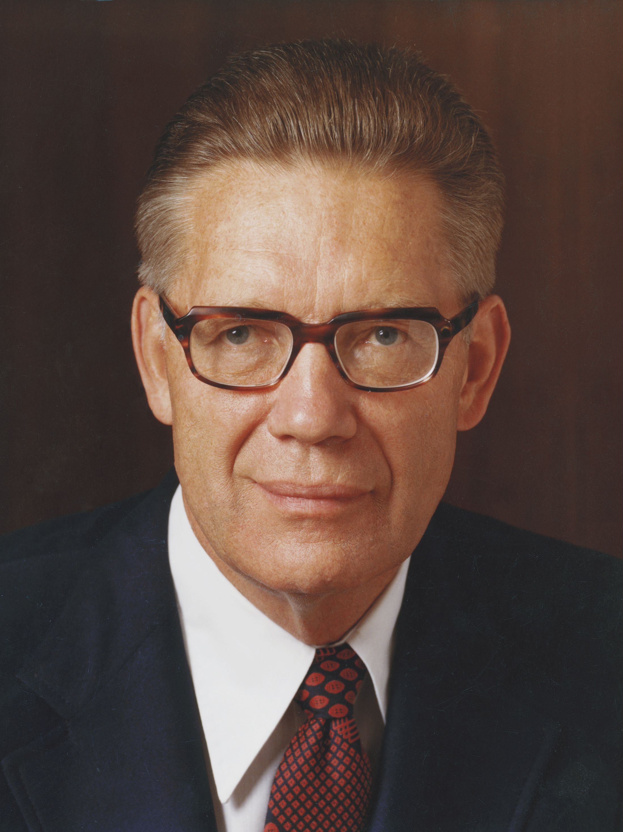
Elder Bruce R. McConkie
“The titles church of the devil and great and abominable church are used to identify all … organizations of whatever name or nature—whether political, philosophical, educational, economic, social, fraternal, civic, or religious—which are designed to take men on a course that leads away from God and his laws and thus from salvation in the kingdom of God” (Bruce R. McConkie, Mormon Doctrine, 2nd ed. [1966], 137–38).

Slide 11
“Church of the Devil”
What do the phrases “church of the devil” and “great and abominable church” refer to?

Slide 12
“Church of the Devil”
What do the phrases “church of the devil” and “great and abominable church” refer to?
The phrase “great and abominable church” does not refer to a particular denomination or church.

Slide 13
The Great and Abominable Church
What are some examples of false ideas or practices that the great and abominable church uses to lead people away from God and His laws?

Slide 14
The Great and Abominable Church
What are some examples of false ideas or practices that the great and abominable church uses to lead people away from God and His laws?
How can knowing that Satan and his followers seek to destroy us and bring us into captivity help us to overcome their efforts?

Slide 15
1 Nephi 13:10–19
In 1 Nephi 13:10–19 we read Nephi’s words describing his vision of individuals who would go forth “out of captivity,” or religious persecution, from the nations of Europe and settle in North America, where they would be “delivered by the power of God out of the hands of all other nations” (1 Nephi 13:19). Latter-day prophets have taught that these individuals were inspired to help prepare and establish a nation with religious freedom—the United States of America—in which the gospel could be restored.

Slide 16
Early American Colonists
Read 1 Nephi 13:20–23, looking for the object that Nephi saw early American colonists “[carrying] forth among them” (verse 20).

Slide 17
Early American Colonists
Read 1 Nephi 13:20–23, looking for the object that Nephi saw early American colonists “[carrying] forth among them” (verse 20).
What book was Nephi referring to?

Slide 18
The Bible
Read 1 Nephi 13:24–28, looking for what the great and abominable church did to the Bible.

Slide 19
The Bible
Read 1 Nephi 13:24–28, looking for what the great and abominable church did to the Bible.
According to verse 27, why were these things removed?

Slide 20
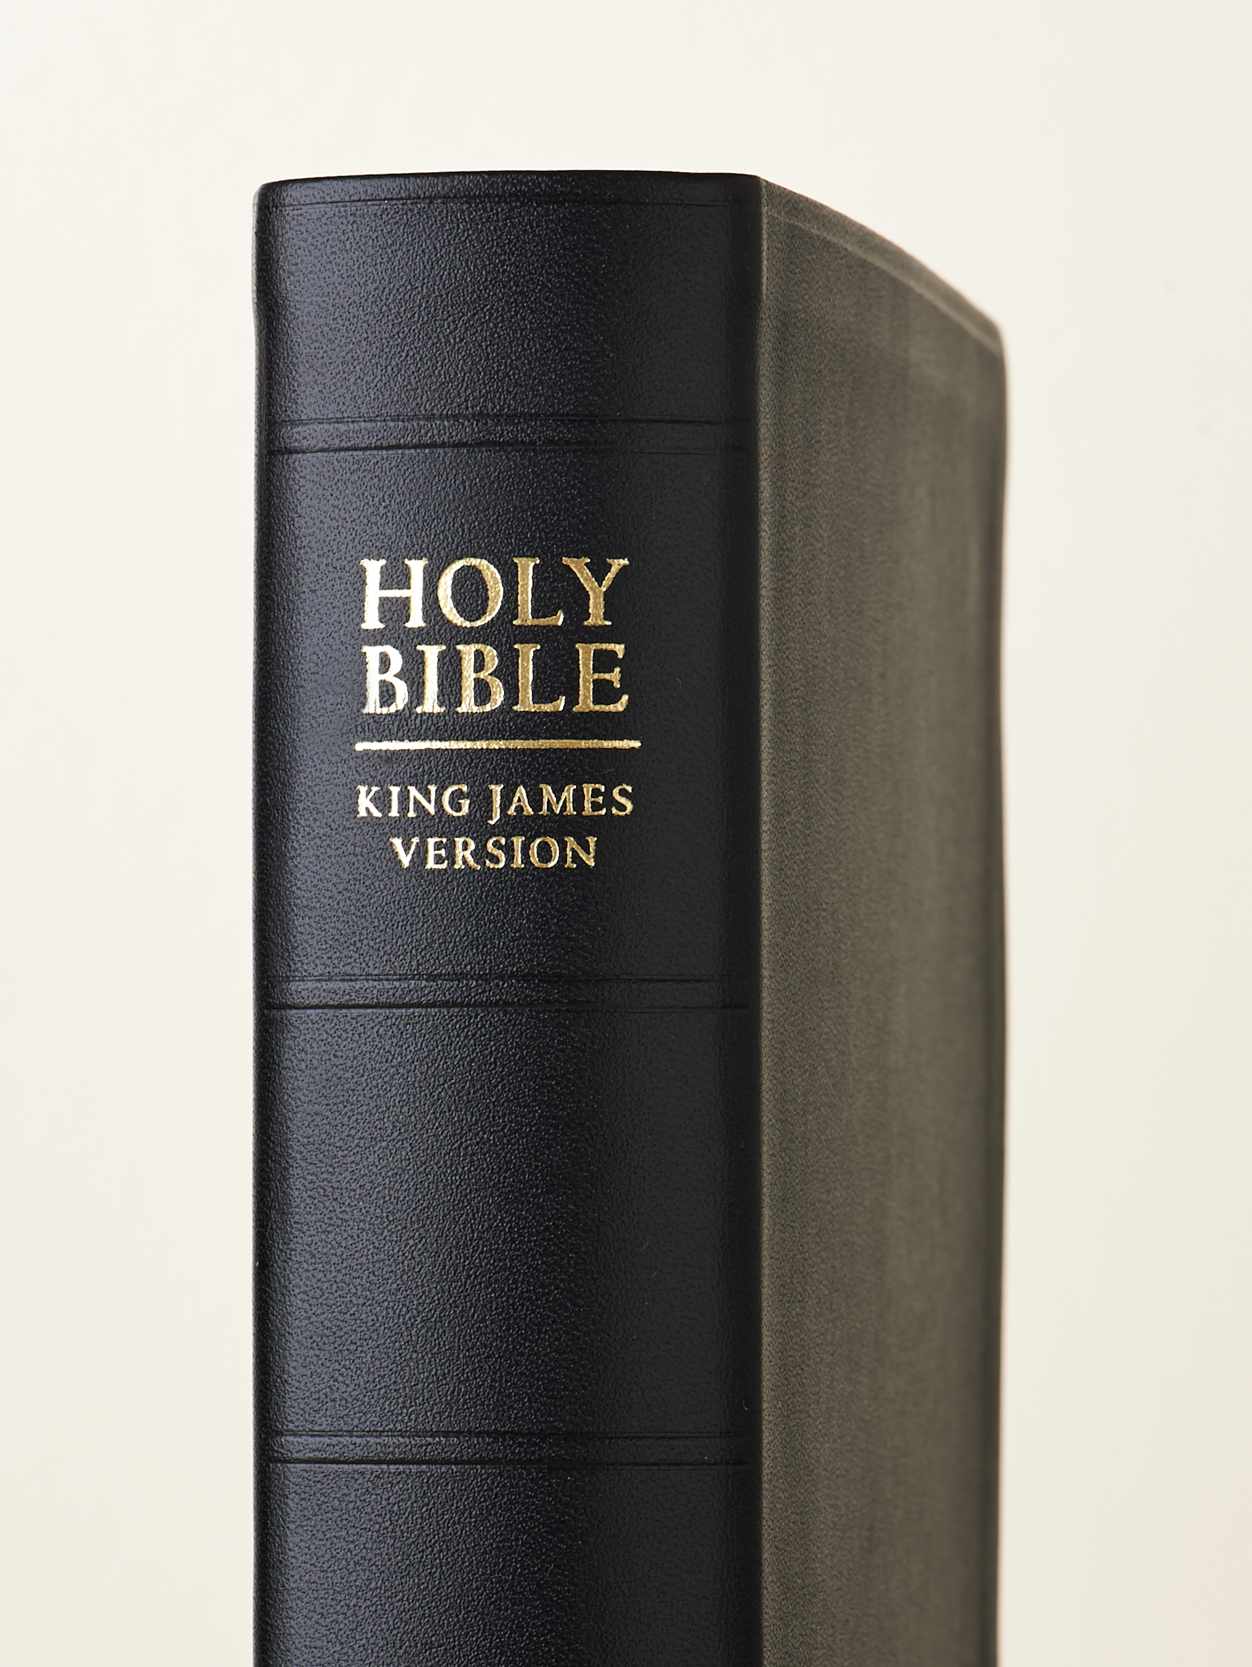
Truths Removed
Read 1 Nephi 13:29, looking for what happened because many plain and precious truths and covenants were removed from the Bible.

Slide 21
Truths Removed
Read 1 Nephi 13:29, looking for what happened because many plain and precious truths and covenants were removed from the Bible.
What are some examples of plain and precious truths and covenants that are not taught clearly in the Bible or are not contained in it?

Slide 22
Truths Removed from the Bible
Examples of truths that are not taught clearly in the Bible or are not contained in it are premortal life, the need for baptism by immersion, eternal marriage, sealing of children to their parents, the spirit world, baptisms for the dead, and the three kingdoms of glory.

Slide 23
Truths Removed from the Bible
Examples of truths that are not taught clearly in the Bible or are not contained in it are premortal life, the need for baptism by immersion, eternal marriage, sealing of children to their parents, the spirit world, baptisms for the dead, and the three kingdoms of glory.
How might misunderstanding these truths or having no knowledge of them cause a person to stumble spiritually?

Slide 24
Tampering with the Bible
In what ways might the great and abominable church’s tampering with the Bible be compared to someone’s efforts to deliberately remove essential parts from another person’s bicycle?

Slide 25
The Lord’s Help
Read 1 Nephi 13:32, 34–36, looking for what the Lord would do to help people overcome the efforts of the great and abominable church.

Slide 26
The Lord’s Help
Read 1 Nephi 13:32, 34–36, looking for what the Lord would do to help people overcome the efforts of the great and abominable church.
According to 1 Nephi 13:34, what will the Lord bring forth because of His mercy?

Slide 27
The Lord’s Help
Read 1 Nephi 13:32, 34–36, looking for what the Lord would do to help people overcome the efforts of the great and abominable church.
According to 1 Nephi 13:34, what will the Lord bring forth because of His mercy?
According to 1 Nephi 13:35–36, what would be “hid up” to come forth unto the Gentiles?

Slide 28
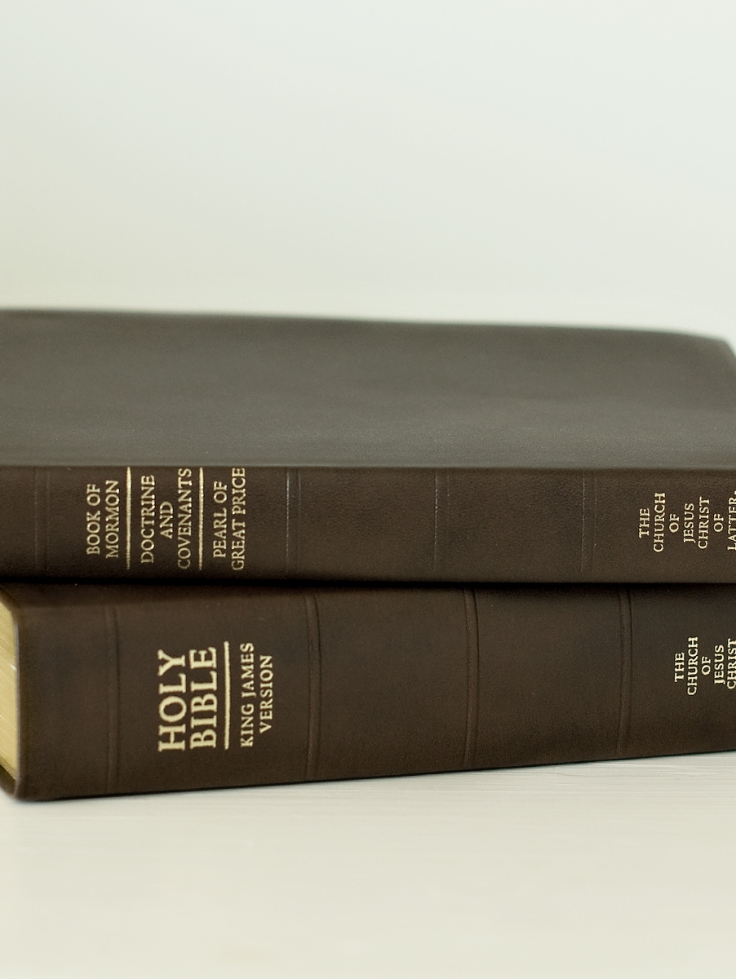
The Latter-day Restoration
Read 1 Nephi 13:39, looking for what else the Lord would bring forth as part of the latter-day Restoration of His gospel.

Slide 29
The Latter-day Restoration
Read 1 Nephi 13:39, looking for what else the Lord would bring forth as part of the latter-day Restoration of His gospel.
What “other books” has the Lord brought forth as part of the Restoration?

Slide 30
The Scriptures of the Restoration
Read 1 Nephi 13:40–41, looking for a description of what the scriptures of the Restoration will make known unto all people.

Slide 31
The Scriptures of the Restoration
Read 1 Nephi 13:40–41, looking for a description of what the scriptures of the Restoration will make known unto all people.
The Book of Mormon and other latter-day scriptures restore plain and precious truths that help us know that Jesus Christ is the Son of God and that we must come unto Him to be saved.

Slide 32
Class Activity
Choose one of these truths: premortal life, the need for baptism by immersion, eternal marriage, sealing of children to their parents, the spirit world, baptisms for the dead, or the three kingdoms of glory.

Slide 33
Class Activity
Choose one of these truths: premortal life, the need for baptism by immersion, eternal marriage, sealing of children to their parents, the spirit world, baptisms for the dead, or the three kingdoms of glory.
Use the index to the triple combination, the Topical Guide, or the Bible Dictionary to locate a scripture passage in the Book of Mormon, Doctrine and Covenants, or Pearl of Great Price that could help someone understand the truth you chose.

Slide 34
Class Activity
Read the scripture passage you located and explain how the passage could help someone understand the particular truth you were assigned. Share your testimony of that truth.

Slide 35
The Atonement of Jesus Christ
The Bible testifies that Jesus Christ suffered and died for our sins, but the Book of Mormon provides a fuller description of what the Savior experienced as part of His Atonement.

Slide 36
The Atonement of Jesus Christ
The Bible testifies that Jesus Christ suffered and died for our sins, but the Book of Mormon provides a fuller description of what the Savior experienced as part of His Atonement.
Read Alma 7:11–13 and share your testimony of how knowing this scripture passage has helped you come unto Jesus Christ.

