Slide 1
1 Nephi 14
Lesson 15

Slide 2
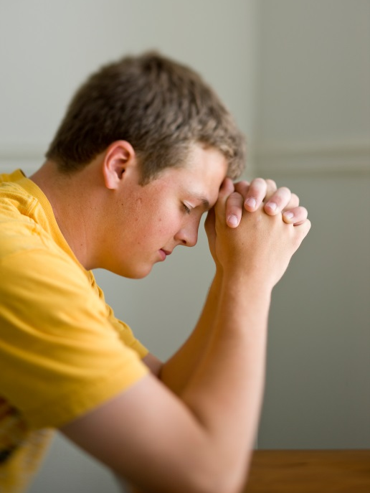
Devotional
Hymn:
Prayer:
Thought:
Notes:
738194

Slide 3
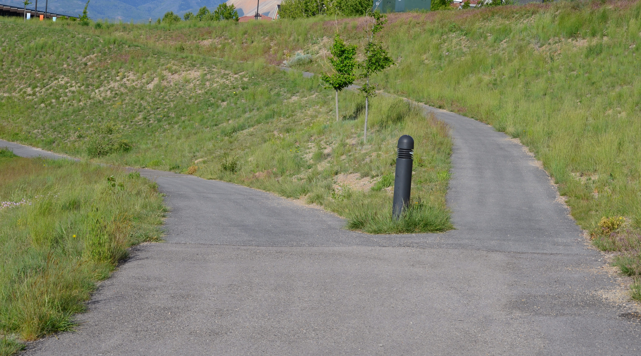
A Fork in the Road
When a person arrives at a fork in a road, he or she must choose between two possible directions. Similarly, at times we must make important decisions about which direction to take in life.

Slide 4
Choose a Direction
Think about a time when you or someone you know has had to make a choice about a direction to take in life.

Slide 5
Choose a Direction
Think about a time when you or someone you know has had to make a choice about a direction to take in life.
How did you or the person you know decide which choice to make?

Slide 6
Making Choices
Read 1 Nephi 14:1–2, looking for the choices Nephi indicated the Gentiles could make once they learned about the gospel and the blessings that would come to them if they made those choices.

Slide 7
Responding to the Gospel
How will some Gentiles respond to the gospel?

Slide 8
Responding to the Gospel
How will some Gentiles respond to the gospel?
What blessings did Nephi see would come to those who hearkened unto the Lamb of God?

Slide 9
Responding to the Gospel
How will some Gentiles respond to the gospel?
What blessings did Nephi see would come to those who hearkened unto the Lamb of God?
The phrase “stumbling blocks” (1 Nephi 14:1) often refers to obstacles that keep people from following the Lord. To be “numbered among the house of Israel” (1 Nephi 14:2) means to be counted among the Lord’s covenant people.

Slide 10
Choices and Consequences
Read 1 Nephi 14:5–6, looking for additional choices that the Gentiles could make, as well as the consequences of those choices.

Slide 11
Choices and Consequences
Read 1 Nephi 14:5–6, looking for additional choices that the Gentiles could make, as well as the consequences of those choices.
Read 1 Nephi 14:7, looking for additional consequences that come to those who repent and to those who choose not to repent.

Slide 12
Choices and Consequences
Read 1 Nephi 14:5–6, looking for additional choices that the Gentiles could make, as well as the consequences of those choices.
Read 1 Nephi 14:7, looking for additional consequences that come to those who repent and to those who choose not to repent.
The “great and marvelous work” mentioned in 1 Nephi 14:7 refers to the Restoration of the gospel and the Lord’s Church in the latter days.

Slide 13
Blessings of Repentance
What blessings will come to those who repent and do not harden their hearts against the Lord and His work?

Slide 14
Blessings of Repentance
What blessings will come to those who repent and do not harden their hearts against the Lord and His work?
If we repent and do not harden our hearts against the Lord and His work, then we will receive peace and eternal life.

Slide 15
Choosing Not to Repent
What will happen to those who respond to the gospel by hardening their hearts and choosing not to repent?

Slide 16
Choosing Not to Repent
What will happen to those who respond to the gospel by hardening their hearts and choosing not to repent?
If we do not repent but harden our hearts against the Lord and His work, we will eventually be brought down into captivity and destruction.

Slide 17
Choosing Not to Repent
What will happen to those who respond to the gospel by hardening their hearts and choosing not to repent?
If we do not repent but harden our hearts against the Lord and His work, we will eventually be brought down into captivity and destruction.
What are some examples of captivity and destruction that may come to those who choose not to repent?

Slide 18
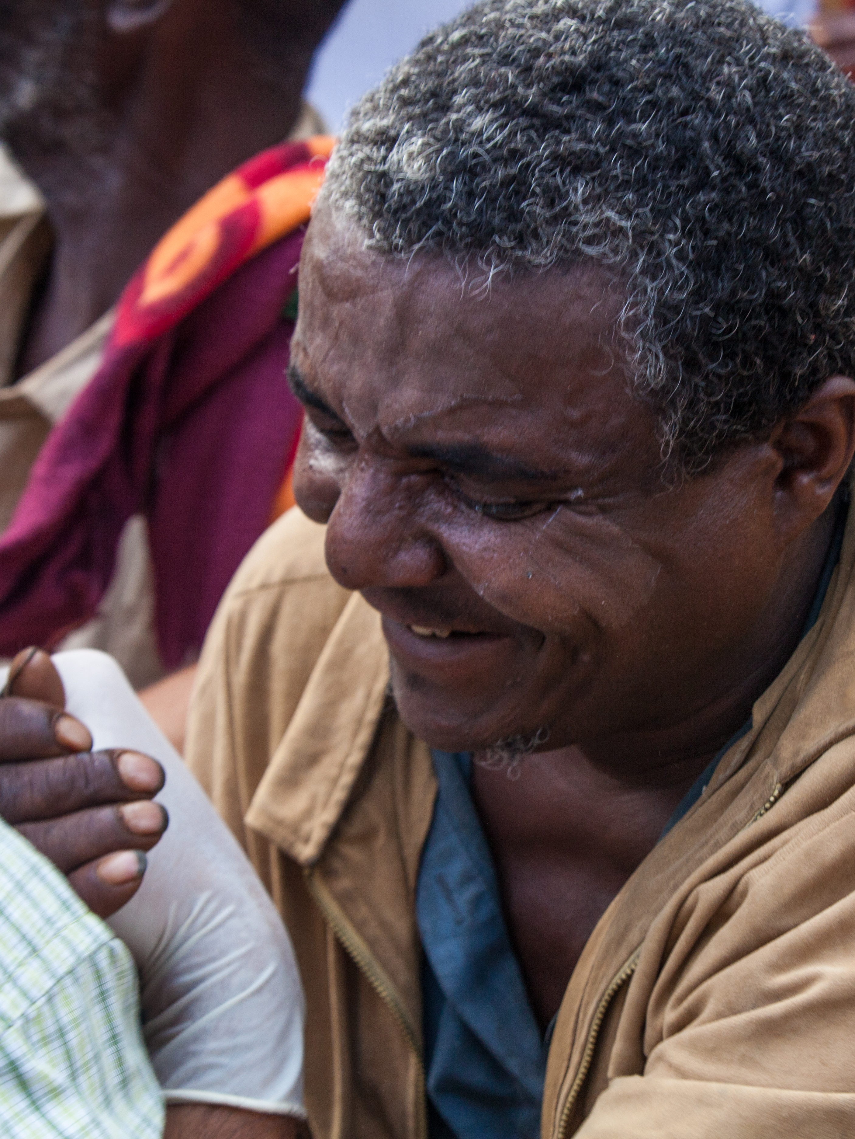
Responding to the Gospel
What are some different ways people may respond when they learn about the restored gospel of Jesus Christ?

Slide 19
Responding to the Gospel
What are some different ways people may respond when they learn about the restored gospel of Jesus Christ?
Why do you think people can have such different responses when they learn about the restored gospel?

Slide 20
Responding to the Gospel
What are some different ways people may respond when they learn about the restored gospel of Jesus Christ?
Why do you think people can have such different responses when they learn about the restored gospel?
What differences have you seen in the lives of those who embrace the gospel compared to those who harden their hearts against the Lord and His work?

Slide 21
Two Churches
Read 1 Nephi 14:9–10, looking for what the angel called the two churches.

Slide 22
Two Churches
Read 1 Nephi 14:9–10, looking for what the angel called the two churches.
The church of the Lamb of God is the authorized Church of Jesus Christ, and the church of the devil (also called the great and abominable church) refers to any organization that strives to lead people away from God and His laws.

Slide 23
First Presidency Message
“As this work progresses in its onward course, and becomes more and more an object of political and religious interest and excitement, no king, ruler, or subject, no community or individual, will stand neutral. All will at length be influenced by one spirit or the other; and will take sides either for or against the kingdom of God” (in James R. Clark, comp., Messages of the First Presidency of The Church of Jesus Christ of Latter-day Saints [1965], 1:257).

Slide 24
The Church with More People
Read 1 Nephi 14:11–12, looking for which church will have more people and why.

Slide 25
The Church with More People
Read 1 Nephi 14:11–12, looking for which church will have more people and why.
Why will the church of the Lamb of God have fewer people than the great and abominable church?

Slide 26
The Church with More People
Read 1 Nephi 14:11–12, looking for which church will have more people and why.
Why will the church of the Lamb of God have fewer people than the great and abominable church?
Where did Nephi say the members of the church of the Lamb of God will be located?

Slide 27
The Great and Abominable Church
Read 1 Nephi 14:13, looking for what purpose the great and abominable church will gather together multitudes.

Slide 28
The Great and Abominable Church
Read 1 Nephi 14:13, looking for what purpose the great and abominable church will gather together multitudes.
What are some ways that you have seen individuals or organizations fight against the Savior and His work?

Slide 29
The Great and Abominable Church
Read 1 Nephi 14:13, looking for what purpose the great and abominable church will gather together multitudes.
What are some ways that you have seen individuals or organizations fight against the Savior and His work?
When have you experienced opposition because of your beliefs or standards as a member of The Church of Jesus Christ of Latter-day Saints?

Slide 30
Facing Opposition
Read 1 Nephi 14:14, looking for how the Lord will help His covenant people as they face opposition from the church of the devil.

Slide 31
Facing Opposition
Read 1 Nephi 14:14, looking for how the Lord will help His covenant people as they face opposition from the church of the devil.
If we keep our covenants, we will be armed with righteousness and with the power of God.

Slide 32
Armed with Righteousness
What does the phrase “armed with righteousness and with the power of God” mean to you?

Slide 33
Armed with Righteousness
What does the phrase “armed with righteousness and with the power of God” mean to you?
When have you felt that you were “armed with righteousness and with the power of God”? What did you do that helped you feel God’s power or protection?

Slide 34
What Will Happen?
Read 1 Nephi 14:3–4, 15–17, looking for what will happen to the great and abominable church.

Slide 35
What Will Happen?
Read 1 Nephi 14:3–4, 15–17, looking for what will happen to the great and abominable church.
How can knowing what will happen to the great and abominable church help us to have hope as members of the much smaller church of the Lamb of God?

Slide 36
Armed with Righteousness
Evaluate your life and consider what you might do to be better armed with righteousness. Act on any promptings you receive. As you remain faithful, you will have the opportunity to enter into sacred temples and make additional covenants with the Lord. The promises and covenants you make there will bring great power and protection into your life as you keep those promises and covenants.

Slide 37
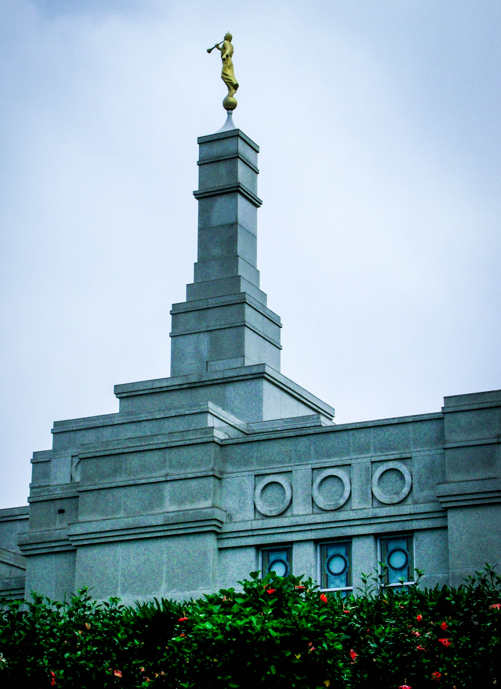
1 Nephi 14:18–28
In 1 Nephi 14:18–28 the angel showed Nephi a vision of the Apostle John and informed Nephi that he would be shown the same things that John would be shown, including the end of the world. The angel commanded Nephi not to write the rest of his vision because John was appointed to record the remainder of it. These verses refer at least in part to John’s writings in the book of Revelation.

