Slide 1
1 Nephi 15
Lesson 16

Slide 2

Devotional
Hymn:
Prayer:
Thought:

Slide 3
A Scenario
Imagine that a friend approaches you and asks about a recent statement made by Church leaders that is difficult for your friend to understand and accept. What you would say to this friend?

Slide 4
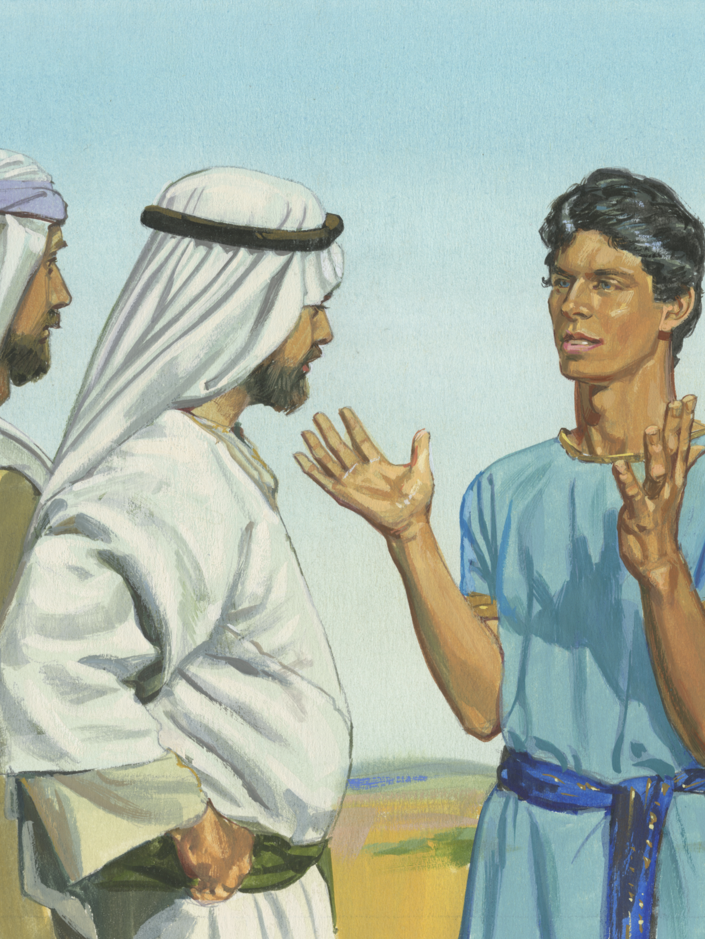
Nephi
Read 1 Nephi 15:1–2, looking for what Nephi encountered when he returned to his father’s tent.

Slide 5
Nephi
Read 1 Nephi 15:1–2, looking for what Nephi encountered when he returned to his father’s tent.
What were Nephi’s brethren disputing about?

Slide 6
Struggling to Understand
Read 1 Nephi 15:3, looking for why Nephi’s brethren were struggling to understand the things Lehi had taught them.

Slide 7
Struggling to Understand
Read 1 Nephi 15:3, looking for why Nephi’s brethren were struggling to understand the things Lehi had taught them.
What principle can we learn from verse 3 about what can prevent us from understanding spiritual truth?

Slide 8
Struggling to Understand
Read 1 Nephi 15:3, looking for why Nephi’s brethren were struggling to understand the things Lehi had taught them.
What principle can we learn from verse 3 about what can prevent us from understanding spiritual truth?
If we harden our hearts and do not look to the Lord, then we will struggle to understand spiritual truth.

Slide 9
Where to Turn
In our day, where might individuals who are struggling to understand spiritual truth choose to turn rather than looking to the Lord?

Slide 10
Where to Turn
In our day, where might individuals who are struggling to understand spiritual truth choose to turn rather than looking to the Lord?
When struggling to understand spiritual truth, why do you think it is important to look to the Lord to help us understand spiritual truth?

Slide 11
1 Nephi 15:4–7
Nephi was overcome with grief because of the hard-heartedness of his brethren and because of the destruction of his people that he had seen in his vision. When Nephi regained his strength, he asked his brethren why they were arguing. They responded that they could not understand what Lehi had taught about the house of Israel and the Gentiles.

Slide 12
Nephi’s Question
Read 1 Nephi 15:8–9, looking for the question Nephi asked his brethren and how they responded.

Slide 13
Nephi’s Question
Read 1 Nephi 15:8–9, looking for the question Nephi asked his brethren and how they responded.
What was the reason his brethren gave for not turning to the Lord for answers?

Slide 14
Nephi’s Question
Read 1 Nephi 15:8–9, looking for the question Nephi asked his brethren and how they responded.
What was the reason his brethren gave for not turning to the Lord for answers?
Based on their response to Nephi’s question, what do you think Nephi’s brethren failed to understand?

Slide 15
How to Obtain Answers
Read 1 Nephi 15:10–11, looking for a principle Nephi taught his brethren to help them learn how to obtain answers from God.

Slide 16
How to Obtain Answers
Read 1 Nephi 15:10–11, looking for a principle Nephi taught his brethren to help them learn how to obtain answers from God.
If we do not harden our hearts and we ask the Lord in faith and keep His commandments, then we will receive answers and understanding from Him.

Slide 17
How to Obtain Answers
Read 1 Nephi 15:10–11, looking for a principle Nephi taught his brethren to help them learn how to obtain answers from God.
If we do not harden our hearts and we ask the Lord in faith and keep His commandments, then we will receive answers and understanding from Him.
Why do you think it is necessary to ask in faith and keep God’s commandments in order to receive answers and understanding from Him?

Slide 18
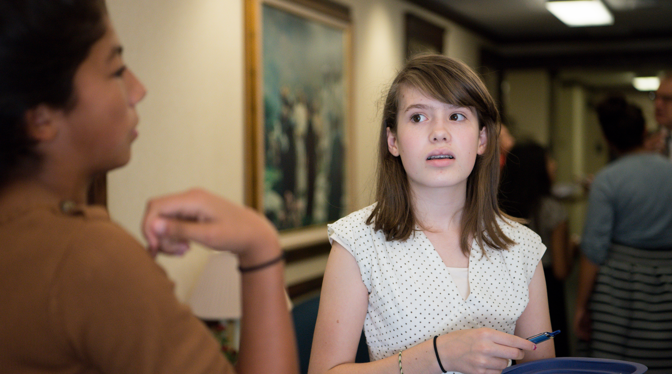
Helping Your Friend
Remember the scenario in the beginning of the lesson. How could you use the principles you have identified in 1 Nephi 15 to help your friend in this scenario?

Slide 19
Ask in Faith
How has the principle you identified in 1 Nephi 15:11 blessed you or someone you know?

Slide 20
1 Nephi 15:12–20
To help resolve the disputations of his brethren, Nephi taught them the meaning of Lehi’s prophecy about the “natural branches of the olive tree” and the Gentiles (see 1 Nephi 10:12–14; 15:7). He explained that the olive tree represented the house of Israel. Because Lehi’s family had left Jerusalem and was separated from the rest of the house of Israel, it was like a branch that had been broken from the olive tree (see 1 Nephi 15:12).

Slide 21
1 Nephi 15:12–20
Nephi further explained that in the latter days, many years after Lehi’s descendants would have “dwindled in unbelief” (1 Nephi 15:13), the fulness of the gospel would be given to the Gentiles. The Gentiles would then bring the gospel to Lehi’s posterity, restoring them to the knowledge of their Redeemer and to the covenant blessings of their fathers.

Slide 22
1 Nephi 15:12–20
This would be like gathering and grafting their branch back into the olive tree (see 1 Nephi 15:13–17). This restoration would happen not only for Lehi’s descendants but for all the house of Israel (see 1 Nephi 15:18–20).

Slide 23
Lehi’s Vision
In the remainder of 1 Nephi 15, we read Nephi’s answers to the questions his brethren had about Lehi’s vision. Nephi used what he learned in his own vision to teach them. For example, as recorded in 1 Nephi 15:21–22, Nephi explained that the tree he and his father saw in vision was a representation of the tree of life.

Slide 24
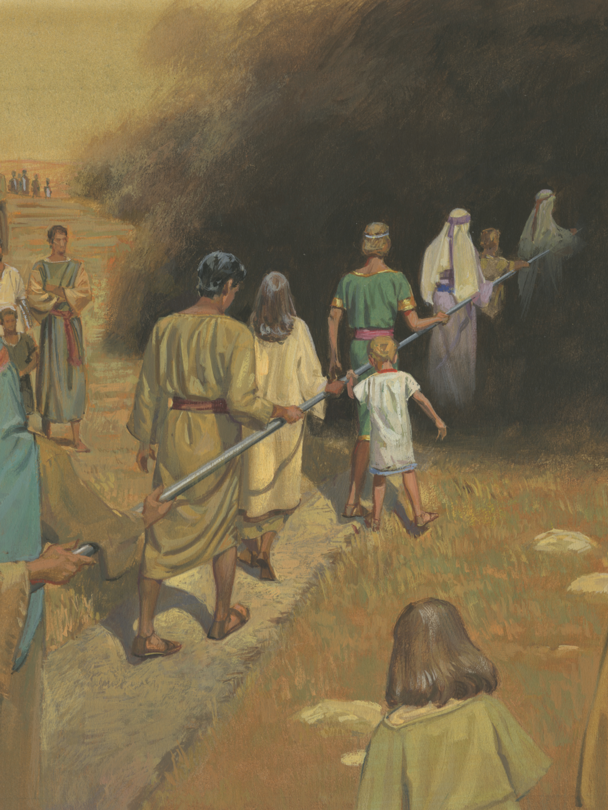
Another Question
Read 1 Nephi 15:23, looking for what Nephi’s brethren asked him next.

Slide 25
Another Question
Read 1 Nephi 15:23, looking for what Nephi’s brethren asked him next.
If you had been in Nephi’s position, what would you teach Nephi’s brethren about the meaning of the iron rod?

Slide 26
The Iron Rod
Read 1 Nephi 15:24–25, looking for what Nephi taught his brethren about the iron rod.

Slide 27
The Iron Rod
Read 1 Nephi 15:24–25, looking for what Nephi taught his brethren about the iron rod.
The phrase “fiery darts” (verse 24) can refer to any temptation or evil influence that the adversary uses to try to harm us.

Slide 28
The Word of God
What principle about the word of God can we learn from verse 24?

Slide 29
The Word of God
What principle about the word of God can we learn from verse 24?
Continually hearkening and holding fast to the word of God enables us to withstand Satan’s attempts to blind and destroy us.

Slide 30
Blinded
Imagine having to cross a room blindfolded. How would a blindfold make this task more difficult?

Slide 31
Blinded
Imagine having to cross a room blindfolded. How would a blindfold make this task more difficult?
In Lehi’s vision the mists of darkness represent “the temptations of the devil” (1 Nephi 12:17).

Slide 32
Blinded
Imagine having to cross a room blindfolded. How would a blindfold make this task more difficult?
In Lehi’s vision the mists of darkness represent “the temptations of the devil” (1 Nephi 12:17).
Why do you think Satan tries to blind those he desires to destroy?

Slide 33
Blinded
Imagine having to cross a room blindfolded. How would a blindfold make this task more difficult?
In Lehi’s vision the mists of darkness represent “the temptations of the devil” (1 Nephi 12:17).
Why do you think Satan tries to blind those he desires to destroy?
In what ways can temptations blind us or cause us to not see clearly?

Slide 34
The Iron Rod
Imagine while blindfolded you had a rod to hold on to. When you are walking and cannot see, what difference does it make to have something to hold on to?

Slide 35
The Iron Rod
Imagine while blindfolded you had a rod to hold on to. When you are walking and cannot see, what difference does it make to have something to hold on to?
In Lehi’s vision the iron rod did not eliminate the mists of darkness, but it did allow those who held on to the rod to come through the mists of darkness in safety.

Slide 36
The Word of God
In what ways is the iron rod like the word of God?

Slide 37
The Word of God
In what ways is the iron rod like the word of God?
Where can we obtain the word of God?

Slide 38
The Word of God
In what ways is the iron rod like the word of God?
Where can we obtain the word of God?
What can we do to hearken and hold fast to the word of God?

Slide 39
The Word of God
In what ways is the iron rod like the word of God?
Where can we obtain the word of God?
What can we do to hearken and hold fast to the word of God?
How has studying and following the word of God strengthened you against Satan’s attacks?

Slide 40
1 Nephi 15:26–36
Nephi told his brethren that the river their father saw in his vision represented an awful hell prepared for the wicked, separating them from God and His people.

Slide 41
1 Nephi 15:26–36
Nephi told his brethren that the river their father saw in his vision represented an awful hell prepared for the wicked, separating them from God and His people.
1 Nephi 15:26–36 teaches that no unclean thing can enter the presence of God.

