Slide 1
1 Nephi 17
Lesson 18

Slide 2

Devotional
Hymn:
Prayer:
Thought:

Slide 3
Commandments
What are a few of the Lord’s commandments that some people might feel are difficult to obey?

Slide 4
Commandments
What are a few of the Lord’s commandments that some people might feel are difficult to obey?
Why might people feel these commandments are difficult to obey?

Slide 5
Difficulties and Blessings
Read 1 Nephi 17:1–2, looking for some of the difficulties Lehi’s family experienced as they traveled in the wilderness.

Slide 6
Difficulties and Blessings
Read 1 Nephi 17:1–2, looking for some of the difficulties Lehi’s family experienced as they traveled in the wilderness.
What blessings did they receive?

Slide 7
Difficulties and Blessings
Read 1 Nephi 17:1–2, looking for some of the difficulties Lehi’s family experienced as they traveled in the wilderness.
What blessings did they receive?
Lehi’s family was also blessed in many other ways, including receiving guidance from the Lord (see 1 Nephi 17:12–13).

Slide 8
A Principle
Read 1 Nephi 17:3 and identify the principle that begins with the word if.

Slide 9
A Principle
Read 1 Nephi 17:3 and identify the principle that begins with the word if.
If we keep the commandments, then the Lord will strengthen us and provide means for us to accomplish that which He has commanded.

Slide 10
Bountiful
After traveling in the wilderness for eight years, Lehi’s family arrived at a place they called Bountiful, which was near the sea.

Slide 11
Bountiful
After traveling in the wilderness for eight years, Lehi’s family arrived at a place they called Bountiful, which was near the sea.
Read 1 Nephi 17:7–8, looking for what the Lord commanded Nephi to do.

Slide 12
Bountiful
After traveling in the wilderness for eight years, Lehi’s family arrived at a place they called Bountiful, which was near the sea.
Read 1 Nephi 17:7–8, looking for what the Lord commanded Nephi to do.
Why might building a ship have been difficult for Nephi?

Slide 13
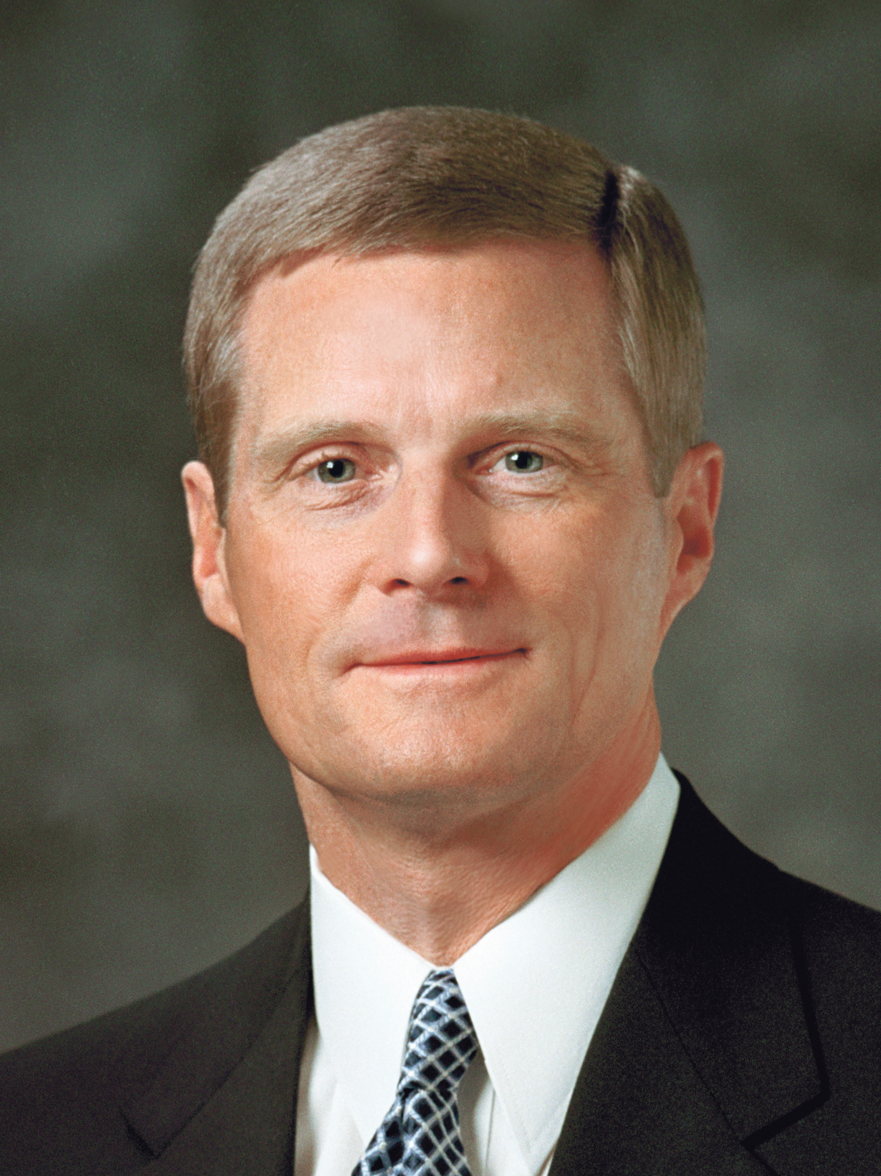
Elder David A. Bednar
“Nephi was not a sailor. He had been reared in Jerusalem, an inland city, rather than along the borders of the Mediterranean Sea. It seems unlikely that he knew much about or had experience with the tools and skills necessary to build a ship. He may not have ever previously seen an oceangoing vessel. In essence, then, Nephi was commanded and instructed to build something he had never built before” (David A. Bednar, “Learning to Love Learning,” Ensign, Feb. 2010, 28).

Slide 14
Different Attitudes
Read 1 Nephi 17:9–11, 15–16. What impresses you about Nephi’s response?

Slide 15
Different Attitudes
Read 1 Nephi 17:9–11, 15–16. What impresses you about Nephi’s response?
Read 1 Nephi 17:17–21. How would you describe Laman and Lemuel’s attitude?

Slide 16
Different Attitudes
Read 1 Nephi 17:9–11, 15–16. What impresses you about Nephi’s response?
Read 1 Nephi 17:17–21. How would you describe Laman and Lemuel’s attitude?
When have you seen others respond as Nephi did to commandments that were challenging for them to obey?

Slide 17
Nephi’s Faith
Read Nephi’s expression of faith in 1 Nephi 17:50.

Slide 18
Nephi’s Faith
Read Nephi’s expression of faith in 1 Nephi 17:50.
Read 1 Nephi 17:51, adding your name after the word me and replacing the phrase “build a ship” with the commandment you thought of at the beginning of class that may be difficult for you to obey.

Slide 19
Nephi’s Faith
Read Nephi’s expression of faith in 1 Nephi 17:50.
Read 1 Nephi 17:51, adding your name after the word me and replacing the phrase “build a ship” with the commandment you thought of at the beginning of class that may be difficult for you to obey.
How can you respond like Nephi rather than like Laman and Lemuel to commandments that may be difficult to obey?

Slide 20
1 Nephi 17:20–22
According to 1 Nephi 17:20–22, Nephi’s brethren murmured because they had had to leave Jerusalem, claiming that the Israelites who were living there were “a righteous people” (verse 22), even though they had sought to kill Lehi (see 1 Nephi 1:19–20). Nephi responded by explaining why the ancient Israelites were able to conquer the land of Canaan, where Jerusalem is located, and why Jerusalem would be destroyed.

Slide 21
The Ancient Israelites
Read 1 Nephi 17:32–40, looking for what Nephi taught about why the ancient Israelites were able to conquer the land of Canaan after they were freed from bondage in Egypt.

Slide 22
The Ancient Israelites
Read 1 Nephi 17:32–40, looking for what Nephi taught about why the ancient Israelites were able to conquer the land of Canaan after they were freed from bondage in Egypt.
According to verse 35, how does the Lord regard “all flesh,” or all people?

Slide 23
The Ancient Israelites
Read 1 Nephi 17:32–40, looking for what Nephi taught about why the ancient Israelites were able to conquer the land of Canaan after they were freed from bondage in Egypt.
According to verse 35, how does the Lord regard “all flesh,” or all people?
The phrase “the Lord esteemeth all flesh in one” (1 Nephi 17:35) means that He loves, values, and desires to bless all people.

Slide 24
Favored of God
The phrase “he that is righteous is favored of God” (1 Nephi 17:35) does not mean that God treats His children unfairly. Rather, it means that those who are righteous—meaning those who choose to obey God’s commandments and make and keep covenants with Him—are able to receive certain blessings that are withheld from those who do not enter covenants with God and obey His commandments.

Slide 25
The Lord’s Covenant Blessings
Those who are righteous receive the Lord’s covenant blessings.

Slide 26
The Lord’s Covenant Blessings
Those who are righteous receive the Lord’s covenant blessings.
What are some other examples of blessings we can receive only if we keep the covenants we have made with God?

Slide 27
1 Nephi 17:41–44
Nephi told his brethren that the ancient Israelites had hardened their hearts against the Lord and His prophets “from time to time” (1 Nephi 17:42). The people in Jerusalem eventually became so wicked that Lehi had needed to flee with his family into the wilderness. Nephi told Laman and Lemuel that they were like those in Jerusalem who had sought to kill Lehi.

Slide 28
The Effect of Sins
Read 1 Nephi 17:45, looking for the effect Laman and Lemuel’s iniquities, or sins, had on them.

Slide 29
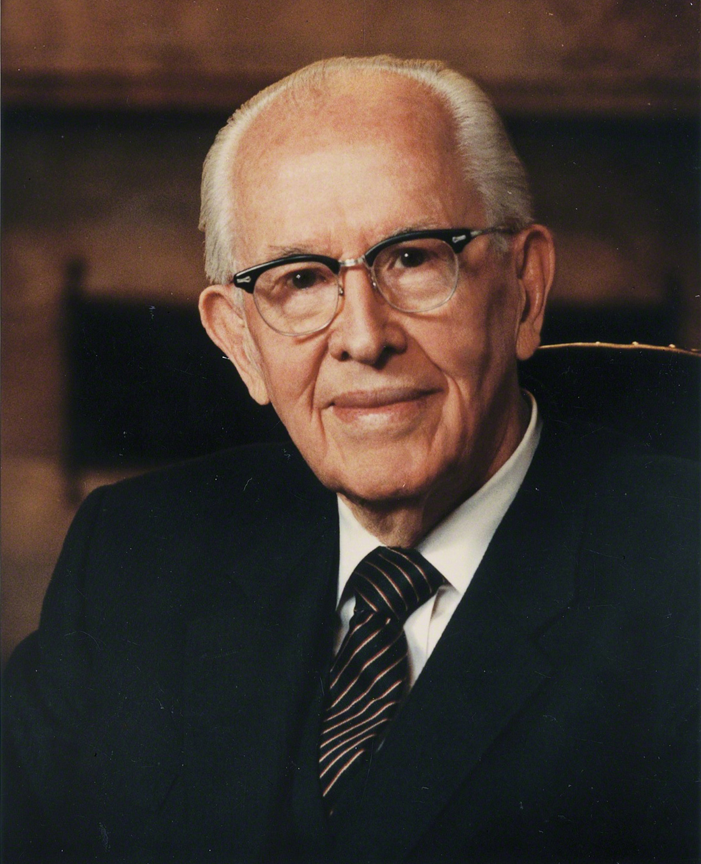
President Ezra Taft Benson
“We hear the words of the Lord most often by a feeling. If we are humble and sensitive, the Lord will prompt us through our feelings” (Ezra Taft Benson, “Seek the Spirit of the Lord,” Ensign, Apr. 1988, 4).

Slide 30
Hear the Words of the Lord
According to President Benson, how do we often hear the words of the Lord?

Slide 31
Hear the Words of the Lord
According to President Benson, how do we often hear the words of the Lord?
What principle can we learn from 1 Nephi 17:45 about what can make it difficult to feel and recognize the voice of the Lord?

Slide 32
Hear the Words of the Lord
According to President Benson, how do we often hear the words of the Lord?
What principle can we learn from 1 Nephi 17:45 about what can make it difficult to feel and recognize the voice of the Lord?
When we choose to sin, it becomes more difficult to feel and recognize the voice of the Lord.

Slide 33
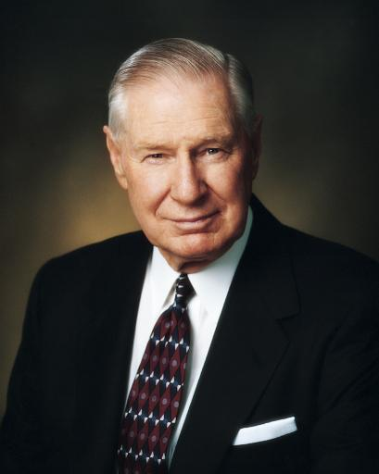
President James E. Faust
“Occasionally … we find dead spots where the signal coming to a cell phone fails. This can happen when the cell phone user is in a tunnel or a canyon or when there is other interference.
“So it is with divine communication. … We often put ourselves in spiritual dead spots—places and situations that block out divine messages. Some of these dead spots include anger, pornography, transgression, selfishness, and other situations that offend the Spirit” (James E. Faust, “Did You Get the Right Message?” Ensign or Liahona, May 2004, 67).

Slide 34
When We Have Sinned
When we have sinned, what can we do to make it easier to once again feel and recognize the voice of the Lord?

Slide 35
When We Have Sinned
When we have sinned, what can we do to make it easier to once again feel and recognize the voice of the Lord?
Think about whether you are participating in any sinful behavior that might make it difficult for you to feel and recognize the voice of the Lord. Repent as necessary so you can feel and recognize the still, small voice of the Lord speaking to you.

Slide 36
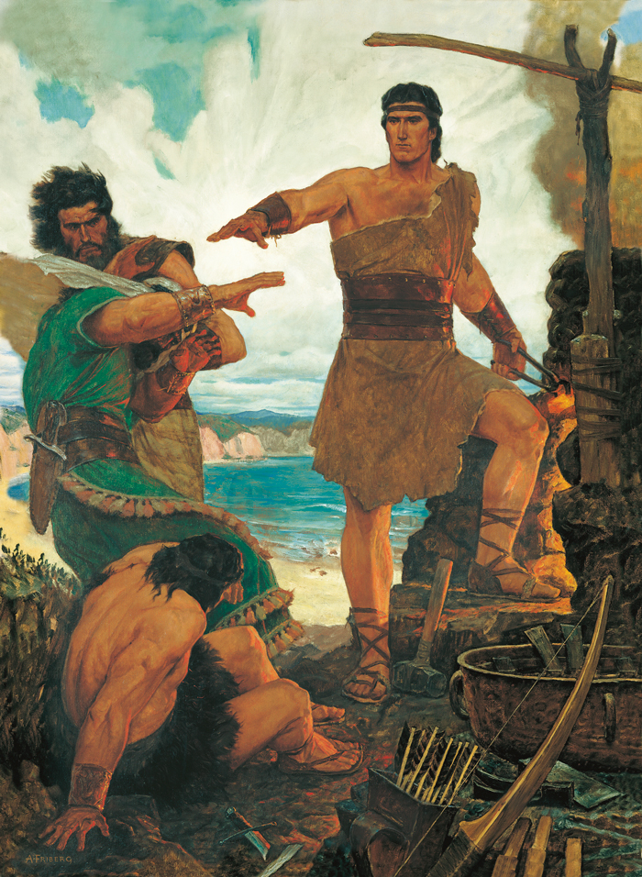
Nephi and His Brothers
What is happening in this picture?

Slide 37
Nephi and His Brothers
What is happening in this picture?
Read 1 Nephi 17:48, 53–54. Why did the Lord shock Nephi’s brethren?

