Slide 1
1 Nephi 18
Lesson 19

Slide 2

Devotional
Hymn:
Prayer:
Thought:

Slide 3
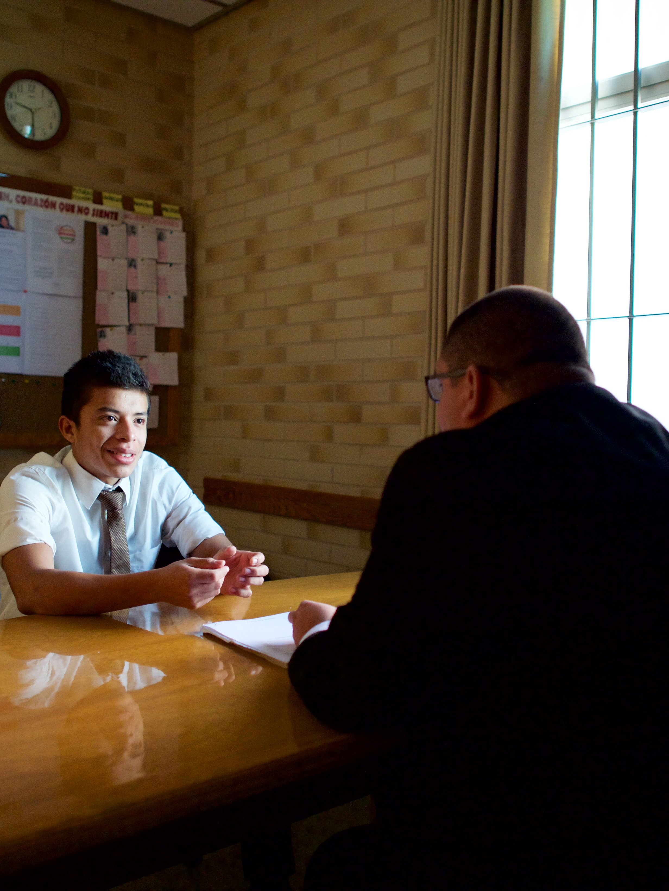
A Scenario
Imagine that one day your bishop or branch president invites you into his office and extends to you the calling to serve as class or quorum president. You have never served in a presidency before and feel overwhelmed and uncertain about how to do this calling.

Slide 4
A Scenario
Imagine that one day your bishop or branch president invites you into his office and extends to you the calling to serve as class or quorum president. You have never served in a presidency before and feel overwhelmed and uncertain about how to do this calling.
Why might God ask you to do something that you don’t know how to do?

Slide 5
A Scenario
Imagine that one day your bishop or branch president invites you into his office and extends to you the calling to serve as class or quorum president. You have never served in a presidency before and feel overwhelmed and uncertain about how to do this calling.
Why might God ask you to do something that you don’t know how to do?
How could you learn to serve in this calling?

Slide 6
Building a Ship
Read 1 Nephi 18:1–2. How did Nephi and his brethren know how to build the ship?

Slide 7
Building a Ship
Read 1 Nephi 18:1–2. How did Nephi and his brethren know how to build the ship?
Read 1 Nephi 18:3. What did Nephi do that allowed the Lord to show him and his brethren how to build the ship?

Slide 8
Building a Ship
Read 1 Nephi 18:1–2. How did Nephi and his brethren know how to build the ship?
Read 1 Nephi 18:3. What did Nephi do that allowed the Lord to show him and his brethren how to build the ship?
What principle can we learn about how we can receive specific guidance?

Slide 9
Prayer
If we pray often unto the Lord, we can receive the specific guidance we need.

Slide 10
Prayer
If we pray often unto the Lord, we can receive the specific guidance we need.
What do you think might have happened if Nephi and his brethren had not sought the guidance of the Lord but instead built the ship their own way, or “after the manner of men” (1 Nephi 18:2)?

Slide 11
1 Nephi 18:4–8
After the ship was finished, the Lord directed Lehi to set sail with his family for the promised land. In these verses we also learn of two additional children born to Lehi and Sariah after they left Jerusalem.

Slide 12
1 Nephi 18:4–8
After the ship was finished, the Lord directed Lehi to set sail with his family for the promised land. In these verses we also learn of two additional children born to Lehi and Sariah after they left Jerusalem.
Read 1 Nephi 18:7, looking for the names of these two children.

Slide 13

Should You Speak Up?
Think about the last time you were in a situation in which you wondered if you should speak up to confront or correct unrighteous behavior.

Slide 14
Should You Speak Up?
Think about the last time you were in a situation in which you wondered if you should speak up to confront or correct unrighteous behavior.
Why might speaking up to confront another person’s unrighteous behavior be a difficult thing to do?

Slide 15
On the Ship
Read 1 Nephi 18:9, looking for what some people on the ship began to do.

Slide 16
On the Ship
Read 1 Nephi 18:9, looking for what some people on the ship began to do.
Why do you think the behavior of these people was a problem?

Slide 17
Much Rudeness
It is not wrong to dance, listen to music, or have fun, but verse 9 indicates that Laman, Lemuel, and others did these things “with much rudeness.” In this context the word rudeness refers to being vulgar or coarse. Vulgar and coarse dancing, music, and speech are offensive to the Lord and result in losing the companionship of the Holy Ghost.

Slide 18
What Would You Do?
If you were on this ship and knew that your family members’ behavior was offensive to the Lord, what would you do?

Slide 19
What Would You Do?
If you were on this ship and knew that your family members’ behavior was offensive to the Lord, what would you do?
Read 1 Nephi 18:10, looking for what Nephi chose to do.

Slide 20
What Would You Do?
If you were on this ship and knew that your family members’ behavior was offensive to the Lord, what would you do?
Read 1 Nephi 18:10, looking for what Nephi chose to do.
According to verse 10, why did Nephi choose to speak to his brethren about their rude behavior?

Slide 21
Confronting Unrighteous Behavior
What principle can we learn from Nephi’s example about confronting unrighteous or sinful behavior?

Slide 22
Confronting Unrighteous Behavior
What principle can we learn from Nephi’s example about confronting unrighteous or sinful behavior?
When we fear the Lord’s judgments more than the judgments of others, we can have the courage to confront unrighteous behavior.

Slide 23
Confronting Unrighteous Behavior
What principle can we learn from Nephi’s example about confronting unrighteous or sinful behavior?
When we fear the Lord’s judgments more than the judgments of others, we can have the courage to confront unrighteous behavior.
When do you think a person should choose to confront unrighteous behavior?

Slide 24
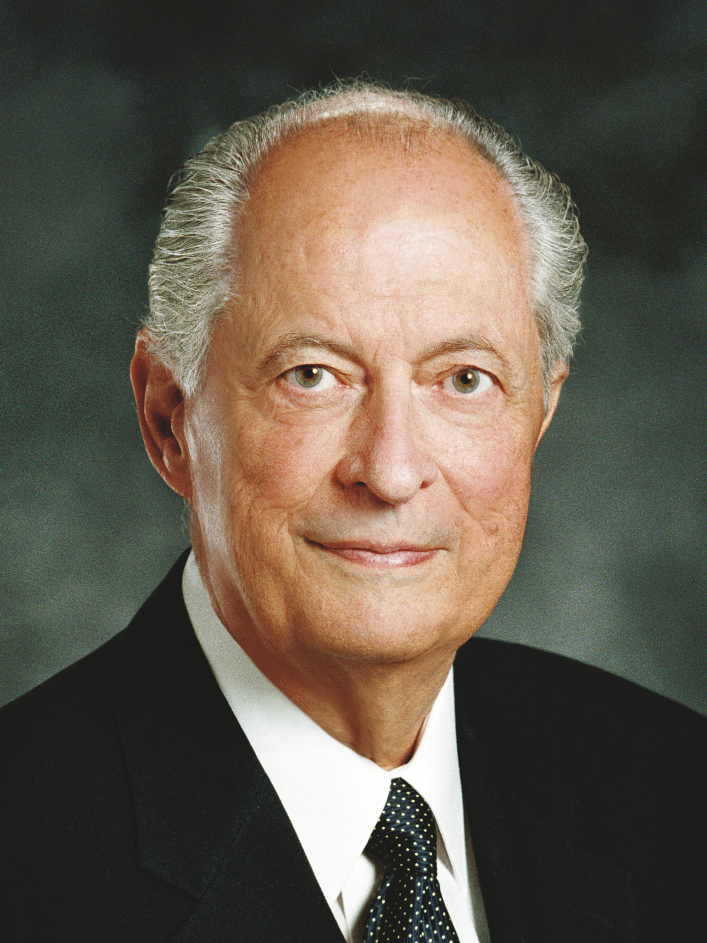
Elder Robert D. Hales
“To respond in a Christlike way cannot be scripted or based on a formula. The Savior responded differently in every situation. When He was confronted by wicked King Herod, He remained silent. When He stood before Pilate, He bore a simple and powerful testimony of His divinity and purpose. Facing the moneychangers who were defiling the temple, He exercised His divine responsibility to preserve and protect that which was sacred.
Continued on next page.

Slide 25
Elder Robert D. Hales, cont.
“Lifted up upon a cross, He uttered the incomparable Christian response: ‘Father, forgive them; for they know not what they do’ (Luke 23:34). …
“As we respond to others, each circumstance will be different. … As true disciples seek guidance from the Spirit, they receive inspiration tailored to each encounter. And in every encounter, true disciples respond in ways that invite the Spirit of the Lord” (Robert D. Hales, “Christian Courage: The Price of Discipleship,” Ensign or Liahona, Nov. 2008, 72–73).

Slide 26
The Guidance of the Spirit
Why do you think it is important to seek and follow the guidance of the Spirit as we respond to the unrighteous behavior of others?

Slide 27
The Guidance of the Spirit
Why do you think it is important to seek and follow the guidance of the Spirit as we respond to the unrighteous behavior of others?
When have you or someone you know appropriately confronted someone else’s unrighteous behavior?

Slide 28
How Would You Respond?
Think of how you would respond if a family member or Church leader asked you to change the music you listen to, the way you dance, or the way you speak. Would you be willing to listen and change?

Slide 29
How Would You Respond?
Think of how you would respond if a family member or Church leader asked you to change the music you listen to, the way you dance, or the way you speak. Would you be willing to listen and change?
Read 1 Nephi 18:11. How did Laman and Lemuel respond to Nephi’s counsel?

Slide 30
How Would You Respond?
Think of how you would respond if a family member or Church leader asked you to change the music you listen to, the way you dance, or the way you speak. Would you be willing to listen and change?
Read 1 Nephi 18:11. How did Laman and Lemuel respond to Nephi’s counsel?
Why do you think the Lord allowed Laman and Lemuel to bind Nephi?

Slide 31
Consequences
Read 1 Nephi 18:12–14, 17–19, looking for words and phrases that show the consequences of Laman and Lemuel’s behavior.

Slide 32
Consequences
Read 1 Nephi 18:12–14, 17–19, looking for words and phrases that show the consequences of Laman and Lemuel’s behavior.
What gospel principles can you learn from this account?

Slide 33
Consequences
Read 1 Nephi 18:12–14, 17–19, looking for words and phrases that show the consequences of Laman and Lemuel’s behavior.
What gospel principles can you learn from this account?
Choosing to sin will bring negative consequences upon ourselves and sometimes upon others as well.

Slide 34
The Effect of Disobedience
If you became rebellious and disobedient, how might it affect your family? How might it affect your friends? How might it affect your class or quorum?

Slide 35
The Effect of Disobedience
If you became rebellious and disobedient, how might it affect your family? How might it affect your friends? How might it affect your class or quorum?
Read 1 Nephi 18:15–16, looking for what principles can we learn from Nephi about how we can respond to our trials.

Slide 36
Look to God
We can choose to look to God and remain faithful during our trials.

Slide 37
Look to God
We can choose to look to God and remain faithful during our trials.
What do you think it means to look to God in our trials?

Slide 38

Elder L. Whitney Clayton
“No matter the burdens we face in life as a consequence of natural conditions, the misconduct of others, or our own mistakes and shortcomings, we are all children of a loving Heavenly Father, who sent us to earth as part of His eternal plan for our growth and progress. Our unique individual experiences can help us prepare to return to Him. … We must do everything we can to bear our burdens ‘well’ [see D&C 121:7–8]. …
Continued on next page.

Slide 39
Elder L. Whitney Clayton, cont.
“… I know that as we keep the commandments of God and our covenants, He helps us with our burdens. He strengthens us. When we repent, He forgives us and blesses us with peace of conscience and joy” (L. Whitney Clayton, “That Your Burdens May Be Light,” Ensign or Liahona, Nov. 2009, 13–14).

Slide 40
Remaining Faithful
When have you or someone you know chosen to look to God and remain faithful during a trial? How were you (or the person you thought of) blessed for doing so?

Slide 41
The Storm
Read 1 Nephi 18:20–23, looking for what happened as the storm continued to threaten to destroy the ship.

Slide 42
1 Nephi 18:24–25
After Lehi’s family arrived in the promised land, they began to till the earth and plant the seeds they had brought with them. They found that this new land was rich in a variety of natural resources.

