Slide 1
Studying the Scriptures
Lesson 2

Slide 2
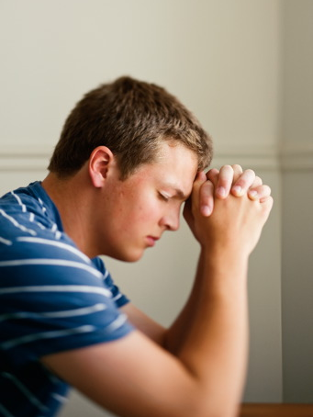
Devotional
Hymn:
Prayer:
Thought:

Slide 3
Daily Practice
When trying to develop a skill or ability, how might the results of practicing once per week compare to the results of practicing daily? Why might daily practice make an important difference?

Slide 4
Daily Practice
When trying to develop a skill or ability, how might the results of practicing once per week compare to the results of practicing daily? Why might daily practice make an important difference?
If you developed a particular skill or ability to a high degree through daily practice but then stopped practicing, what could eventually happen?

Slide 5
Daily Practice
When trying to develop a skill or ability, how might the results of practicing once per week compare to the results of practicing daily? Why might daily practice make an important difference?
If you developed a particular skill or ability to a high degree through daily practice but then stopped practicing, what could eventually happen?
How might you relate this to daily scripture study?

Slide 6
King Benjamin’s Advice
Read Mosiah 1:3, 5, looking for words or phrases that indicate what would have happened to the Nephites if they had not studied the scriptures.

Slide 7
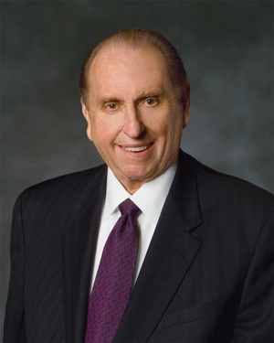
President Thomas S. Monson
“Spending time each day in scripture study will, without doubt, strengthen our foundations of faith and our testimonies of truth” (Thomas S. Monson, “How Firm a Foundation,” Ensign or Liahona, Nov. 2006, 68).

Slide 8
President Thomas S. Monson
“Spending time each day in scripture study will, without doubt, strengthen our foundations of faith and our testimonies of truth” (Thomas S. Monson, “How Firm a Foundation,” Ensign or Liahona, Nov. 2006, 68).
What principle can we learn based on this teaching by President Monson?

Slide 9
President Thomas S. Monson
“Spending time each day in scripture study will, without doubt, strengthen our foundations of faith and our testimonies of truth” (Thomas S. Monson, “How Firm a Foundation,” Ensign or Liahona, Nov. 2006, 68).
What principle can we learn based on this teaching by President Monson?
If we study the scriptures daily, we can strengthen our faith and testimonies.

Slide 10
Daily Scripture Study
Even though we may fully intend to study the scriptures, sometimes we may allow other priorities to distract us from studying the scriptures daily.

Slide 11
Daily Scripture Study
Even though we may fully intend to study the scriptures, sometimes we may allow other priorities to distract us from studying the scriptures daily.
What advice would you give to help someone develop a habit of daily scripture study?

Slide 12
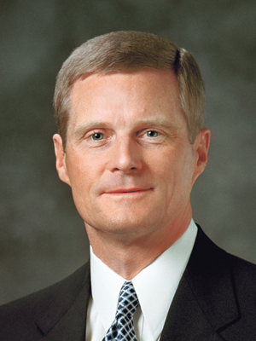
Elder David A. Bednar
“Given the hectic pace of our lives, good intentions and simply ‘hoping’ to find the time for meaningful scripture study are not sufficient. My experience suggests that a specific and scheduled time set aside each day and, as much as possible, a particular place for study greatly increase the effectiveness of our searching in and study of the scriptures” (David A. Bednar, “Because We Have Them before Our Eyes,” New Era, Apr. 2006, 6).

Slide 13
Regular Scripture Study
Have you ever had a time in your life when you have studied the scriptures regularly? How were your testimony and faith strengthened as a result?

Slide 14
Regular Scripture Study
Have you ever had a time in your life when you have studied the scriptures regularly? How were your testimony and faith strengthened as a result?
Make a goal to study the scriptures daily.

Slide 15
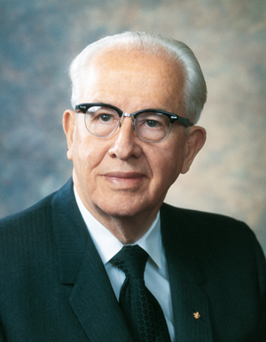
President Ezra Taft Benson
“It is not just that the Book of Mormon teaches us truth, though it indeed does that. It is not just that the Book of Mormon bears testimony of Christ, though it indeed does that, too. But there is something more. There is a power in the book which will begin to flow into your lives the moment you begin a serious study of the book. You will find greater power to resist temptation. You will find the power to avoid deception. You will find the power to stay on the strait and narrow path.
Continued on next page.

Slide 16
President Ezra Taft Benson, cont.
“The scriptures are called ‘the words of life’ (see D&C 84:85), and nowhere is that more true than it is of the Book of Mormon. When you begin to hunger and thirst after those words, you will find life in greater and greater abundance” (Ezra Taft Benson, “The Book of Mormon—Keystone of Our Religion,” Ensign, Oct. 2011, 56–57).

Slide 17
If We Study
According to President Benson, what blessings can we experience from studying the Book of Mormon?

Slide 18
If We Study
According to President Benson, what blessings can we experience from studying the Book of Mormon?
If we study the Book of Mormon, we will have greater power to resist temptation, avoid deception, and stay on the strait and narrow path.

Slide 19
Blessings of the Book of Mormon
In what ways can studying the Book of Mormon give us greater power to resist temptation, avoid deception, and stay on the strait and narrow path?

Slide 20
Blessings of the Book of Mormon
In what ways can studying the Book of Mormon give us greater power to resist temptation, avoid deception, and stay on the strait and narrow path?
When have you experienced these or other blessings from studying the Book of Mormon?

Slide 21
Course Expectation
One of the expectations for this seminary course of study is that students read the entire Book of Mormon. This is a requirement to receive a seminary diploma.

Slide 22
Developing Scripture Study Skills
In seminary, we will learn an effective pattern for studying the scriptures that you can also follow at home.

Slide 23
Developing Scripture Study Skills
In seminary, we will learn an effective pattern for studying the scriptures that you can also follow at home.
The pattern begins with seeking to understand the context and content of the scriptures, which includes understanding the background and setting of the accounts as well as the meaning of words, phrases, and teachings.

Slide 24
Developing Scripture Study Skills
In seminary, we will learn an effective pattern for studying the scriptures that you can also follow at home.
The pattern begins with seeking to understand the context and content of the scriptures, which includes understanding the background and setting of the accounts as well as the meaning of words, phrases, and teachings.
What are some ways we might do that?

Slide 25
Context and Content
Read 3 Nephi 17:1–5, looking for who is speaking and who is being spoken to.

Slide 26
Context and Content
Read 3 Nephi 17:1–5, looking for who is speaking and who is being spoken to.
What happened before the events in this account? (See the chapter summaries for 3 Nephi 8–16.)

Slide 27
Context and Content
Read 3 Nephi 17:1–5, looking for who is speaking and who is being spoken to.
What happened before the events in this account? (See the chapter summaries for 3 Nephi 8–16.)
How does your knowledge of this background influence your understanding of why the people wanted the Savior to stay a little longer?

Slide 28
Context and Content
When we understand the background and setting of a scripture account, we are better prepared to identify and understand the doctrines and principles it contains.

Slide 29
Doctrines and Principles
Doctrines and principles are eternal, unchanging truths of the gospel of Jesus Christ that provide direction for our lives. They are the lessons that ancient prophets intended us to learn from the events, stories, and sermons they recorded in the scriptures.

Slide 30
Doctrines and Principles
Some writers in the scriptures used phrases such as thus we see (see Helaman 3:27–29) or words such as therefore (see Alma 32:16) to point directly to doctrines and principles.

Slide 31
Doctrines and Principles
Many doctrines and principles, however, are not stated so directly in the scriptures. Instead, these truths are implied and are illustrated through the accounts, teachings, and parables recorded in the scriptures.

Slide 32
Identifying Doctrines and Principles
As you read, ask yourself questions such as:
  What did the writer intend for us to learn from this story?
  What truths are taught in this passage of scripture?

Slide 33
Identifying Doctrines and Principles
As you read, ask yourself questions such as:
  What did the writer intend for us to learn from this story?
  What truths are taught in this passage of scripture?
Read 3 Nephi 17:6–9, looking for doctrines and principles that we can learn from these verses.

Slide 34
We Can Experience His Power
The Savior feels great compassion for us. Jesus Christ can heal all kinds of afflictions. As we come unto Jesus Christ in faith, we can experience His healing power.

Slide 35
Understanding Principles and Doctrines
Once we have identified a doctrine or principle, it is important that we seek to understand what it means and how we might apply it in our lives.

Slide 36
Understanding Principles and Doctrines
Once we have identified a doctrine or principle, it is important that we seek to understand what it means and how we might apply it in our lives.
As we seek to understand how to apply a doctrine or principle in our lives, the Holy Ghost can help us feel its truth and importance. This can also occur as we ponder, write about, or share experiences concerning how we obtained a testimony of a doctrine or principle.

Slide 37
Understanding Principles and Doctrines
When have you or someone you know experienced the Savior’s compassion and healing power?

Slide 38
Understanding and Feeling the Truth and Importance
Understanding and feeling the truth and importance of doctrines and principles increases our desire to apply them in our lives. Application takes place when we do something about the doctrines and principles we have learned.

Slide 39
Understanding and Feeling the Truth and Importance
Understanding and feeling the truth and importance of doctrines and principles increases our desire to apply them in our lives. Application takes place when we do something about the doctrines and principles we have learned.
How might we apply or act on the doctrines and principles we identified in 3 Nephi 17:6–9?

Slide 40
Applying the Principles
When we act on the principles we learn, we will have a greater opportunity to feel the Holy Spirit confirm the truth of those principles (see John 7:17; Moroni 10:5). This is the real value of the knowledge gained from scripture study.

