Slide 1
1 Nephi 19
Lesson 20

Slide 2

Devotional
Hymn:
Prayer:
Thought:

Slide 3
Who Do You Love?
Think of somebody you love very much.

Slide 4
Who Do You Love?
Think of somebody you love very much.
What thoughts or feelings would you have if you saw others mocking or trying to harm the person you love? Why?

Slide 5
The Small Plates
In 1 Nephi 19:1–6, Nephi again described the Lord’s commandment to include on the small plates “the more plain and precious parts” (verse 3) of Nephi’s ministry and prophecies and to record on the large plates a more general history of his people (see also 1 Nephi 6; 9).

Slide 6
Our Savior
Read 1 Nephi 19:7. In this verse, the phrase “God of Israel” refers to Jesus Christ. The verse also includes the word naught, which means “nothing.” To set someone at naught is to treat that person as if he or she is worthless.

Slide 7
Our Savior
Read 1 Nephi 19:7. In this verse, the phrase “God of Israel” refers to Jesus Christ. The verse also includes the word naught, which means “nothing.” To set someone at naught is to treat that person as if he or she is worthless.
According to 1 Nephi 19:7, how do some people trample the Savior under their feet, or “set him at naught”?

Slide 8
Our Savior
Read 1 Nephi 19:7. In this verse, the phrase “God of Israel” refers to Jesus Christ. The verse also includes the word naught, which means “nothing.” To set someone at naught is to treat that person as if he or she is worthless.
According to 1 Nephi 19:7, how do some people trample the Savior under their feet, or “set him at naught”?
How is refusing to hearken to the Lord’s counsel like setting Him at naught or trampling Him under one’s feet?

Slide 9
His Mortal Ministry
Read 1 Nephi 19:8–10, looking for ways people would treat the Savior as a thing of naught during His mortal ministry.

Slide 10
His Mortal Ministry
Read 1 Nephi 19:8–10, looking for ways people would treat the Savior as a thing of naught during His mortal ministry.
What truth do these verses teach us about what Jesus Christ did and why He did it?

Slide 11
The Savior Suffered for Us
Jesus Christ allowed Himself to suffer and be crucified because of His loving-kindness and long-suffering for the children of men.

Slide 12
The Savior Suffered for Us
Jesus Christ allowed Himself to suffer and be crucified because of His loving-kindness and long-suffering for the children of men.
How did the Savior’s willingness to suffer and be crucified demonstrate His love for us?

Slide 13
The Savior Suffered for Us
Jesus Christ allowed Himself to suffer and be crucified because of His loving-kindness and long-suffering for the children of men.
How did the Savior’s willingness to suffer and be crucified demonstrate His love for us?
What feelings do you have for the Savior as you consider what He has suffered and done for us?

Slide 14
The Savior Suffered for Us
Jesus Christ allowed Himself to suffer and be crucified because of His loving-kindness and long-suffering for the children of men.
How did the Savior’s willingness to suffer and be crucified demonstrate His love for us?
What feelings do you have for the Savior as you consider what He has suffered and done for us?
How would you finish this statement? I will show the Savior that He is of great worth to me by…

Slide 15
1 Nephi 19:11–17
At the time of Jesus Christ’s death, some of the members of the house of Israel (including Lehi’s descendants) would be visited with the Lord’s voice because of their righteousness, and others would experience destruction (see 3 Nephi 9–10).

Slide 16
1 Nephi 19:11–17
Zenos prophesied that the people at Jerusalem who rejected Jesus Christ and crucified Him would be persecuted by all people. When their descendants would turn their hearts to Jesus Christ, He would fulfill the covenants He had made with their fathers and gather them back to Him.

Slide 17
Nephi’s Reason
Read 1 Nephi 19:18–19, looking for Nephi’s reason for writing what he did.

Slide 18
Nephi’s Reason
Read 1 Nephi 19:18–19, looking for Nephi’s reason for writing what he did.
What is a truth that these verses teach us about one of the purposes of the Book of Mormon?

Slide 19
Nephi’s Reason
Read 1 Nephi 19:18–19, looking for Nephi’s reason for writing what he did.
What is a truth that these verses teach us about one of the purposes of the Book of Mormon?
One reason the Book of Mormon was written was to persuade us to remember the Lord our Redeemer.

Slide 20
Nephi’s Reason
Read 1 Nephi 19:18–19, looking for Nephi’s reason for writing what he did.
What is a truth that these verses teach us about one of the purposes of the Book of Mormon?
One reason the Book of Mormon was written was to persuade us to remember the Lord our Redeemer.
How has the Book of Mormon persuaded and helped you to remember the Lord?

Slide 21
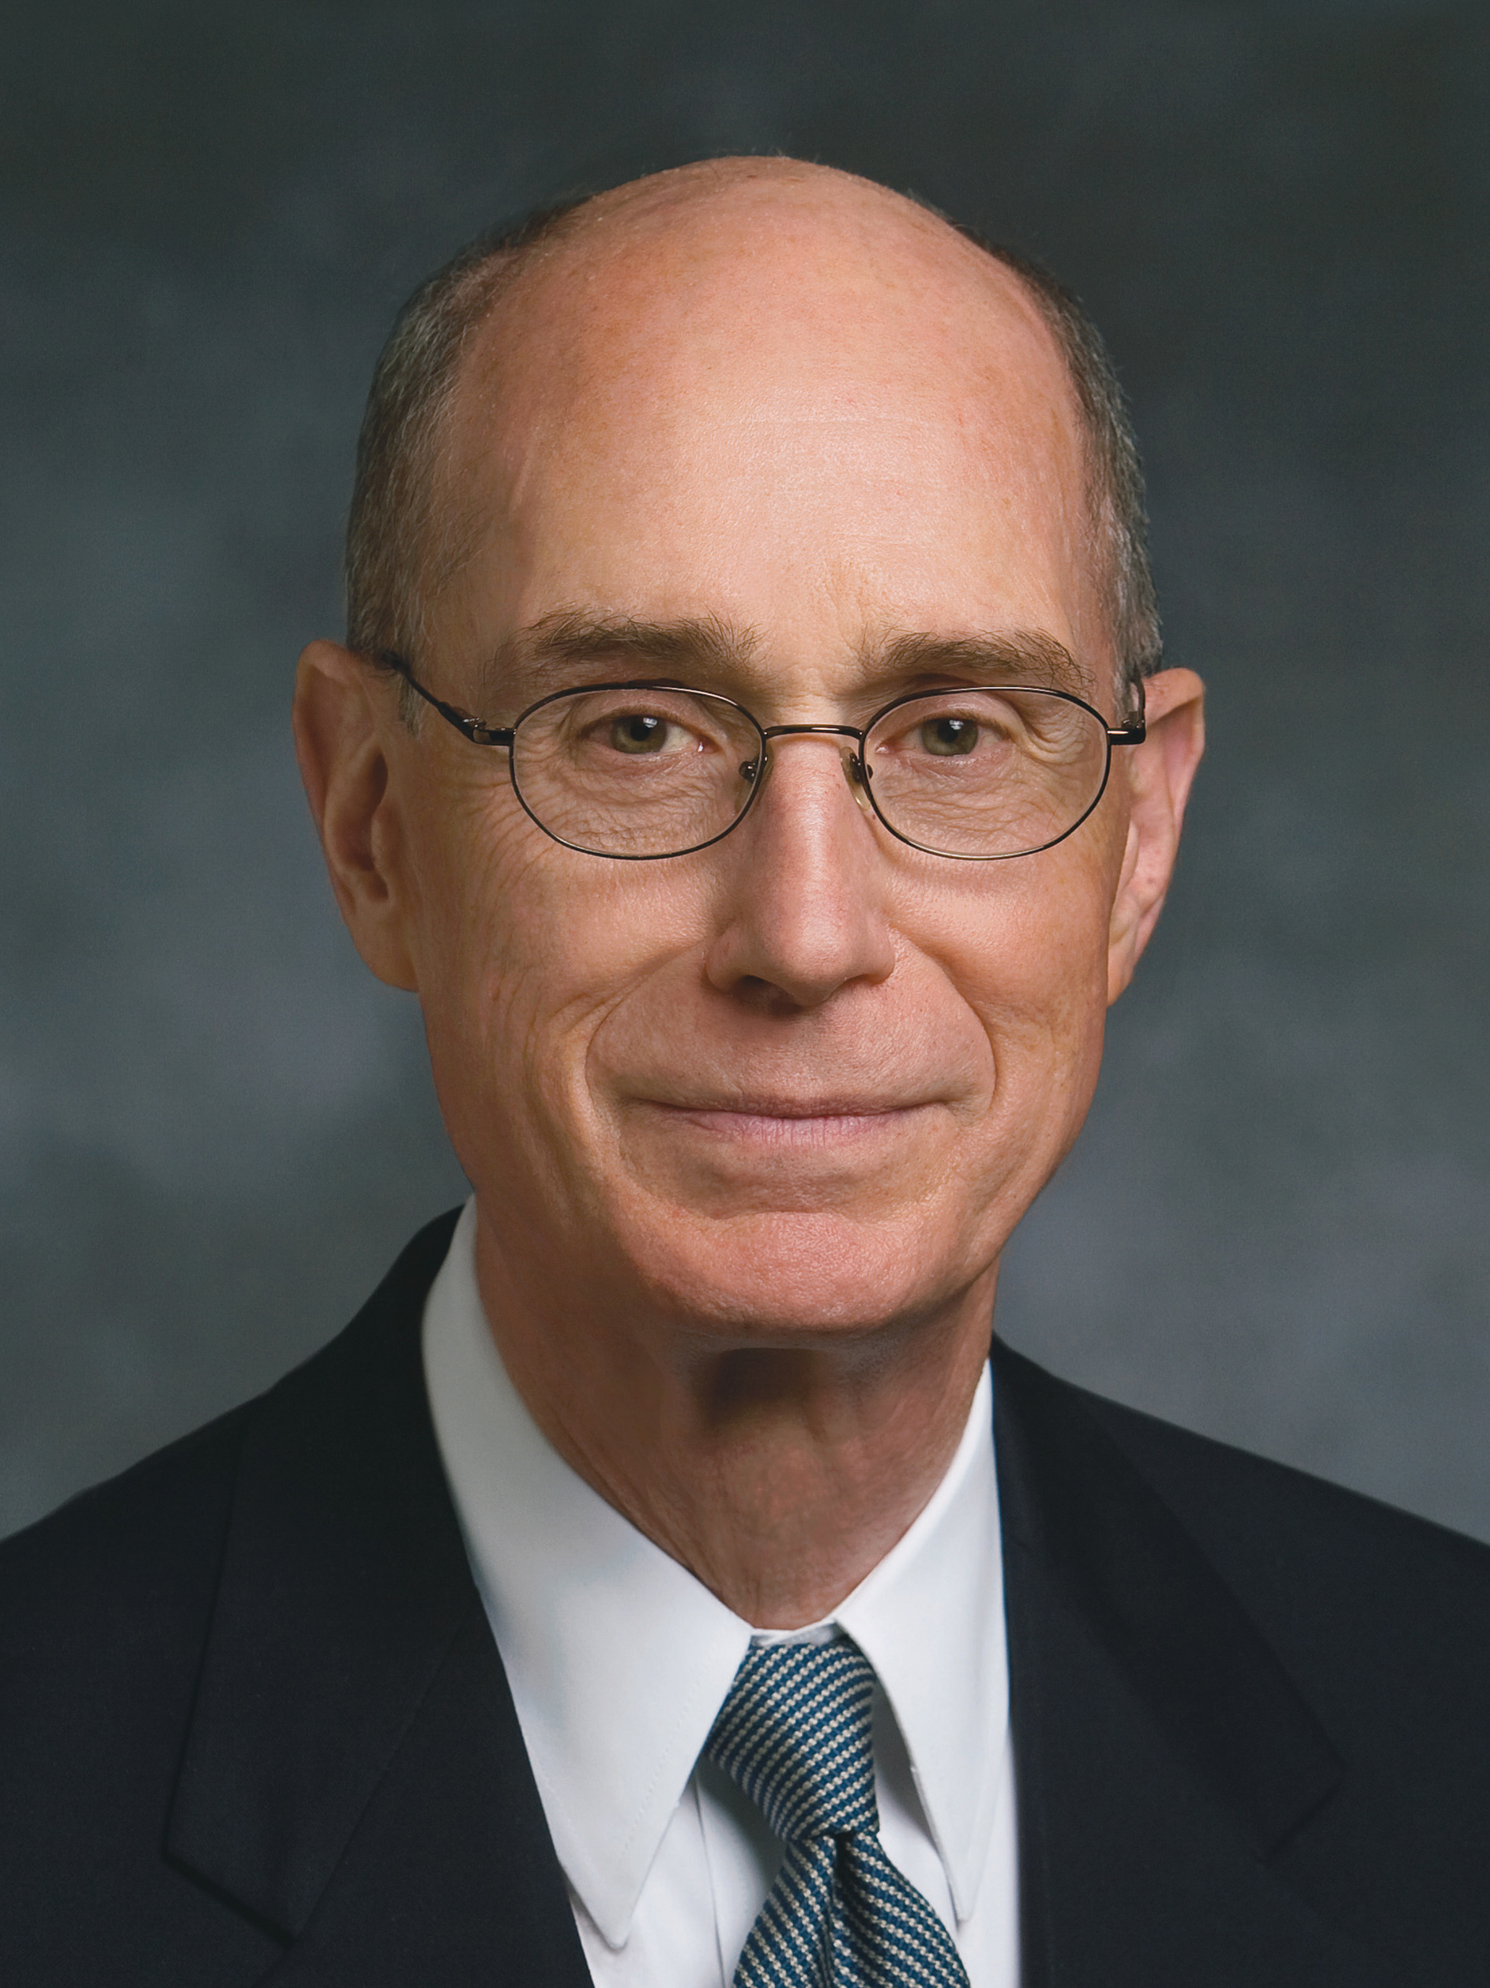
President Henry B. Eyring
“I will make you this promise about reading the Book of Mormon: You will be drawn to it as you understand that the Lord has embedded in it His message to you. Nephi, Mormon, and Moroni knew that, and those who put it together put in messages for you. I hope you have confidence that the book was written for your students. There are simple, direct messages for them that will tell them how to change.
Continued on next page.

Slide 22
President Henry B. Eyring, cont.
“That is what the book is about. It is a testimony of the Lord Jesus Christ and the Atonement and how it may work in their lives. You will have an experience this year feeling the change that comes by the power of the Atonement because of studying this book” (Henry B. Eyring, “The Book of Mormon Will Change Your Life,” Ensign, Feb. 2004, 11).

Slide 23
Messages for You
As you study the Book of Mormon, how is it helpful to know that prophets such as Nephi, Mormon, and Moroni included messages for you?

Slide 24
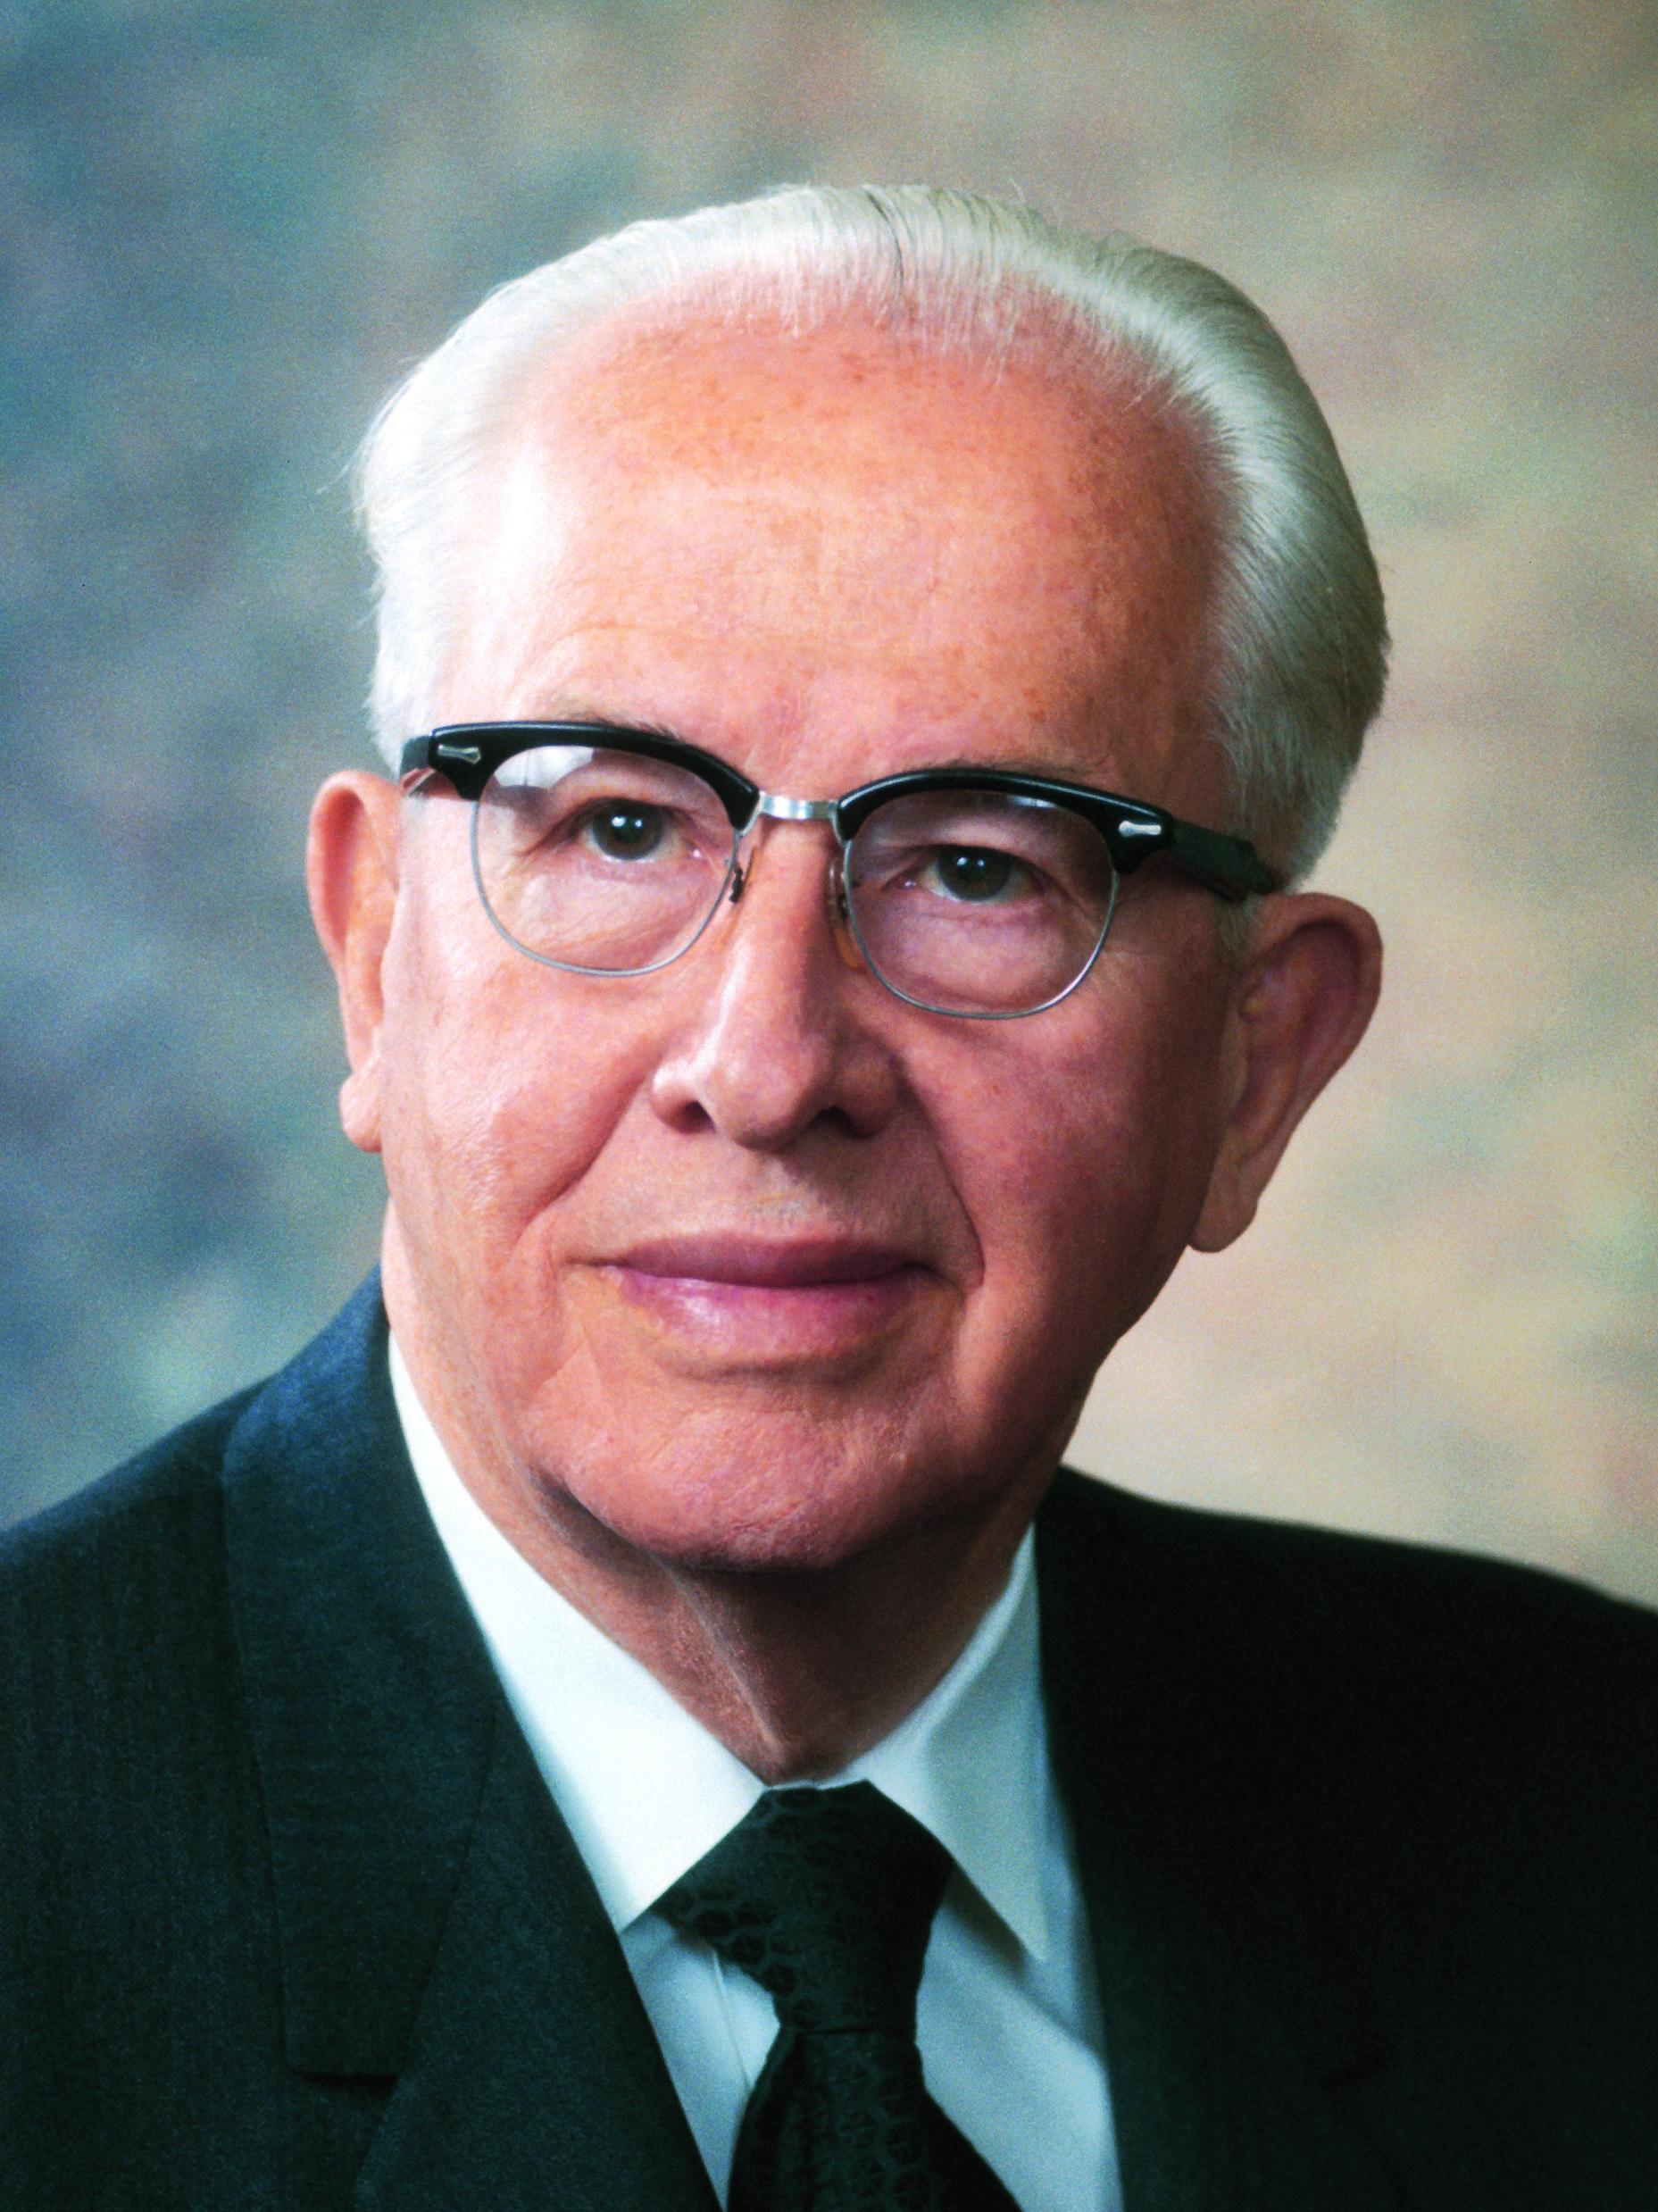
President Ezra Taft Benson
“The Book of Mormon was written for us today. God is the author of the book. It is a record of a fallen people, compiled by inspired men for our blessing. Those people never had the book—it was meant for us. Mormon, the ancient prophet after whom the book is named, abridged centuries of records. God, who knows the end from the beginning, told him what to include in his abridgment that we would need for our day” (Ezra Taft Benson, “The Book of Mormon Is the Word of God,” Ensign, Jan. 1988, 3).

Slide 25
President Ezra Taft Benson
“If they saw our day, and chose those things which would be of greatest worth to us, is not that how we should study the Book of Mormon? We should constantly ask ourselves, ‘Why did the Lord inspire Mormon (or Moroni or Alma) to include that in his record? What lesson can I learn from that to help me live in this day and age?’” (Ezra Taft Benson, “The Book of Mormon—Keystone of Our Religion,” Ensign, Nov. 1986, 6).

Slide 26
The Book of Mormon
How can knowing that God inspired prophets such as Mormon, Moroni, and Alma with what to include in their record influence your study of the Book of Mormon?

Slide 27
The Book of Mormon
How can knowing that God inspired prophets such as Mormon, Moroni, and Alma with what to include in their record influence your study of the Book of Mormon?
What can we do to better find and understand the messages and lessons that God would like us to receive from the Book of Mormon and other scriptures?

Slide 28
Scriptural Messages
Read 1 Nephi 19:22–23, looking for Nephi’s description of how he helped his brethren apply scriptural messages and lessons to themselves.

Slide 29
Scriptural Messages
Read 1 Nephi 19:22–23, looking for Nephi’s description of how he helped his brethren apply scriptural messages and lessons to themselves.
What do you think it means to liken scriptures to ourselves?

Slide 30
Likening the Scriptures
What is a principle we can learn from 1 Nephi 19:22–23 about the blessings of likening the scriptures to ourselves?

Slide 31
Likening the Scriptures
What is a principle we can learn from 1 Nephi 19:22–23 about the blessings of likening the scriptures to ourselves?
As we liken the scriptures to ourselves, we will learn and profit from them.

Slide 32
Likening the Scriptures
Read 1 Nephi 19:24, looking for how Nephi’s brethren could profit from likening the scriptures to themselves.

Slide 33
Likening the Scriptures
Read 1 Nephi 19:24, looking for how Nephi’s brethren could profit from likening the scriptures to themselves.
In what ways can likening the scriptures to ourselves give us hope?

Slide 34
Likening the Scriptures
Read 1 Nephi 19:24, looking for how Nephi’s brethren could profit from likening the scriptures to themselves.
In what ways can likening the scriptures to ourselves give us hope?
In addition to receiving hope, what are other ways we can profit from likening the scriptures to ourselves?

Slide 35
Recognizing Similarities
Recognizing similarities between circumstances in the scriptures and situations in our own lives prepares us to find and apply scriptural truths. The same truths applied by people we read about in the scriptures can be applied by us when we are in similar circumstances.

Slide 36
Likening 1 Nephi 3:7
LIKENING SCRIPTURES TO OURSELVES | APPLYING SCRIPTURAL TRUTHS
How does the teaching, situation, or circumstance described in the scripture passage relate to my life or the world around me? | How can I act upon the truth taught in the scripture passage?
Read 1 Nephi 3:7 and complete the chart.

