Slide 1
2 Nephi 2 (Part 2)
Lesson 24

Slide 2

Devotional
Hymn:
Prayer:
Thought:

Slide 3
Agency
How would you define agency?

Slide 4
Agency
How would you define agency?
Elder Bruce R. McConkie (1915–85) of the Quorum of the Twelve Apostles explained that “agency is the ability and freedom to choose good or evil” (Mormon Doctrine, 2nd ed. [1966], 26).

Slide 5
Agency
How would you define agency?
Elder Bruce R. McConkie (1915–85) of the Quorum of the Twelve Apostles explained that “agency is the ability and freedom to choose good or evil” (Mormon Doctrine, 2nd ed. [1966], 26).
When an individual is choosing between choices he or she believes represent right or wrong, good or evil, the agency is best referred to as moral agency.

Slide 6
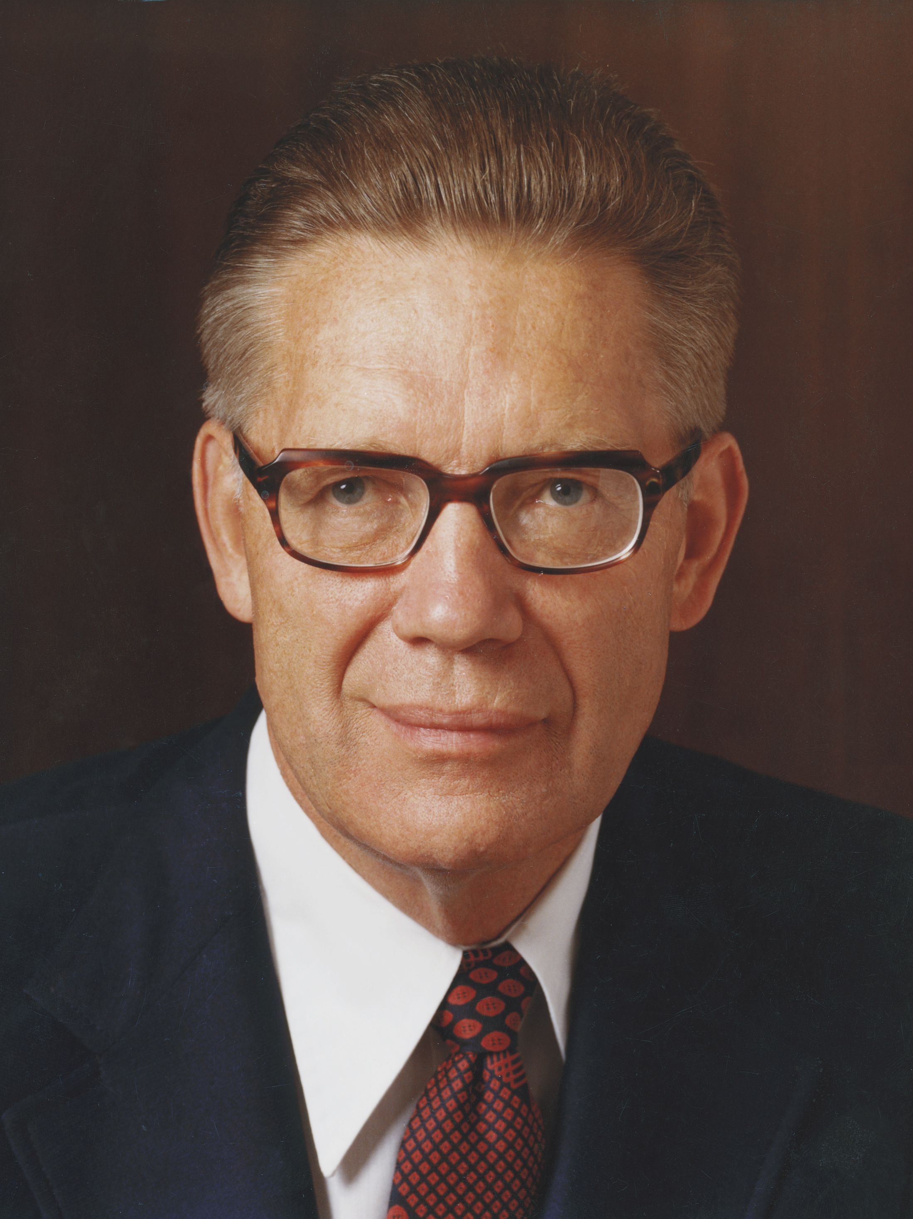
Elder Bruce R. McConkie
“Four great principles must be in force if there is to be agency: 1. Laws must exist … which can be obeyed or disobeyed; 2. Opposites must exist—good and evil, virtue and vice, right and wrong—that is, there must be an opposition, one force pulling one way and another pulling the other; 3. A knowledge of good and evil must be had by those who are to enjoy the agency, that is, they must know the differences between the opposites; and 4. An unfettered power of choice must prevail” (Bruce R. McConkie, Mormon Doctrine, 2nd ed. [1966], 26).

Slide 7
Four Principles of Agency
What are the four principles that are necessary for agency to exist?

Slide 8
Four Principles of Agency
What are the four principles that are necessary for agency to exist?
Laws, opposition, knowledge of good and evil, power to choose.

Slide 9
Four Principles of Agency
What are the four principles that are necessary for agency to exist?
Laws, opposition, knowledge of good and evil, power to choose.
Read 2 Nephi 2:11, looking for all the pairs of opposites in this verse.

Slide 10
Opposition
Read 2 Nephi 2:11–12, 15–16, looking for phrases that emphasize why there must be opposition for us to exercise agency.

Slide 11
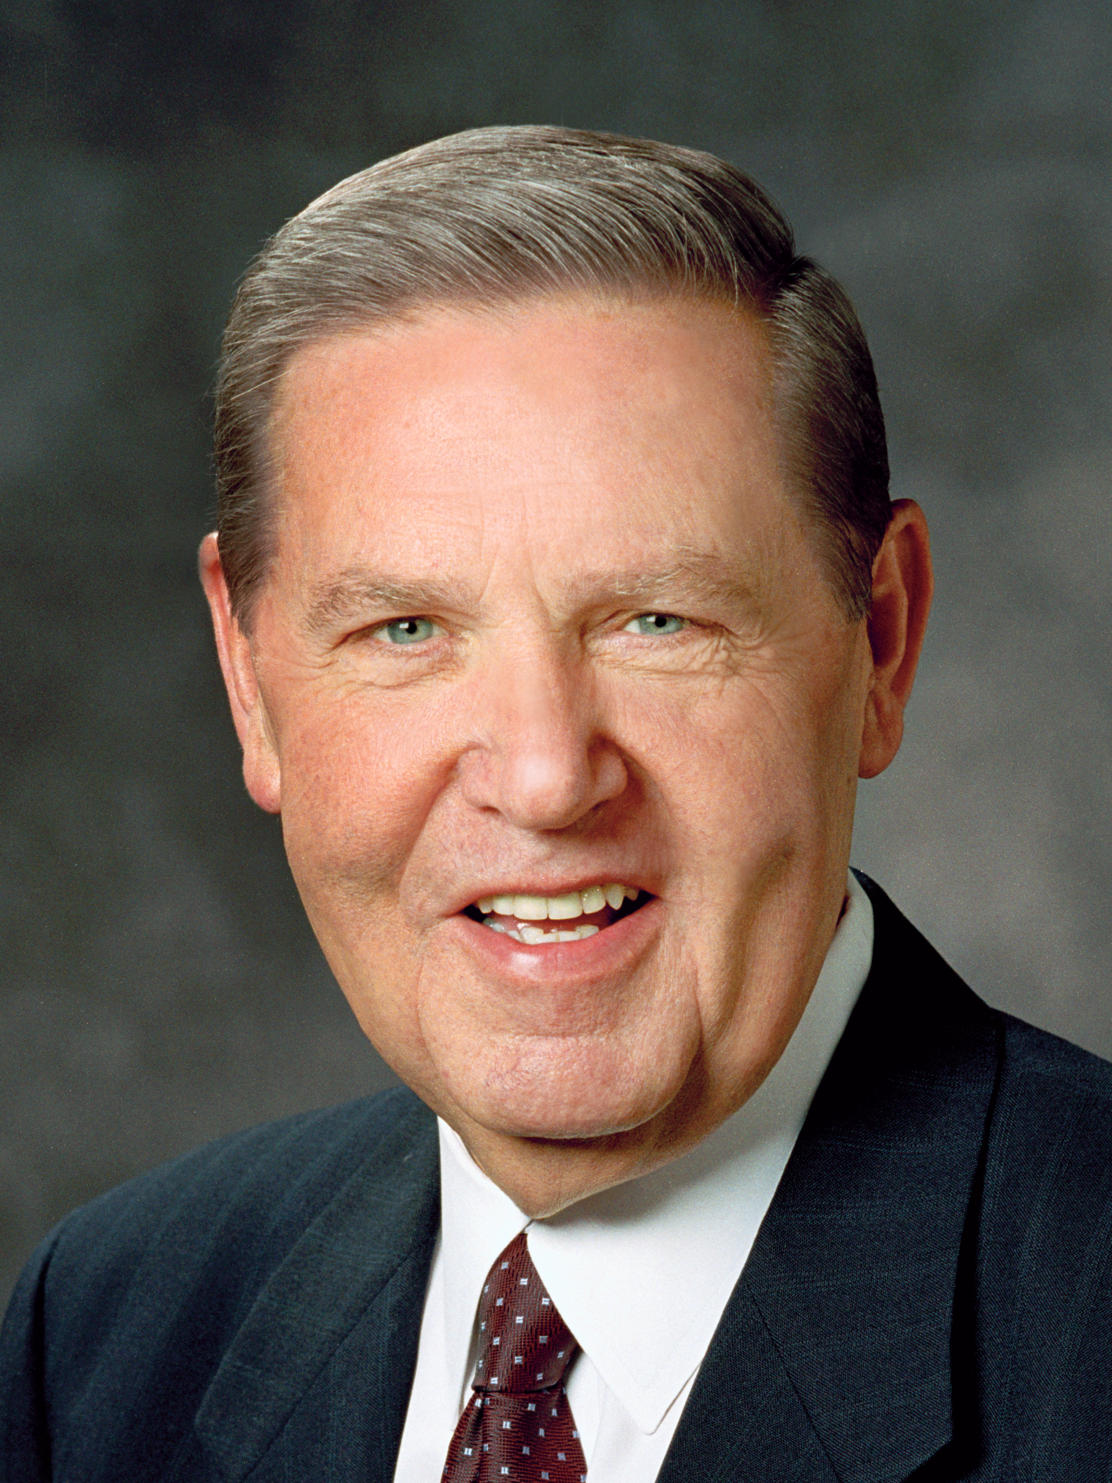
Elder Jeffrey R. Holland
“God’s premortal children could not become like him and enjoy his breadth of blessings unless they obtained both a physical body and temporal experience in an arena where both good and evil were present. …
Continued on the next page.

Slide 12
Elder Jeffrey R. Holland, cont.
“… We wanted the chance to become like our heavenly parents, to face suffering and overcome it, to endure sorrow and still live rejoicingly, to confront good and evil and be strong enough to choose the good” (Jeffrey R. Holland, Christ and the New Covenant: The Messianic Message of the Book of Mormon [1997], 200, 204).

Slide 13
Opposition
What were God’s purposes in placing us on earth, where opposition exists?

Slide 14
Laws
Why are laws important?

Slide 15
Laws
Why are laws important?
Read 2 Nephi 2:13, looking for the consequences that would come if there were no laws, or commandments.

Slide 16
Laws
Why are laws important?
Read 2 Nephi 2:13, looking for the consequences that would come if there were no laws, or commandments.
How do God’s commandments help us distinguish between right and wrong?

Slide 17

God’s Commandments
What are some examples of commandments that have helped you recognize the difference between righteousness and wickedness?

Slide 18
God’s Commandments
What are some examples of commandments that have helped you recognize the difference between righteousness and wickedness?
When have you faced a choice between righteousness and wickedness and you made the right choice? How were you blessed for obeying God’s law?

Slide 19
Instructed Sufficiently
Read 2 Nephi 2:5. How do you think all people can be instructed sufficiently that they know good from evil?

Slide 20
Instructed Sufficiently
Read 2 Nephi 2:5. How do you think all people can be instructed sufficiently that they know good from evil?
Read Moroni 7:16, looking for what God has given to all of us to help us to know good from evil.

Slide 21
The Spirit of Christ
“The Light of Christ is the divine energy, power, or influence that proceeds from God through Christ and gives life and light to all things. The Light of Christ influences people for good and prepares them to receive the Holy Ghost. One manifestation of the Light of Christ is what we call a conscience” (“Light of Christ,” Gospel Topics, topics.lds.org).

Slide 22
Knowledge of Good and Evil
Why do you think it is important for every accountable person to have a basic knowledge of good and evil through the Light of Christ?

Slide 23
The Atonement of Jesus Christ
Read 2 Nephi 2:26, looking for what resulted from Jesus Christ performing the Atonement and redeeming all mankind from the Fall.

Slide 24
The Atonement of Jesus Christ
Read 2 Nephi 2:26, looking for what resulted from Jesus Christ performing the Atonement and redeeming all mankind from the Fall.
What do you think it means that we became “free forever … to act for ourselves and not be acted upon, save it be by the punishment of the law at the great and last day”?

Slide 25
Free to Choose
“You are free to choose and act, but you are not free to choose the consequences of your actions. The consequences may not be immediate, but they will always follow” (True to the Faith: A Gospel Reference [2004], 12).

Slide 26
Free to Choose
“You are free to choose and act, but you are not free to choose the consequences of your actions. The consequences may not be immediate, but they will always follow” (True to the Faith: A Gospel Reference [2004], 12).
What are some examples of consequences that may not be immediate but that will certainly follow a person’s actions?

Slide 27
Doctrinal Mastery Passage
Read 2 Nephi 2:27, looking for words and phrases that show future consequences of choices we make now.

Slide 28
Doctrinal Mastery Passage
Read 2 Nephi 2:27, looking for words and phrases that show future consequences of choices we make now.
Why do you think it is important for us to understand the consequences of our choices in this life?

Slide 29
Doctrinal Mastery Passage
Read 2 Nephi 2:27, looking for words and phrases that show future consequences of choices we make now.
Why do you think it is important for us to understand the consequences of our choices in this life?
How can knowing these consequences motivate us to make righteous choices?

Slide 30
Righteous Choices
In your experience, how do righteous choices help us remain free to choose?

Slide 31
Righteous Choices
In your experience, how do righteous choices help us remain free to choose?
What are some examples of how the righteous use of our agency results in additional freedom?

Slide 32
Agency
What is a truth that 2 Nephi 2:27 teaches about agency?

Slide 33
Agency
What is a truth that 2 Nephi 2:27 teaches about agency?
We are free to choose liberty and eternal life through Jesus Christ or to choose captivity and death.

Slide 34
Choosing Eternal Life
Read 2 Nephi 2:28–29, looking for further insight into how we can exercise our agency and choose eternal life instead of captivity and death.

Slide 35
Choosing Eternal Life
Read 2 Nephi 2:28–29, looking for further insight into how we can exercise our agency and choose eternal life instead of captivity and death.
According to verse 28, what did Lehi desire that his sons do?

Slide 36
Choosing Eternal Life
Read 2 Nephi 2:28–29, looking for further insight into how we can exercise our agency and choose eternal life instead of captivity and death.
According to verse 28, what did Lehi desire that his sons do?
How will doing these things help you maintain your liberty and eventually receive eternal life?

Slide 37
Choosing Eternal Life
Read 2 Nephi 2:28–29, looking for further insight into how we can exercise our agency and choose eternal life instead of captivity and death.
According to verse 28, what did Lehi desire that his sons do?
How will doing these things help you maintain your liberty and eventually receive eternal life?
What are some choices that lead to captivity, or a loss of freedom?

