Slide 1
2 Nephi 3
Lesson 25

Slide 2

Devotional
Hymn:
Prayer:
Thought:

Slide 3
Joseph
2 Nephi 3 includes information about four men with the same first name. Much of this chapter focuses on a prophecy by Joseph of Egypt about the Prophet Joseph Smith.

Slide 4
Joseph
2 Nephi 3 includes information about four men with the same first name. Much of this chapter focuses on a prophecy by Joseph of Egypt about the Prophet Joseph Smith.
When the angel Moroni first appeared to Joseph Smith, he said that Joseph’s name would “be both good and evil spoken of among all people” (Joseph Smith—History 1:33).

Slide 5
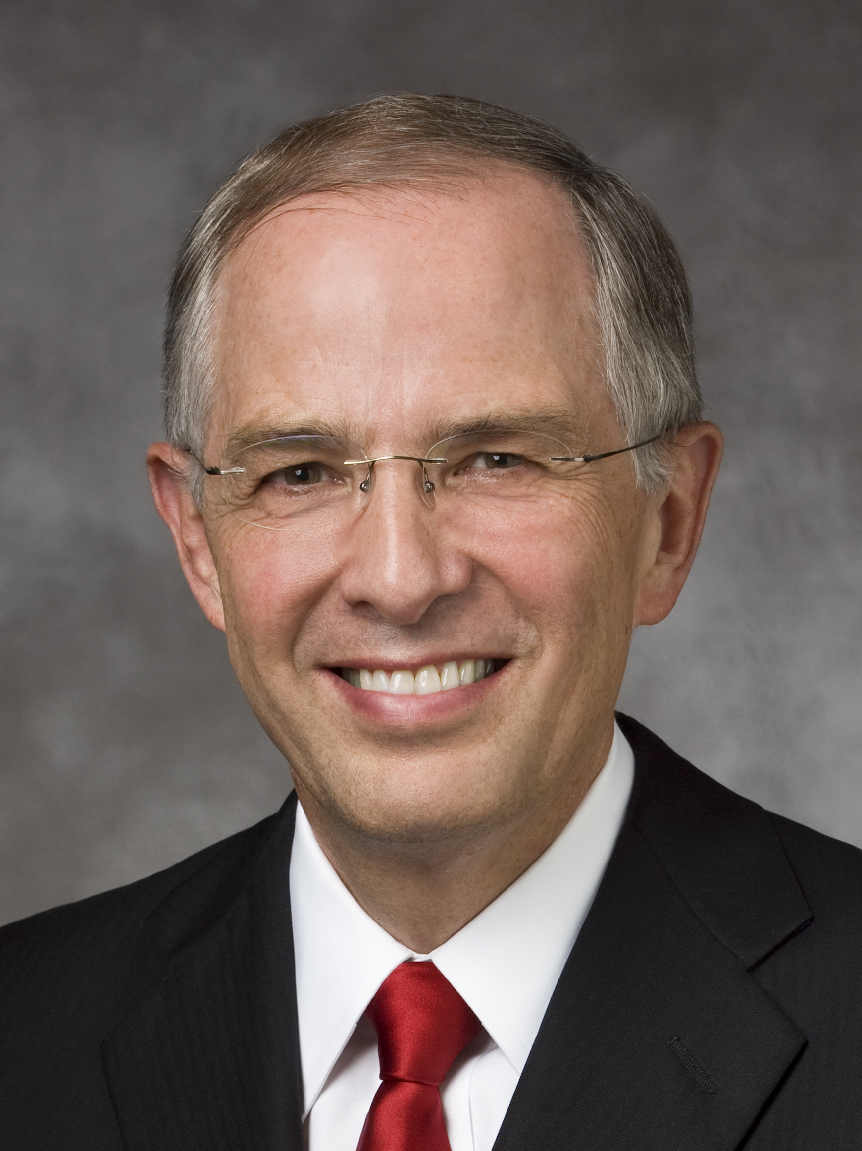
Elder Neil L. Andersen
“The negative commentary about the Prophet Joseph Smith will increase as we move toward the Second Coming of the Savior. The half-truths and subtle deceptions will not diminish. There will be family members and friends who will need your help. …
“To the youth … , I give a specific challenge: Gain a personal witness of the Prophet Joseph Smith” (Neil L. Andersen, “Joseph Smith,” Ensign or Liahona, Nov. 2014, 30).

Slide 6
The Prophet Joseph Smith
Read 2 Nephi 3:6–15, looking for words or phrases that Joseph of Egypt used to describe Joseph Smith and the work he would accomplish. The phrase “fruit of my loins” refers to Joseph of Egypt’s descendants.

Slide 7
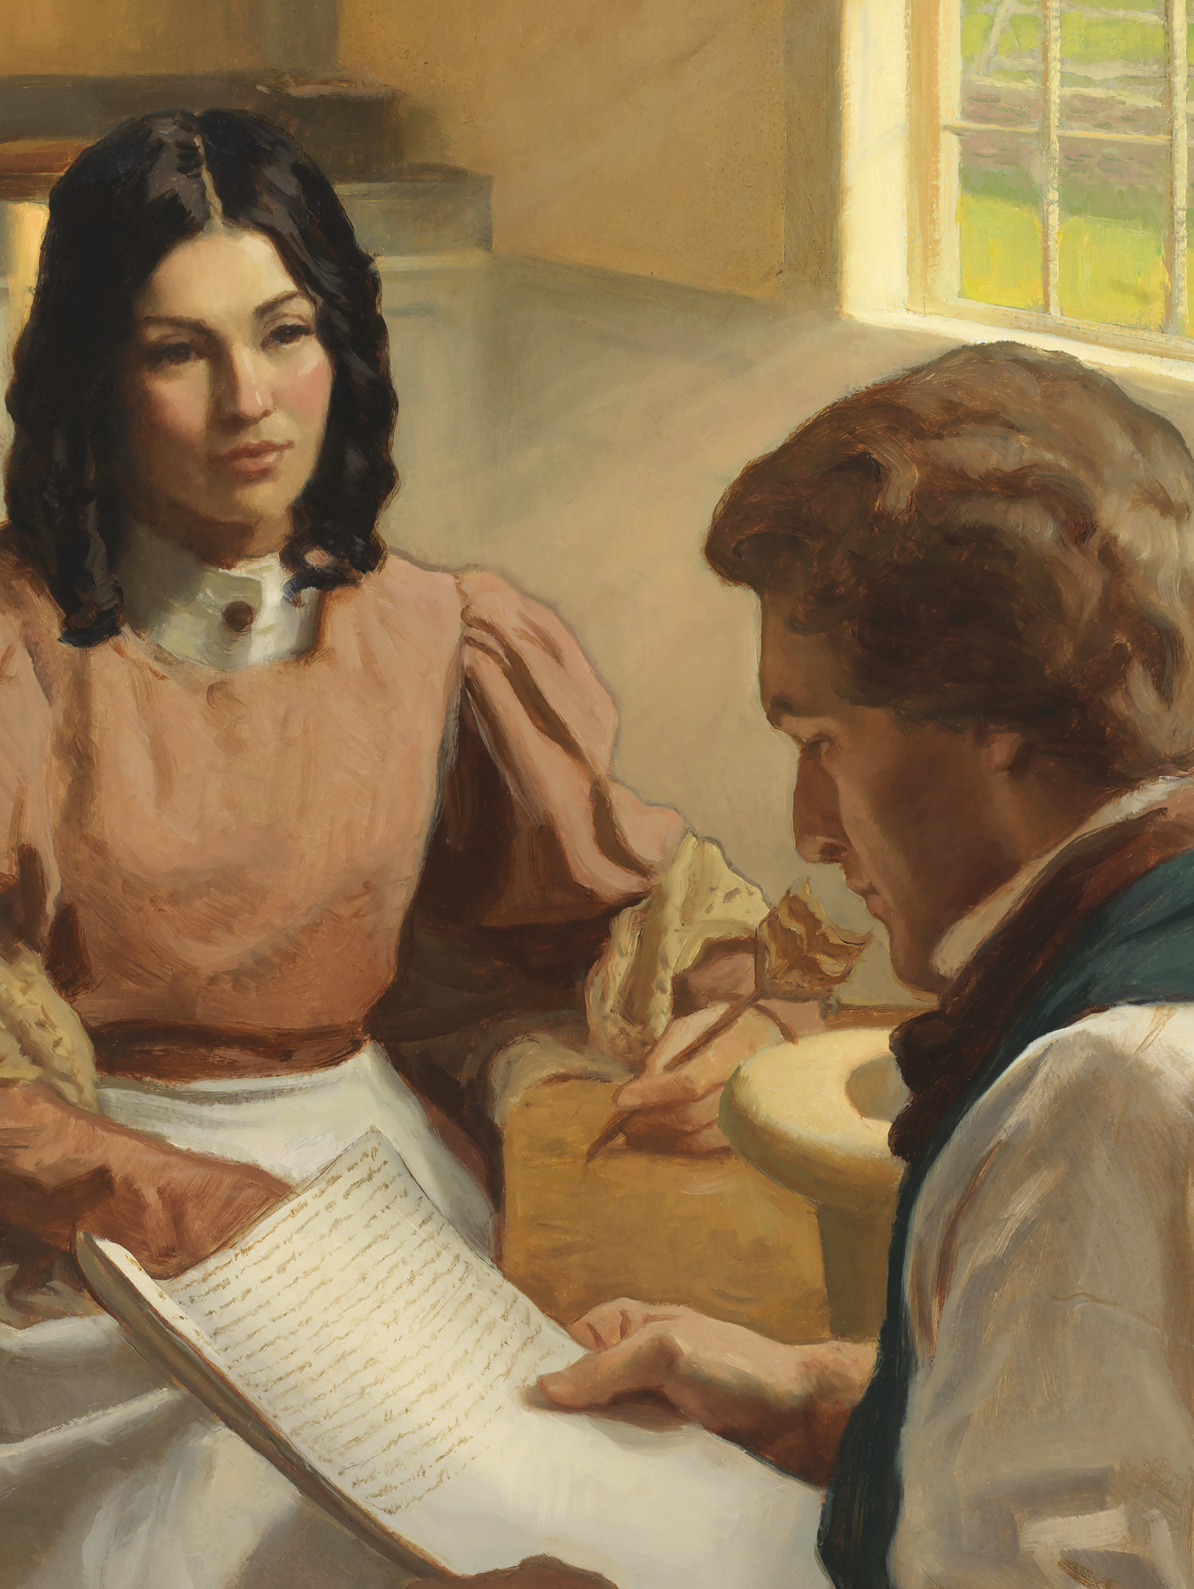
Bring Forth the Word
One of the things that Joseph of Egypt prophesied was that the Lord would give power to Joseph Smith “to bring forth my word” (2 Nephi 3:11).

Slide 8
Bring Forth the Word
One of the things that Joseph of Egypt prophesied was that the Lord would give power to Joseph Smith “to bring forth my word” (2 Nephi 3:11).
Read Doctrine and Covenants 135:3, looking for examples of the word of God that Joseph Smith brought forth. John Taylor (1808–1887), who later became the third President of the Church, wrote these words soon after the death of the Prophet Joseph Smith.

Slide 9
The Word of God
What are some examples of the word of God that Joseph Smith brought forth?

Slide 10
The Word of God
What are some examples of the word of God that Joseph Smith brought forth?
2 Nephi 3:12 mentions two books: the book written by the descendants of Joseph of Egypt was the Book of Mormon; the book written by the descendants of Judah was the Bible.

Slide 11
The Book of Mormon and Bible
Search 2 Nephi 3:12 for phrases that describe the impact that the Book of Mormon and Bible will have on the world as they “grow together.”

Slide 12
The Book of Mormon and Bible
Search 2 Nephi 3:12 for phrases that describe the impact that the Book of Mormon and Bible will have on the world as they “grow together.”
Complete this statement: The Book of Mormon and the Bible work together to …

Slide 13
Confounding False Doctrines
The Book of Mormon and the Bible work together to confound false doctrines, establish peace, and bring people to the knowledge of the Lord’s covenants.

Slide 14
Confounding False Doctrines
The Book of Mormon and the Bible work together to confound false doctrines, establish peace, and bring people to the knowledge of the Lord’s covenants.
What are some examples of how the Book of Mormon works with the Bible to confound false doctrines?

Slide 15
The Book of Mormon—A Book from God
https://www.lds.org/media-library/video/2014-07-1020-the-book-of-mormon-a-book-from-god?lang=eng

Slide 16
The Book of Mormon
Read 2 Nephi 3:15. In what ways does the Book of Mormon help bring people to salvation?

Slide 17
The Book of Mormon
Read 2 Nephi 3:15. In what ways does the Book of Mormon help bring people to salvation?
When have you experienced the power of the Book of Mormon in your life or seen its influence in the lives of friends or family members?

Slide 18
The Prophet Joseph Smith
Read 2 Nephi 3:24, looking for words and phrases that describe the Prophet Joseph Smith.

Slide 19
The Prophet Joseph Smith
Read 2 Nephi 3:24, looking for words and phrases that describe the Prophet Joseph Smith.
Based on what we have learned from 2 Nephi 3, how would you summarize why the Lord raised up the Prophet Joseph Smith?

Slide 20
The Prophet Joseph Smith
Read 2 Nephi 3:24, looking for words and phrases that describe the Prophet Joseph Smith.
Based on what we have learned from 2 Nephi 3, how would you summarize why the Lord raised up the Prophet Joseph Smith?
The Lord raised up the Prophet Joseph Smith to help bring about the Restoration of the gospel.

Slide 21
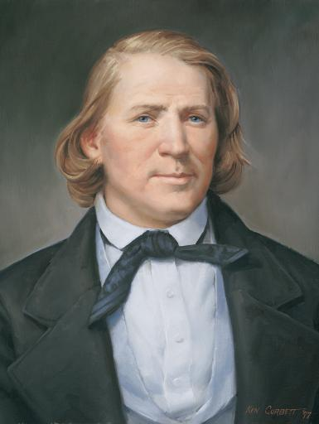
President Brigham Young
“It was decreed in the counsels of eternity, long before the foundations of the earth were laid, that he, Joseph Smith, should be the man, in the last dispensation of this world, to bring forth the word of God to the people, and receive the fulness of the keys and power of the Priesthood of the Son of God. The Lord had his eyes upon him, and upon his father, and upon his father’s father, and upon their progenitors clear back … to Adam.
Continued on the next page.

Slide 22
President Brigham Young, cont.
“He has watched that family and that blood as it has circulated from its fountain to the birth of that man. He was fore-ordained in eternity to preside over this last dispensation” (Teachings of Presidents of the Church: Brigham Young [1997], 96, 343.).

Slide 23
Raised Up by the Lord
Why is it important to know that Joseph Smith was raised up by the Lord to help bring about the Restoration of the gospel?

Slide 24
Your Testimony
What have you learned or felt today that has strengthened your testimony of the Prophet Joseph Smith?

Slide 25
Your Testimony
What have you learned or felt today that has strengthened your testimony of the Prophet Joseph Smith?
What did Joseph Smith do, teach, or restore that you feel is “of great worth” (2 Nephi 3:7) to you?

Slide 26
Elder Neil L. Andersen
“A testimony of the Prophet Joseph Smith can come differently to each of us. It may come as you kneel in prayer, asking God to confirm that he was a true prophet. It may come as you read the Prophet’s account of the First Vision. A testimony may distill upon your soul as you read the Book of Mormon again and again.
Continued on the next page.

Slide 27
Elder Neil L. Andersen, cont.
“It may come as you bear your own testimony of the Prophet or as you stand in the temple and realize that through Joseph Smith the holy sealing power was restored to the earth. With faith and real intent, your testimony of the Prophet Joseph Smith will strengthen” (Neil L. Andersen, “Joseph Smith,” Ensign or Liahona, Nov. 2014, 30).

Slide 28
Doctrinal Mastery: Review
Match the doctrine or principle on the left with the doctrinal mastery scripture passage that supports it on the right.
If we pray always, God will consecrate our performance for the welfare of our souls.
God gives knowledge line upon line.
If we feast upon the words of Christ, we can know all things that we should do.
2 Nephi 28:30
2 Nephi 32:3
2 Nephi 32:8–9

