Slide 1
2 Nephi 4
Lesson 26

Slide 2

Devotional
Hymn:
Prayer:
Thought:
Notes:
ID 272818

Slide 3

Studying the Scriptures
Why do you study the scriptures?

Slide 4
Studying the Scriptures
Why do you study the scriptures?
As you study 2 Nephi 4:1–16 today, look for truths that Nephi taught about the blessings of studying the scriptures.

Slide 5
At Lehi’s Death
In 2 Nephi 4:1–12, before Lehi died, he counseled and blessed his and Ishmael’s posterity one last time. This included a blessing that the Lord would be merciful to the posterity of Laman and Lemuel.

Slide 6
At Lehi’s Death
In 2 Nephi 4:1–12, before Lehi died, he counseled and blessed his and Ishmael’s posterity one last time. This included a blessing that the Lord would be merciful to the posterity of Laman and Lemuel.
Read 2 Nephi 4:13–14, looking for what happened shortly after Lehi’s death.

Slide 7
At Lehi’s Death
In 2 Nephi 4:1–12, before Lehi died, he counseled and blessed his and Ishmael’s posterity one last time. This included a blessing that the Lord would be merciful to the posterity of Laman and Lemuel.
Read 2 Nephi 4:13–14, looking for what happened shortly after Lehi’s death.
Why were Laman and Lemuel and the sons of Ishmael angry with Nephi?

Slide 8
The Plates of Nephi
According to 2 Nephi 4:14, Nephi recorded more historical details on the large plates of Nephi.

Slide 9
The Plates of Nephi
According to 2 Nephi 4:14, Nephi recorded more historical details on the large plates of Nephi.
Read 2 Nephi 4:15–16, looking for what Nephi said he engraved upon the small plates.

Slide 10
The Plates of Nephi
According to 2 Nephi 4:14, Nephi recorded more historical details on the large plates of Nephi.
Read 2 Nephi 4:15–16, looking for what Nephi said he engraved upon the small plates.
What phrase describes how Nephi felt about the scriptures?

Slide 11
The Plates of Nephi
According to 2 Nephi 4:14, Nephi recorded more historical details on the large plates of Nephi.
Read 2 Nephi 4:15–16, looking for what Nephi said he engraved upon the small plates.
What phrase describes how Nephi felt about the scriptures?
What truth do we learn from 2 Nephi 4:15 about why scriptures are written?

Slide 12
The Blessing of Scriptures
Scriptures are written for our learning and profit.

Slide 13
The Blessing of Scriptures
Scriptures are written for our learning and profit.
How do you think pondering the scriptures would have profited (or benefitted) Nephi at this time when his father had died and his brothers were angry with him?

Slide 14
The Blessing of Scriptures
Scriptures are written for our learning and profit.
How do you think pondering the scriptures would have profited (or benefitted) Nephi at this time when his father had died and his brothers were angry with him?
How have the scriptures profited (or benefitted) you?

Slide 15
Our Weaknesses and Sins
What thoughts or feelings might people have when they contemplate their weaknesses and sins?

Slide 16
Our Weaknesses and Sins
What thoughts or feelings might people have when they contemplate their weaknesses and sins?
Think about a weakness or sin that may be causing you frustration or discouragement.

Slide 17
Our Weaknesses and Sins
What thoughts or feelings might people have when they contemplate their weaknesses and sins?
Think about a weakness or sin that may be causing you frustration or discouragement.
As you continue your study of 2 Nephi 4 today, look for truths that can help you overcome the sin or weakness you thought of.

Slide 18
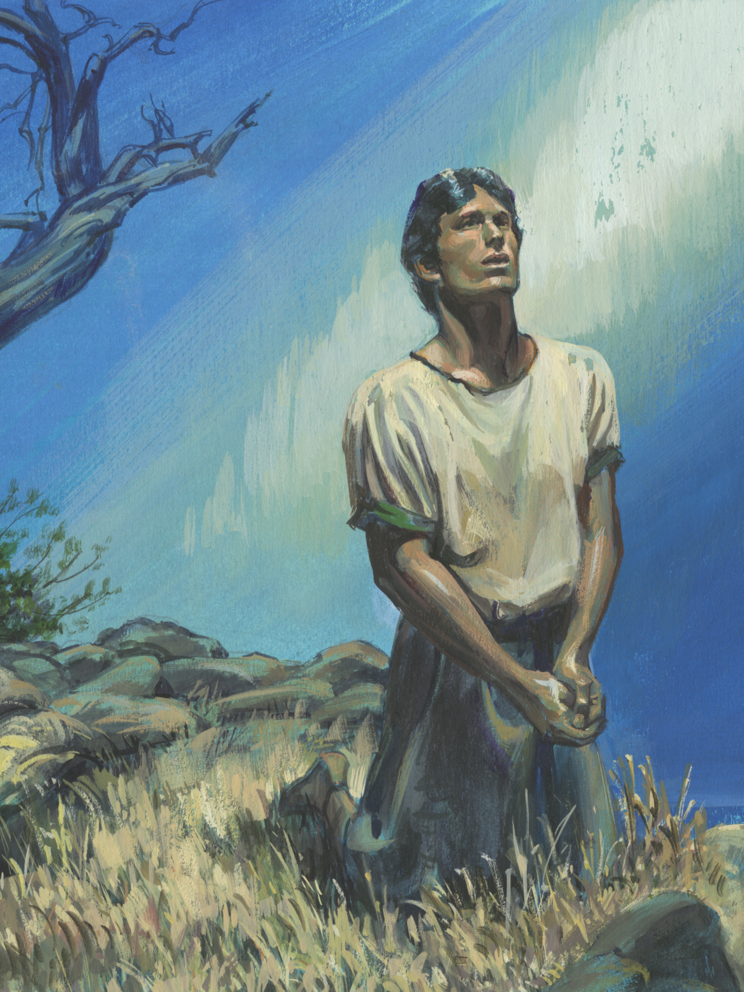
Nephi’s Sorrow
Read 2 Nephi 4:17–18, looking for reasons Nephi felt sorrow. The word wretched means miserable. In the scriptures, the word flesh often refers to the body, and in our fallen state our physical bodies are often a source of temptation and weakness. The word beset means to be attacked from all sides.

Slide 19
Nephi’s Sorrow
Read 2 Nephi 4:17–18, looking for reasons Nephi felt sorrow. The word wretched means miserable. In the scriptures, the word flesh often refers to the body, and in our fallen state our physical bodies are often a source of temptation and weakness. The word beset means to be attacked from all sides.
Thinking about Nephi’s feelings, how would you complete this statement? My heart sorroweth because …

Slide 20
Nephi’s Hope
Read 2 Nephi 4:19, looking for a phrase that indicates Nephi’s hope.

Slide 21
Nephi’s Hope
Read 2 Nephi 4:19, looking for a phrase that indicates Nephi’s hope.
What do you think Nephi meant when he said, “I know in whom I have trusted”?

Slide 22
Trust in the Lord
Read 2 Nephi 4:20–25, looking for experiences that helped Nephi learn to trust in the Lord.

Slide 23
Trust in the Lord
Read 2 Nephi 4:20–25, looking for experiences that helped Nephi learn to trust in the Lord.
Read 2 Nephi 4:26–29, looking for the effect that remembering past spiritual experiences had on Nephi.

Slide 24
Trust in the Lord
Read 2 Nephi 4:20–25, looking for experiences that helped Nephi learn to trust in the Lord.
Read 2 Nephi 4:26–29, looking for the effect that remembering past spiritual experiences had on Nephi.
How would you complete this principle? Trusting in the Lord and remembering past spiritual experiences can help us …

Slide 25
Trusting in the Lord
Trusting in the Lord and remembering past spiritual experiences can help us overcome temptations and discouragement. You may want to write this principle next to 2 Nephi 4:26–29 in your scriptures.

Slide 26
Trusting in the Lord
Trusting in the Lord and remembering past spiritual experiences can help us overcome temptations and discouragement. You may want to write this principle next to 2 Nephi 4:26–29 in your scriptures.
How can trusting in the Lord and remembering spiritual experiences we have had help us during times of temptation and discouragement?

Slide 27
The Lord’s Help
Think of a time when the Lord helped you overcome temptation or difficulty as you trusted in Him.

Slide 28
The Lord’s Help
Think of a time when the Lord helped you overcome temptation or difficulty as you trusted in Him.
How did the Lord help you?

Slide 29
The Lord’s Help
Think of a time when the Lord helped you overcome temptation or difficulty as you trusted in Him.
How did the Lord help you?
How has that experience influenced you?

Slide 30
Prayer
Read 2 Nephi 4:30–35, looking for statements that provide a good example of what we can pray for during difficult times. You may consider marking what you find.

Slide 31
Prayer
Read 2 Nephi 4:30–35, looking for statements that provide a good example of what we can pray for during difficult times. You may consider marking what you find.
How would you summarize what Nephi prayed for as recorded in verses 31–33?

Slide 32
Prayer
Read 2 Nephi 4:30–35, looking for statements that provide a good example of what we can pray for during difficult times. You may consider marking what you find.
How would you summarize what Nephi prayed for as recorded in verses 31–33?
How would you summarize as a principle what we can learn about prayer from these verses?

Slide 33
Sincere Prayer
If we pray to God sincerely, we can receive His help to overcome sin and discouragement.

Slide 34
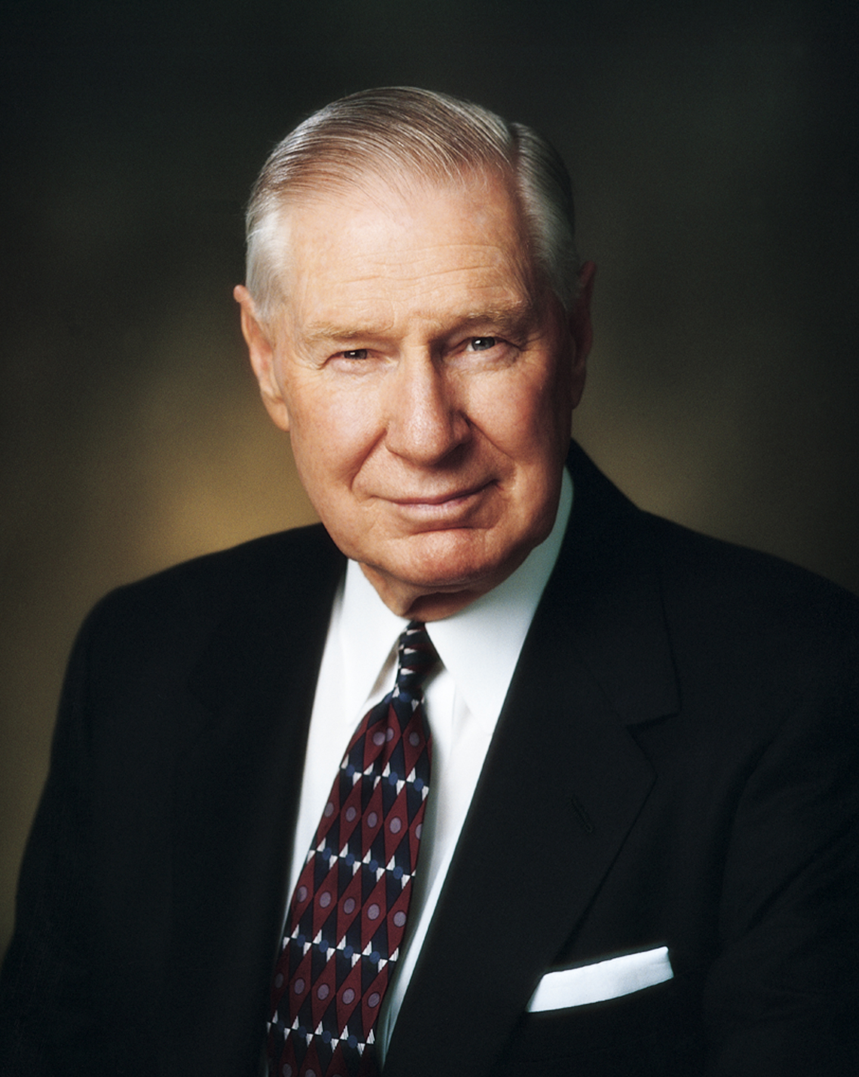
President James E. Faust
“Sincere prayers come from the heart. Indeed, sincerity requires that we draw from the earnest feelings of our hearts” (James E. Faust, “The Lifeline of Prayer,” Ensign, May 2002, 60).

Slide 35
Sincere Prayer
Why do you think sincere prayer from the heart invites God’s help?

Slide 36
Sincere Prayer
Why do you think sincere prayer from the heart invites God’s help?
Think about a time when sincere prayer helped you overcome sin or discouragement.

Slide 37
Doctrinal Mastery: Review
Match the Doctrine/Principle
Doctrinal Mastery Passage
Believe in God and that He has all wisdom.
A witness comes after the trial of faith.
The Holy Ghost reveals truth to those who ask God with real intent.
Moroni 10:4–5
Mosiah 4:9
Ether 12:6

