Slide 1
2 Nephi 5
Lesson 27

Slide 2

Devotional
Hymn:
Prayer:
Thought:
Notes:
ID 272818

Slide 3

A Sign and a Compass
What do these two pictures represent?

Slide 4
A Sign and a Compass
What do these two pictures represent?
What are some situations in your life in which you would want to receive a warning or guidance?

Slide 5
A Sign and a Compass
What do these two pictures represent?
What are some situations in your life in which you would want to receive a warning or guidance?
How can receiving warnings or guidance help in situations like these?

Slide 6
Nephi’s Challenge
Read 2 Nephi 5:1–3, looking for a challenge Nephi faced.

Slide 7
Nephi’s Challenge
Read 2 Nephi 5:1–3, looking for a challenge Nephi faced.
According to 2 Nephi 5:1, what did Nephi do because of his brothers’ anger?

Slide 8
Nephi’s Challenge
Read 2 Nephi 5:1–3, looking for a challenge Nephi faced.
According to 2 Nephi 5:1, what did Nephi do because of his brothers’ anger?
Even after Nephi had prayed for help, what did Laman and Lemuel seek to do?

Slide 9
Prayers
What truth can we learn about prayers from Nephi’s experience?

Slide 10
Prayers
What truth can we learn about prayers from Nephi’s experience?
Our prayers may not always be answered immediately or in the way we desire.

Slide 11
Prayers
What truth can we learn about prayers from Nephi’s experience?
Our prayers may not always be answered immediately or in the way we desire.
Why is it important to continue to be faithful when our prayers are not answered immediately or in the way we desire?

Slide 12
Guidance from the Lord
Read 2 Nephi 5:5–8, looking for what the Lord did to help Nephi and those who believed in the warnings and revelations of God.

Slide 13
Guidance from the Lord
Read 2 Nephi 5:5–8, looking for what the Lord did to help Nephi and those who believed in the warnings and revelations of God.
How do you think Nephi’s desire to “cry much unto the Lord” (2 Nephi 5:1) may have prepared him to receive warnings and guidance from the Lord?

Slide 14
Seek in Prayer
From what you learn in 2 Nephi 5:1 and 2 Nephi 5:5, how would you complete this principle? If we faithfully seek Heavenly Father in prayer …

Slide 15
Seek in Prayer
From what you learn in 2 Nephi 5:1 and 2 Nephi 5:5, how would you complete this principle? If we faithfully seek Heavenly Father in prayer …
If we faithfully seek Heavenly Father in prayer, He will warn and guide us. Consider marking the phrases in 2 Nephi 5:1, 5 that teach this principle.

Slide 16
A Scenario
You have friends who are starting to behave in ways that are not consistent with the standards of the Lord, and you aren’t sure what to do. You would like to continue to spend time with them and do everything you can to help them change. But on the other hand, you also worry about finding yourself in situations where you are uncomfortable and exposed to spiritually degrading or dangerous influences.

Slide 17
What Would You Do?
How can the principle we identified in 2 Nephi 5:1, 5 help you know what to do in this situation?

Slide 18
What Would You Do?
How can the principle we identified in 2 Nephi 5:1, 5 help you know what to do in this situation?
Remember that what is the best choice in one situation may not be in another. By seeking Heavenly Father in prayer, you can be guided on how to act in specific situations.

Slide 19
Guided by the Lord
Write in your class notebook or study journal about a time when you or someone you know was guided or warned by God and the effect it had on you.

Slide 20
Guided by the Lord
Write in your class notebook or study journal about a time when you or someone you know was guided or warned by God and the effect it had on you.
Consider sharing with the class what you wrote. (Do not share anything private or too personal.)

Slide 21
Guided by the Lord
Write in your class notebook or study journal about a time when you or someone you know was guided or warned by God and the effect it had on you.
Consider sharing with the class what you wrote. (Do not share anything private or too personal.)
According to 2 Nephi 5:6, who chose to follow Nephi as he fled into the wilderness? Why did they choose to go with him?

Slide 22
Away from Danger
What principle can we learn from 2 Nephi 5:6 that can help us be led away from danger?

Slide 23
Away from Danger
What principle can we learn from 2 Nephi 5:6 that can help us be led away from danger?
If we choose to believe in the revelations of God and to hearken to His prophets, we can be led away from danger.

Slide 24
Away from Danger
What principle can we learn from 2 Nephi 5:6 that can help us be led away from danger?
If we choose to believe in the revelations of God and to hearken to His prophets, we can be led away from danger.
How has hearkening to God’s prophets led you away from danger?

Slide 25
Separation
The separation of the Nephites from the Lamanites was the result of Laman and Lemuel’s hatred for Nephi. This separation continued for centuries, with the descendants of Laman and Lemuel teaching their children to hate the descendants of Nephi (see Mosiah 10:12–17).

Slide 26
Separation
The separation of the Nephites from the Lamanites was the result of Laman and Lemuel’s hatred for Nephi. This separation continued for centuries, with the descendants of Laman and Lemuel teaching their children to hate the descendants of Nephi (see Mosiah 10:12–17).
Read 2 Nephi 5:27 and think about what it means to live “after the manner of happiness.” Consider marking this verse in your scriptures.

Slide 27
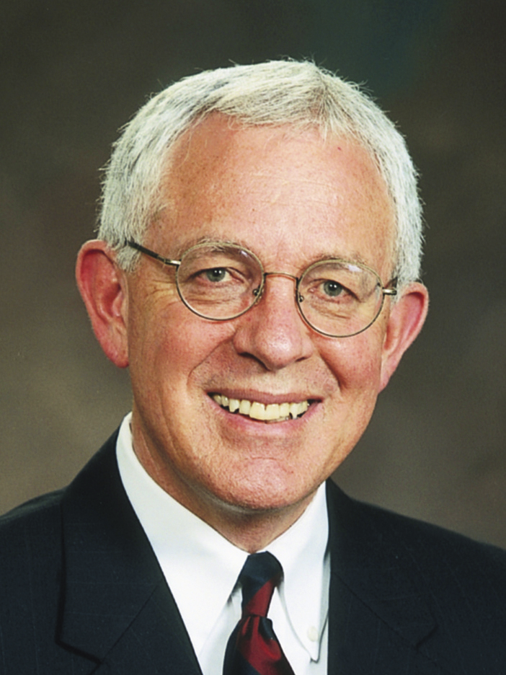
Elder Marlin K. Jensen
“Certain unchanging principles and truths bring happiness to our lives. This subject has been of interest to me for many years because although I am richly blessed and have every reason to be happy, I sometimes struggle and do not always have the natural inclination toward happiness and a cheerful disposition that some people seem to enjoy.
Continued on the next page.

Slide 28
Elder Marlin K. Jensen, cont.
“For that reason, several years ago a Book of Mormon passage caught my attention. … Nephi established a society founded on gospel truths; and of that society he says, ‘And it came to pass that we lived after the manner of happiness’ (2 Ne. 5:27). The passage deeply impressed me. … I wondered … what the individual elements of a truly happy society and life might be, and I began to search Nephi’s writings for clues.
Continued on the next page.

Slide 29
Elder Marlin K. Jensen, cont.
“I … invite you to conduct your own personal search. It could be a lifelong and worthwhile pursuit. …
“… The same patterns and elements of daily life that enabled Nephi and his people to be happy 560 years before Christ work equally well today” (Marlin K. Jensen, “Living after the Manner of Happiness,” Ensign, Dec. 2002, 56, 61).

Slide 30
Struggling With
What did Elder Jensen say he sometimes struggled with?

Slide 31
Struggling With
What did Elder Jensen say he sometimes struggled with?
Do you sometimes struggle to be happy and cheerful?

Slide 32
Struggling With
What did Elder Jensen say he sometimes struggled with?
Do you sometimes struggle to be happy and cheerful?
What did Elder Jensen say could be a “lifelong and worthwhile pursuit”?

Slide 33
The Nephites’ Happiness
Read 2 Nephi 5:6, 10–18, 26–27, looking for elements or actions that contributed to the Nephites’ happiness. Consider marking what you find.

Slide 34
Elements of Nephites’ Happiness
Nephi and his followers went with their families (see 2 Nephi 5:6). They obeyed the Lord (see 2 Nephi 5:10). They worked hard to support themselves (see 2 Nephi 5:11, 15–17). They took scriptures with them (see 2 Nephi 5:12). They built a temple (see 2 Nephi 5:16). They followed righteous leaders (see 2 Nephi 5:18, 26).

Slide 35
The Gospel of Jesus Christ
The actions that allowed Nephi and his people to live after the manner of happiness were based on the teachings of the gospel of Jesus Christ.

Slide 36
The Gospel of Jesus Christ
The actions that allowed Nephi and his people to live after the manner of happiness were based on the teachings of the gospel of Jesus Christ.
We can live after the manner of happiness by applying the teachings of the gospel of Jesus Christ.

Slide 37
The Gospel of Jesus Christ
The actions that allowed Nephi and his people to live after the manner of happiness were based on the teachings of the gospel of Jesus Christ.
We can live after the manner of happiness by applying the teachings of the gospel of Jesus Christ.
Why do you think applying the teachings of the gospel of Jesus Christ enables us to have happiness?

Slide 38
After the Manner of Happiness
Think about the actions of the Nephites that contributed to their happiness. How have these actions helped you live “after the manner of happiness”?

Slide 39
Keeping the Commandments
According to 2 Nephi 5:10–11, what blessings did the people receive because they kept the Lord’s commandments?

Slide 40
Keeping the Commandments
According to 2 Nephi 5:10–11, what blessings did the people receive because they kept the Lord’s commandments?
When have you felt that the Lord has been with you?

Slide 41
Keeping the Commandments
According to 2 Nephi 5:10–11, what blessings did the people receive because they kept the Lord’s commandments?
When have you felt that the Lord has been with you?
How has the Lord’s influence in your life contributed to your happiness?

Slide 42
The Temple
How might the temple have helped the people live “after the manner of happiness”?

Slide 43
The Temple
How might the temple have helped the people live “after the manner of happiness”?
How has the temple brought greater happiness to you or someone you know?

Slide 44
Hard Work
In what ways does hard work contribute to happiness?

Slide 45
Hard Work
In what ways does hard work contribute to happiness?
Examine your life and determine something you will do to live more fully “after the manner of happiness.”

Slide 46
How They Lived
Read 2 Nephi 5:19–24, looking for differences between the way the Lamanites lived and the way the Nephites lived.

Slide 47
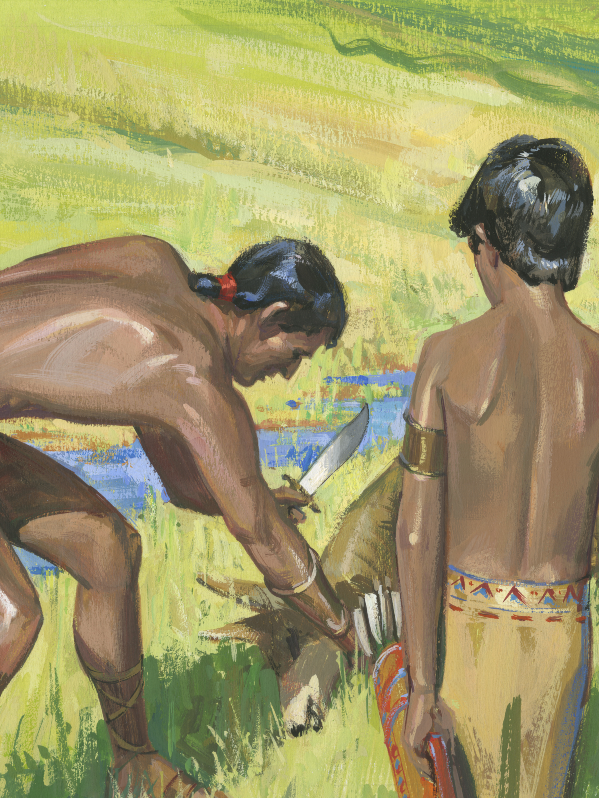
The Lamanites
According to 2 Nephi 5:20, what was the consequence of the Lamanites’ disobedience?

Slide 48
The Lamanites
According to 2 Nephi 5:20, what was the consequence of the Lamanites’ disobedience?
Throughout 2 Nephi 5, the curse mentioned on the Lamanites was separation from God. The changing of the Lamanites’ skin was only a mark or sign of this curse.

Slide 49
Hard Like Flint
How does 2 Nephi 5:21 help you understand why the Lamanites were cut off from the presence of the Lord? The word flint means a hard stone.

Slide 50
Hard Like Flint
How does 2 Nephi 5:21 help you understand why the Lamanites were cut off from the presence of the Lord? The word flint means a hard stone.
What is a principle we can learn from 2 Nephi 5:20–24 that describes what happens when people harden their hearts against the Lord?

Slide 51
Hardening Their Hearts
When people harden their hearts against the Lord, they separate themselves from Him.

Slide 52
Hardening Their Hearts
When people harden their hearts against the Lord, they separate themselves from Him.
What are some reasons why people may choose to harden their hearts against the Lord?

