Slide 1
2 Nephi 6–8
Lesson 28

Slide 2
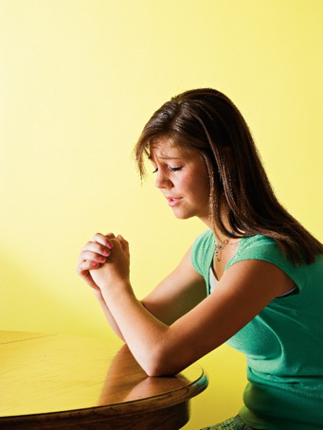
Devotional
Hymn:
Prayer:
Thought:
Notes:
ID 272818

Slide 3
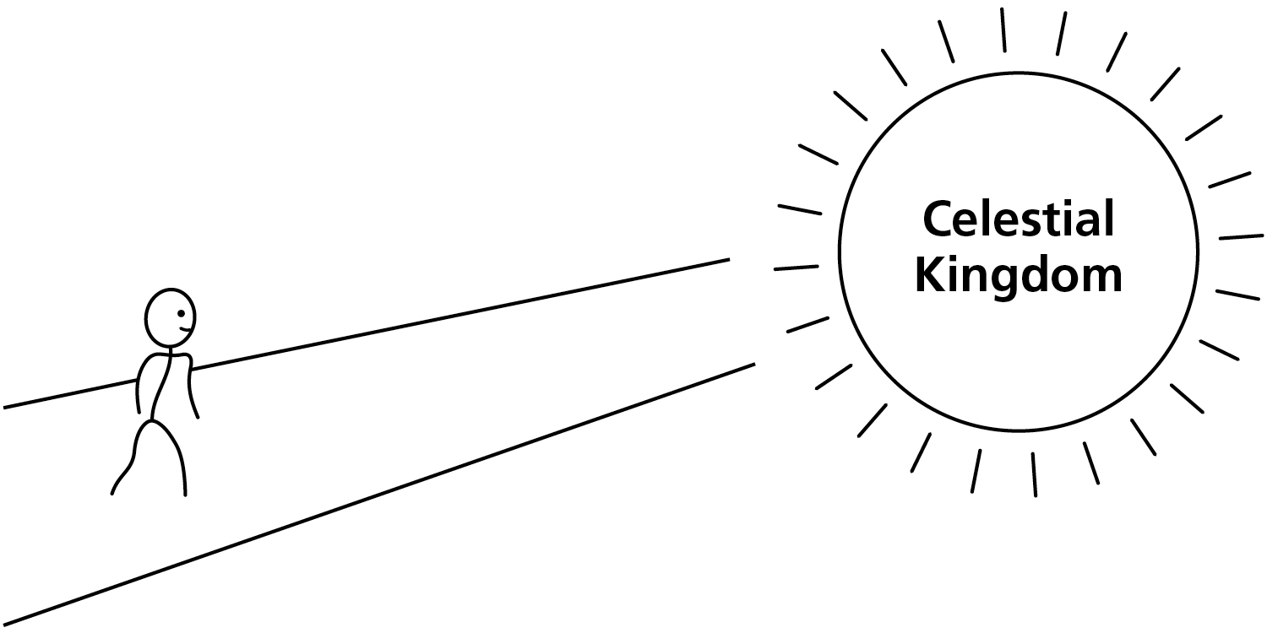
The Path
This picture illustrates that when we are baptized and receive the Holy Ghost, we begin following the path that leads back to Heavenly Father and eternal life.

Slide 4
The Path
We step off the path when we sin or turn away from God. What do you think Satan wants us to believe when we sin and step off the path?

Slide 5
The Path
We step off the path when we sin or turn away from God. What do you think Satan wants us to believe when we sin and step off the path?
What does God want us to do when we turn off the path?

Slide 6
Jacob’s Teaching
In 2 Nephi 6–8, Nephi’s brother Jacob taught how the Lord responds to those who have turned away from Him. As you study these chapters today, look for truths that reflect the Lord’s feelings and efforts toward those who turn away from Him.

Slide 7
The House of Israel
In 2 Nephi 6:1–7, Jacob told his people that he would liken Isaiah’s teachings about the scattering and gathering of Israel unto them.

Slide 8
The House of Israel
In 2 Nephi 6:1–7, Jacob told his people that he would liken Isaiah’s teachings about the scattering and gathering of Israel unto them.
Read 2 Nephi 6:8, looking for what the Lord showed Jacob concerning those in Jerusalem.

Slide 9
Jerusalem
In 587 B.C., shortly after Lehi left Jerusalem, the Babylonians conquered Jerusalem and deported many of the Jews to Babylon. Prophets had repeatedly warned the Jews that this would happen if they did not repent of their wickedness (see 2 Kings 17:13; Jeremiah 26:18; 1 Nephi 1:4; Helaman 8:20).

Slide 10
The Captive Jews
Read the first sentence of 2 Nephi 6:9, looking for what happened to the captive Jews.

Slide 11
The Captive Jews
Read the first sentence of 2 Nephi 6:9, looking for what happened to the captive Jews.
This prophecy was fulfilled around 537 B.C. when King Cyrus of Persia, who had conquered the Babylonians, allowed the Jews to return to Jerusalem.

Slide 12
Jacob’s Prophecy
Read the rest of 2 Nephi 6:9, looking for who would come among the Jews after they returned to Jerusalem.

Slide 13
Jacob’s Prophecy
Read the rest of 2 Nephi 6:9, looking for who would come among the Jews after they returned to Jerusalem.
How would the Savior be treated among the Jews?

Slide 14
Jacob’s Prophecy
Read the rest of 2 Nephi 6:9, looking for who would come among the Jews after they returned to Jerusalem.
How would the Savior be treated among the Jews?
Read 2 Nephi 6:10, looking for what would happen to the Jews after the Savior’s Crucifixion.

Slide 15
Destruction of Jerusalem
The prophecy of Jacob regarding the Jews after the Savior’s Crucifixion (see 2 Nephi 6:10) was fulfilled in A.D. 70 when a Roman army besieged Jerusalem and destroyed the temple. Many Jews were killed, and others were driven and scattered throughout the world.

Slide 16
Turning Away from the Lord
In 2 Nephi 6, Jacob explained that the Jews repeatedly chose (or would choose) to turn away from the Lord. How might you expect the Lord to respond to the Jews’ choices to repeatedly turn away from Him?

Slide 17
The Lord’s Response
Read 2 Nephi 6:11, looking for how the Lord will respond to the Jewish people.

Slide 18
The Lord’s Response
Read 2 Nephi 6:11, looking for how the Lord will respond to the Jewish people.
What truth does this teach us about the Lord?

Slide 19
The Lord’s Response
Read 2 Nephi 6:11, looking for how the Lord will respond to the Jewish people.
What truth does this teach us about the Lord?
The Lord is merciful.

Slide 20
The Lord’s Response
Read 2 Nephi 6:11, looking for how the Lord will respond to the Jewish people.
What truth does this teach us about the Lord?
The Lord is merciful.
How can knowing that the Lord is merciful help us when we step off the path and turn away from Him?

Slide 21
The Lord Is Merciful
Jacob’s teachings in 2 Nephi 6 show the Lord being merciful to His covenant people when they repent, even after they have been very wicked. This does not mean that there are not consequences for our decisions and actions. However, it does indicate that if the Lord would be merciful to these people, He will surely be merciful to us individually as we repent and come unto Him.

Slide 22
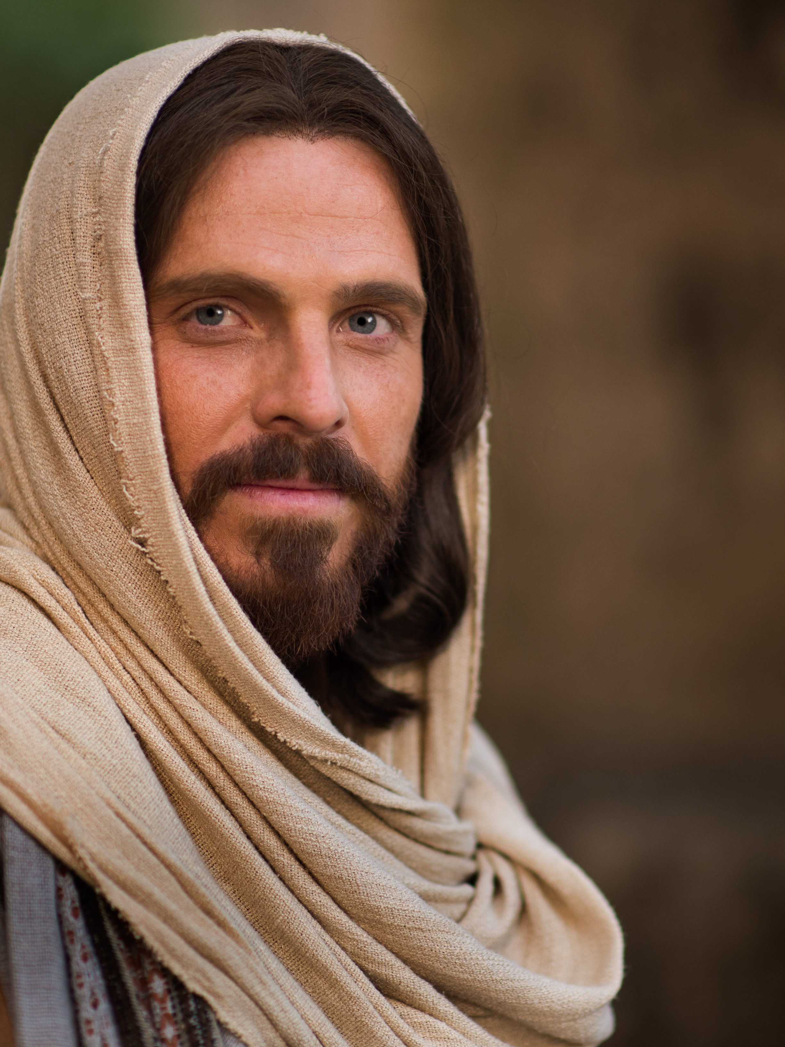
He Is Merciful to You
Ponder the ways the Lord has been merciful to you.

Slide 23
He Is Merciful to You
Ponder the ways the Lord has been merciful to you.
Write the following phrase in your study journal or class notebook: I know the Lord is merciful because … Then write your thoughts and feelings to complete the statement.

Slide 24
He Is Merciful to You
Ponder the ways the Lord has been merciful to you.
Write the following phrase in your study journal or class notebook: I know the Lord is merciful because … Then write your thoughts and feelings to complete the statement.
Consider if there are any sins you need to repent of. The Lord’s mercy and forgiveness is always extended to those who repent.

Slide 25
The Gentiles
The rest of 2 Nephi 6 tells us that Jacob also prophesied of the latter-day Gentiles, who would be saved if they would repent and not fight against Zion. He further explained that God would contend against the enemies of the house of Israel and deliver His covenant people.

Slide 26
Question
Have you ever sold something to another person and later regretted your decision (perhaps because you missed the item you sold or felt you had not charged enough for it)?

Slide 27
The Israelites
Read 2 Nephi 7:1, looking for what the Lord said the Israelites had sold.

Slide 28
The Israelites
Read 2 Nephi 7:1, looking for what the Lord said the Israelites had sold.
What do you think the Lord meant when He said, “For your iniquities have ye sold yourselves”?

Slide 29
Regaining Freedom
Once we have sinned and sold ourselves into captivity, what needs to happen in order for us to regain our freedom?

Slide 30
Regaining Freedom
Once we have sinned and sold ourselves into captivity, what needs to happen in order for us to regain our freedom?
Read 2 Nephi 7:2 and look for what the Savior said about His power to redeem us, or buy us back, from the captivity of sin.

Slide 31
His Power to Redeem
The Lord’s statement, “Is my hand shortened at all that it cannot redeem, or have I no power to deliver?” (2 Nephi 7:2) meant that the hand and arm of the Lord are symbols of His power. He who has a “shortened hand” is weak and powerless.

Slide 32
His Power to Redeem
The Lord’s statement, “Is my hand shortened at all that it cannot redeem, or have I no power to deliver?” (2 Nephi 7:2) meant that the hand and arm of the Lord are symbols of His power. He who has a “shortened hand” is weak and powerless.
The Savior has the power to redeem us because of His Atonement.

Slide 33
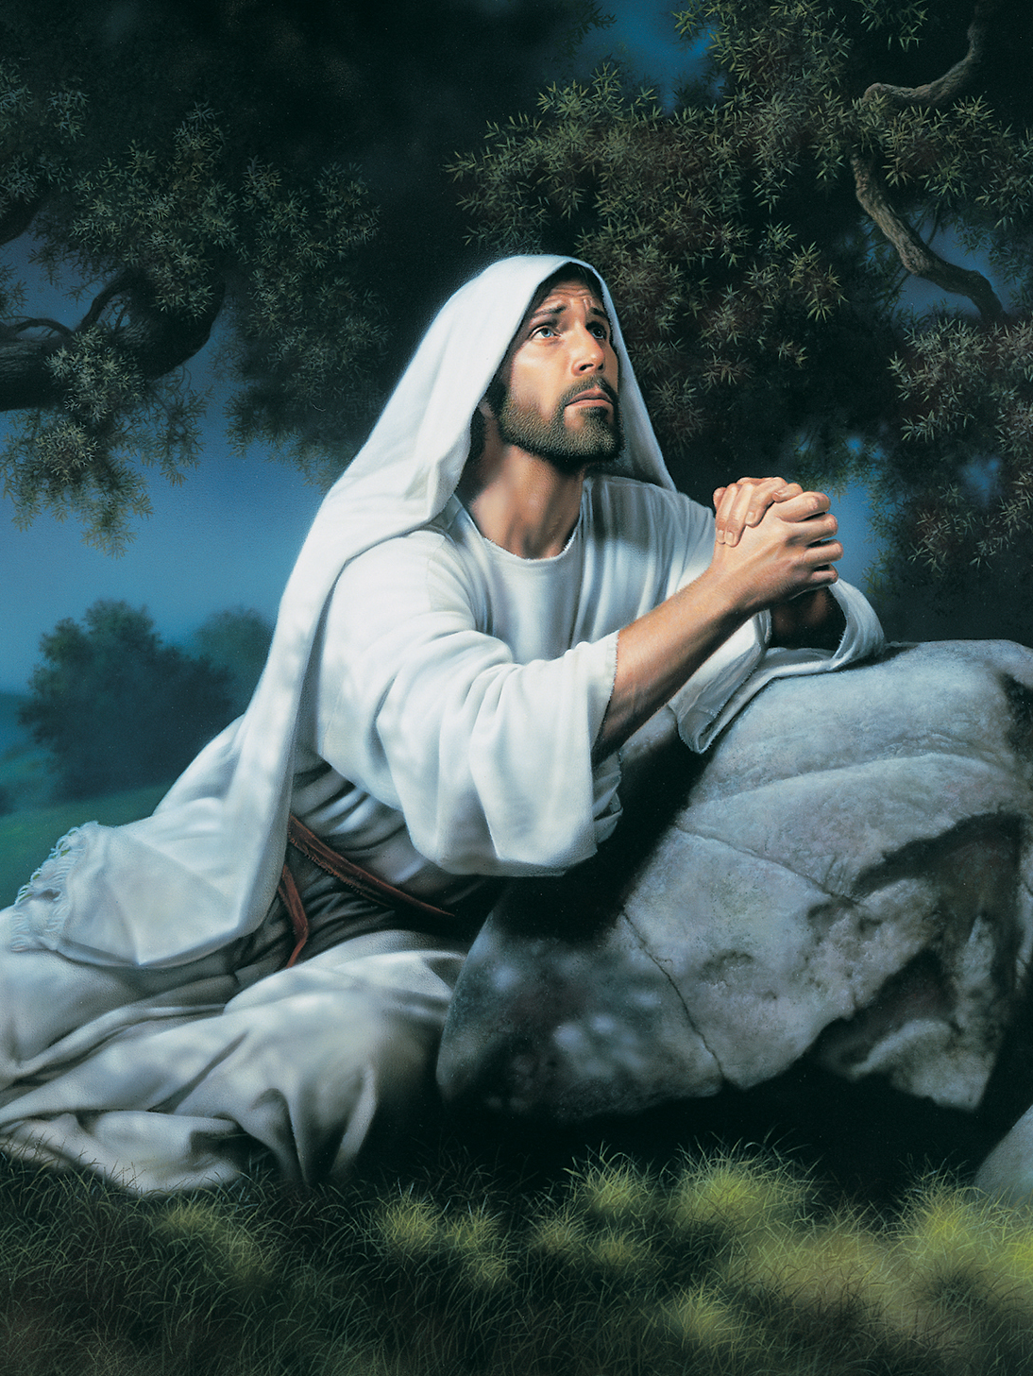
The Atonement of Jesus Christ
Read 2 Nephi 7:5–7, looking for words and phrases that describe what the Savior experienced as part of His Atonement. The phrase “Lord God” in these verses refers to God the Father, and the words “mine,” “I,” “my,” and “me” refer to Jesus Christ.

Slide 34
The Atonement of Jesus Christ
Read 2 Nephi 7:5–7, looking for words and phrases that describe what the Savior experienced as part of His Atonement. The phrase “Lord God” in these verses refers to God the Father, and the words “mine,” “I,” “my,” and “me” refer to Jesus Christ.
What do you think it means in verse 7 that the Savior “set [His] face like a flint”?

Slide 35
Enduring All Things
In 2 Nephi 7:7, a flint is a very hard stone. When the Savior said that He had “set [His] face like a flint,” it refers to the Savior’s firm and unbendable resolve to endure all of the suffering associated with the Atonement.

Slide 36
Enduring All Things
In 2 Nephi 7:7, a flint is a very hard stone. When the Savior said that He had “set [His] face like a flint,” it refers to the Savior’s firm and unbendable resolve to endure all of the suffering associated with the Atonement.
What does the Savior’s willingness to endure the suffering involved with the Atonement indicate about His commitment to us?

Slide 37
His Desire to Redeem Us
Read 2 Nephi 8:1–16 and look for phrases that show the Lord’s desire to redeem us and His power to do so. Consider marking these phrases in your scriptures.

