Slide 1
2 Nephi 11; 16
Lesson 31

Slide 2
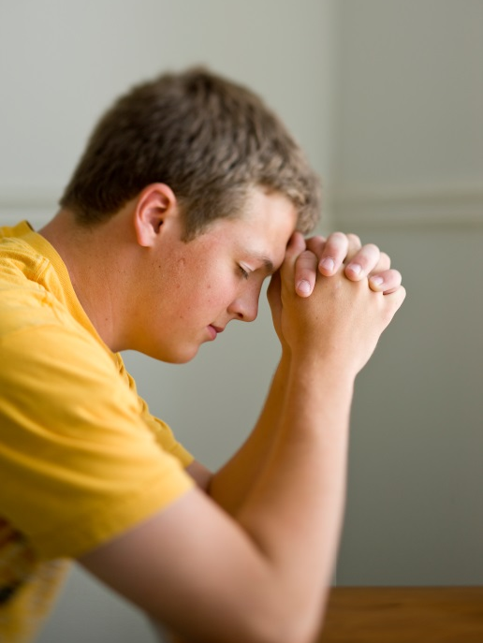
Devotional
Hymn:
Prayer:
Thought:
Notes:
738194

Slide 3
What Happened?
What happened the last time our class met?

Slide 4
What Happened?
What happened the last time our class met?
Is this a complete representation of what happened in our last class?

Slide 5
What Happened?
What happened the last time our class met?
Is this a complete representation of what happened in our last class?
What advantages are there to having multiple witnesses?

Slide 6
Three Prophets
Read 2 Nephi 11:2–3, looking for three different prophets and what each experienced.

Slide 7
Three Prophets
Read 2 Nephi 11:2–3, looking for three different prophets and what each experienced.
According to these verses, what did Nephi, Isaiah, and Jacob experience that enabled them to be special witnesses of Jesus Christ?

Slide 8
The Words of Isaiah
According to 2 Nephi 11:3, why was Nephi going to send the words of Isaiah and Jacob to his children?

Slide 9
The Words of Isaiah
According to 2 Nephi 11:3, why was Nephi going to send the words of Isaiah and Jacob to his children?
What principle can we learn from verses 2–3 concerning how we can strengthen our faith in Jesus Christ?

Slide 10
The Words of Isaiah
According to 2 Nephi 11:3, why was Nephi going to send the words of Isaiah and Jacob to his children?
What principle can we learn from verses 2–3 concerning how we can strengthen our faith in Jesus Christ?
By studying prophets’ testimonies of Jesus Christ, we can strengthen our faith in Jesus Christ.

Slide 11
Prophets’ Testimonies
In addition to the Book of Mormon, where can we find the prophets’ testimonies?

Slide 12
Prophets’ Testimonies
In addition to the Book of Mormon, where can we find the prophets’ testimonies?
How have prophets’ testimonies strengthened your faith in Jesus Christ?

Slide 13
Prophets’ Testimonies
In addition to the Book of Mormon, where can we find the prophets’ testimonies?
How have prophets’ testimonies strengthened your faith in Jesus Christ?
Read 2 Nephi 11:4–6, looking for a phrase Nephi repeated in each verse.

Slide 14
Prophets’ Testimonies
In addition to the Book of Mormon, where can we find the prophets’ testimonies?
How have prophets’ testimonies strengthened your faith in Jesus Christ?
Read 2 Nephi 11:4–6, looking for a phrase Nephi repeated in each verse.
What does it mean to “delight in” something?

Slide 15
Delight
The word delight suggests a feeling that is deeper than just liking or being interested in something. It implies an experience of joy and satisfaction.

Slide 16
Delight
The word delight suggests a feeling that is deeper than just liking or being interested in something. It implies an experience of joy and satisfaction.
Read 2 Nephi 11:4–7, looking for things that delighted Nephi.

Slide 17
Delight
The word delight suggests a feeling that is deeper than just liking or being interested in something. It implies an experience of joy and satisfaction.
Read 2 Nephi 11:4–7, looking for things that delighted Nephi.
What phrases most impress you? Why?

Slide 18
The Words of Isaiah
In 2 Nephi 11:2, we read that Nephi said he delighted in the words of Isaiah. Some people struggle to understand the prophecies of Isaiah because of his poetic writing style and frequent use of imagery. Although Nephi understood this would be the case, he still included many of Isaiah’s words in the Book of Mormon.

Slide 19
The Writings of Isaiah
Read 2 Nephi 11:8, looking for why Nephi delighted in the writings of Isaiah and included them in his record.

Slide 20
The Writings of Isaiah
Read 2 Nephi 11:8, looking for why Nephi delighted in the writings of Isaiah and included them in his record.
What did Nephi hope his people and future readers of the Book of Mormon would experience when they read the words of Isaiah?

Slide 21
The Writings of Isaiah
Read 2 Nephi 11:8, looking for why Nephi delighted in the writings of Isaiah and included them in his record.
What did Nephi hope his people and future readers of the Book of Mormon would experience when they read the words of Isaiah?
Studying the words of Isaiah can help us lift up our hearts and rejoice.

Slide 22
Before and After
What are “before” and “after” photographs effective at doing?

Slide 23
Before and After
What are “before” and “after” photographs effective at doing?
Think about the before and after effects of each of the following: window cleaner, yeast, fire.

Slide 24
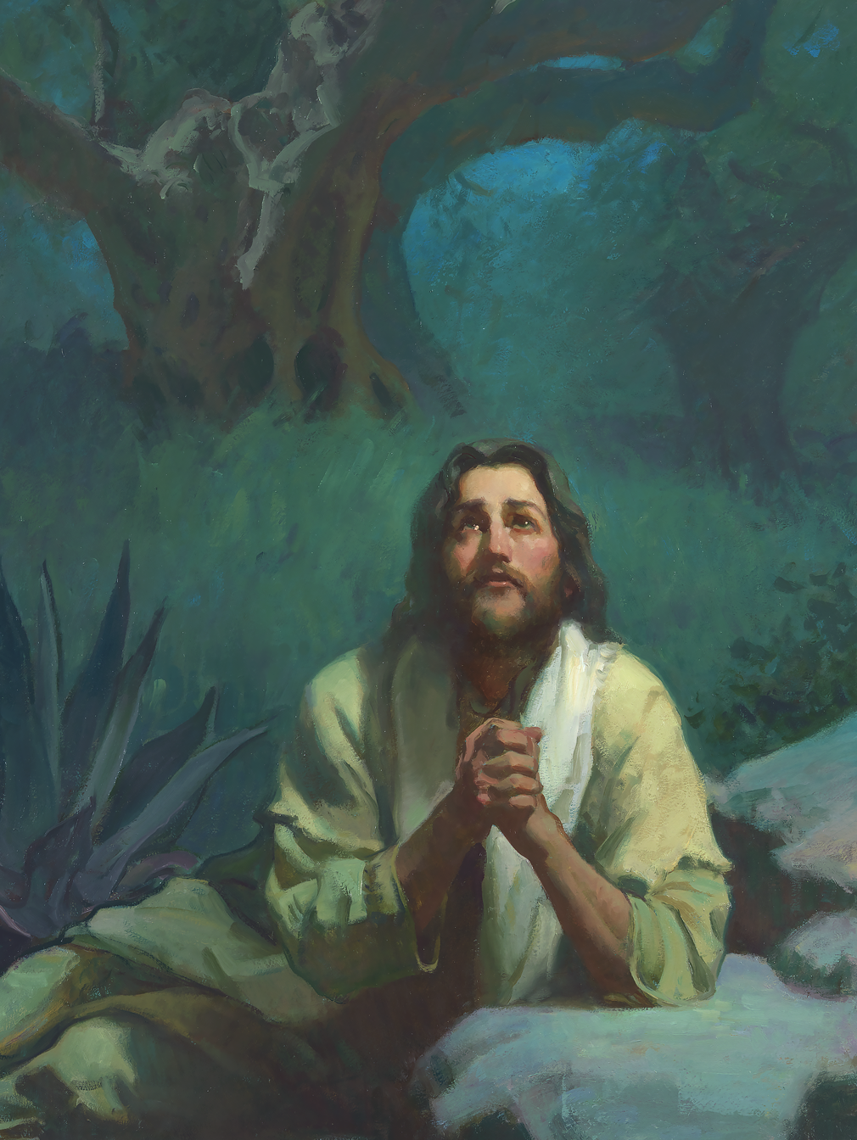
The Effect of the Savior
What kind of before-and-after effect do you think the Savior could have on a person?

Slide 25
The Effect of the Savior
What kind of before-and-after effect do you think the Savior could have on a person?
In 2 Nephi 16, we learn of Isaiah’s call to be a prophet and a special witness of Jesus Christ. Isaiah’s writings include symbolic language. The use of symbols and types is one way the scriptures teach us of the Lord’s saving mission.

Slide 26
Isaiah’s Vision
Read 2 Nephi 16:1–4 and look for what Isaiah saw in this vision. The word train (verse 1) refers to the hem of a robe.

Slide 27
Isaiah’s Vision
Read 2 Nephi 16:1–4 and look for what Isaiah saw in this vision. The word train (verse 1) refers to the hem of a robe.
What else did Isaiah see in this vision?

Slide 28
Isaiah’s Vision
Read 2 Nephi 16:1–4 and look for what Isaiah saw in this vision. The word train (verse 1) refers to the hem of a robe.
What else did Isaiah see in this vision?
Seraphim are angelic beings that minister in the courts of God (see Bible Dictionary, “Seraphim”). The wings of the seraphim are symbolic of their power to move or to act (see D&C 77:4).

Slide 29
In His Presence
Read 2 Nephi 16:5 and look for how Isaiah felt in the presence of the Lord.

Slide 30
In His Presence
Read 2 Nephi 16:5 and look for how Isaiah felt in the presence of the Lord.
The phrase “Wo is unto me! for I am undone” indicates Isaiah felt unworthy to be in the Lord’s presence. The phrase “unclean lips” indicates he was aware of his sins and the sins of his people.

Slide 31
In His Presence
Read 2 Nephi 16:5 and look for how Isaiah felt in the presence of the Lord.
The phrase “Wo is unto me! for I am undone” indicates Isaiah felt unworthy to be in the Lord’s presence. The phrase “unclean lips” indicates he was aware of his sins and the sins of his people.
How might you feel if you had experienced what Isaiah did?

Slide 32
A Symbol of Cleansing
Read 2 Nephi 16:6–7, looking for what happened to Isaiah in his vision. The hot coal taken from the altar was a symbol of cleansing (see Isaiah 6:6, footnote a).

Slide 33
A Symbol of Cleansing
Read 2 Nephi 16:6–7, looking for what happened to Isaiah in his vision. The hot coal taken from the altar was a symbol of cleansing (see Isaiah 6:6, footnote a).
According to verse 7, what did the seraphim say had happened to Isaiah’s sins?

Slide 34
A Symbol of Cleansing
Read 2 Nephi 16:6–7, looking for what happened to Isaiah in his vision. The hot coal taken from the altar was a symbol of cleansing (see Isaiah 6:6, footnote a).
According to verse 7, what did the seraphim say had happened to Isaiah’s sins?
When the angel in Isaiah’s vision touched his lips with the hot coal, it represented the Lord cleansing Isaiah of his unworthiness and forgiving him of his sins.

Slide 35
Pronounced Clean
What feelings might you have if a messenger from the Lord pronounced you clean from your sins? Why might you have those feelings?

Slide 36
Pronounced Clean
What feelings might you have if a messenger from the Lord pronounced you clean from your sins? Why might you have those feelings?
Read 2 Nephi 16:8, looking for what the Lord asked and how Isaiah responded.

Slide 37
Pronounced Clean
What feelings might you have if a messenger from the Lord pronounced you clean from your sins? Why might you have those feelings?
Read 2 Nephi 16:8, looking for what the Lord asked and how Isaiah responded.
How might the knowledge that he was clean from sin affect Isaiah’s willingness to serve the Lord?

Slide 38
Pronounced Clean
What feelings might you have if a messenger from the Lord pronounced you clean from your sins? Why might you have those feelings?
Read 2 Nephi 16:8, looking for what the Lord asked and how Isaiah responded.
How might the knowledge that he was clean from sin affect Isaiah’s willingness to serve the Lord?
From what you learned about Isaiah in this account, how can being cleansed from our sins affect our desire to serve the Lord?

Slide 39
More Willing
As we are forgiven of our sins, we become more willing to do what God asks of us.

Slide 40
More Willing
As we are forgiven of our sins, we become more willing to do what God asks of us.
Why do you think that our willingness to do what God asks of us increases as we are forgiven of our sins?

Slide 41
Evaluate Your Willingness
On a scale of 1–10, where would you rate your willingness to do what God asks if 1 is not willing at all and 10 is very willing?

Slide 42
Evaluate Your Willingness
On a scale of 1–10, where would you rate your willingness to do what God asks if 1 is not willing at all and 10 is very willing?
Are there sins in your life that might be holding you back from being more willing to do what God asks of you?

Slide 43
The Atonement of Jesus Christ
As you are forgiven of our sins, you will have a greater desire to serve the Lord and to help others draw closer to Him and become clean as well. Pray to Heavenly Father, and if necessary talk with parents or priesthood leaders, so that you can repent and have your sins purged through the Atonement of Jesus Christ.

Slide 44
Isaiah’s Message
Read 2 Nephi 16:9–10. What did the Lord tell Isaiah about how the people would respond to his message?

Slide 45
Doctrinal Mastery: The Godhead
How could the following misunderstanding make it difficult for someone to exercise faith in God? God doesn’t really know me or care about what I’m going through.

Slide 46
Doctrinal Mastery: The Godhead
How could the following misunderstanding make it difficult for someone to exercise faith in God? God doesn’t really know me or care about what I’m going through.
On the following slides, read paragraphs from doctrinal topic 1, “The Godhead,” from the Doctrinal Mastery Core Document. Look for truths about the character and attributes of the members of the Godhead that can help correct or clarify the italicized statement above.

Slide 47
Doctrinal Mastery: The Godhead
There are three separate personages in the Godhead: God, the Eternal Father; His Son, Jesus Christ; and the Holy Ghost. The Father and the Son have tangible, glorified bodies of flesh and bone, and the Holy Ghost is a personage of spirit (see D&C 130:22–23). They are one in purpose and are perfectly united in bringing to pass Heavenly Father’s plan of salvation.

Slide 48
Doctrinal Mastery: The Godhead
God the Father is the Supreme Being whom we worship. He is the Father of our spirits (see Hebrews 12:9). He is perfect, has all power, and knows all things. He is also just, merciful, and kind. God loves each of His children perfectly, and all are alike unto Him (see 2 Nephi 26:33). His work and glory is to bring about the immortality and eternal life of man.

Slide 49
Doctrinal Mastery: The Godhead
Jesus Christ is the Firstborn of the Father in the spirit and is the Only Begotten of the Father in the flesh. Under the Father’s direction, Jesus Christ created the heavens and the earth. He is Jehovah of the Old Testament and the Messiah of the New Testament.

Slide 50
Doctrinal Mastery: The Godhead
Jesus Christ does the will of the Father in all things. He lived a sinless life and atoned for the sins of all mankind (see 3 Nephi 11:10–11). His life is the perfect example of how we are to live (see 3 Nephi 12:48). He was the first of Heavenly Father’s children to be resurrected. In our day, as in ancient times, He stands at the head of His Church. He will come again in power and glory and will reign on the earth during the Millennium (see D&C 29:10–11). He will judge all mankind.

Slide 51
Doctrinal Mastery: The Godhead
Because Jesus Christ is our Savior and our Mediator with the Father, all prayers, blessings, and priesthood ordinances should be done in His name (see 3 Nephi 18:15, 20–21).

Slide 52
Doctrinal Mastery: The Godhead
The Holy Ghost is the third member of the Godhead. He is a personage of spirit and does not have a body of flesh and bone. He is often referred to as the Spirit, the Holy Spirit, the Spirit of God, the Spirit of the Lord, and the Comforter.

Slide 53
Doctrinal Mastery: The Godhead
The Holy Ghost bears witness of the Father and the Son, reveals the truth of all things, and sanctifies those who repent and are baptized. Through the power of the Holy Ghost, we can receive spiritual gifts, which are blessings or abilities given by the Lord for our own benefit and to help us serve and bless others.

