Slide 1
2 Nephi 21–24
Lesson 34

Slide 2
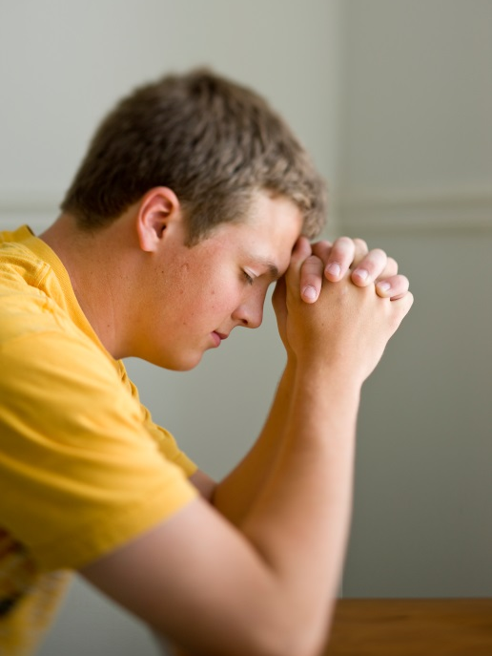
Devotional
Hymn:
Prayer:
Thought:
Notes:
738194

Slide 3
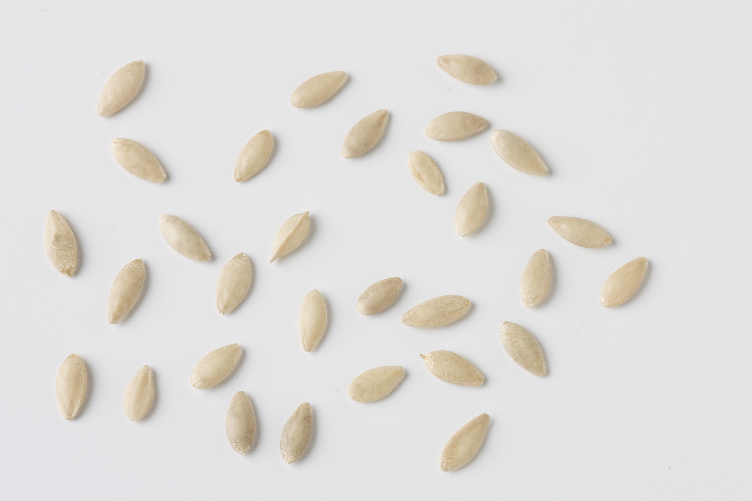
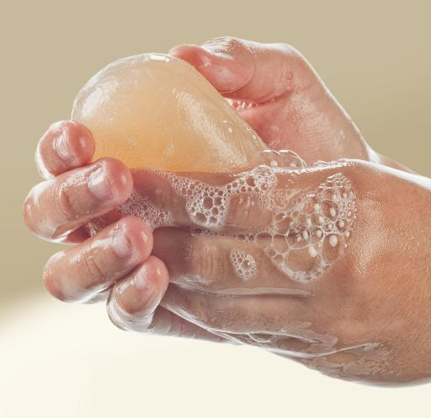
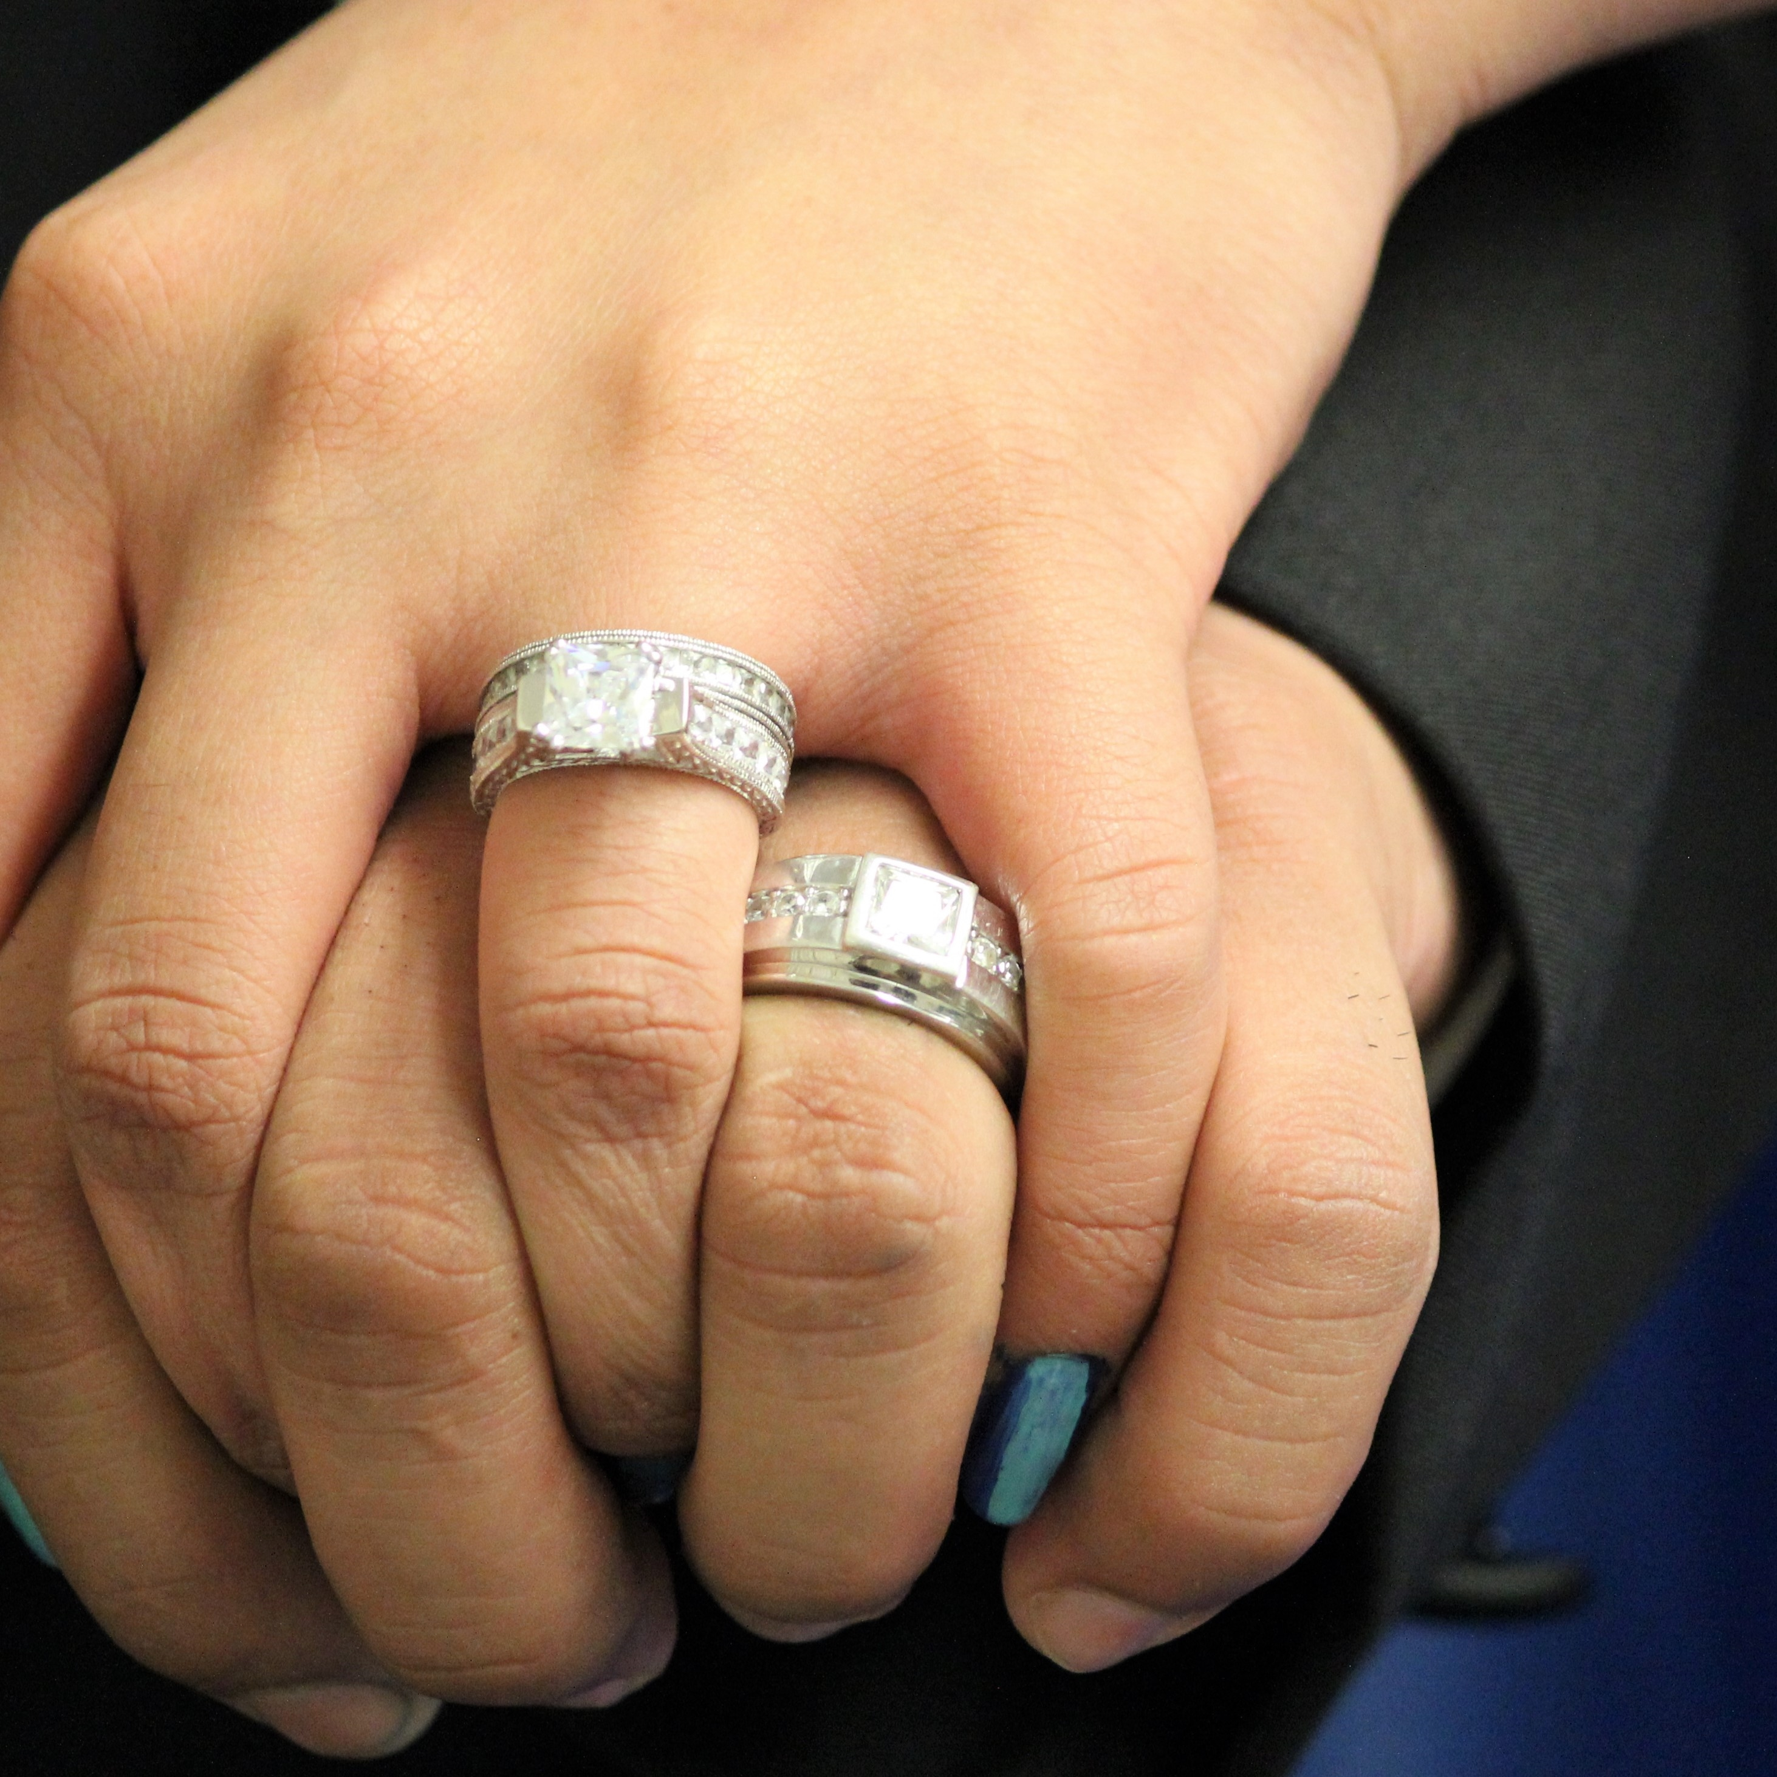
Symbols
What principle of the gospel of Jesus Christ might by symbolized by the seed? the soap? the wedding ring?

Slide 4
Symbols
What principle of the gospel of Jesus Christ might by symbolized by the seed? the soap? the wedding ring?
The seed can symbolize faith in Jesus Christ, the soap can symbolize repentance, and the wedding ring can symbolize celestial marriage.

Slide 5
Symbols
What principle of the gospel of Jesus Christ might by symbolized by the seed? the soap? the wedding ring?
The seed can symbolize faith in Jesus Christ, the soap can symbolize repentance, and the wedding ring can symbolize celestial marriage.
Why do the Lord and His prophets sometimes use symbols in their teaching?

Slide 6
Symbols
In 2 Nephi 21, Nephi continued to record the words of Isaiah, who used several symbols as he prophesied of important events that would occur in the latter days, including the Restoration of the gospel, the gathering of Israel, and the destruction of the wicked at the Second Coming.

Slide 7
Symbols
In 2 Nephi 21, Nephi continued to record the words of Isaiah, who used several symbols as he prophesied of important events that would occur in the latter days, including the Restoration of the gospel, the gathering of Israel, and the destruction of the wicked at the Second Coming.
Read 2 Nephi 21:1, looking for what symbols Isaiah spoke of.

Slide 8
A Tree Stump
What did Isaiah call the tree stump?

Slide 9
A Tree Stump
What did Isaiah call the tree stump?
What did he call the sprout growing from the stem?

Slide 10
A Tree Stump
What did Isaiah call the tree stump?
What did he call the sprout growing from the stem?
Read the chapter heading of 2 Nephi 21. Who is the “stem of Jesse”?

Slide 11
A Tree Stump
What did Isaiah call the tree stump?
What did he call the sprout growing from the stem?
Read the chapter heading of 2 Nephi 21. Who is the “stem of Jesse”?
In 2 Nephi 21:2–9, Isaiah described some of the Savior’s characteristics and testified that His judgments are righteous. Isaiah also prophesied of conditions during the Millennium—the thousand-year period of peace following the Savior’s Second Coming.

Slide 12
The Root of Jesse
Read 2 Nephi 21:10, looking for how Isaiah described the root of the stem. The phrase “root of Jesse” as used in this verse refers to a descendant of Jesse. (Jesse was the father of King David.) While we sometimes use roots to symbolize ancestors, in the Old Testament the English word root is used in reference to ancestors and descendants.

Slide 13
The Rod and the Root of Jesse
Read Doctrine and Covenants 113:1–6, looking for the meanings of the rod and the root of Jesse.

Slide 14
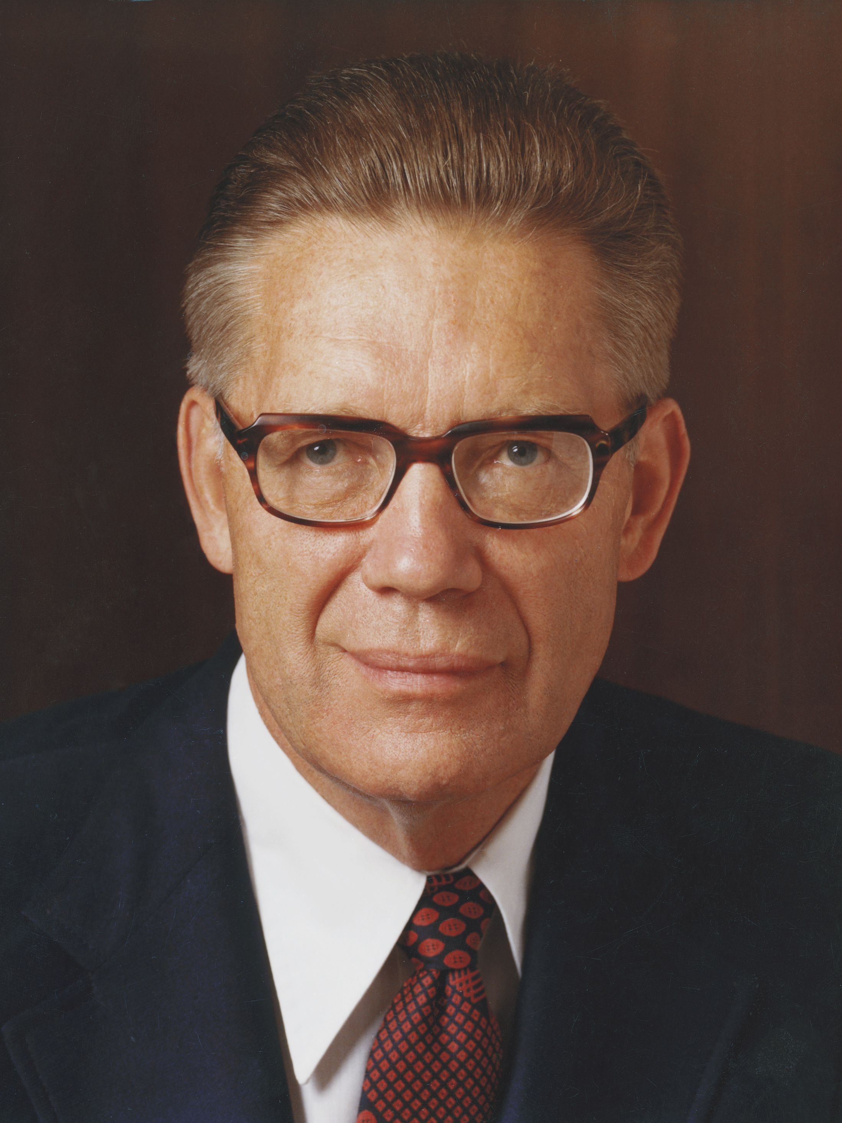
Elder Bruce R. McConkie
“Are we amiss in saying that the prophet here mentioned is Joseph Smith, to whom the priesthood came, who received the keys of the kingdom, and who raised the ensign for the gathering of the Lord’s people in our dispensation? And is he not also the ‘servant in the hands of Christ, who is partly a descendant of Jesse as well as of Ephraim, or of the house of Joseph, on whom there is laid much power’?” (Bruce R. McConkie, The Millennial Messiah: The Second Coming of the Son of Man [1982], 339–40).

Slide 15
The Rod and the Root of Jesse
Whom do the rod and root of Jesse represent?

Slide 16
The Rod and the Root of Jesse
Whom do the rod and root of Jesse represent?
Read 2 Nephi 21:11–12, looking for what Isaiah prophesied the Lord would do in the last days.

Slide 17
The Rod and the Root of Jesse
Whom do the rod and root of Jesse represent?
Read 2 Nephi 21:11–12, looking for what Isaiah prophesied the Lord would do in the last days.
The word ensign refers to a standard, flag, or banner that is used as a rallying point or as a signal to assemble. The phrase “set his hand again the second time to recover the remnant of his people” in verse 11 refers to the Restoration of the Church and the latter-day gathering of Israel.

Slide 18
The Restored Church
In the last days, the Lord has restored His Church through the Prophet Joseph Smith and is gathering His people.

Slide 19
The Restored Church
In the last days, the Lord has restored His Church through the Prophet Joseph Smith and is gathering His people.
How have you come to know that the Lord restored His Church through the Prophet Joseph Smith?

Slide 20
The Restored Church
In the last days, the Lord has restored His Church through the Prophet Joseph Smith and is gathering His people.
How have you come to know that the Lord restored His Church through the Prophet Joseph Smith?
How is the Lord gathering His people today?

Slide 21
The Restored Church
In the last days, the Lord has restored His Church through the Prophet Joseph Smith and is gathering His people.
How have you come to know that the Lord restored His Church through the Prophet Joseph Smith?
How is the Lord gathering His people today?
What can we do to help the Lord gather His people?

Slide 22
What Do You Fear?
What are some things or circumstances that teenagers fear?

Slide 23
Jesus Christ
Read 2 Nephi 22:1–6, looking for what the people will say about the Lord Jehovah, or Jesus Christ.

Slide 24
Jesus Christ
Read 2 Nephi 22:1–6, looking for what the people will say about the Lord Jehovah, or Jesus Christ.
Based on what people will say about Jesus Christ as recorded in 2 Nephi 22:1–6, what truths can we learn about Him?

Slide 25
Jesus Christ
Read 2 Nephi 22:1–6, looking for what the people will say about the Lord Jehovah, or Jesus Christ.
Based on what people will say about Jesus Christ as recorded in 2 Nephi 22:1–6, what truths can we learn about Him?
Jesus Christ is our source of strength and salvation. If we trust Jesus Christ, we will not be afraid.

Slide 26
Our Source of Strength and Salvation
How can Jesus Christ be a source of strength for a teenager?

Slide 27
Our Source of Strength and Salvation
How can Jesus Christ be a source of strength for a teenager?
Why is it important to understand that Jesus Christ is the source of our salvation?

Slide 28
Our Source of Strength and Salvation
How can Jesus Christ be a source of strength for a teenager?
Why is it important to understand that Jesus Christ is the source of our salvation?
What are some ways we can show our trust in Jesus Christ?

Slide 29
Our Source of Strength and Salvation
How can Jesus Christ be a source of strength for a teenager?
Why is it important to understand that Jesus Christ is the source of our salvation?
What are some ways we can show our trust in Jesus Christ?
How can trusting in Jesus Christ help us overcome fear?

Slide 30
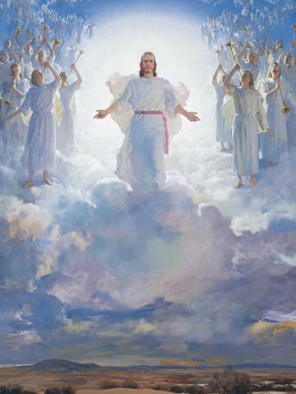
The Second Coming
In 2 Nephi 23, Isaiah refers to Babylon, an ancient city that is often used in the scriptures to symbolize the wickedness of the world, to describe what will happen to the wicked at the Savior’s Second Coming. In 2 Nephi 24, Isaiah describes what the Second Coming will be like for the righteous.

Slide 31
The Last Days
Read 2 Nephi 23:1, 5–9, 11, 15, 19, 22, looking for the consequences the wicked will experience in the last days.

Slide 32
The Last Days
Read 2 Nephi 23:1, 5–9, 11, 15, 19, 22, looking for the consequences the wicked will experience in the last days.
Read 2 Nephi 24:1–7, 24–27, looking for the Lord’s promises to His people.

Slide 33
The Last Days
Read 2 Nephi 23:1, 5–9, 11, 15, 19, 22, looking for the consequences the wicked will experience in the last days.
Read 2 Nephi 24:1–7, 24–27, looking for the Lord’s promises to His people.
According to 2 Nephi 23:22, what truth can we learn about what will happen to the Lord’s people and to the wicked when He comes again?

Slide 34
The Lord’s People
The Lord will be merciful to His people, but the wicked will perish.

Slide 35
The Lord’s People
The Lord will be merciful to His people, but the wicked will perish.
What do you think it means to be among the Lord’s people?

Slide 36
The Wicked Will Perish
Isaiah referred to the fall of Lucifer, or Satan, as another illustration of how the wicked will perish. Read 2 Nephi 24:12–16, looking for phrases in these verses that show Satan’s arrogance.

Slide 37
The Wicked Will Perish
Isaiah referred to the fall of Lucifer, or Satan, as another illustration of how the wicked will perish. Read 2 Nephi 24:12–16, looking for phrases in these verses that show Satan’s arrogance.
What do these verses teach about the consequences that will come upon the wicked?

Slide 38
Isaiah’s Prophecies
Isaiah’s prophecies in 2 Nephi 21–24 reflect one of the main messages of the Book of Mormon—that the obedient will prosper and the disobedient will perish. Think about the blessings that come from being part of the Lord’s people—those who are obedient to Him.

Slide 39
Doctrinal Mastery: The Godhead
Read 2 Nephi 26:33. This doctrinal mastery scripture passage supports this truth: God loves each of His children perfectly, and all are alike unto Him.

Slide 40
Doctrinal Mastery: The Godhead
Read 2 Nephi 26:33. This doctrinal mastery scripture passage supports this truth: God loves each of His children perfectly, and all are alike unto Him.
What does it mean that “all are alike unto God”?

Slide 41
Doctrinal Mastery: The Godhead
Read 2 Nephi 26:33. This doctrinal mastery scripture passage supports this truth: God loves each of His children perfectly, and all are alike unto Him.
What does it mean that “all are alike unto God”?
Share an experience you have had that helps you know that God loves each of His children perfectly and that all are alike in His eyes.

Slide 42
Doctrinal Mastery: The Godhead
Read 2 Nephi 26:33. This doctrinal mastery scripture passage supports this truth: God loves each of His children perfectly, and all are alike unto Him.
What does it mean that “all are alike unto God”?
Share an experience you have had that helps you know that God loves each of His children perfectly and that all are alike in His eyes.
How can understanding that God loves each of His children perfectly, and all are alike unto Him influence the way we view and treat other people?

Slide 43
Race and the Church
“The Church unequivocally condemns racism, including any and all past racism by individuals both inside and outside the Church.
Continued on the next slide.

Slide 44
Race and the Church
“In 2006, then Church president Gordon B. Hinckley declared that ‘no man who makes disparaging remarks concerning those of another race can consider himself a true disciple of Christ. Nor can he consider himself to be in harmony with the teachings of the Church. Let us all recognize that each of us is a son or daughter of our Father in Heaven, who loves all of His children’” (“Race and the Church: All Are Alike unto God,” Feb. 29, 2012, mormonnewsroom.org).

