Slide 1
2 Nephi 26
Lesson 36

Slide 2

Devotional
Hymn:
Prayer:
Thought:

Slide 3
Understanding God
Why do you think God might allow a whole group of people to be destroyed?

Slide 4
Understanding God
Why do you think God might allow a whole group of people to be destroyed?
As you study 2 Nephi 26 today, look for truths that can help us understand why God would allow certain groups of people to be destroyed.

Slide 5
Nephi’s Descendants
Read 2 Nephi 26:3, 5–6, looking for what Nephi foresaw would happen to some of his descendants at the time of the Savior’s death and Resurrection and why.

Slide 6
Nephi’s Descendants
Read 2 Nephi 26:3, 5–6, looking for what Nephi foresaw would happen to some of his descendants at the time of the Savior’s death and Resurrection and why.
Read 2 Nephi 26:9–11, looking for what Nephi foresaw would happen to some of his descendants among the fourth generation after the Savior appeared to them and why.

Slide 7
Nephi’s Descendants
The phrase “the Spirit ceaseth to strive with man” in 2 Nephi 26:11 means that the Spirit of the Lord withdraws from individuals because of their unrighteousness.

Slide 8
Nephi’s Descendants
The phrase “the Spirit ceaseth to strive with man” in 2 Nephi 26:11 means that the Spirit of the Lord withdraws from individuals because of their unrighteousness.
What principles can we learn from 2 Nephi 26:3, 5–6, 9–11 about what can lead people to perish or be destroyed?

Slide 9
Two Principles
Those who reject the prophets and persecute the Savior’s followers will perish. Those who are prideful and choose works of darkness rather than light will lose the Spirit and be destroyed.

Slide 10
Two Principles
Those who reject the prophets and persecute the Savior’s followers will perish. Those who are prideful and choose works of darkness rather than light will lose the Spirit and be destroyed.
Why do you think “speedy destruction” (2 Nephi 26:10, 11) follows when the Spirit ceases “to strive with man” (2 Nephi 26:11)?

Slide 11
How Would You Feel?
What thoughts or feelings might you have had if you had been in Nephi’s situation and had foreseen the destruction of many of your descendants?

Slide 12
How Would You Feel?
What thoughts or feelings might you have had if you had been in Nephi’s situation and had foreseen the destruction of many of your descendants?
Read 2 Nephi 26:7 and look for Nephi’s reaction to the vision of the people’s destruction.

Slide 13
How Would You Feel?
What thoughts or feelings might you have had if you had been in Nephi’s situation and had foreseen the destruction of many of your descendants?
Read 2 Nephi 26:7 and look for Nephi’s reaction to the vision of the people’s destruction.
What does the statement “Thy ways are just” mean to you?

Slide 14
The Justice of God
Someone who is just will always treat people fairly. The justice of God requires that the wicked be punished for their actions and that the righteous be rewarded for their actions.

Slide 15
The Justice of God
Someone who is just will always treat people fairly. The justice of God requires that the wicked be punished for their actions and that the righteous be rewarded for their actions.
Read 2 Nephi 26:8–9, 13, looking for blessings that Nephi said would come to his righteous descendants.

Slide 16
The Book of Mormon
In 2 Nephi 26:14–19, Nephi prophesied that the Book of Mormon would come forth in the last days during a time when many people would be prideful and unbelieving.

Slide 17
The Book of Mormon
In 2 Nephi 26:14–19, Nephi prophesied that the Book of Mormon would come forth in the last days during a time when many people would be prideful and unbelieving.
Read 2 Nephi 26:20–21, looking for obstacles people may stumble over in the last days.

Slide 18
Flaxen Cord
Read 2 Nephi 26:22, looking for another way that the devil seeks to impede our efforts to follow God. The phrase “flaxen cord” refers to flax, which is the material used to make linen.

Slide 19
Flaxen Cord
Read 2 Nephi 26:22, looking for another way that the devil seeks to impede our efforts to follow God. The phrase “flaxen cord” refers to flax, which is the material used to make linen.
What is significant about the phrase “until he bindeth them” in 2 Nephi 26:22? What does this verse teach you about how Satan works?

Slide 20

The Bondage of Sin
The devil subtly leads people into the bondage of sin.

Slide 21
The Bondage of Sin
The devil subtly leads people into the bondage of sin.
To help you understand this truth, imagine having your wrists bound together loosely with a single strand of thread. This represents committing a sin, such as being unkind to a family member. A single strand of thread can easily be broken.

Slide 22
Unable to Break the Thread
Continue to imagine your wrists being wrapped by the thread several times, each time representing another sin that could be committed or examples of unkind acts toward family members. There will come a time that you will not be able to break the thread.

Slide 23
Unable to Break the Thread
Continue to imagine your wrists being wrapped by the thread several times, each time representing another sin that could be committed or examples of unkind acts toward family members. There will come a time that you will not be able to break the thread.
How have you seen Satan leading people with “flaxen cord[s]”?

Slide 24
Unable to Break the Thread
Continue to imagine your wrists being wrapped by the thread several times, each time representing another sin that could be committed or examples of unkind acts toward family members. There will come a time that you will not be able to break the thread.
How have you seen Satan leading people with “flaxen cord[s]”?
Which of these sins (flaxen cords) do you think are most dangerous for people your age?

Slide 25
Strong Cords
Why do you think some people do not remove Satan’s flaxen cords before they become “strong cords”?

Slide 26
Strong Cords
When people are bound by the devil’s “strong cords” in this life, they still have their agency. However, their desire and ability to withstand and overcome temptation have been weakened. Nevertheless, the Savior can still help them to become free from the bondage of sin if they will exercise faith in Him and repent.

Slide 27
The Lord’s Ways
Read 2 Nephi 26:23–24, looking for how the Lord’s ways differ from the devil’s ways.

Slide 28
The Lord’s Ways
Read 2 Nephi 26:23–24, looking for how the Lord’s ways differ from the devil’s ways.
What is the purpose of everything the Lord does?

Slide 29
The Lord’s Ways
Read 2 Nephi 26:23–24, looking for how the Lord’s ways differ from the devil’s ways.
What is the purpose of everything the Lord does?
Because the Lord loves all people, everything He does is for their benefit.

Slide 30
The Lord’s Ways
Read 2 Nephi 26:23–24, looking for how the Lord’s ways differ from the devil’s ways.
What is the purpose of everything the Lord does?
Because the Lord loves all people, everything He does is for their benefit.
What evidence of the Lord’s love for and effort to benefit His children did Nephi refer to in verse 24?

Slide 31
Manifestation of God’s Love
How is allowing His children to experience the consequences of their choices a manifestation of God’s love for both the wicked and the righteous?

Slide 32
The Destruction of the Nephites
The Nephites who were destroyed a few generations after the Savior’s visit were in a deep state of wickedness and corruption. The destruction of these people prevented them from committing additional acts of wickedness, and, like those destroyed in the Flood during the time of Noah, the wicked Nephites were brought into the spirit world where they could eventually be taught the gospel of Jesus Christ and have opportunities to repent (see 1 Peter 3:18–20; Moses 7:39).

Slide 33
The Lord Loves All People
Why do you think it is important to understand that the Lord loves all people and that everything He does is for their benefit?

Slide 34
The Lord Loves All People
Why do you think it is important to understand that the Lord loves all people and that everything He does is for their benefit?
How can understanding this truth help someone who questions one of the Lord’s teachings, laws, or standards?

Slide 35
About the Lord
Read 2 Nephi 26:25–28, 33. What truth can we learn about the Lord from these verses?

Slide 36
About the Lord
Read 2 Nephi 26:25–28, 33. What truth can we learn about the Lord from these verses?
The Lord invites all people to come unto Him and partake of His salvation.

Slide 37
About the Lord
Read 2 Nephi 26:25–28, 33. What truth can we learn about the Lord from these verses?
The Lord invites all people to come unto Him and partake of His salvation.
2 Nephi 26:33 is a doctrinal mastery passage. Mark this verse in your scriptures in a distinctive way so you can locate it easily.

Slide 38
Come unto Christ
How can it help you to know that the Lord invites all to come unto Him?

Slide 39
Come unto Christ
How can it help you to know that the Lord invites all to come unto Him?
How have you felt the Lord inviting you to come unto Him?

Slide 40
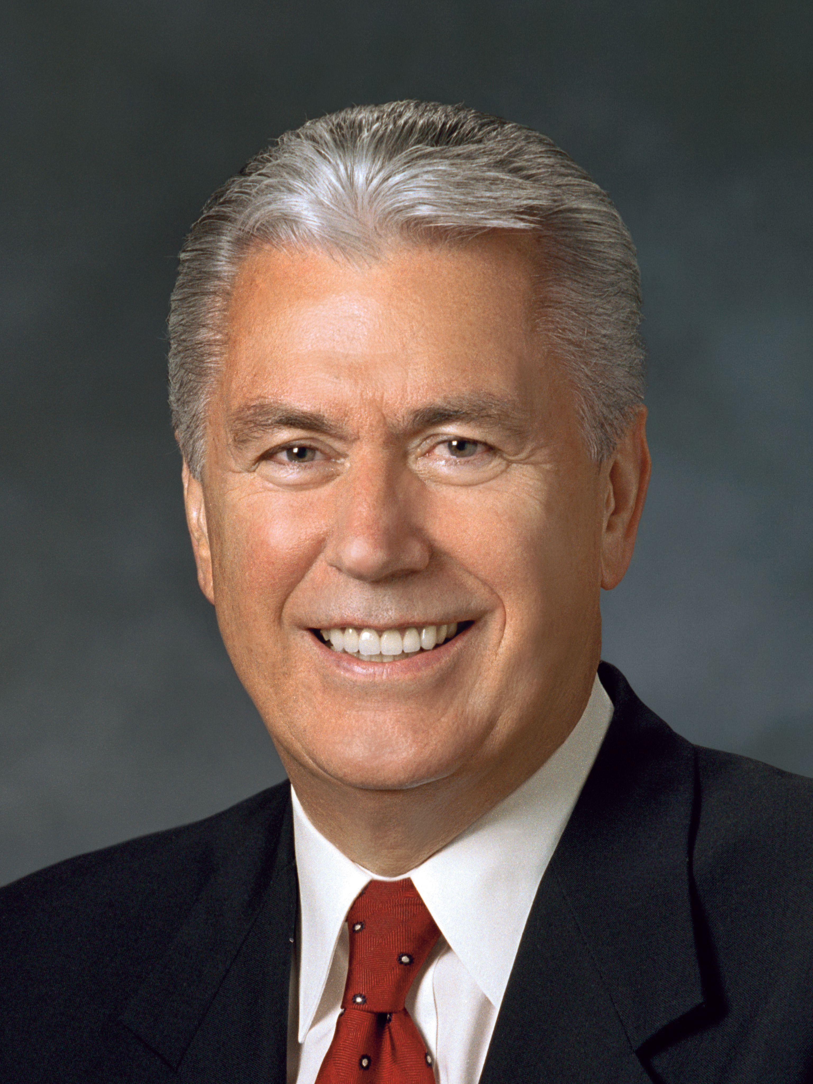
President Dieter F. Uchtdorf
“I hope that we welcome and love all of God’s children, including those who might dress, look, speak, or just do things differently. It is not good to make others feel as though they are deficient. Let us lift those around us. Let us extend a welcoming hand. Let us bestow upon our brothers and sisters in the Church a special measure of humanity, compassion, and charity so that they feel, at long last, they have finally found home. …
Continued on the next page.

Slide 41
President Dieter F. Uchtdorf, cont.
“It seems only right and proper that we extend to others that which we so earnestly desire for ourselves.
“I am not suggesting that we accept sin or overlook evil, in our personal life or in the world. Nevertheless, in our zeal, we sometimes confuse sin with sinner, and we condemn too quickly and with too little compassion. …
Continued on the next page.

Slide 42
President Dieter F. Uchtdorf, cont.
“… Let our hearts and hands be stretched out in compassion toward others, for everyone is walking his or her own difficult path” (Dieter F. Uchtdorf, “You Are My Hands,” Ensign or Liahona, May 2010, 68–69).

Slide 43
Doctrinal Mastery: The Godhead
Jesus Christ does the will of the Father in all things. Jesus Christ lived a sinless life and atoned for the sins of all mankind.

Slide 44
Doctrinal Mastery: The Godhead
Jesus Christ does the will of the Father in all things. Jesus Christ lived a sinless life and atoned for the sins of all mankind.
3 Nephi 11:10–11 is a doctrinal mastery passage that supports these doctrines.

Slide 45
Doctrinal Mastery: The Godhead
Jesus Christ does the will of the Father in all things. Jesus Christ lived a sinless life and atoned for the sins of all mankind.
3 Nephi 11:10–11 is a doctrinal mastery passage that supports these doctrines.
Read Luke 22:39–44 and Moses 4:1–2, looking for examples of how Jesus Christ submitted to the will of the Father in all things.

Slide 46
Doctrinal Mastery: The Godhead
What can we learn from the Savior’s example about how to strengthen our own relationship with Heavenly Father?

