Slide 1
2 Nephi 29–30
Lesson 39

Slide 2

Devotional
Hymn:
Prayer:
Thought:

Slide 3
A Scenario
While assisting the full-time missionaries with their work one evening, you begin a conversation with a married couple in a park. They tell you that they belong to another Christian faith. After discussing some shared beliefs about Jesus Christ, the missionaries tell the couple that there is additional scripture that can help them learn more about the Savior.
Continued on next page.

Slide 4
A Scenario, cont.
When the missionaries try to give the couple a copy of the Book of Mormon, the couple refuses it, saying, “We believe that God has already spoken and that His words are in the Bible. There can’t be any additional scripture, because the Bible contains all of God’s words that are necessary for salvation. Thank you for the offer, but we don’t need your book.”

Slide 5
How Would You Respond?
If you were in this situation, how would you respond to the couple’s comments about the Bible and the Book of Mormon?

Slide 6
How Would You Respond?
If you were in this situation, how would you respond to the couple’s comments about the Bible and the Book of Mormon?
Nephi prophesied that many would respond to the Book of Mormon in this way in our day. As you study 2 Nephi 29 today, look for truths that help us understand why the Lord gives additional scripture.

Slide 7
The Book of Mormon
Read 2 Nephi 29:1–2, looking for what the words of Nephi’s seed (descendants) and the words of the Lord (the words of the Book of Mormon) would do in the last days.

Slide 8
The Standard
According to 2 Nephi 29:1–2, in the last days, the words of the Book of Mormon will “proceed forth” to Nephi’s seed or descendants, and they will also “hiss forth unto the ends of the earth.” To “hiss forth” means to go forth with intensity. The word standard refers to a flag or banner that is used as a rallying point or a signal to assemble.

Slide 9
Additional Scripture
Read 2 Nephi 29:3–6, looking for how some Gentiles would react to additional scripture. In the Book of Mormon, the word Gentiles generally refers to people who are not of Jewish descent or from the area of Jerusalem. The word Jews generally refers to people who came from the area of Jerusalem or from the tribe of Judah.

Slide 10
Additional Scripture
Read 2 Nephi 29:3–6, looking for how some Gentiles would react to additional scripture. In the Book of Mormon, the word Gentiles generally refers to people who are not of Jewish descent or from the area of Jerusalem. The word Jews generally refers to people who came from the area of Jerusalem or from the tribe of Judah.
What did the Lord say about people who react this way?

Slide 11
The Word of the Lord
Read 2 Nephi 29:7–10, looking for truths we can learn about the Lord and His revealed word.

Slide 12
Statements of Truth
As the Creator of all people, the Lord remembers them and brings forth His word unto them (see 2 Nephi 29:7). The testimony of two nations witnesses that the Lord is God and that He speaks the same words to all nations (see 2 Nephi 29:8). The Lord is the same yesterday, today, and forever (see 2 Nephi 29:9). The Lord’s work is not finished, and He will continue to speak according to His will to accomplish His work (see 2 Nephi 29:9).

Slide 13
The Scenario
Remember the scenario at the beginning of the lesson involving the couple who believed that there could not be additional scripture beyond the Bible and that they did not need the Book of Mormon. How did the truths taught in 2 Nephi 29:7–10 help you address this concern?

Slide 14
The Scenario
Remember the scenario at the beginning of the lesson involving the couple who believed that there could not be additional scripture beyond the Bible and that they did not need the Book of Mormon. How did the truths taught in 2 Nephi 29:7–10 help you address this concern?
How have you been blessed by the additional scripture that God has revealed?

Slide 15
2 Nephi 29:11–14
In 2 Nephi 29:11–14, the Lord taught that He commands people in all nations to record His words, including the tribes of Israel that He has led away. One day, the Jews, the Nephites, and the lost tribes of Israel will have each other’s words, and the Lord’s word will be “gathered in one” (verse 14).

Slide 16
Summary of 2 Nephi 30:1–8
From 2 Nephi 30:1–8 we learn that Heavenly Father covenants with those who repent and believe in His Son, Jesus Christ, regardless of their lineage or nationality. Nephi prophesied that many Gentiles (in this context, members of The Church of Jesus Christ of Latter-day Saints) will believe the words of the Book of Mormon and carry them to the descendants of Lehi.
Continued on next page.

Slide 17
Summary of 2 Nephi 30:1–8, cont.
These descendants will be restored to the knowledge of Jesus Christ. The scattered Jews will also begin to believe in the Savior, and they, as well as the believing descendants of Lehi, will become “a delightsome people” (2 Nephi 30:6, 7) and will take the gospel to all nations of the earth.

Slide 18
Writing a Headline
Imagine that you are writing a news article about spiritual conditions of the world today. What headline would you write?

Slide 19
Writing a Headline
Imagine that you are writing a news article about spiritual conditions of the world today. What headline would you write?
The Lord has revealed that the time preceding His Second Coming will be one of great wickedness and turmoil (see Matthew 24:6–7; D&C 45:27; 88:91).

Slide 20
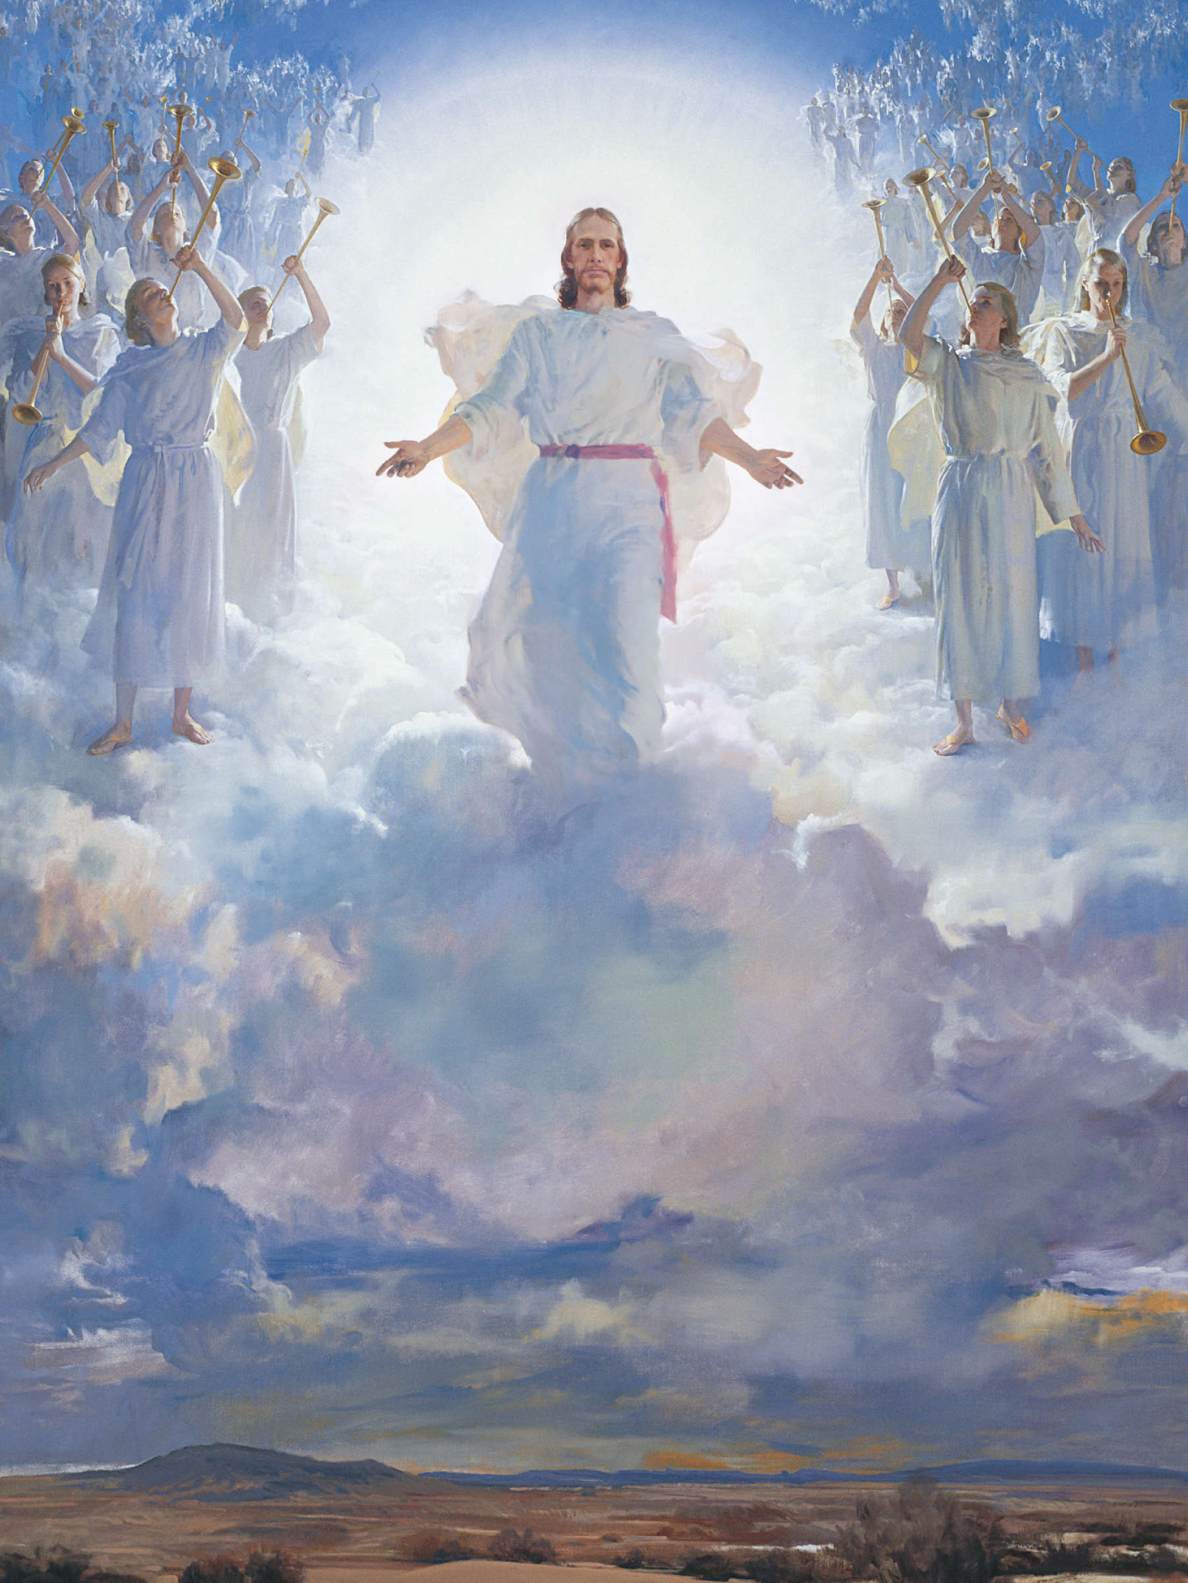
The Second Coming
Read 2 Nephi 30:9–10, looking for what Nephi prophesied would happen prior to and at the Savior’s Second Coming. (A similar prophecy is found in Isaiah 11.)

Slide 21
The Second Coming
Read 2 Nephi 30:9–10, looking for what Nephi prophesied would happen prior to and at the Savior’s Second Coming. (A similar prophecy is found in Isaiah 11.)
The Lord will cause a great division among the people, and at His coming He will destroy the wicked.

Slide 22
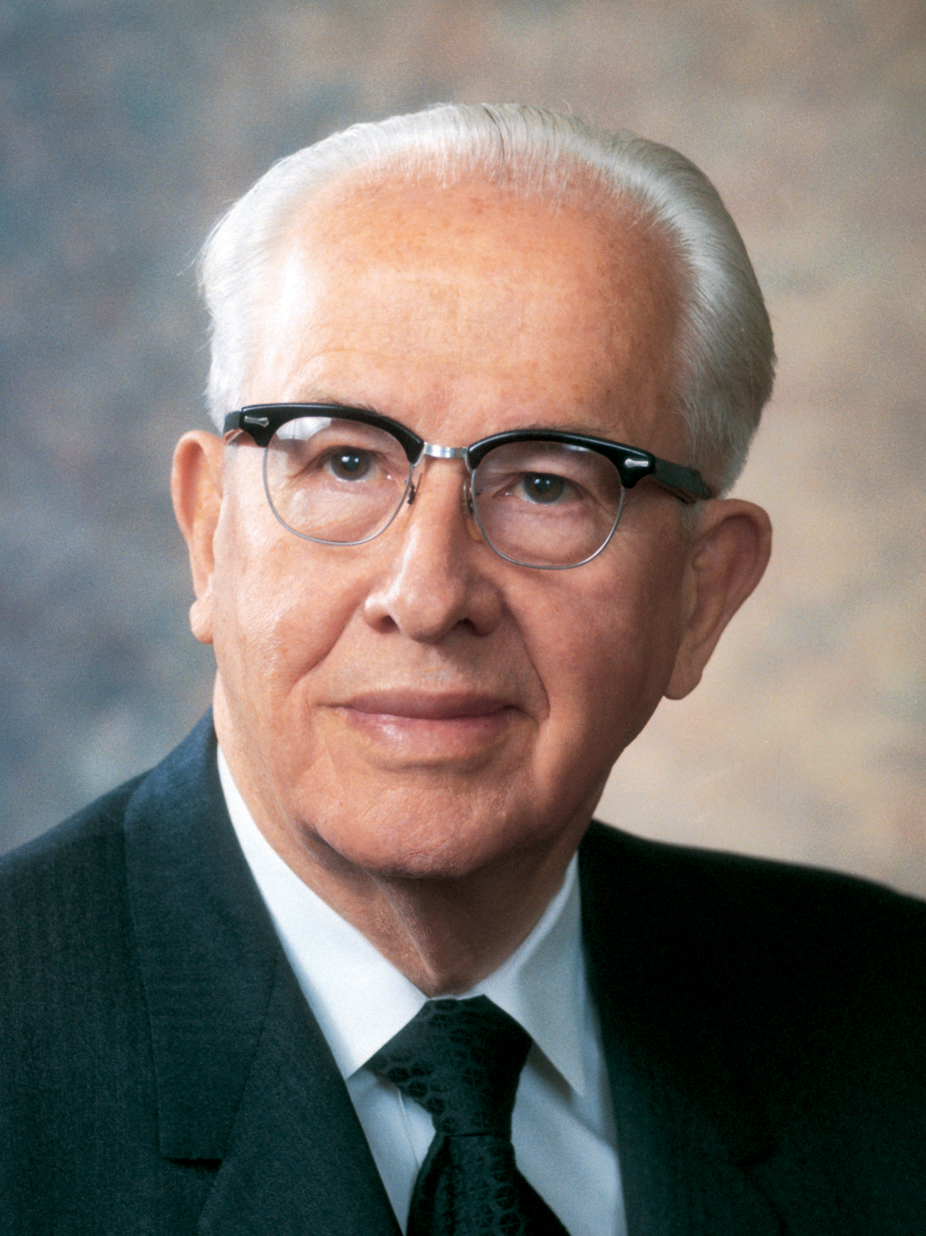
President Ezra Taft Benson
“I testify that as the forces of evil increase under Lucifer’s leadership and as the forces of good increase under the leadership of Jesus Christ, there will be growing battles between the two until the final confrontation. As the issues become clearer and more obvious, all mankind will eventually be required to align themselves either for the kingdom of God or for the kingdom of the devil.
Continued on the next page.

Slide 23
President Ezra Taft Benson, cont.
“As these conflicts rage, either secretly or openly, the righteous will be tested. God’s wrath will soon shake the nations of the earth and will be poured out on the wicked without measure. (See JS—H 1:45; D&C 1:9.)” (Ezra Taft Benson, “I Testify,” Ensign, Nov. 1988, 87).

Slide 24
On the Lord’s Side
What must we do in order to be on the Lord’s side of the great division that will occur?

Slide 25
On the Lord’s Side
What must we do in order to be on the Lord’s side of the great division that will occur?
Nephi also prophesied concerning the Millennium—the 1,000 years following the Savior’s Second Coming.

Slide 26
On the Lord’s Side
What must we do in order to be on the Lord’s side of the great division that will occur?
Nephi also prophesied concerning the Millennium—the 1,000 years following the Savior’s Second Coming.
Read 2 Nephi 30:12–18, looking for descriptions of conditions during the Millennium.

Slide 27
Another Headline
Write another headline for a news article, this time describing one or more conditions during the Millennium.

Slide 28
Another Headline
Write another headline for a news article, this time describing one or more conditions during the Millennium.
How would you summarize what you have learned from 2 Nephi 30:12–18 about the Millennium?

Slide 29
Another Headline
Write another headline for a news article, this time describing one or more conditions during the Millennium.
How would you summarize what you have learned from 2 Nephi 30:12–18 about the Millennium?
During the Millennium, peace will prevail, all things will be revealed, and Satan will not have power over people’s hearts.

Slide 30
President George Q. Cannon
“We talk about Satan being bound. Satan will be bound by the power of God; but he will be bound also by the determination of the people of God not to listen to him, not to be governed by him” (George Q. Cannon, in Conference Report, Oct. 1897, 65).

Slide 31
The Millennium
How will Satan be bound during the Millennium?

Slide 32
The Millennium
How will Satan be bound during the Millennium?
Of the millennial conditions you have studied in 2 Nephi 30, which one do you most look forward to? Why?

Slide 33
Doctrinal Mastery: The Godhead
Who do you look to as good examples? What makes them good examples to follow?

Slide 34
The Godhead—Jesus Christ
“Jesus Christ does the will of the Father in all things. He lived a sinless life and atoned for the sins of all mankind (see 3 Nephi 11:10–11). His life is the perfect example of how we are to live (see 3 Nephi 12:48). He was the first of Heavenly Father’s children to be resurrected. In our day, as in ancient times, He stands at the head of His Church. He will come again in power and glory and will reign on the earth during the Millennium (see D&C 29:10–11). He will judge all mankind” (Doctrinal Mastery Core Document, “Jesus Christ”).

Slide 35
Doctrinal Mastery: The Godhead
The doctrine that Jesus Christ’s life is the perfect example of how we are to live is supported by the doctrinal mastery passage found in 3 Nephi 12:48.

