Slide 1
The Plan of Salvation
Lesson 4

Slide 2

Devotional
Hymn:
Prayer:
Thought:

Slide 3
Pleasure and Happiness
How would you describe the difference between pleasure and happiness?

Slide 4
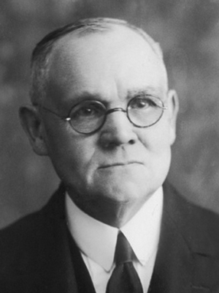
Elder James E. Talmage
“The present is an age of pleasure-seeking, and men are losing their sanity in the mad rush for sensations that do but excite and disappoint. …
“Happiness includes all that is really desirable and of true worth in pleasure, and much beside. …
“Happiness leaves no bad after-taste, it is followed by no depressing reaction; it calls for no repentance, brings no regret, entails no remorse; pleasure too often makes necessary repentance, contrition, and suffering” (James E. Talmage, Improvement Era, Dec. 1913, 172–73).

Slide 5
True Happiness
How did Elder Talmage describe the difference between pleasure and happiness?

Slide 6
True Happiness
How did Elder Talmage describe the difference between pleasure and happiness?
What in your life has brought you true happiness? Would you like to be happier?

Slide 7
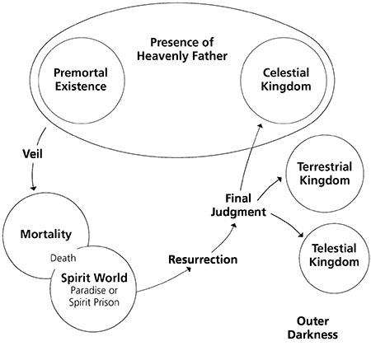
Plan of Happiness

Slide 8
Premortal Life
In the premortal spirit world, we learned about our Heavenly Father’s plan for our eternal happiness (see Moses 4:1–2; Abraham 3:22–28). Through this plan, we would be able to become like Him and dwell in His presence forever.

Slide 9
Creation
Under the direction of Heavenly Father, Jesus Christ created the earth. God placed Adam and Eve on the earth in the Garden of Eden, where they lived in His presence. God allowed them to make the choice to leave His presence and experience mortality. Adam and Eve chose to do so, and this event is called the Fall.

Slide 10
The Fall
The Fall of Adam and Eve made it possible for them to bring children into the world. Without the Fall, Heavenly Father’s children—including us—would not have been able to come to earth and receive a physical body (see 2 Nephi 2:22–23).

Slide 11
The Purpose of Life
What were some of Heavenly Father’s purposes in allowing us to come to earth and receive a physical body?

Slide 12
The Purpose of Life
What were some of Heavenly Father’s purposes in allowing us to come to earth and receive a physical body?
Read 2 Nephi 2:25. What did Lehi teach about one of the purposes of our existence?

Slide 13
The Purpose of Life
What were some of Heavenly Father’s purposes in allowing us to come to earth and receive a physical body?
Read 2 Nephi 2:25. What did Lehi teach about one of the purposes of our existence?
The Fall of Adam and Eve enabled us to come to earth and have joy.

Slide 14
What Brings Happiness
Read Mosiah 2:41. What principle can we learn from this verse about what will bring us happiness in this life and in the next?

Slide 15
What Brings Happiness
Read Mosiah 2:41. What principle can we learn from this verse about what will bring us happiness in this life and in the next?
If we keep the Lord’s commandments, we can be happy in this life and eventually dwell with Heavenly Father in a state of never-ending happiness.

Slide 16
What Brings Happiness
Read Mosiah 2:41. What principle can we learn from this verse about what will bring us happiness in this life and in the next?
If we keep the Lord’s commandments, we can be happy in this life and eventually dwell with Heavenly Father in a state of never-ending happiness.
Why do you think obedience to God’s commandments brings happiness?

Slide 17
For the Strength of Youth
Choose a topic in the booklet For the Strength of Youth (2011) and look for how following a particular commandment or standard can help us be happy in this life and in the next.

Slide 18
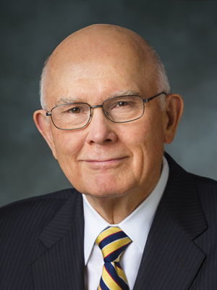
Elder Dallin H. Oaks
“Joy is the ultimate sensation of well-being. It comes from being complete and in harmony with our Creator and his eternal laws. …
“… Despite all we can do, we cannot have a fulness of joy in this world or through our own efforts. (See D&C 101:36.) Only in Christ can our joy be full” (Dallin H. Oaks, “Joy and Mercy,” Ensign, Nov. 1991, 73–74).

Slide 19
Elder Dallin H. Oaks
“Joy is the ultimate sensation of well-being. It comes from being complete and in harmony with our Creator and his eternal laws. …
“… Despite all we can do, we cannot have a fulness of joy in this world or through our own efforts. (See D&C 101:36.) Only in Christ can our joy be full” (Dallin H. Oaks, “Joy and Mercy,” Ensign, Nov. 1991, 73–74).
According to this statement by Elder Oaks, what can’t we receive in this world or through our own efforts alone?

Slide 20
Elder Dallin H. Oaks
“Joy is the ultimate sensation of well-being. It comes from being complete and in harmony with our Creator and his eternal laws. …
“… Despite all we can do, we cannot have a fulness of joy in this world or through our own efforts. (See D&C 101:36.) Only in Christ can our joy be full” (Dallin H. Oaks, “Joy and Mercy,” Ensign, Nov. 1991, 73–74).
What do you think it means to experience a “fulness of joy”?

Slide 21
Our Mortal Life
In this life we will experience sorrow and pain, but we may also experience a great measure of joy in this life as we live in harmony with God and His laws.

Slide 22
Our Mortal Life
In this life we will experience sorrow and pain, but we may also experience a great measure of joy in this life as we live in harmony with God and His laws.
We can obtain a fulness of joy only as we become like our Heavenly Father—which is a process that continues throughout this life and into the next. Book of Mormon prophets taught why we cannot obtain a fulness of joy without Jesus Christ and His atoning sacrifice for us.

Slide 23
Book of Mormon Scriptures
Read the following scripture passages, looking for the condition we would be in without Jesus Christ and His Atonement.
2 Nephi 9:6–9
Mosiah 16:6–7
Alma 41:10–11
Alma 42:11–14

Slide 24
If We Choose to Sin
According to Alma 41:10–11, if we choose to sin, then we will be unhappy.

Slide 25
If We Choose to Sin
According to Alma 41:10–11, if we choose to sin, then we will be unhappy.
What would happen if there were no salvation from sin and physical death through the Atonement of Jesus Christ?

Slide 26
If We Choose to Sin
According to Alma 41:10–11, if we choose to sin, then we will be unhappy.
What would happen if there were no salvation from sin and physical death through the Atonement of Jesus Christ?
Without the Atonement of Jesus Christ, there would be no Resurrection and we would be shut out from God’s presence and be miserable forever.

Slide 27
Spiritual and Physical Death
The condition of being shut out or separated from God’s presence is referred to as spiritual death. Physical death is the separation of our spirit from our body. Both of these conditions prevent us from being like our Heavenly Father and experiencing a fulness of joy.

Slide 28
The Spirit World
When our mortal bodies die, our spirits enter the spirit world and await the Resurrection. The spirits of those who are righteous are received into a state of peace called paradise (see Alma 40:11–12). The spirits of those who did not receive the gospel during mortality or who rebelled against it enter spirit prison, where they have the opportunity to learn and accept the gospel (see D&C 138:30–35).

Slide 29
Doctrines and Principles
Read the following scripture passages, looking for doctrines and principles that help us understand what Jesus Christ has done to help us overcome physical and spiritual death and experience a fulness of joy.
Mosiah 16:8–11
Alma 11:42–45
Alma 12:33–34
Alma 42:15, 22–23

Slide 30
Mosiah 16:8–11
If we have chosen to do good works, then we will receive endless life and happiness after we are resurrected.

Slide 31
Alma 11:42–45
Through the Atonement of Jesus Christ, all will be resurrected and brought back to the presence of God to be judged according to their works.

Slide 32
Alma 12:33–34
If we repent and harden not our hearts, then we can receive God’s mercy and enter into His rest.

Slide 33
Mormon 7:6–7
If we are found guiltless before God at the Judgment Day, then we will dwell with Him in a state of never-ending happiness.

Slide 34
Jesus Christ
How would you summarize Jesus Christ’s role in Heavenly Father’s plan for our eternal happiness?

Slide 35
Jesus Christ
How would you summarize Jesus Christ’s role in Heavenly Father’s plan for our eternal happiness?
Jesus Christ and His atoning sacrifice are central to Heavenly Father’s plan for our eternal happiness.

Slide 36
Jesus Christ
How would you summarize Jesus Christ’s role in Heavenly Father’s plan for our eternal happiness?
Jesus Christ and His atoning sacrifice are central to Heavenly Father’s plan for our eternal happiness.
How does each part of Heavenly Father’s plan depend upon or relate to Jesus Christ and His atoning sacrifice?

