Slide 1
2 Nephi 32
Lesson 41

Slide 2

Devotional
Hymn:
Prayer:
Thought:

Slide 3
Need Direction?
What situations or choices do you currently face for which you would like some direction?

Slide 4
Need Direction?
What situations or choices do you currently face for which you would like some direction?
What do you do when you feel the need for direction?

Slide 5
2 Nephi 31
After Nephi taught his people about following the doctrine of Christ and beginning on the path to eternal life as recorded in 2 Nephi 31, the people wanted further direction from him.

Slide 6
A Question
Read 2 Nephi 32:1, looking for a question that Nephi’s people had regarding what he had taught them.

Slide 7
A Question
Read 2 Nephi 32:1, looking for a question that Nephi’s people had regarding what he had taught them.
How would you express this question in your own words?

Slide 8
Nephi’s Response
Read 2 Nephi 32:2–3, looking for Nephi’s answer to the people’s question in verse 1. 2 Nephi 32:3 is a doctrinal mastery passage. Mark this in a distinctive way so you can locate it easily.

Slide 9
Nephi’s Response
Read 2 Nephi 32:2–3, looking for Nephi’s answer to the people’s question in verse 1. 2 Nephi 32:3 is a doctrinal mastery passage. Mark this in a distinctive way so you can locate it easily.
What principle about receiving direction from the Lord can we learn from Nephi’s answer in verse 3?

Slide 10
Feast upon the Words of Christ
When we feast on the words of Christ, they will tell us all things that we should do.

Slide 11
Feast upon the Words of Christ
When we feast on the words of Christ, they will tell us all things that we should do.
What do you think it means to feast on the words of Christ? How is feasting different from snacking?

Slide 12
Feast upon the Words of Christ
When we feast on the words of Christ, they will tell us all things that we should do.
What do you think it means to feast on the words of Christ? How is feasting different from snacking?
What are some places where we can find the words of Jesus Christ?

Slide 13
Feast upon the Words of Christ
When we feast on the words of Christ, they will tell us all things that we should do.
What do you think it means to feast on the words of Christ? How is feasting different from snacking?
What are some places where we can find the words of Jesus Christ?
Why is it important to know that the words of Jesus Christ can tell us all things that we should do?

Slide 14
Additional Counsel
Read 2 Nephi 32:4–7, looking for additional counsel Nephi gave about receiving direction from God.

Slide 15
Additional Counsel
Read 2 Nephi 32:4–7, looking for additional counsel Nephi gave about receiving direction from God.
What do you think it means to “ask” or “knock” (verse 4)? What did Nephi say are the consequences for those who will not ask or knock?

Slide 16
Additional Counsel
Read 2 Nephi 32:4–7, looking for additional counsel Nephi gave about receiving direction from God.
What do you think it means to “ask” or “knock” (verse 4)? What did Nephi say are the consequences for those who will not ask or knock?
According to 2 Nephi 32:5, what blessing will we have if we receive the Holy Ghost?

Slide 17
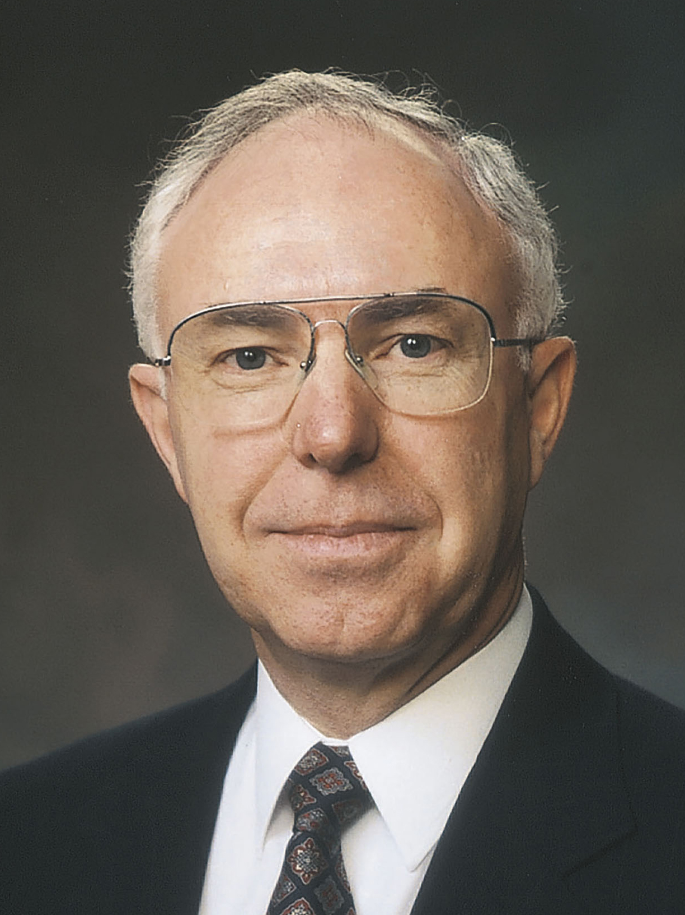
Elder Spencer J. Condie
“You may be facing decisions regarding a mission, your future career, and, eventually, marriage. As you read the scriptures and pray for direction, you may not actually see the answer in the form of printed words on the page, but as you read you will receive distinct impressions, and promptings, and, as promised, the Holy Ghost ‘will show unto you all things what ye should do’ [2 Nephi 32:5]” (Spencer J. Condie, “Becoming a Great Benefit to Our Fellow Beings,” Ensign, May 2002, 45).

Slide 18
An Experience
Think of a time when the words of Christ helped give you guidance regarding something you should do. Share an experience that is not too sacred or private.

Slide 19
Feast, Snack, or Starve?
Think about how well you seek the words of Jesus Christ in each of the settings in the next slide. For each item in the list, decide if you feast, snack, or starve. For example, you may feast during your personal scripture study but only snack when you listen to or watch general conference. If you do not pay attention in sacrament meeting, you might choose the word starve for that item.

Slide 20
Feast, Snack, or Starve?
1. Personal scripture study 6. Family home evening
2. Sacrament meeting 7. Aaronic Priesthood
3. General conference quorum meeting or
4. Family scripture study Young Women class
5. Seminary 8. Personal prayer

Slide 21
Make Goals
Choose one of the activities in which you are currently “snacking” or “starving,” and make goals that will help you “feast upon the words of Christ” more in that setting. Write this goal in your class notebook or study journal. (You might think about your Duty to God or Personal Progress goals in connection with these goals.) As you feast on the words of Jesus Christ, the Holy Ghost will help you follow the path to eternal life.

Slide 22
A Scenario
Imagine you have a friend who feels unworthy to pray because of a sin he or she has committed. What could you say to encourage this friend to continue to pray?

Slide 23
Praying
Read 2 Nephi 32:8. Why do you think the Holy Ghost wants us to pray? Why do you think Satan does not want us to pray?

Slide 24
Nephi’s Encouragement
Read 2 Nephi 32:9, looking for what Nephi encouraged his people to do. The word faint means to weaken, give up, or lose hope, and the word consecrate means “to dedicate, to make holy, or to become righteous” (Guide to the Scriptures, “Consecrate, Law of Consecration,” scriptures.lds.org).

Slide 25
Nephi’s Encouragement
Read 2 Nephi 32:9, looking for what Nephi encouraged his people to do. The word faint means to weaken, give up, or lose hope, and the word consecrate means “to dedicate, to make holy, or to become righteous” (Guide to the Scriptures, “Consecrate, Law of Consecration,” scriptures.lds.org).
What principle about prayer can we learn from verse 9?

Slide 26
Pray Always
If we pray always, God will consecrate our performance for the welfare of our souls. 2 Nephi 32:8–9 is a doctrinal mastery passage. Mark it in a distinctive way so you can locate it easily.

Slide 27
Pray Always
If we pray always, God will consecrate our performance for the welfare of our souls. 2 Nephi 32:8–9 is a doctrinal mastery passage. Mark it in a distinctive way so you can locate it easily.
What do you think it means to “pray always”?

Slide 28
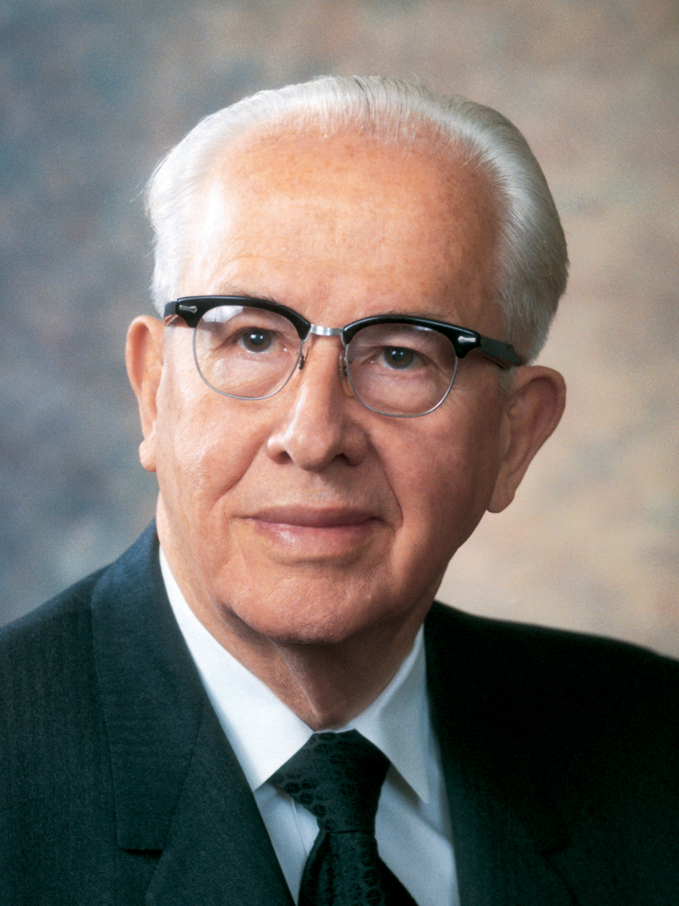
President Ezra Taft Benson
“We should pray frequently. We should be alone with our Heavenly Father at least two or three times each day—‘morning, mid-day, and evening,’ as the scripture indicates. (Alma 34:21.) In addition, we are told to pray always. (See 2 Ne. 32:9; D&C 88:126.) This means that our hearts should be full, drawn out in prayer unto our Heavenly Father continually. (See Alma 34:27.)” (Teachings of Presidents of the Church: Ezra Taft Benson [2014], 52).

Slide 29
Pray Always
According to President Benson, what does it mean to pray always?

Slide 30
Pray Always
According to President Benson, what does it mean to pray always?
What do you think it means that the Lord will consecrate our performance for the welfare of our souls?

Slide 31
Pray Always
According to President Benson, what does it mean to pray always?
What do you think it means that the Lord will consecrate our performance for the welfare of our souls?
What are some ways in which you have tried to follow the commandment to pray always?

Slide 32
Pray Always
According to President Benson, what does it mean to pray always?
What do you think it means that the Lord will consecrate our performance for the welfare of our souls?
What are some ways in which you have tried to follow the commandment to pray always?
In what ways do you feel the Lord has blessed you as you have sought to pray always?

Slide 33
Follow Nephi’s Counsel
The Lord can direct our lives through the Holy Ghost as we feast upon the words of Christ. He will bless us for our righteous desires and efforts to pray always.

Slide 34
Follow Nephi’s Counsel
The Lord can direct our lives through the Holy Ghost as we feast upon the words of Christ. He will bless us for our righteous desires and efforts to pray always.
In the next 24 hours, try to follow Nephi’s counsel to pray always. You will have an opportunity at the beginning of the next lesson to share your experiences and ways in which you were blessed by praying always.

Slide 35
Doctrinal Mastery: The Godhead
Read 3 Nephi 12:48. What doctrine does this verse support in the Doctrinal Mastery Core Document under the topic “The Godhead”?

Slide 36
Doctrinal Mastery: The Godhead
Read 3 Nephi 12:48. What doctrine does this verse support in the Doctrinal Mastery Core Document under the topic “The Godhead”?
Jesus Christ’s life is the perfect example of how we are to live.

Slide 37
Doctrinal Mastery: The Godhead
Watch this video and look for examples of Christlike attributes that we can seek to develop in our own lives.
https://www.lds.org/media-library/video/2014-01-001-christlike-attributes?lang=eng

Slide 38
Doctrinal Mastery: The Godhead
Share one Christlike attribute. How did the Savior demonstrate this attribute in His life?

Slide 39
Doctrinal Mastery: The Godhead
Share one Christlike attribute. How did the Savior demonstrate this attribute in His life?
How have you seen someone bless your life by exemplifying this attribute? Please share this experience.

Slide 40
Doctrinal Mastery: The Godhead
Share one Christlike attribute. How did the Savior demonstrate this attribute in His life?
How have you seen someone bless your life by exemplifying this attribute? Please share this experience.
How have you tried to exemplify this attribute to help someone else? Please share this experience.

