Slide 1
2 Nephi 33
Lesson 42

Slide 2

Devotional
Hymn:
Prayer:
Thought:

Slide 3
Invitation to Pray
In the last lesson, you were invited to try something you can do to follow Nephi’s counsel to pray always. Share your experience of seeking to pray always and how you felt blessed for doing so.

Slide 4
The Book of Mormon
Have you ever given a copy of the Book of Mormon to someone who was not a member of the Church? If you have, did you include a personal note or testimony with the book?

Slide 5
The Book of Mormon
Have you ever given a copy of the Book of Mormon to someone who was not a member of the Church? If you have, did you include a personal note or testimony with the book?
What feelings would you have if, after giving a copy of the Book of Mormon to your friend with your testimony written in it, you saw your friend throw the book in the trash when he or she thought you were not looking?

Slide 6
2 Nephi 33
2 Nephi 33 contains Nephi’s final testimony and his hopes concerning how people will receive his words. As you study 2 Nephi 33 today, look for truths concerning the importance of how we choose to respond to the teachings of Nephi and other prophets in the Book of Mormon.

Slide 7
The Power of the Holy Ghost
Read 2 Nephi 33:1, looking for what happens when someone speaks by the power of the Holy Ghost.

Slide 8
The Power of the Holy Ghost
Read 2 Nephi 33:1, looking for what happens when someone speaks by the power of the Holy Ghost.
When someone speaks by the power of the Holy Ghost, what does the Holy Ghost do with the truth that is spoken?

Slide 9
The Power of the Holy Ghost
Read 2 Nephi 33:1, looking for what happens when someone speaks by the power of the Holy Ghost.
When someone speaks by the power of the Holy Ghost, what does the Holy Ghost do with the truth that is spoken?
The Holy Ghost carries truth to our hearts. Mark the phrases that teach this truth in 2 Nephi 33:1.

Slide 10
Having the Spirit
Think of a time when the Holy Ghost carried the truth of a message to your heart. How would you describe what it was like to have the Spirit carry truth to your heart?

Slide 11
Having the Spirit
Think of a time when the Holy Ghost carried the truth of a message to your heart. How would you describe what it was like to have the Spirit carry truth to your heart?
What did you learn as a result of your experience?

Slide 12
Things of Naught
Read 2 Nephi 33:2, looking for one reason why a person might not feel the Holy Ghost teaching or testifying of truth. The word naught means “nothing.” To “esteem [written words] as things of naught” is to think that they are worthless.

Slide 13
If We Harden Our Hearts
What principle can we learn from 2 Nephi 33:2 about what will happen if we harden our hearts against the Spirit?

Slide 14
If We Harden Our Hearts
What principle can we learn from 2 Nephi 33:2 about what will happen if we harden our hearts against the Spirit?
If we harden our hearts against the Holy Spirit, we will not understand the value of the word of God.

Slide 15
If We Harden Our Hearts
What principle can we learn from 2 Nephi 33:2 about what will happen if we harden our hearts against the Spirit?
If we harden our hearts against the Holy Spirit, we will not understand the value of the word of God.
What do you think it means to harden one’s heart against the Holy Spirit?

Slide 16
If We Harden Our Hearts
What principle can we learn from 2 Nephi 33:2 about what will happen if we harden our hearts against the Spirit?
If we harden our hearts against the Holy Spirit, we will not understand the value of the word of God.
What do you think it means to harden one’s heart against the Holy Spirit?
What are some reasons why people might harden their hearts against the Spirit?

Slide 17
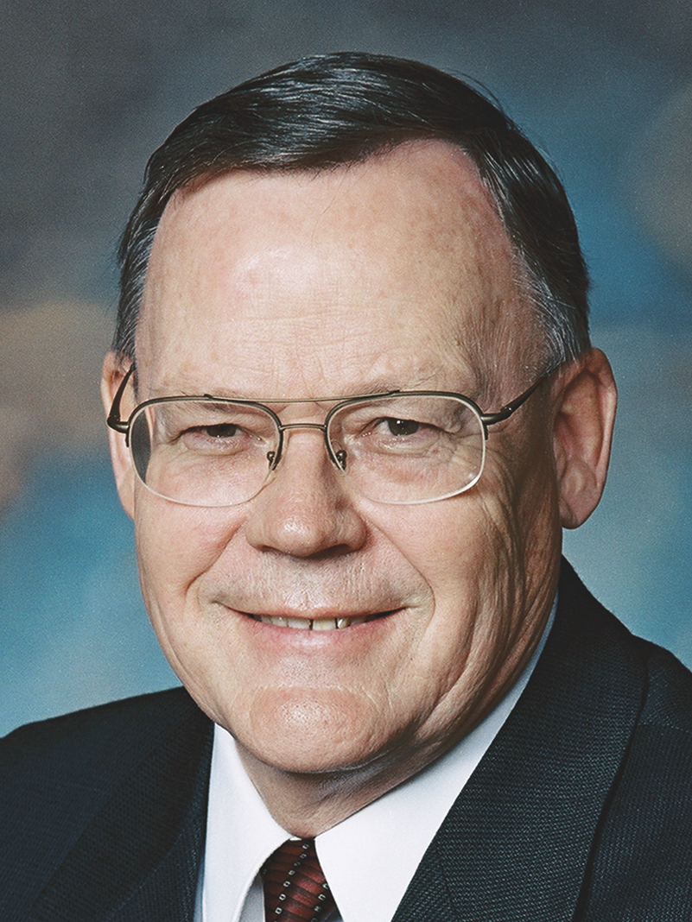
Elder Gerald N. Lund
“The heart is a tender place. It is sensitive to many influences, both positive and negative. It can be hurt by others. It can be deadened by sin. It can be softened by love. Early in our lives, we learn to guard our hearts. It is like we erect a fence around our hearts with a gate in it. No one can enter that gate unless we allow him or her to.
Continued on the next page.

Slide 18
Elder Gerald N. Lund, cont.
“In some cases the fence we erect around our hearts could be likened to a small picket fence with a Welcome sign on the gate. Other hearts have been so hurt or so deadened by sin that they have an eight-foot (2.5-m) chain-link fence topped with razor wire around them. The gate is padlocked and has a large No Trespassing sign on it. …
Continued on the next page.

Slide 19
Elder Gerald N. Lund, cont.
“… The condition of our hearts directly affects our sensitivity to spiritual things. Let us make it a part of our everyday striving to open our hearts to the Spirit. Since we are the guardians of our hearts, we can choose to do so” (Gerald N. Lund, “Opening Our Hearts,” Ensign or Liahona, May 2008, 33, 34).

Slide 20
Opening Your Heart
What are some things you have done to open your heart to receive truth from the Holy Ghost in Church meetings, in classes, or during personal scripture study?

Slide 21
Opening Your Heart
What are some things you have done to open your heart to receive truth from the Holy Ghost in Church meetings, in classes, or during personal scripture study?
Consider the condition of your heart and determine if you are allowing messages of truth to enter your heart. What will you do to better open your heart to the Holy Ghost?

Slide 22
Nephi’s Words
Read 2 Nephi 33:3–7, looking for how Nephi felt about his people and about what he had written. Consider marking any words or phrases that stand out to you.

Slide 23
Nephi’s Words
Read 2 Nephi 33:3–7, looking for how Nephi felt about his people and about what he had written. Consider marking any words or phrases that stand out to you.
According to 2 Nephi 33:4, what do Nephi’s words persuade us to do?

Slide 24
Nephi’s Words
Read 2 Nephi 33:3–7, looking for how Nephi felt about his people and about what he had written. Consider marking any words or phrases that stand out to you.
According to 2 Nephi 33:4, what do Nephi’s words persuade us to do?
The Book of Mormon persuades people to do good, to believe in Jesus Christ, and to endure to the end.

Slide 25
Nephi’s Warning
In 2 Nephi 33:8–9, Nephi expressed charity for the Jews and the Gentiles (all of God’s children), and he emphasized the need for all people to be reconciled to Jesus Christ and remain faithful to Him. Nephi concluded his record with a warning to those who read his words.

Slide 26
Nephi’s Warning
In 2 Nephi 33:8–9, Nephi expressed charity for the Jews and the Gentiles (all of God’s children), and he emphasized the need for all people to be reconciled to Jesus Christ and remain faithful to Him. Nephi concluded his record with a warning to those who read his words.
Read 2 Nephi 33:10–15, looking for what Nephi warned would happen if we do not respect the words of the Lord and His servants.

Slide 27
Nephi’s Words
Based on 2 Nephi 33:10–15, what can we do to respect Nephi’s words?

Slide 28
Nephi’s Words
Based on 2 Nephi 33:10–15, what can we do to respect Nephi’s words?
According to verse 11, what will happen to those who do not believe Nephi’s words?

Slide 29
Nephi’s Words
Based on 2 Nephi 33:10–15, what can we do to respect Nephi’s words?
According to verse 11, what will happen to those who do not believe Nephi’s words?
According to verse 14, what will happen to those who do not respect the word of the Lord and His servants?

Slide 30
The Lord and His Servants
If we do not respect the words of the Lord and His servants, then their words will condemn us at the last day.

Slide 31
The Lord and His Servants
If we do not respect the words of the Lord and His servants, then their words will condemn us at the last day.
Notice the phrase “you and I shall stand face to face” in 2 Nephi 33:11. What do you think it might be like to meet Nephi if you have cast away his words?

Slide 32
The Lord and His Servants
If we do not respect the words of the Lord and His servants, then their words will condemn us at the last day.
Notice the phrase “you and I shall stand face to face” in 2 Nephi 33:11. What do you think it might be like to meet Nephi if you have cast away his words?
What might it feel like to meet Nephi if you have respected his words?

Slide 33
“I Must Obey”
Notice Nephi’s words “I must obey” in 2 Nephi 33:15. Review the chapter summaries of 1 and 2 Nephi, looking for examples of Nephi’s obedience.

Slide 34
“I Must Obey”
Notice Nephi’s words “I must obey” in 2 Nephi 33:15. Review the chapter summaries of 1 and 2 Nephi, looking for examples of Nephi’s obedience.
How can these examples of Nephi’s obedience help us to respect his words, believe in Jesus Christ, and do good?

Slide 35
Doctrinal Mastery: The Godhead
In the last few lessons, you have been studying this doctrine: Jesus Christ’s life is the perfect example of how we are to live.

Slide 36
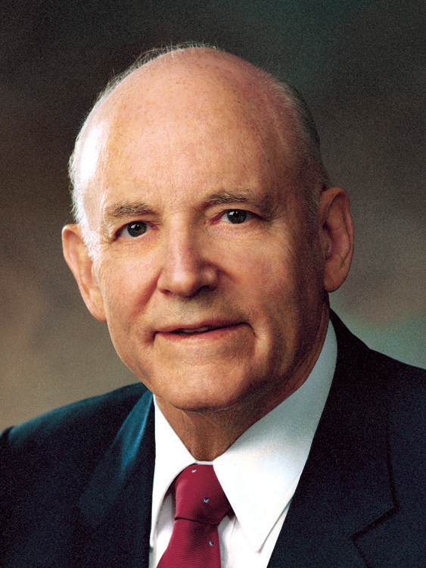
President Howard W. Hunter
“Let us follow the Son of God in all ways and in all walks of life. Let us make him our exemplar and our guide. We should at every opportunity ask ourselves, ‘What would Jesus do?’ and then be more courageous to act upon the answer. We must follow Christ, in the best sense of that word. We must be about his work as he was about his Father’s. ... To the extent that our mortal powers permit, we should make every effort to become like Christ—the one perfect and sinless example this world has ever seen” (Teachings of Presidents of the Church: Howard W. Hunter [2015], 309).

Slide 37
Doctrinal Mastery: The Godhead
How would you complete this statement? I will better follow the Savior’s example this week by …

Slide 38
Doctrinal Mastery: The Godhead
You may want to return to what you have written later in the week to review and reflect on how well you have followed what you have committed to do. Be sure to pray for the Lord’s help as you seek to better follow His example.

