Slide 1
Jacob 1:1–2:11
Lesson 43

Slide 2

Devotional
Hymn:
Prayer:
Thought:

Slide 3
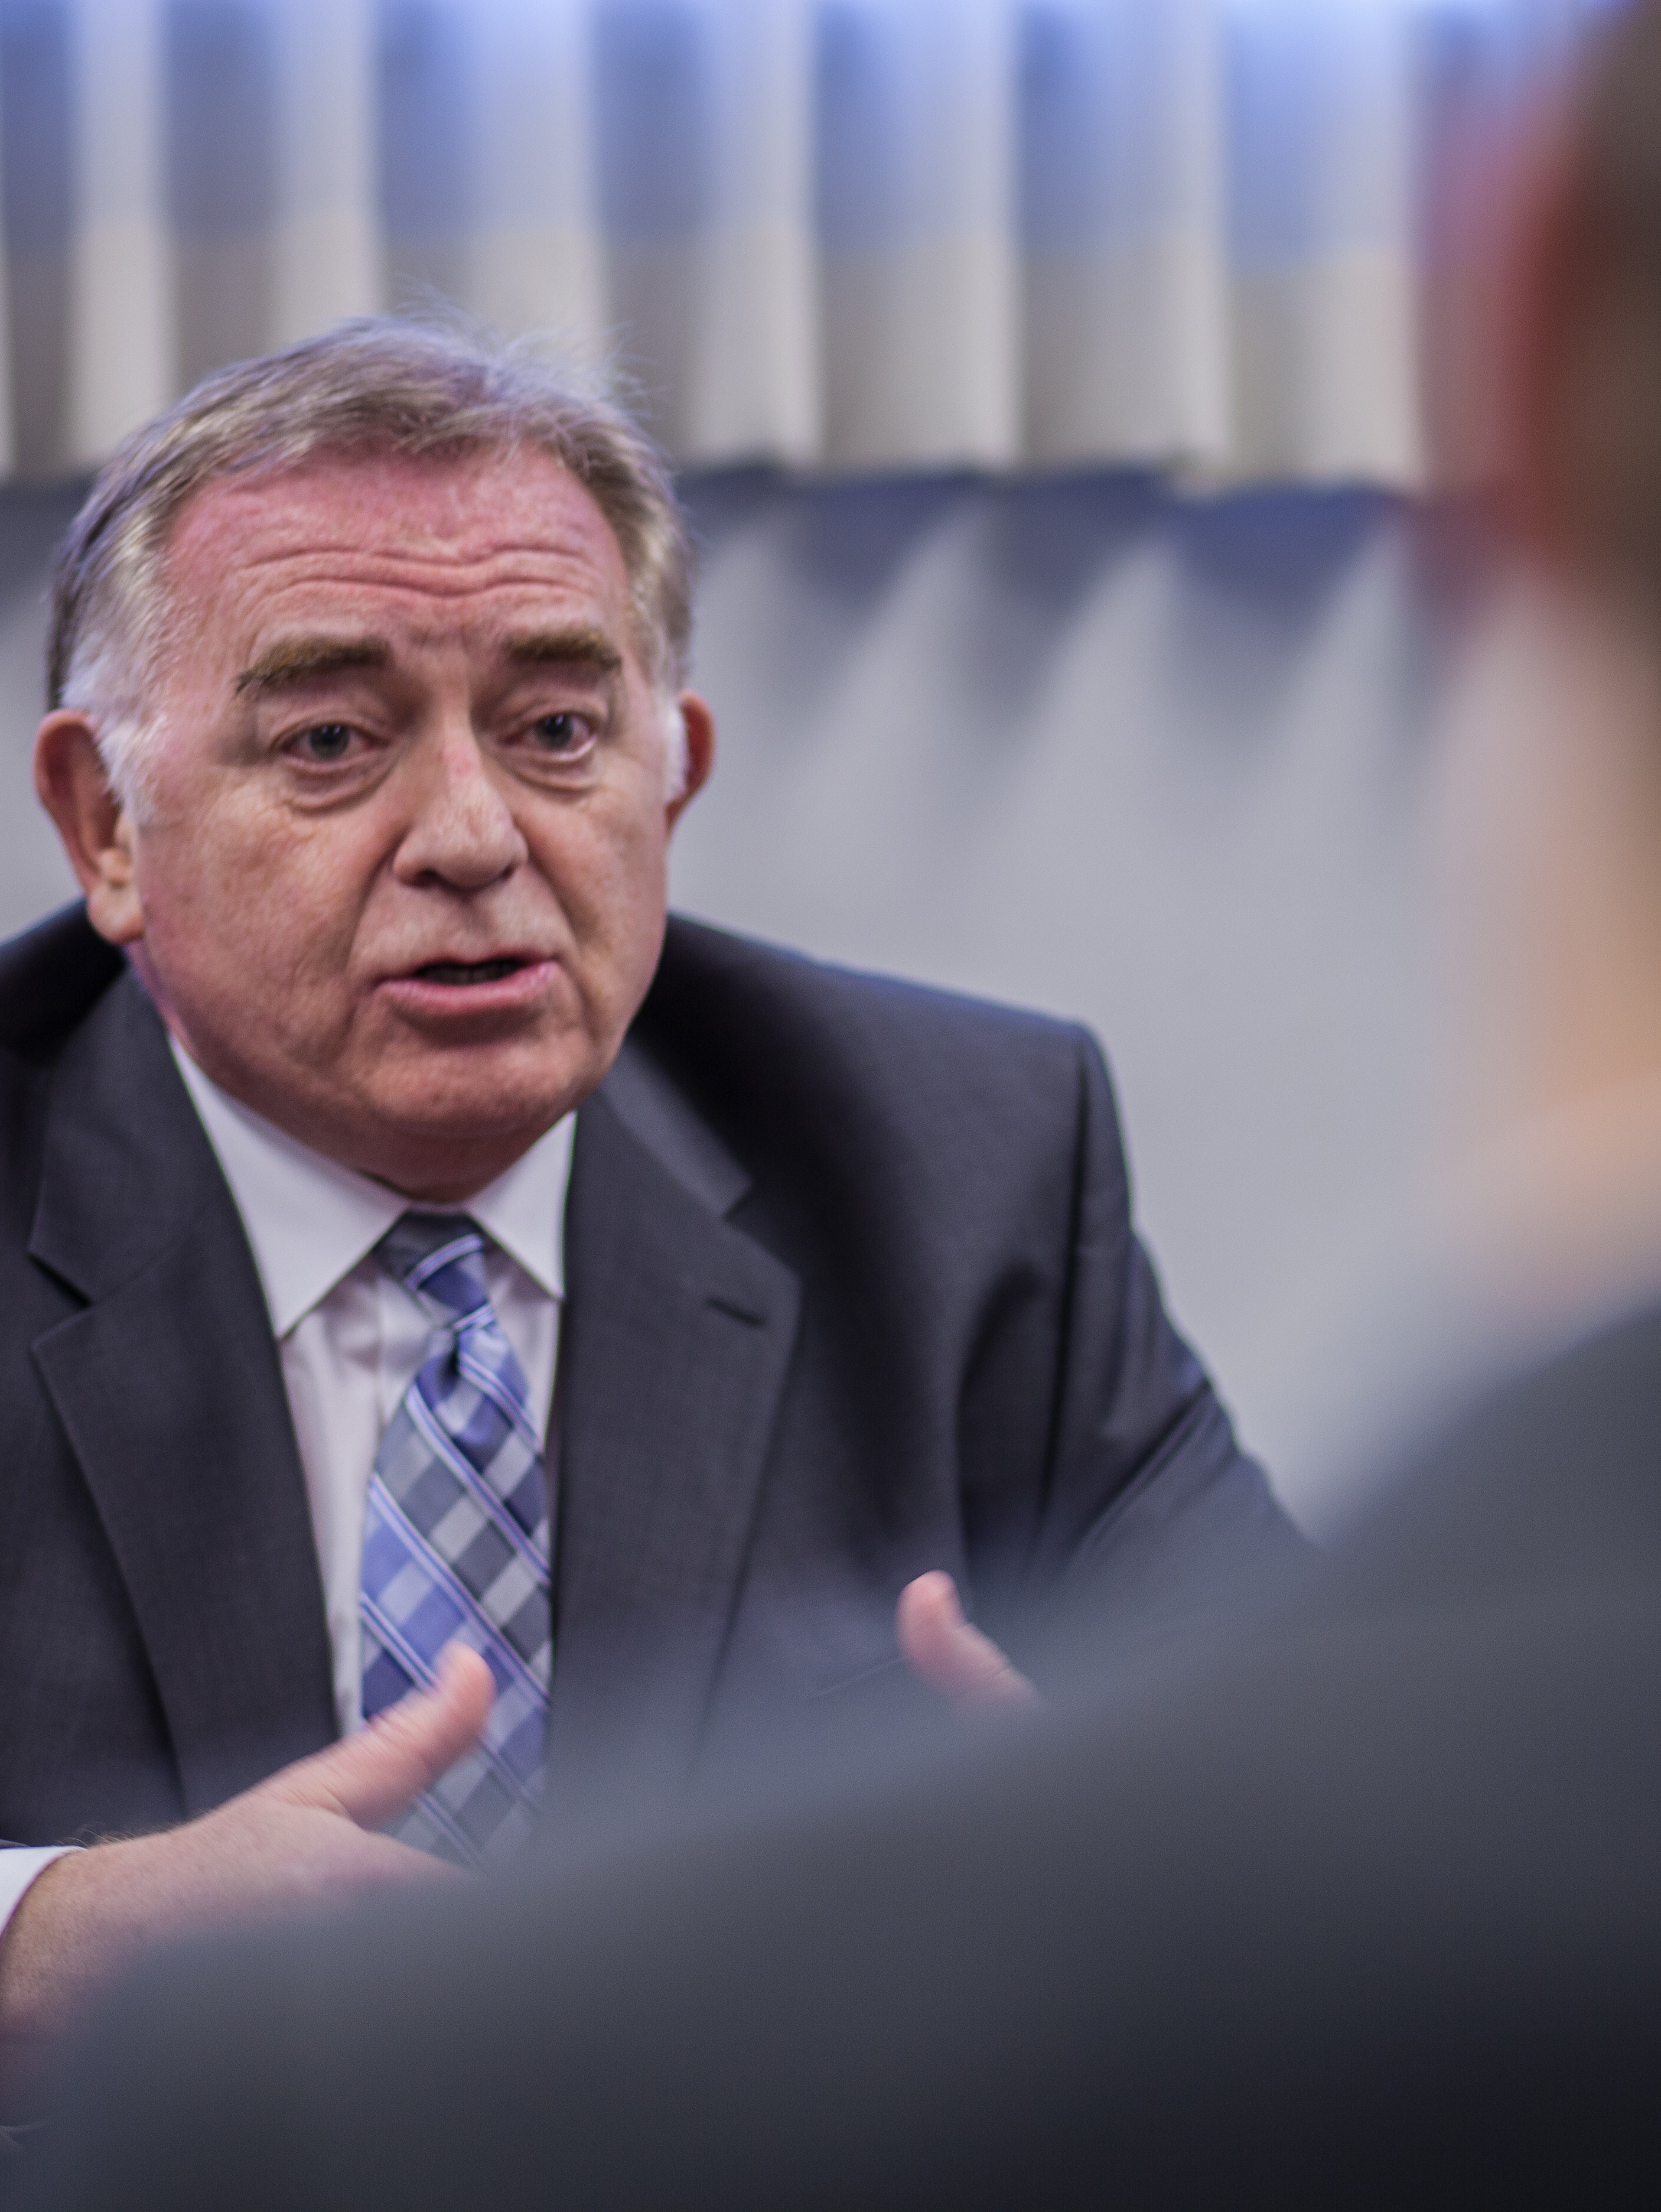
A Scenario
Imagine that you know a young man whose bishop has counseled him to repent and make a change in his life. The bishop has warned the young man of consequences he may suffer if he continues to commit a particular sin. This young man says that his bishop is too old to understand the way things are today and that the bishop should not interfere with his life or try to control his choices.

Slide 4
The Role of Priesthood Leaders
Do you think this young man understands the role of bishops and other leaders in the Church? Why or why not?

Slide 5
The Role of Priesthood Leaders
Do you think this young man understands the role of bishops and other leaders in the Church? Why or why not?
As you study Jacob 1:1–2:11 today, look for truths Jacob taught about the role of priesthood leaders in the Church.

Slide 6
Jacob and Joseph
Nephi had consecrated his younger brothers Jacob and Joseph as priests and teachers of the people (see 2 Nephi 5:26; Jacob 1:18). In Jacob 1:1–3, as Nephi neared the end of his life, he gave Jacob charge over the small plates, which contained the spiritual record of their people.

Slide 7
Jacob
Read Jacob 1:4 and look for what Nephi commanded Jacob to record on the plates and why.

Slide 8
Jacob
Read Jacob 1:4 and look for what Nephi commanded Jacob to record on the plates and why.
What does the phrase “for the sake of our people” mean?

Slide 9
Revelation to Jacob
Read Jacob 1:5–6. What did the Lord reveal to Jacob? The phrase “great anxiety” (verse 5) refers to his deep concern for the people.

Slide 10
Revelation to Jacob
Read Jacob 1:5–6. What did the Lord reveal to Jacob? The phrase “great anxiety” (verse 5) refers to his deep concern for the people.
How might knowing these things have helped Jacob in teaching his people?

Slide 11
Difficult Phrases
Read Jacob 1:7–8, looking for phrases in these verses that you do not understand. Mark what you find.

Slide 12
Come unto Christ
“Come unto Christ”: To come unto Christ, a person “must have faith in Him unto repentance—making the necessary changes to bring their life into agreement with His teachings” (Preach My Gospel: A Guide to Missionary Service [2004], 2).

Slide 13
Partaking of the Goodness of God
“Partake of the goodness of God”: An invitation to receive God’s blessings through obedience to the commandments and ordinances of the gospel.

Slide 14
Enter into His Rest
“Enter into his rest”: Entering into the rest of the Lord means enjoying peace in this life and receiving “the fulness of [God’s] glory” in the next life (D&C 84:24).

Slide 15
Provocation in the Days of Temptation
“Provocation in the days of temptation”: Refers to the ancient Israelites provoking God’s anger by rebelling against Him in the wilderness (see Hebrews 3:8–9; D&C 84:23–24).

Slide 16
View His Death
“View [Christ’s] death”: One definition of view is to look at or examine attentively. When Jacob wrote that he wanted to persuade people to “believe in Christ, and view his death,” he may have meant that he wanted them to examine the Atonement of Jesus Christ attentively, realize its importance, and gain a personal testimony of it.

Slide 17
Suffer His Cross
“Suffer his cross”: Refers to our willingness to deny ourselves of ungodliness and worldly lusts and to keep the Lord’s commandments (see Joseph Smith Translation, Matthew 16:26 [in Matthew 16:24, footnote e]; Luke 9:23; 2 Nephi 9:18). It also refers to our willingness to endure and sacrifice as we follow the Savior.

Slide 18
Bear the Shame of the World
“Bear the shame of the world”: Refers to keeping the commandments despite the worldly pressure, humiliation, and opposition that often come to disciples of Jesus Christ.

Slide 19
Priesthood Leaders
What does Jacob 1:7 teach us about what priesthood leaders do?

Slide 20
Priesthood Leaders
What does Jacob 1:7 teach us about what priesthood leaders do?
Priesthood leaders labor diligently to persuade us to come unto Christ and partake of the goodness of God.

Slide 21
Priesthood Leaders
What does Jacob 1:7 teach us about what priesthood leaders do?
Priesthood leaders labor diligently to persuade us to come unto Christ and partake of the goodness of God.
According to Jacob 1:7, what will happen if we come unto Jesus Christ and partake of the goodness of God?

Slide 22
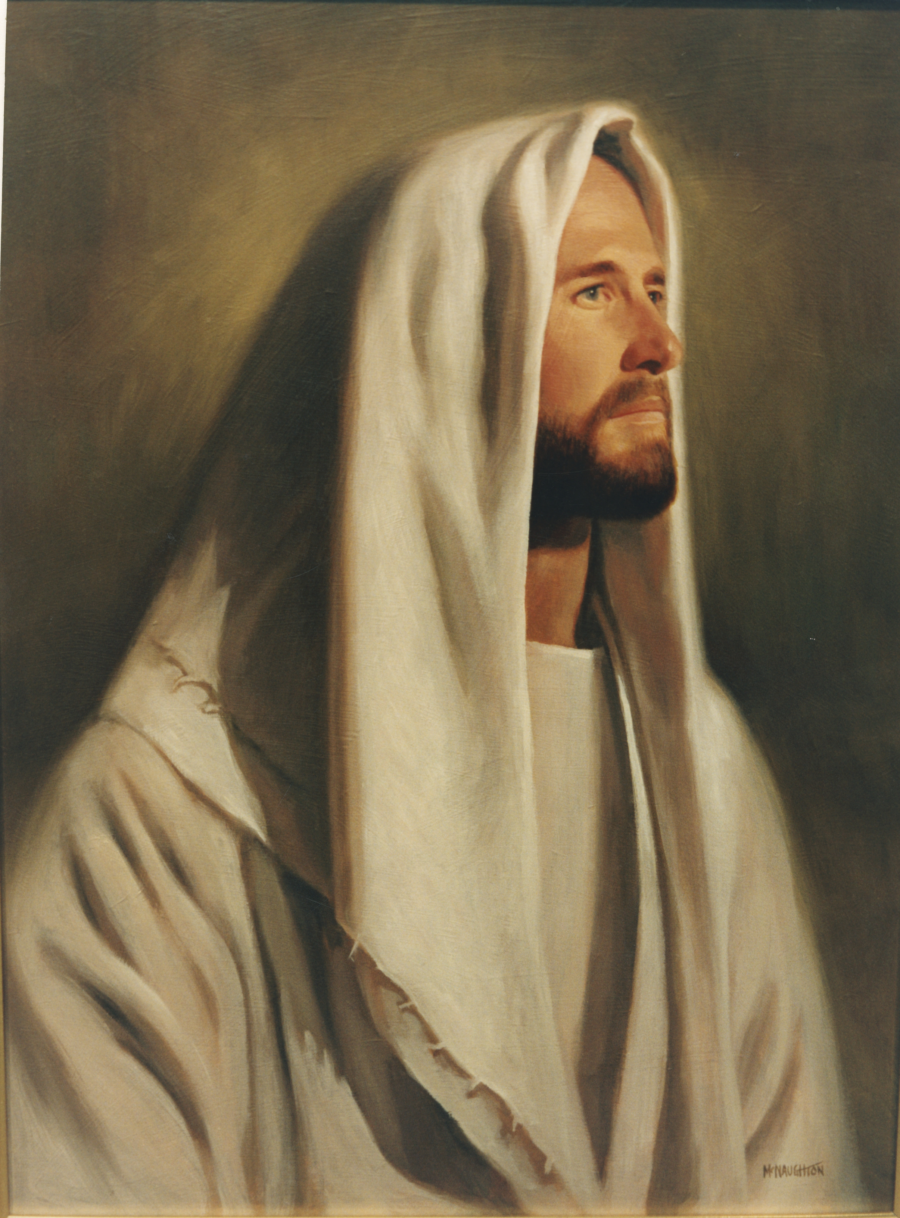
Come unto Christ
If we come unto Christ and partake of the goodness of God, then we will enter into God’s rest.

Slide 23
Come unto Christ
If we come unto Christ and partake of the goodness of God, then we will enter into God’s rest.
What are some examples of how we can experience peace as we exercise faith in Jesus Christ, repent, and live according to His teachings?

Slide 24
Wicked Practices
Nephi anointed a new king over his people shortly before his death. After the death of Nephi, the people began to indulge in certain wicked practices.

Slide 25
Wicked Practices
Nephi anointed a new king over his people shortly before his death. After the death of Nephi, the people began to indulge in certain wicked practices.
Read Jacob 1:15–16 and look for certain wicked practices that concerned Jacob.

Slide 26
Wicked Practices
Nephi anointed a new king over his people shortly before his death. After the death of Nephi, the people began to indulge in certain wicked practices.
Read Jacob 1:15–16 and look for certain wicked practices that concerned Jacob.
If you had been in Jacob’s position, why might you have been concerned about these behaviors?

Slide 27
Fulfilling Responsibility
Read Jacob 1:17–19, looking for what Jacob and Joseph did to fulfill their responsibility as priesthood leaders.

Slide 28
Fulfilling Responsibility
Read Jacob 1:17–19, looking for what Jacob and Joseph did to fulfill their responsibility as priesthood leaders.
What do you think it means to obtain an “errand from the Lord” (Jacob 1:17)?

Slide 29
Fulfilling Responsibility
Read Jacob 1:17–19, looking for what Jacob and Joseph did to fulfill their responsibility as priesthood leaders.
What do you think it means to obtain an “errand from the Lord” (Jacob 1:17)?
What principle can we learn from verse 19 regarding the responsibility of priesthood leaders?

Slide 30
Priesthood Leaders
Priesthood leaders have a divinely given responsibility to teach the word of God and warn against sin.

Slide 31
Priesthood Leaders
Priesthood leaders have a divinely given responsibility to teach the word of God and warn against sin.
Why is it important to understand that Church leaders seek to teach us what the Lord wants us to know? How might keeping this in mind influence our attitude when we listen to them teach?

Slide 32
Priesthood Leaders
Priesthood leaders have a divinely given responsibility to teach the word of God and warn against sin.
Why is it important to understand that Church leaders seek to teach us what the Lord wants us to know? How might keeping this in mind influence our attitude when we listen to them teach?
Why is it a blessing to have Church leaders who warn us of sinful attitudes and behaviors?

Slide 33
Consequences
What did Jacob say would be the consequences if he and Joseph did not perform their responsibilities?

Slide 34
Consequences
What did Jacob say would be the consequences if he and Joseph did not perform their responsibilities?
The phrase “their blood would come upon our garments” (Jacob 1:19) means that Jacob and Joseph would be partially responsible for the sins of the people if they did not perform their responsibilities.

Slide 35
Call to Repentance
How would you feel if, like Jacob, you were in a leadership position and were inspired to call people to repentance for immorality, worldliness, and pride?

Slide 36
Call to Repentance
How would you feel if, like Jacob, you were in a leadership position and were inspired to call people to repentance for immorality, worldliness, and pride?
Read Jacob 2:2–3, 6–7, 9–11 and look for phrases that indicate Jacob’s feelings about his task of calling the people to repentance. Mark what you find.

Slide 37
Call to Repentance
How would you feel if, like Jacob, you were in a leadership position and were inspired to call people to repentance for immorality, worldliness, and pride?
Read Jacob 2:2–3, 6–7, 9–11 and look for phrases that indicate Jacob’s feelings about his task of calling the people to repentance. Mark what you find.
What do these phrases indicate about Jacob’s feelings toward calling his people to repentance?

Slide 38
Call to Repentance
Why do you think Jacob performed his duty to call his people to repentance even though it was so difficult for him?

Slide 39
Review of the Scenario
Imagine that you know a young man whose bishop has counseled him to repent and make a change in his life. The bishop has warned the young man of consequences he may suffer if he continues to commit a particular sin. This young man says that his bishop is too old to understand the way things are today and that the bishop should not interfere with his life or try to control his choices.

Slide 40
Review of the Scenario
How might the truths we have discussed today help the young man understand why his bishop was inviting him to change?

Slide 41
Review of the Scenario
How might the truths we have discussed today help the young man understand why his bishop was inviting him to change?
When has a Church leader blessed your life by encouraging you to live righteously? Please do not share anything too personal or private.

Slide 42
What You Learned Today
What have Church leaders taught you recently? How can you apply it in your life?

Slide 43
What You Learned Today
What have Church leaders taught you recently? How can you apply it in your life?
How can you apply what you have learned today in your callings and other Church responsibilities?

Slide 44
Doctrinal Mastery: The Godhead
Read 3 Nephi 18:15, 20–21 and look for the counsel the Savior gave to the Nephites.

Slide 45
Doctrinal Mastery: The Godhead
Read 3 Nephi 18:15, 20–21 and look for the counsel the Savior gave to the Nephites.
What are some other things that we do in the Savior’s name?

Slide 46
Doctrinal Mastery: The Godhead
3 Nephi 18:15, 20–21 is the doctrinal mastery passage that supports this doctrine: Because Jesus Christ is our Savior and our Mediator with the Father, all prayers, blessings, and priesthood ordinances should be done in His name. Mark this statement in your Doctrinal Mastery Core Document and make note of it in your scriptures near 3 Nephi 18:15, 20–21.

