Slide 1
Jacob 2:12–35
Lesson 44

Slide 2

Devotional
Hymn:
Prayer:
Thought:

Slide 3
Comparisons
Who is the best athlete you know of? Who is the richest person you are aware of? Who is the most famous person you know of?

Slide 4
Comparisons
Who is the best athlete you know of? Who is the richest person you are aware of? Who is the most famous person you know of?
We may often compare one person’s talents, wealth, beauty, or other attributes and achievements against another’s, sometimes without thinking about it. Have you ever compared yourself with another person in one of these ways?

Slide 5
Comparing with Others
Read Jacob 2:12–13, looking for what led some of the Nephites to compare themselves with others.

Slide 6
Comparing with Others
Read Jacob 2:12–13, looking for what led some of the Nephites to compare themselves with others.
What words or phrases in Jacob 2:13 indicate how some of the Nephites were comparing themselves with others?

Slide 7
Comparing with Others
Read Jacob 2:12–13, looking for what led some of the Nephites to compare themselves with others.
What words or phrases in Jacob 2:13 indicate how some of the Nephites were comparing themselves with others?
How can comparison lead to pride?

Slide 8
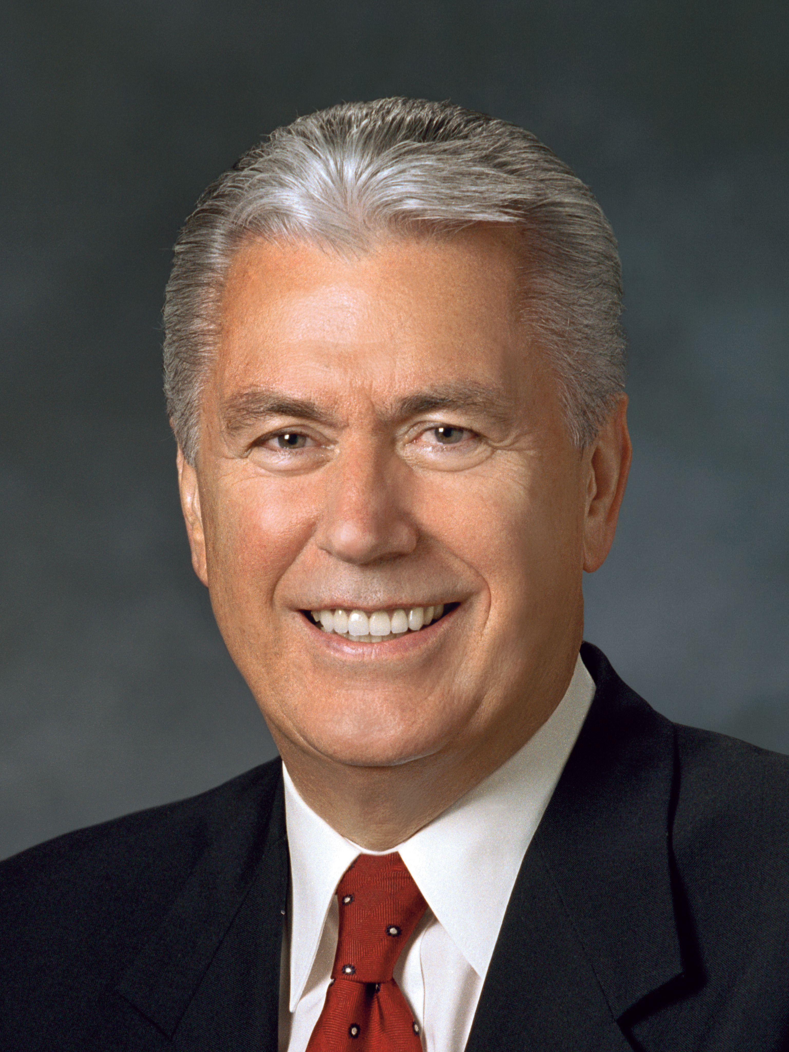
President Dieter F. Uchtdorf
“At its core, pride is a sin of comparison, for though it usually begins with ‘Look how wonderful I am and what great things I have done,’ it always seems to end with ‘Therefore, I am better than you.’ …
“… This is the sin of ‘Thank God I am more special than you.’ At its core is the desire to be admired or envied. It is the sin of self-glorification” (Dieter F. Uchtdorf, “Pride and the Priesthood,” Ensign or Liahona, Nov. 2010, 56).

Slide 9
Pride
How does President Uchtdorf’s statement help explain what it means to be lifted up in pride?

Slide 10
Pride
How does President Uchtdorf’s statement help explain what it means to be lifted up in pride?
Read Jacob 2:14–16, looking for phrases that show the consequences of pride.

Slide 11
Pride
How does President Uchtdorf’s statement help explain what it means to be lifted up in pride?
Read Jacob 2:14–16, looking for phrases that show the consequences of pride.
Pride can destroy our souls.

Slide 12
Pride
How does President Uchtdorf’s statement help explain what it means to be lifted up in pride?
Read Jacob 2:14–16, looking for phrases that show the consequences of pride.
Pride can destroy our souls.
Why do you think pride has the power to “destroy [our] souls” (Jacob 2:16)?

Slide 13
Overcoming Pride
Read Jacob 2:17–19 and look for phrases that teach how we can overcome pride and inappropriate attitudes about material wealth. Mark the phrases you find.

Slide 14
Overcoming Pride
Read Jacob 2:17–19 and look for phrases that teach how we can overcome pride and inappropriate attitudes about material wealth. Mark the phrases you find.
Choose one phrase you have found. How can this phrase help us overcome pride or inappropriate attitudes toward material wealth?

Slide 15
Seek the Kingdom of God
What do you think it means to seek the kingdom of God before riches?

Slide 16
Seek the Kingdom of God
What do you think it means to seek the kingdom of God before riches?
How can seeking the kingdom of God before riches help a person overcome pride?

Slide 17
How God Feels
Read Jacob 2:20–21, looking for how God feels about each of His children.

Slide 18
How God Feels
Read Jacob 2:20–21, looking for how God feels about each of His children.
Each individual is precious in the sight of God.

Slide 19
How God Feels
Read Jacob 2:20–21, looking for how God feels about each of His children.
Each individual is precious in the sight of God.
How might understanding this truth help us avoid the sin of pride?

Slide 20
How God Feels
Read Jacob 2:20–21, looking for how God feels about each of His children.
Each individual is precious in the sight of God.
How might understanding this truth help us avoid the sin of pride?
What experiences have you had that have helped you know that each individual is precious in the sight of God?

Slide 21
The Sin of Pride
What is one thing you might do to better avoid or overcome the sin of pride?

Slide 22
The Sin of Pride
What is one thing you might do to better avoid or overcome the sin of pride?
After Jacob warned the Nephites about pride, he proceeded to warn them about something he called “a grosser crime” (Jacob 2:22). The word grosser means more serious.

Slide 23
A Grosser Crime
Read Jacob 2:22–23, looking for what Jacob said was a grosser crime than pride.

Slide 24
A Grosser Crime
Read Jacob 2:22–23, looking for what Jacob said was a grosser crime than pride.
The word whoredoms refers to sexual sins. One way the Nephites were committing sexual sins was by entering into unauthorized plural marriages (see Jacob 1:15).

Slide 25
Marriage
Read Jacob 2:24–27, looking for what the Lord declared about marriage. The word concubine refers to a woman in Old Testament times who was legally married to a man but had a lower social status than a wife. The Lord did not condemn David and Solomon for practicing plural marriage in general; rather, He condemned them for entering into specific plural marriages that He had not authorized (see D&C 132:37–39).

Slide 26
The Word of the Lord
According to Jacob 2:27, what is the “word of the Lord” regarding having more than one wife?

Slide 27
The Word of the Lord
According to Jacob 2:27, what is the “word of the Lord” regarding having more than one wife?
Unless the Lord commands otherwise, He has ordained that marriage is to be between one man and one woman. Write this truth in your scriptures.

Slide 28
One Man and One Woman
Unlike in Old Testament times, in Book of Mormon times and in our day, the Lord has commanded that a man should be married to one wife. (See also D&C 49:15–16.) At certain times in the history of the world, the Lord has commanded His people to practice plural marriage.

Slide 29
Plural Marriage
Plural marriage was practiced in Old Testament times by Abraham and Sarah (see Genesis 16:1–3; D&C 132:34–35, 37) and by their grandson Jacob (see D&C 132:37), and it was practiced for a time during the early days of the restored Church, beginning with the Prophet Joseph Smith (see D&C 132:32–33, 53).

Slide 30
Practicing Plural Marriage
Read Jacob 2:30, looking for when the Lord’s people are authorized to practice plural marriage.

Slide 31
Practicing Plural Marriage
Read Jacob 2:30, looking for when the Lord’s people are authorized to practice plural marriage.
Plural marriage is authorized only when the Lord commands it. Write this truth in your scriptures.

Slide 32
Practicing Plural Marriage
Read Jacob 2:30, looking for when the Lord’s people are authorized to practice plural marriage.
Plural marriage is authorized only when the Lord commands it. Write this truth in your scriptures.
If the Lord commands individuals to practice plural marriage, He will issue that command through His prophet—the President of the Church—and through no one else (see D&C 132:45–48).

Slide 33
Plural Marriage
According to Jacob 2:30, why did the Lord command some of His children to practice plural marriage?

Slide 34
Plural Marriage
According to Jacob 2:30, why did the Lord command some of His children to practice plural marriage?
The Lord’s general command is to not participate in plural marriage. However, He may command His people to participate in plural marriage for a time when He deems it necessary to “raise up seed” unto Him—that is, when He wants His people to bring more children into the world who will be born in the covenant and raised in gospel-centered homes.

Slide 35
Plural Marriage in Church History
In obedience to direction from God through a revelation to the Prophet Joseph Smith, some Latter-day Saints followed this practice for years during the 1800s (see D&C 132).

Slide 36
Plural Marriage in Church History
In obedience to direction from God through a revelation to the Prophet Joseph Smith, some Latter-day Saints followed this practice for years during the 1800s (see D&C 132).
In 1890, when conditions had changed in the Church and in the laws of the United States, Church President Wilford Woodruff was inspired to issue a manifesto in which he declared that the Latter-day Saints were to refrain from contracting plural marriages (see Official Declaration 1).

Slide 37
A Second Manifesto
A small number of plural marriages were performed under the sanction of some Church leaders until a second manifesto, authored by Church President Joseph F. Smith, ended the practice worldwide in 1904. Since that time, any Latter-day Saint who adopts this practice is subject to losing his or her membership in the Church.

Slide 38
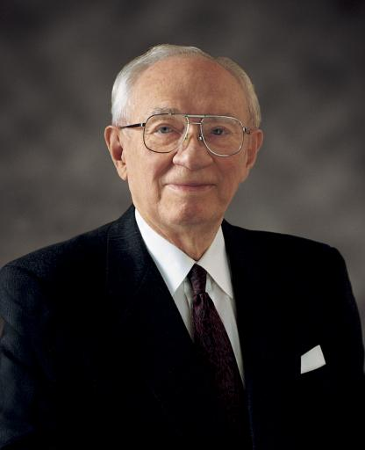
President Gordon B. Hinckley
“I wish to state categorically that this Church has nothing whatever to do with those practicing polygamy. They are not members of this Church. Most of them have never been members. They are in violation of the civil law. They know they are in violation of the law. They are subject to its penalties. …
Continued on the next page.

Slide 39
President Gordon B. Hinckley, cont.
“If any of our members are found to be practicing plural marriage, they are excommunicated, the most serious penalty the Church can impose. Not only are those so involved in direct violation of the civil law, they are in violation of the law of this Church. An article of our faith is binding upon us. It states, ‘We believe in being subject to kings, presidents, rulers, and magistrates, in obeying, honoring, and sustaining the law’ (A of F 1:12). …
Continued on the next page.

Slide 40
President Gordon B. Hinckley, cont.
“More than a century ago God clearly revealed unto His prophet Wilford Woodruff that the practice of plural marriage should be discontinued, which means that it is now against the law of God. Even in countries where civil or religious law allows polygamy, the Church teaches that marriage must be monogamous and does not accept into its membership those practicing plural marriage” (Gordon B. Hinckley, “What Are People Asking about Us?” Ensign, Nov. 1998, 71–72).

Slide 41
More Information
If you want to know more information on the history of the practice of plural marriage in the Church, see “Plural Marriage in The Church of Jesus Christ of Latter-day Saints,” Gospel Topics, topics.lds.org.

Slide 42
Sexual Sin
Jacob was speaking to the Nephites about the most prominent way they were committing sexual sin. Read Jacob 2:28, looking for how the Lord feels about chastity and sexual sin.

Slide 43
Sexual Sin
Jacob was speaking to the Nephites about the most prominent way they were committing sexual sin. Read Jacob 2:28, looking for how the Lord feels about chastity and sexual sin.
The Lord delights in chastity, and sexual sin is an abomination before the Lord. You may wish to mark these words in your scriptures.

Slide 44
Chastity
“Chastity is sexual purity, a condition that is ‘pleasing unto God’ (Jacob 2:7). To be chaste, you must be morally clean in your thoughts, words, and actions. You must not have any sexual relations before you are legally married. When you are married, you must be completely faithful to your husband or wife.
Continued on the next page.

Slide 45
Chastity
“Physical intimacy between husband and wife is beautiful and sacred. It is ordained of God for the creation of children and for the expression of love within marriage” (True to the Faith: A Gospel Reference [2004], 29).

Slide 46
The Law of Chastity
Why do you think chastity and sexual sin are such important topics?

Slide 47
The Law of Chastity
Why do you think chastity and sexual sin are such important topics?
Why can it be challenging to live the law of chastity in our day?

Slide 48
The Law of Chastity
Why do you think chastity and sexual sin are such important topics?
Why can it be challenging to live the law of chastity in our day?
What has helped you live the law of chastity in a world that frequently challenges it?

Slide 49
Chastity: What Are the Limits?
Watch this video and look for anything that might help you guard against sexual sin.
https://www.lds.org/youth/video/chastity-what-are-the-limits?lang=eng

Slide 50
For the Strength of Youth
“Never do anything that could lead to sexual transgression. Treat others with respect, not as objects used to satisfy lustful and selfish desires. Before marriage, do not participate in passionate kissing, lie on top of another person, or touch the private, sacred parts of another person’s body, with or without clothing. Do not do anything else that arouses sexual feelings. Do not arouse those emotions in your own body. …
Continued on the next slide.

Slide 51
For the Strength of Youth, cont.
“Avoid situations that invite increased temptation. … Do not participate in discussions or any media that arouse sexual feelings. Do not participate in any type of pornography. The Spirit can help you know when you are at risk and give you the strength to remove yourself from the situation” (For the Strength of Youth [booklet, 2011], 36).

Slide 52
Follow the Guidelines
How can following the guidelines in For the Strength of Youth help us live the law of chastity?

Slide 53
Questions about Sexual Sin
If you have any questions about sexual sin, talk to your parents or your bishop or branch president.

Slide 54
Immoral Choices
Read Jacob 2:31–35, looking for how the immoral choices of Nephite men had affected their families. Although Jacob was speaking only to men, the law of chastity is equally important for women.

Slide 55
Rationalizing
Some young people rationalize that they can break the law of chastity because their actions do not hurt anyone else. According to Jacob 2:31–35, how might a person’s immorality affect other people?

Slide 56
Rationalizing
Some young people rationalize that they can break the law of chastity because their actions do not hurt anyone else. According to Jacob 2:31–35, how might a person’s immorality affect other people?
What could you say to someone who claims that the law of chastity is outdated and unnecessary?

Slide 57
Becoming Clean
Commit yourself to choose to be morally clean by living the law of chastity. If you have sinned against the law of chastity, seek help from your bishop or branch president, who can help you repent and become clean through the Atonement of Jesus Christ.

Slide 58
Doctrinal Mastery: The Godhead
In the last lesson, you studied 3 Nephi 18:15, 20–21 and this doctrine: Because Jesus Christ is our Savior and our Mediator with the Father, all prayers, blessings, and priesthood ordinances should be done in His name.

Slide 59
Doctrinal Mastery: The Godhead
In the last lesson, you studied 3 Nephi 18:15, 20–21 and this doctrine: Because Jesus Christ is our Savior and our Mediator with the Father, all prayers, blessings, and priesthood ordinances should be done in His name.
Have you ever wondered why we do so many things in the Savior’s name?

Slide 60
Doctrinal Mastery: The Godhead
We are separated from our Father in Heaven, His power, and blessings by both the Fall and personal sin. Jesus Christ is our Mediator with Heavenly Father. A mediator is someone who intervenes between individuals or groups in order to resolve differences and bring them together.

Slide 61
Doctrinal Mastery: The Godhead
Through His atoning sacrifice, the Savior provides a way for all people to overcome the negative consequences of the Fall, repent of their sins, be reconciled to Heavenly Father, and receive the blessings of salvation. This is one reason we pray to the Father in the name of Jesus Christ.

Slide 62
Doctrinal Mastery: The Godhead
In addition to prayer, what are some other things we are commanded to do in the name of Jesus Christ?

