Slide 1
Jacob 3–4
Lesson 45

Slide 2

Devotional
Hymn:
Prayer:
Thought:

Slide 3
Three Scenarios
A young woman is striving to live righteously but suffers because her father is addicted to alcohol.

Slide 4
Three Scenarios
A young woman is striving to live righteously but suffers because her father is addicted to alcohol.
A young man does his best to live the gospel but experiences trials because of his parents’ divorce.

Slide 5
Three Scenarios
A young woman is striving to live righteously but suffers because her father is addicted to alcohol.
A young man does his best to live the gospel but experiences trials because of his parents’ divorce.
A young woman diligently tries to love her family but struggles at home because of her sister’s selfishness and inconsiderate actions.

Slide 6
Experiencing Trials
Jacob had been speaking directly to people who were guilty of pride and sexual sins. Then he turned his attention to righteous people who were experiencing trials because of the wickedness of others. As you study Jacob 3 today, look for truths that can help those who suffer because of the choices of other people.

Slide 7
The Pure in Heart
Read Jacob 3:1, looking for the counsel Jacob gave to the pure in heart who were suffering because of the wickedness of others.

Slide 8
The Pure in Heart
Read Jacob 3:1, looking for the counsel Jacob gave to the pure in heart who were suffering because of the wickedness of others.
What did Jacob promise the pure in heart if they would do those things?

Slide 9
Look unto God
If we look unto God with firmness of mind and pray with exceeding faith, He will console us in our afflictions. You may wish to mark the words that teach this principle in Jacob 3:1. The word console means to comfort someone who is sad or troubled.

Slide 10
The Three Scenarios
How could looking to God with firmness of mind and praying to Him with exceeding faith help the individuals in the scenarios from earlier in the lesson?

Slide 11
Praying with Faith
How has praying with faith helped you during a time of trial?

Slide 12
Praying with Faith
How has praying with faith helped you during a time of trial?
How has the Lord consoled you?

Slide 13
Jacob’s Counsel
Read Jacob 3:2, looking for the additional counsel Jacob gave to those who are pure in heart.

Slide 14
Jacob’s Counsel
Read Jacob 3:2, looking for the additional counsel Jacob gave to those who are pure in heart.
Read Jacob 3:3–4, looking for the warning Jacob gave to the impure Nephites.

Slide 15
The Lamanites
Read Jacob 3:5–7, looking for ways the Lamanites were more righteous than some of the Nephites.

Slide 16
The Lamanites
Read Jacob 3:5–7, looking for ways the Lamanites were more righteous than some of the Nephites.
According to verse 5, how did some of the Nephites feel about the Lamanites?

Slide 17
The Lamanites
Read Jacob 3:5–7, looking for ways the Lamanites were more righteous than some of the Nephites.
According to verse 5, how did some of the Nephites feel about the Lamanites?
Read Jacob 3:9, looking for two reasons some of the Nephites reviled against the Lamanites. The word revile means to criticize in an angry or insulting manner.

Slide 18
All Are Alike unto God
“God loves all of His children and makes salvation available to all. God created the many diverse races and ethnicities and esteems them all equally. As the Book of Mormon puts it, ‘all are alike unto God’ (2 Nephi 26:33 )” (“Race and the Priesthood,” Gospel Topics, topics.lds.org).

Slide 19
The Lamanites
The Nephites also reviled the Lamanites because of their filthiness—meaning their sins. According to Jacob 3:9, what did Jacob tell the Nephites to remember rather than the Lamanites’ filthiness?

Slide 20
The Lamanites
The Nephites also reviled the Lamanites because of their filthiness—meaning their sins. According to Jacob 3:9, what did Jacob tell the Nephites to remember rather than the Lamanites’ filthiness?
What principle can we learn from Jacob’s words in verse 9?

Slide 21
Repent of Our Sins
Rather than criticizing others for their sins, we are to recognize and repent of our own sins.

Slide 22
Repent of Our Sins
Rather than criticizing others for their sins, we are to recognize and repent of our own sins.
Why do you think this is an important principle to live by?

Slide 23
Jacob’s Warning
Read Jacob 3:10, looking for the warning Jacob specifically gave to the Nephite fathers.

Slide 24
Jacob’s Warning
Read Jacob 3:10, looking for the warning Jacob specifically gave to the Nephite fathers.
In Jacob 3:11–12, Jacob told his people to wake up spiritually and warned them of the awful consequences of sexual sin.

Slide 25

Exercises
What are some different types of exercises you have done? How did these exercises help you strengthen your muscles?

Slide 26
Exercises
What are some different types of exercises you have done? How did these exercises help you strengthen your muscles?
How is the process of strengthening your muscles similar to the process of strengthening your faith in Jesus Christ?

Slide 27
Strengthening Our Faith
Read Jacob 4:5–6, 10–11, looking for things Jacob taught that can help us strengthen our faith in Jesus Christ.

Slide 28
Strengthening Our Faith
Read Jacob 4:5–6, 10–11, looking for things Jacob taught that can help us strengthen our faith in Jesus Christ.
To convey the principles taught in these verses, complete this sentence: We can strengthen our faith in Jesus Christ by choosing to …

Slide 29
Our Faith in Jesus Christ
We can strengthen our faith in Jesus Christ by choosing to believe in Him and by worshipping the Father in His name. (See Jacob 4:5.)

Slide 30
Our Faith in Jesus Christ
We can strengthen our faith in Jesus Christ by choosing to believe in Him and by worshipping the Father in His name. (See Jacob 4:5.)
We can strengthen our faith in Jesus Christ by choosing to search the words of the prophets. (See Jacob 4:6.)

Slide 31
Our Faith in Jesus Christ
We can strengthen our faith in Jesus Christ by choosing to take counsel from His hand. (See Jacob 4:10.)

Slide 32
Our Faith in Jesus Christ
We can strengthen our faith in Jesus Christ by choosing to take counsel from His hand. (See Jacob 4:10.)
What do you think it means to “take counsel from [the Lord’s] hand” (verse 10)?

Slide 33
Our Faith in Jesus Christ
We can strengthen our faith in Jesus Christ by choosing to be reconciled to God through the Atonement of Christ. (See Jacob 4:11.)
What does it mean to be reconciled to God?

Slide 34
Knowing Future Events
Read Jacob 4:13, looking for how Jacob and other prophets were able to know of the coming of Jesus Christ and other events that would occur in the future.

Slide 35
Knowing Future Events
Read Jacob 4:13, looking for how Jacob and other prophets were able to know of the coming of Jesus Christ and other events that would occur in the future.
Read Jacob 4:14, looking for the actions of many of the ancient Jews that indicated they lacked faith in Jesus Christ.

Slide 36
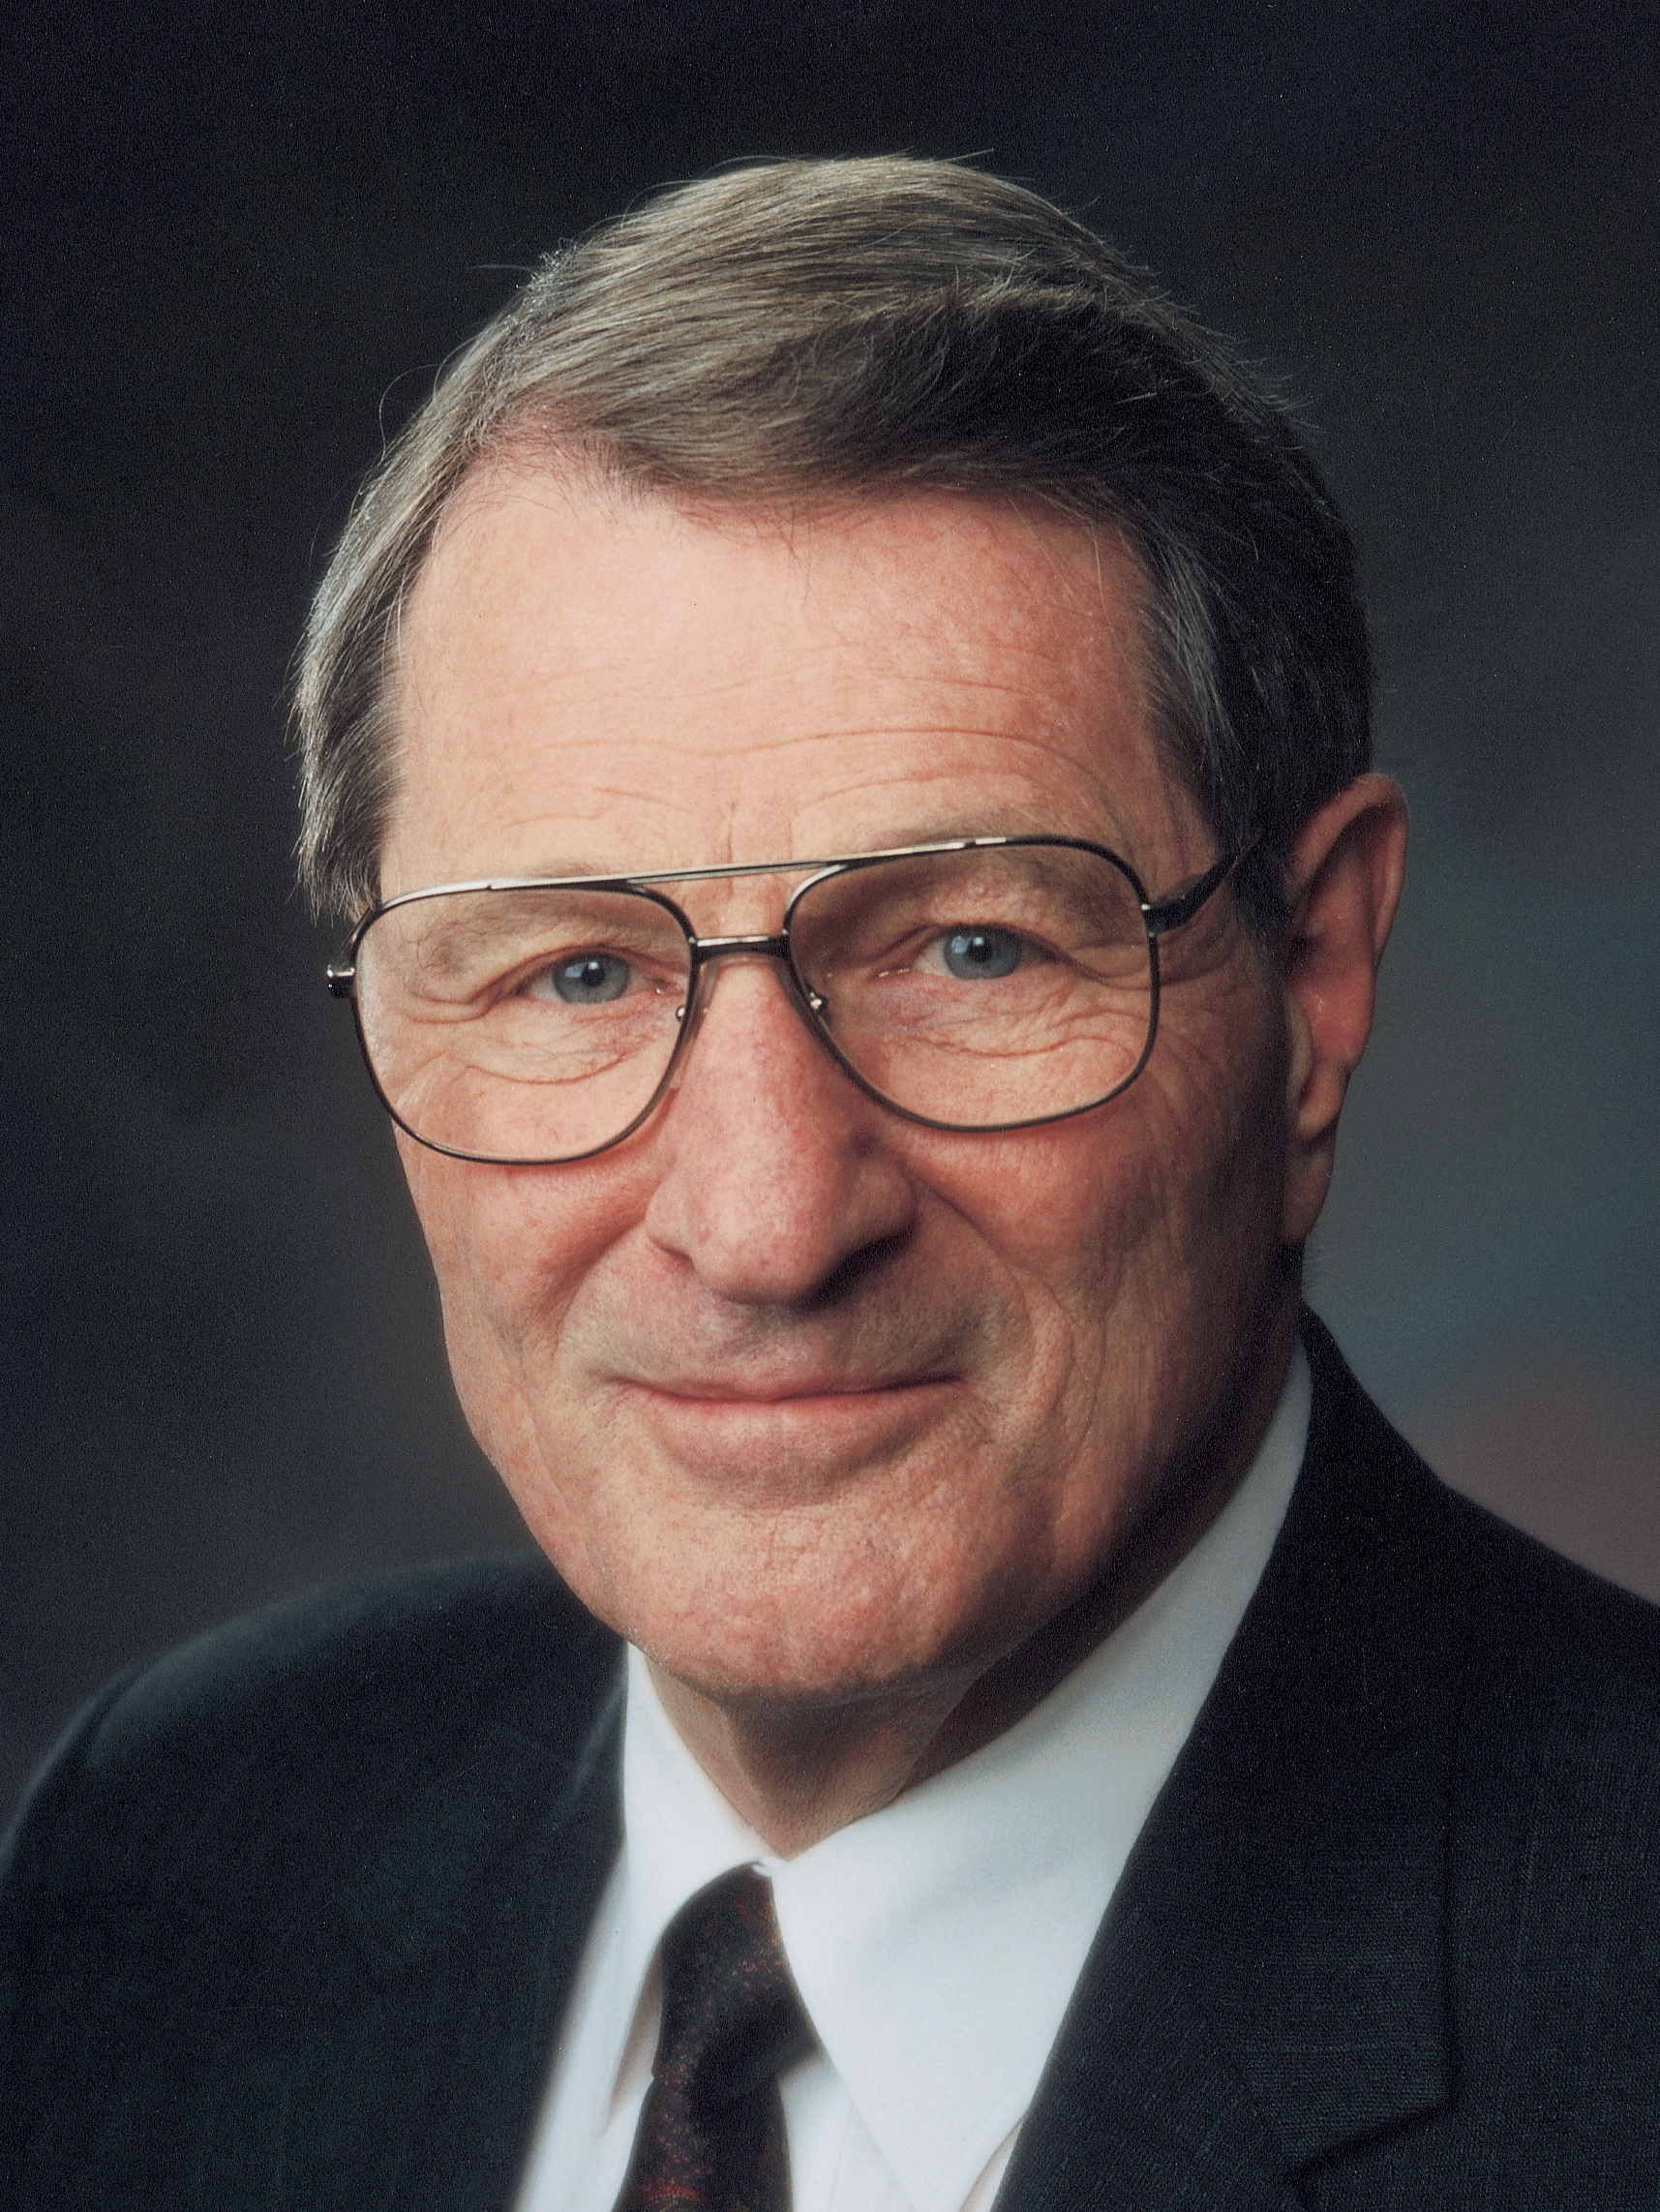
Elder Neal A. Maxwell
Notice the phrase “looking beyond the mark” (verse 14). Elder Neal A. Maxwell (1926–2004) of the Quorum of the Twelve Apostles taught that in this verse, “the mark is Christ” (“Jesus of Nazareth, Savior and King,” Ensign, Dec. 2007, 45). Take note of this next to Jacob 4:14.

Slide 37
Looking Beyond the Mark
What do you think it might mean to look beyond the mark?

Slide 38
Looking Beyond the Mark
What do you think it might mean to look beyond the mark?
What principle can we learn from Jacob 4:14 about the consequences of centering our lives on anything other than the Savior and His gospel?

Slide 39
The Center of Our Lives
If we center our lives on anything other than the Savior and His gospel, then we will become blind to the truth and we will stumble and fall spiritually.

Slide 40
The Center of Our Lives
What are some examples of things someone might center his or her life on other than Jesus Christ and His gospel?

Slide 41
The Center of Our Lives
What are some examples of things someone might center his or her life on other than Jesus Christ and His gospel?
What are some things you have done to make Jesus Christ and His gospel higher priorities over these things? How has doing that strengthened your faith in Christ?

Slide 42
Summary
In Jacob 4:15–18, Jacob prophesied that the Jews would reject Jesus Christ. Jacob also wrote that he would explain how the Jews would eventually be able to receive the blessings of the gospel. These verses provide an introduction to the allegory of the tame and wild olive trees, which is recorded in Jacob 5.

Slide 43
What Will You Do?
Continue to strengthen your faith in Jesus Christ by focusing your life on Him and on the truths of His gospel. What will you do to focus on the Savior throughout the next few days?

Slide 44
Doctrinal Mastery: The Godhead
Do you remember this doctrine? Because Jesus Christ is our Savior and our Mediator with the Father, all prayers, blessings, and priesthood ordinances should be done in His name.

Slide 45
Doctrinal Mastery: The Godhead
Do you remember this doctrine? Because Jesus Christ is our Savior and our Mediator with the Father, all prayers, blessings, and priesthood ordinances should be done in His name.
Which doctrinal mastery passage supports this doctrine? (a) 2 Nephi 26:33; (b) 3 Nephi 12:48; (c) 3 Nephi 18:15, 20–21; (d) 3 Nephi 11:10–11.

Slide 46
Doctrinal Mastery: The Godhead
Using the name of Jesus Christ in prayers, blessings, and priesthood ordinances invokes His divine authority and power (see Abraham 1:18). Read one of the scripture passages below. Look for some of the results of prayers, blessings, and priesthood ordinances that are done in the name of Jesus Christ.
Acts 2:37–38; Acts 3:2–8; Doctrine and Covenants 84:66–70; Moses 1:21–22

