Slide 1
Jacob 5:1–51
Lesson 46

Slide 2
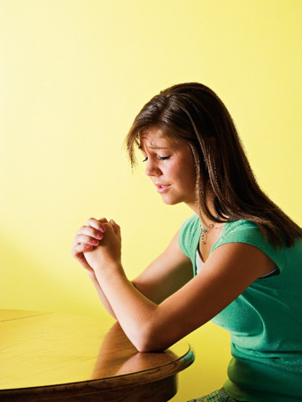
Devotional
Hymn:
Prayer:
Thought:
Notes:
ID 272818

Slide 3
A Scenario
A young woman transgresses a commandment. She experiences guilt, feels terrible about herself, and questions if the Lord still loves her.

Slide 4
A Scenario
A young woman transgresses a commandment. She experiences guilt, feels terrible about herself, and questions if the Lord still loves her.
Have you ever wondered about the Lord’s willingness to love and care for us when we sin and turn away from Him?

Slide 5
An Allegory
Jacob prophesied that the Jews would reject Jesus Christ (see Jacob 4:15). In order to teach how the Jews would someday build upon Jesus Christ again as their foundation, Jacob quoted an allegory given by a prophet named Zenos. An allegory is a story in which the characters, objects, and happenings have symbolic meanings.

Slide 6
Zenos
Read Jacob 5:1–2 and look for who Zenos was speaking to.

Slide 7
The House of Israel
When the Old Testament prophet Jacob made covenants with the Lord, the Lord changed his name to Israel. The phrase “house of Israel” refers to Jacob’s descendants and to all people who have been baptized and have made covenants with the Lord.

Slide 8
The House of Israel
When the Old Testament prophet Jacob made covenants with the Lord, the Lord changed his name to Israel. The phrase “house of Israel” refers to Jacob’s descendants and to all people who have been baptized and have made covenants with the Lord.
Read Jacob 5:3 and look for what Zenos used in his allegory to represent the house of Israel.

Slide 9
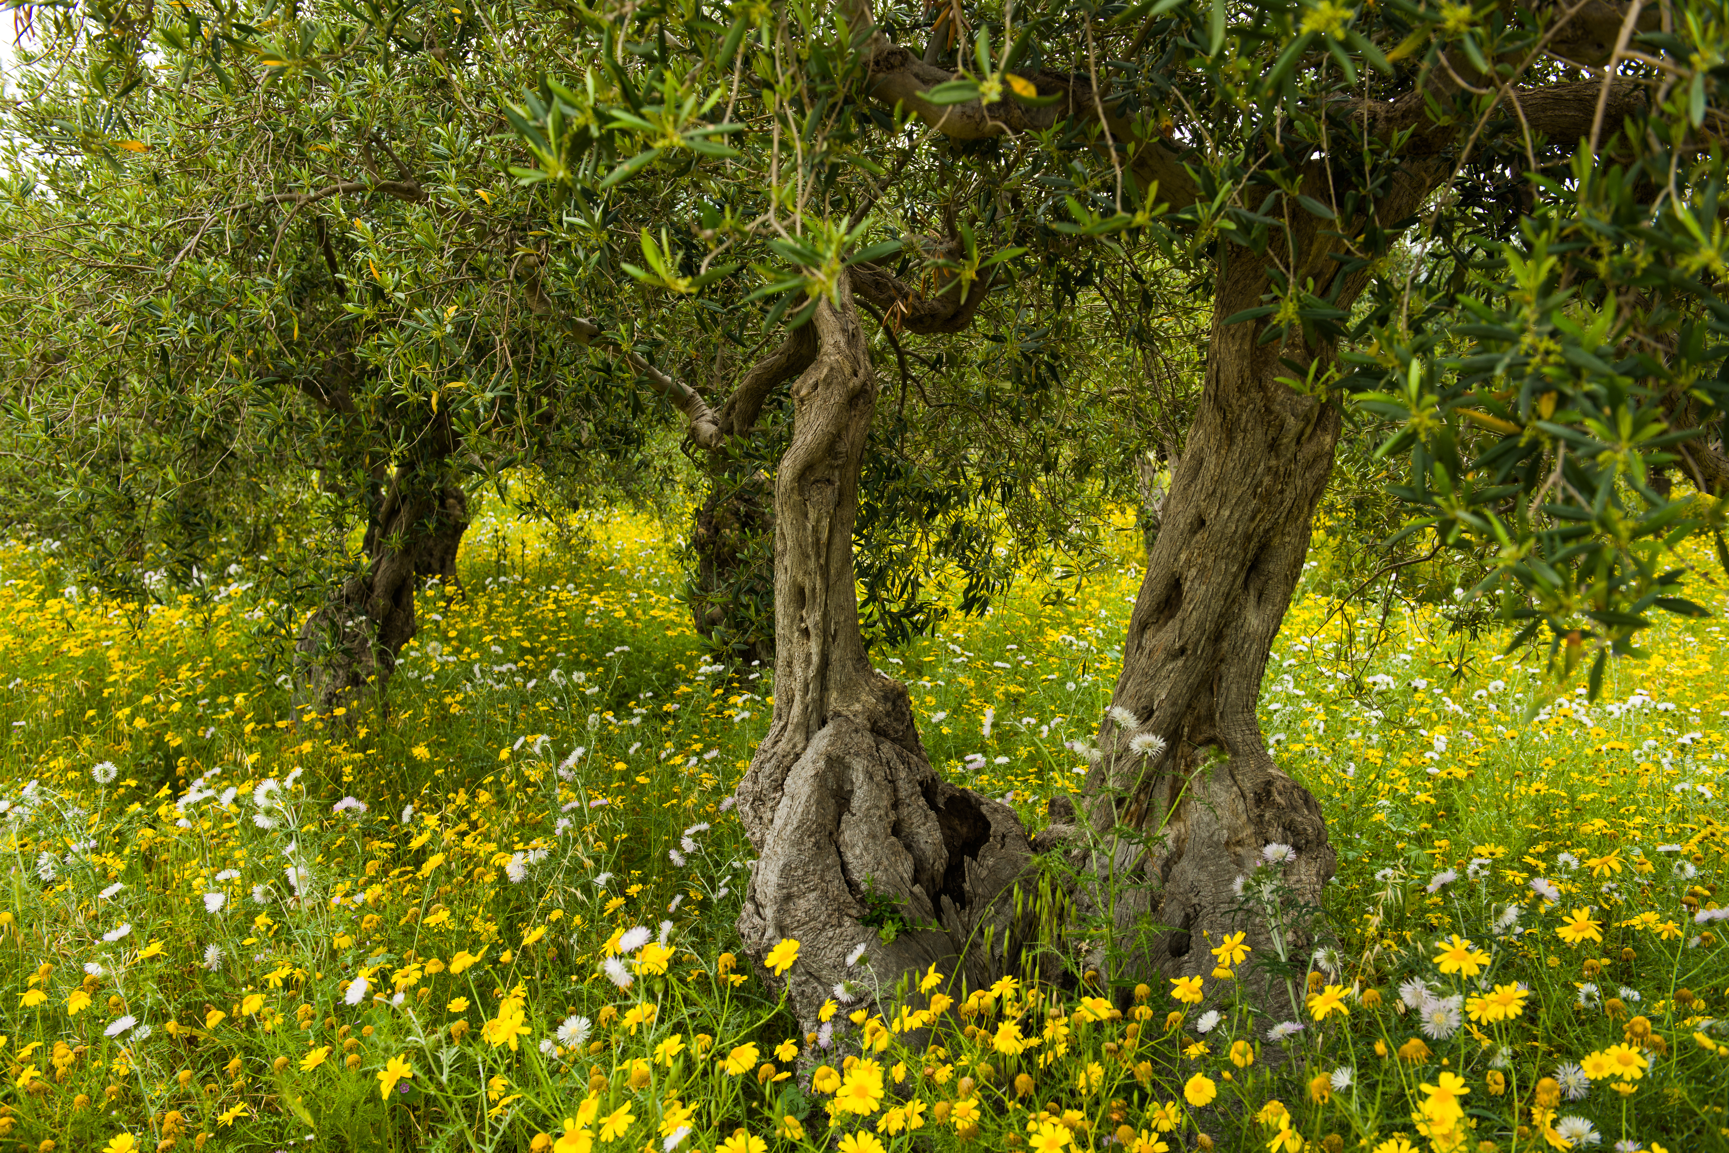
The Olive Tree
Olive trees were extremely valuable in ancient Israel, where Zenos lived. Olives were used for food, and olive oil was used for cooking and medicine and as fuel for lamps. Olive trees required much care and labor to help them produce good fruit. In this allegory, the tame olive tree is located in a vineyard, which represents the world.

Slide 10
The Tame Olive Tree
According to Jacob 5:3, what began to happen to the tame olive tree?

Slide 11
The Tame Olive Tree
According to Jacob 5:3, what began to happen to the tame olive tree?
What does the decay of the tree symbolize?

Slide 12
The Tame Olive Tree
According to Jacob 5:3, what began to happen to the tame olive tree?
What does the decay of the tree symbolize?
What is apostasy?

Slide 13
The Tame Olive Tree
According to Jacob 5:3, what began to happen to the tame olive tree?
What does the decay of the tree symbolize?
What is apostasy?
Read Jacob 5:4–6, looking for the main figure in this allegory.

Slide 14
The Master of the Vineyard
Whom do you think the master of the vineyard represents?

Slide 15
The Master of the Vineyard
Whom do you think the master of the vineyard represents?
What do you think his actions of pruning, digging, and nourishing might represent?

Slide 16
A Repeated Phrase
Read Jacob 5:7, 11, 13, 32, looking for the phrase repeated in each verse that shows how the master felt about the decay of his olive tree. Mark this phrase each time it occurs.

Slide 17
A Repeated Phrase
Read Jacob 5:7, 11, 13, 32, looking for the phrase repeated in each verse that shows how the master felt about the decay of his olive tree. Mark this phrase each time it occurs.
What do these verses teach us about how the Lord feels about us, even if we turn away from Him?

Slide 18
The Lord Loves Us
The Lord loves us and continues to care for us even if we turn away from Him. You may wish to write this truth next to Jacob 5:7.

Slide 19
The Lord Loves Us
The Lord loves us and continues to care for us even if we turn away from Him. You may wish to write this truth next to Jacob 5:7.
How could this truth help people who have sinned and wonder whether God still loves them?

Slide 20
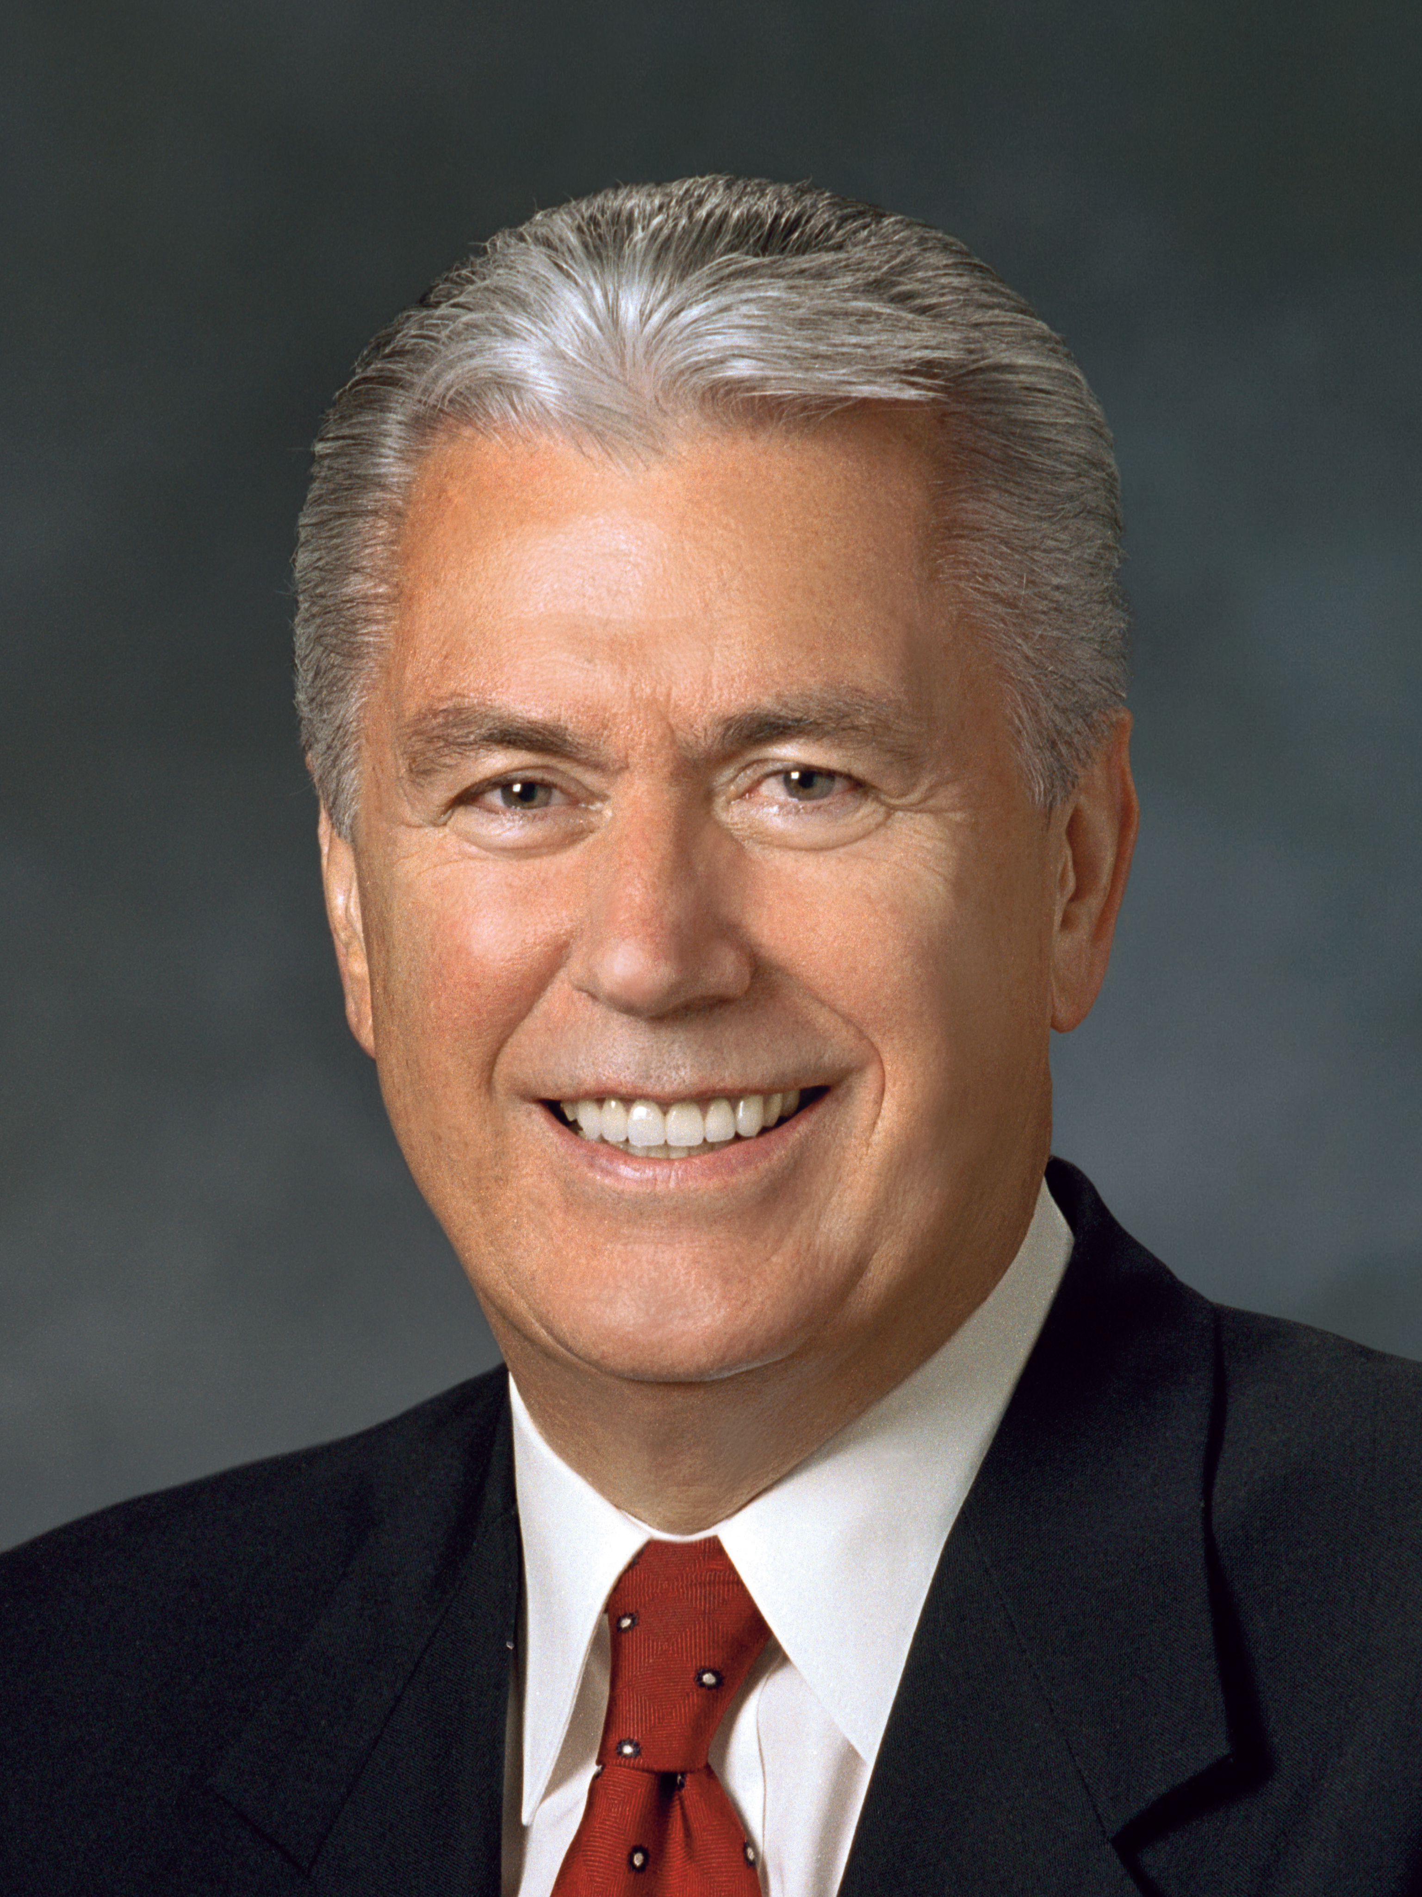
President Dieter F. Uchtdorf
“God loves you this very day and always.
“He is not waiting to love you until you have overcome your weaknesses and bad habits. He loves you today with a full understanding of your struggles. … He knows of your sufferings. He knows of your remorse for the times you have fallen short or failed. And still He loves you” (Dieter F. Uchtdorf, “Living the Gospel Joyful,” Ensign or Liahona, Nov. 2014, 123).

Slide 21
Examples
What are some examples, from the scriptures or from your life, that illustrate that the Lord continues to love and care for people even after they have turned away from Him?

Slide 22
Examples
What are some examples, from the scriptures or from your life, that illustrate that the Lord continues to love and care for people even after they have turned away from Him?
As recorded in Jacob 5:7, the master of the vineyard commanded that the main decaying branches of the olive tree be removed and that branches from a wild olive tree be brought to him.

Slide 23
The Master of the Vineyard
Read Jacob 5:9–10, looking for what the master of the vineyard did next to save the tame olive tree.

Slide 24
The Master of the Vineyard
Read Jacob 5:9–10, looking for what the master of the vineyard did next to save the tame olive tree.
To graft is to insert a branch from one tree into a different tree.

Slide 25
The Master of the Vineyard
Read Jacob 5:9–10, looking for what the master of the vineyard did next to save the tame olive tree.
To graft is to insert a branch from one tree into a different tree.
What might be symbolized by the Lord’s command to graft wild olive branches into the tame olive tree?

Slide 26
The Master of the Vineyard
Read Jacob 5:9–10, looking for what the master of the vineyard did next to save the tame olive tree.
To graft is to insert a branch from one tree into a different tree.
What might be symbolized by the Lord’s command to graft wild olive branches into the tame olive tree?
What might be represented by the burning of the withered branches (see verse 9)?

Slide 27
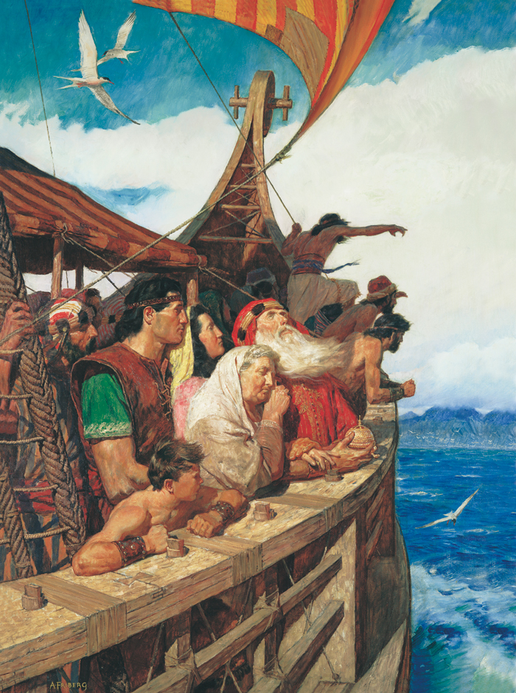
Lehi and His People
Jacob 5:6 states that the tame olive tree had begun to produce young and tender branches.

Slide 28
Lehi and His People
Jacob 5:6 states that the tame olive tree had begun to produce young and tender branches.
Read Jacob 5:8, 13–14, looking for what the master did with these branches.

Slide 29
Lehi and His People
Jacob 5:6 states that the tame olive tree had begun to produce young and tender branches.
Read Jacob 5:8, 13–14, looking for what the master did with these branches.
How does the journey of Lehi’s family provide an example of the master’s actions in Jacob 5:8, 13–14?

Slide 30
Young and Tender Branches
In Jacob 5:15–28, a long time after the master of the vineyard had performed his work, he and his servant, who represents the prophets, went to see the olive trees now scattered throughout the vineyard. They saw that all the branches that had been grafted brought forth good fruit.

Slide 31
Young and Tender Branches
In Jacob 5:15–28, a long time after the master of the vineyard had performed his work, he and his servant, who represents the prophets, went to see the olive trees now scattered throughout the vineyard. They saw that all the branches that had been grafted brought forth good fruit.
What might the good or tame fruit throughout most of the vineyard represent?

Slide 32
The Corruption of the Vineyard
In Jacob 5:29–40, all the fruit throughout the vineyard later became corrupt.

Slide 33
The Corruption of the Vineyard
In Jacob 5:29–40, all the fruit throughout the vineyard later became corrupt.
Read Jacob 5:32, 39, looking for phrases that indicate this corruption of the vineyard. Mark the phrases you find.

Slide 34
The Corruption of the Vineyard
In Jacob 5:29–40, all the fruit throughout the vineyard later became corrupt.
Read Jacob 5:32, 39, looking for phrases that indicate this corruption of the vineyard. Mark the phrases you find.
What do you think this corruption throughout the vineyard might represent?

Slide 35
The Great Apostasy
The period of corruption mentioned in Jacob 5:32, 39 might refer to the period of the Great Apostasy, during which the fulness of the gospel of Jesus Christ was lost from the earth. Write “The Great Apostasy” next to one of the phrases you found in Jacob 5:32 or Jacob 5:39.

Slide 36
Jesus Christ’s Feelings
Read Jacob 5:41. What does the Lord’s weeping in this allegory teach us about His feelings for us?

Slide 37
Jesus Christ’s Feelings
Read Jacob 5:41. What does the Lord’s weeping in this allegory teach us about His feelings for us?
What do you think it means when the Lord asks, “What could I have done more for my vineyard”?

Slide 38
What Caused the Corruption
Read Jacob 5:47–48, looking for what had corrupted the vineyard.

Slide 39
What Caused the Corruption
Read Jacob 5:47–48, looking for what had corrupted the vineyard.
What principle can we learn from verse 48 about how pride can affect us?

Slide 40
What Caused the Corruption
Read Jacob 5:47–48, looking for what had corrupted the vineyard.
What principle can we learn from verse 48 about how pride can affect us?
Pride can prevent us from fulfilling our potential as the Lord’s covenant people.

Slide 41
What Caused the Corruption
Read Jacob 5:47–48, looking for what had corrupted the vineyard.
What principle can we learn from verse 48 about how pride can affect us?
Pride can prevent us from fulfilling our potential as the Lord’s covenant people.
How could pride prevent us from growing the way the Lord wants us to?

Slide 42
He Cares
Read Jacob 5:49–51, looking for what the Lord decided to do with His vineyard.

Slide 43
He Cares
Read Jacob 5:49–51, looking for what the Lord decided to do with His vineyard.
The Lord loves us and continues to care for us even if we turn away from Him. Remember this truth, especially when you feel discouraged because of your mistakes and sins. The next lesson will include a discussion of the master’s final efforts to save his vineyard.

Slide 44
Doctrinal Mastery
Let's continue working on doctrinal mastery. You have been studying this doctrine: Because Jesus Christ is our Savior and our Mediator with the Father, all prayers, blessings, and priesthood ordinances should be done in His name.

Slide 45
Doctrinal Mastery
Let's continue working on doctrinal mastery. You have been studying this doctrine: Because Jesus Christ is our Savior and our Mediator with the Father, all prayers, blessings, and priesthood ordinances should be done in His name.
Think about how your life has been blessed through prayers, priesthood blessings, and priesthood ordinances performed in the name of Jesus Christ. How have you been blessed in one of these ways?

