Slide 1
Overview of the
Book of Mormon
Lesson 5

Slide 2
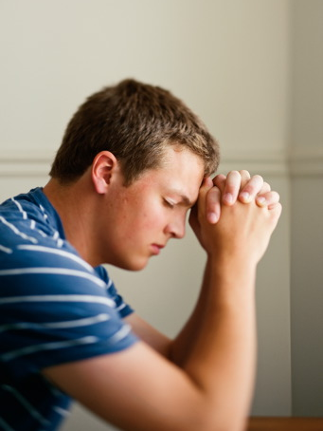
Devotional
Hymn:
Prayer:
Thought:

Slide 3
Sharing the Book of Mormon
What information about the Book of Mormon might be helpful for you to be able to explain as you share the Book of Mormon with others?

Slide 4
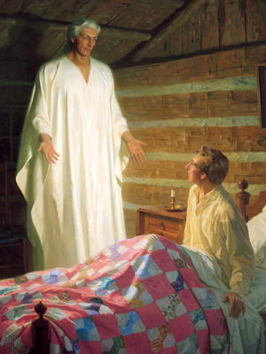
Obtaining the Plates

Slide 5
Joseph Smith
Read paragraphs 6–8 of “The Testimony of the Prophet Joseph Smith,” located in the introductory material at the beginning of the Book of Mormon. Look for what Joseph Smith learned about himself and about the Book of Mormon during his first encounter with Moroni (paragraph six begins with the phrase “he called me by name”).

Slide 6
The Fulness of the Gospel
The Book of Mormon contains the fulness of the gospel of Jesus Christ.

Slide 7
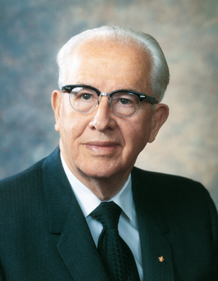
President Ezra Taft Benson
“The Lord Himself has stated that the Book of Mormon contains the ‘fulness of the gospel of Jesus Christ’ (D&C 20:9). That does not mean it contains every teaching, every doctrine ever revealed. Rather, it means that in the Book of Mormon we will find the fulness of those doctrines required for our salvation. And they are taught plainly and simply so that even children can learn the ways of salvation and exaltation” (Ezra Taft Benson, “The Book of Mormon—Keystone of Our Religion,” Ensign, Oct. 2011, 55).

Slide 8
Additional Information
Turn to the introduction to the Book of Mormon and read the first five paragraphs, looking for additional information that might be important to explain when teaching someone about the Book of Mormon.

Slide 9
Additional Information
Turn to the introduction to the Book of Mormon and read the first five paragraphs, looking for additional information that might be important to explain when teaching someone about the Book of Mormon.
Why do you think this information might be important to explain?

Slide 10
The Western Hemisphere
The Book of Mormon does not claim to give a history of all the peoples who lived anciently in the Western Hemisphere. It is primarily a record only of the Nephites and Lamanites and the people of Jared. There may have been other people who inhabited the continents in the Western Hemisphere before, during, and after the events recorded in the Book of Mormon.

Slide 11
The Book of Mormon
Like the Bible, the Book of Mormon consists of smaller books. Each of these smaller books is named after a prophet or record keeper who recorded important events, teachings, prophecies, and revelations.

Slide 12
The Book of Mormon
Like the Bible, the Book of Mormon consists of smaller books. Each of these smaller books is named after a prophet or record keeper who recorded important events, teachings, prophecies, and revelations.
Considering that this book contains the teachings of many different prophets and record keepers, as well as those of the Savior Himself, why is it called the Book of Mormon?

Slide 13
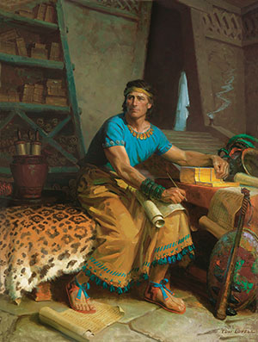
The Book of Mormon
The Book of Mormon is named after Mormon because he was responsible for abridging (or condensing) and compiling many records into the narrative found in the Book of Mormon.

Slide 14
The Book of Mormon
The Book of Mormon is named after Mormon because he was responsible for abridging (or condensing) and compiling many records into the narrative found in the Book of Mormon.
Turn to “A Brief Explanation about the Book of Mormon” and read items 1–4, looking for ways each set of plates is important to the Book of Mormon.

Slide 15
The Book of Mormon
If you were responsible for writing, abridging, and compiling an important spiritual record of your people for future generations, how would you know what to include in the record and what to leave out of it?

Slide 16
Book of Mormon Writers
Read the following scripture passages, looking for what Book of Mormon writers chose to include and emphasize in their records and why they chose to include those truths.
1 Nephi 6:4–6
2 Nephi 25:23, 26
Words of Mormon 1:4–8
Mormon 8:1, 34–35

Slide 17
Book of Mormon Writers
Book of Mormon writers recorded prophecies, teachings, and testimonies of Jesus Christ to persuade others to believe in Him. The Lord guided Book of Mormon writers through revelation to write what would be of most help to us.
How might understanding these truths help you as you study the Book of Mormon?

Slide 18
President Ezra Taft Benson
“Mormon wrote near the end of the Nephite civilization. Under the inspiration of God, who sees all things from the beginning, he abridged centuries of records, choosing the stories, speeches, and events that would be most helpful to us.
“Each of the major writers of the Book of Mormon testified that he wrote for future generations. …
Continued on next page.

Slide 19
President Ezra Taft Benson, cont.
“If they saw our day, and chose those things which would be of greatest worth to us, is not that how we should study the Book of Mormon? We should constantly ask ourselves, ‘Why did the Lord inspire Mormon (or Moroni or Alma) to include that in his record? What lesson can I learn from that to help me live in this day and age?’” (Ezra Taft Benson, “The Book of Mormon—Keystone of Our Religion,” 55–56).

Slide 20
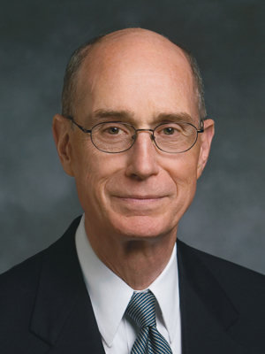
President Henry B. Eyring
“I will make you this promise about reading the Book of Mormon: You will be drawn to it as you understand that the Lord has embedded in it His message to you. Nephi, Mormon, and Moroni knew that, and those who put it together put in messages for you. I hope you have confidence that the book was written for your students.
Continued on next page.

Slide 21
President Henry B. Eyring, cont.
“There are simple, direct messages for them that will tell them how to change. That is what the book is about. It is a testimony of the Lord Jesus Christ and the Atonement and how it may work in their lives. You will have an experience this year feeling the change that comes by the power of the Atonement because of studying this book” (Henry B. Eyring, “The Book of Mormon Will Change Your Life,” Ensign, Feb. 2004, 11).

Slide 22
The Book of Mormon
According to President Eyring, what will happen as we study the Book of Mormon and look for the messages the Lord has placed in it for us?

Slide 23
The Book of Mormon
According to President Eyring, what will happen as we study the Book of Mormon and look for the messages the Lord has placed in it for us?
Share a passage from the Book of Mormon that has particular significance for you.

Slide 24
First Role Play
Share your testimony of the Book of Mormon to someone. Invite this person to study the Book of Mormon and ask God whether it is true (see Moroni 10:3–5). When you have finished this role play, switch roles and participate in the next role play.

Slide 25
Second Role Play
Present the Book of Mormon to the other person, who will pretend to be someone who knows nothing about the Book of Mormon. Consider answering the following questions.
What is the Book of Mormon about?
Who wrote it?
Why should we read it?

